Slide 1
The Tuskegee Airmen
Possibly the most remarkable group of individuals in recent history!
Trade Mark Tuskegee Airmen National
Prepared for Hiram College by Roger F. Cram

Slide 2
I want to tell you about a six-year
study I conducted at Hiram College in Ohio into the problem-solving and leadership characteristics of the Tuskegee Airmen.

Slide 3
I researched, not so much WHAT
the Tuskegee Airmen accomplished,
but rather HOW they accomplished
their remarkable achievements.

Slide 4
The Tuskegee Airmen - magnificent
people performing magnificently,
at their finest hour – what were
their values? What decision-
making techniques did these
leaders of peace use when
performing at their best?

Slide 5
What I actually discovered from
my research were the values the
Tuskegee Airmen used in making
their decisions, for pattern of 14
repeated ideals gradually emerged
from my data.

Slide 6
As I studied the Tuskegee Airmen, I wanted to know and understand how they envisioned their goals, their future accomplishments. Why were they trying to fight for and protect a country that didn’t want them? What VISION were they reaching for that justified this?

Slide 7
To discuss the Tuskegee Airmen’s VISION, I want to go back to 1932 when Benjamin O. Davis Jr. entered West Point.

Slide 8
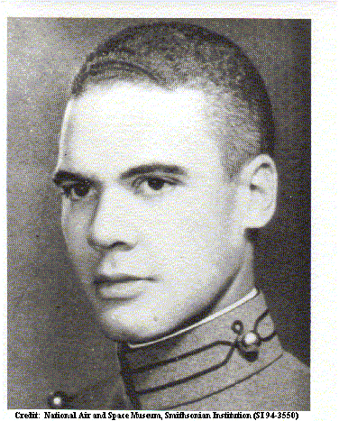
Benjamin O. Davis Jr.

Slide 9
He was the first black man to enter West Point the in the entire century. When one graduates from West Point, they are an officer, and the Army did not want a black officer. They felt that the whites would not take orders or obey him.

Slide 10
Only 3 other blacks entered West Point in the prior century.

Slide 11
In 1876, black Cadet Johnson C. Whittaker was admitted to West Point. No one spoke to him during his training other than to give him orders. He was not allowed a roommate. On April 6, 1880, he was found unconscious, tied to his bunk, with his ear lopes partially cut off.

Slide 12
The first black man to graduate from West Point was Lt. Henry O. Flipper in 1881. But no one wanted a black officer, so trumped up charges were created accusing him of embezzling money from the commissary. He was found not guilty in his trial, but discharged from the Army because his court martial found him guilty of behavior unbecoming an officer.

Slide 13
Flipper was given a full pardon from President Clinton in 1999 – 117 years later. Benjamin Davis Jr. was next in line to be subject to this treatment.

Slide 14
Benjamin O. Davis Jr. entered West Point in 1932. They took away his roommate, leaving him alone. No one spoke to him for four years other than to give him orders. He was totally ostracized.

Slide 15
During the Sunday morning breakfast, Davis had to go from table to table, salute the white cadets and ask for permission to eat. There were 85 tables in the mess hall. Most tables refused to let Davis eat forcing him to repeat this humiliating process at the next table.

Slide 16
Benjamin O. Davis Jr. wanted to show that blacks were equal to whites; therefore, the harder the whites treated Davis, the more prejudice they displayed, the more determined he was to succeed, for such discrimination only reinforced and confirmed his cause.

Slide 17
1936 Benjamin O. Davis Jr. Graduated 43rd out of 250 cadets in his class.

Slide 18
What was Benjamin O. Davis’s vision that allowed him to be subjected to such treatment? What vision did he reinforce for his men when he later became the commander of the Tuskegee Airmen?

Slide 19
To be the first black fighter pilots in the U.S. Military, to help integrating the military, to set an example of the black man’s capabilities for the blacks and the whites back home, thus to pave the way for jobs and opportunities for generations of blacks in the future.

Slide 20
Yes, as I studied the Tuskegee Airmen, I wanted to know and understand how they envisioned their goals Here’s what my research revealed:

Slide 21
(Vision) Envision things as excellent as they can be, not as they are, and then strive to create positive change toward these envisioned goals. All great accomplishments started as a vision that others could not see.

Slide 22
As I studied the Tuskegee Airmen and
Those helping them pave their way,
I wanted to know and understand
how they overcame their many
OBSTACLES?
Here is what my research discovered.

Slide 23
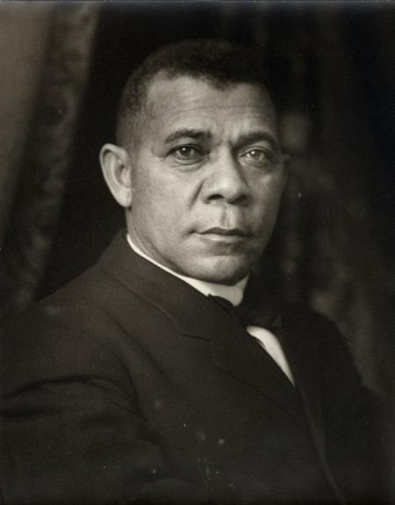
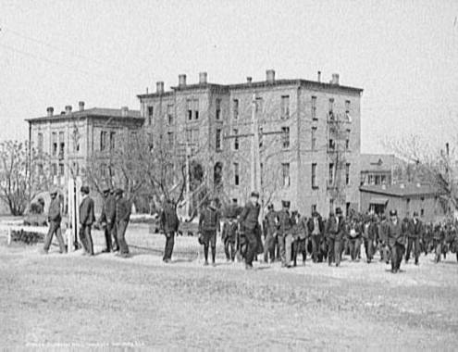
Quotecollection.com
Americasliberty.gov Tuskegee Institute 1906
Booker T. Washington
Overcoming Obstacles
In 1881 on the 4th of July, Booker T. Washington, at the age of 26, opened the Tuskegee Institute as principal, an educational institution for blacks located at Tuskegee, Alabama. Booker T. Washington was born a slave. He applied for funding from the State of Alabama, but they did not want a school for blacks, so they offered him very little funding hoping to discourage him.

Slide 24
Alabama did not give him enough money for labor costs to build the Tuskegee Institute, so he built it himself along with the students. This was the start of the College Work Study Program.
Alabama did not give him enough money to buy bricks, so they made the bricks from the clay soil on the property. The buildings are still standing and are used today.
The Tuskegee Institute became Tuskegee University.

Slide 25
Eleanor Roosevelt asked husband, President Theodore Roosevelt, to promise, if he was re-elected to a third term as president, to start a flying school for blacks at Tuskegee Alabama.
The president promised.

Slide 26
After he was reelected, Eleanor asked him to make good on his promise. President Roosevelt stated with WWII starting he was too busy to worry about a black flying school. You do not want to break a promises to Eleanor Roosevelt!

Slide 27
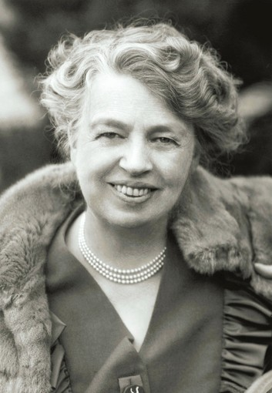
Eleanor Roosevelt Overcoming Obstacles
Fought her husband on black integration of the military.
March 1941 – went to Tuskegee
Found pilot Alfred “Chief” Anderson flying a Piper Cub.
When for an airplane ride with the black pilot.
Had photo taken with Alfred Anderson to show her husband.
Elizamclaren.com

Slide 28
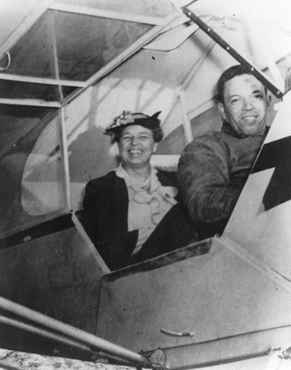
Overcoming Obstacles
Eleanor Roosevelt with Alfred Anderson in a Piper Cub airplane. If blacks were good enough pilots to fly the first lady, they surely are good enough to fly military aircraft.
This trip Eleanor Roosevelt took to Tuskegee happened in March of 1941.
She showed her husband, the president, the photograph on the left in March of 1941.
The flying program for blacks at Tuskegee, Alabama, was approved in March of 1941.
Tuskegee University Archives

Slide 29
All Black 99th Pursuit Squadron
The Army Air Corps reluctantly started this experiment designed to fail, to show all that blacks were not capable of flying aircraft.
Many Congressmen, Senators, Military encouraged program’s failure.
Cadet pilots started training at Tuskegee, Alabama on July 1941.

Slide 30
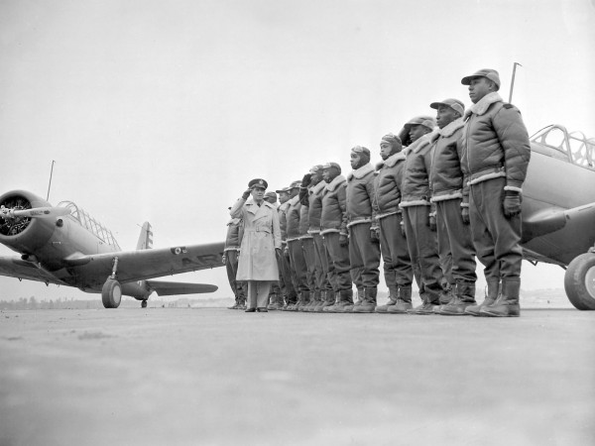
Defensemedianetwork.com
Starting class of Black cadets at Tuskegee, Alabama.

Slide 31
Program Designed for Failure
All Tuskegee Cadets initially had to be college graduates. White fighter pilots had to be high school graduates.
Fighter pilot training was chosen because it was the most difficult and demanding flying, thus assuring the most failures.
61% of first class quickly failed. They were put on a demerit system. Three demerits and they were dropped. Demerits were issued for…
Dust under their bed
Bed sheets not tight enough
Undesirable attitude

Slide 32
The Tuskegee Airmen were dropped from the training program for minor infractions as mentioned. Any excuse was used to reduce their morale and make the program fail.
The first training class at Tuskegee lost 61% of the original recruits within six weeks of training. Only five cadets in the first class graduated. The second training class lost 73% of their cadets with only three graduating.

Slide 33
After graduation, the first Tuskegee class was to be sent overseas to fight the war in Europe. But the U.S. Army Air Corps fighting the war refused to accept black pilots into their ranks. So the first graduating class was kept in Tuskegee and put through their training again with the new incoming recruits.

Slide 34
After their second training was completed, they were supposed to be sent overseas to fight the war in Europe. But again, the U.S. Army Air Corps fighting the war refused to accept black pilots into their ranks.
So the graduating class, after being trained twice, was kept in Tuskegee and put through their training again with the new incoming recruits.

Slide 35
After their third training was completed, they were supposed to be sent overseas to fight the war in Europe. But again, the U.S. Army Air Corps fighting the war refused to accept black pilots into their ranks.
So the first graduating class, after being trained three times, in order to justify the tax payer’s expense, was sent to Northern Africa.

Slide 36
Why Northern Africa? Because the war was almost over in that area. There were very few German aircraft. The southern congressmen, senators, and military officials that were so vocal about blacks being incapable of flying aircraft didn’t want the Tuskegee Airmen to shoot down any enemy aircraft. It was the intention to make the black pilots look incompetent, so the Tuskegee Airmen were frequently assigned missions and areas void of the enemy. As the months passed, the Tuskegee Airmen were criticized for their limited kills.

Slide 37
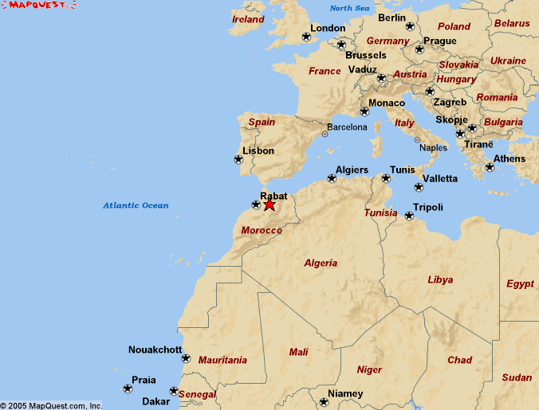
Morocco

Slide 38
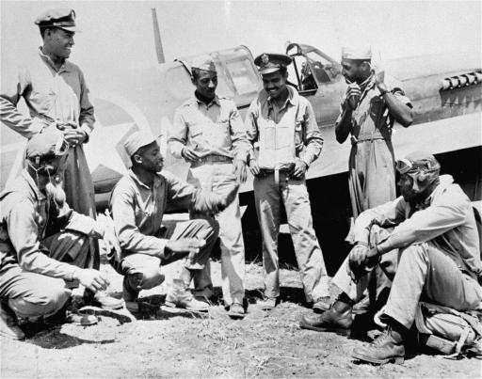
National Archives and Records
99th Fighter Squadron in Morocco.

Slide 39
Some of the Tuskegee Airmen were given
worn out fighter aircraft not safe to fly. The
intent was to show that black men could not
fly aircraft, just another example of how
prejudice and discrimination were designed
to make the Tuskegee training program
a failure. But the Tuskegee Airmen simply took all those worn-out aircraft apart and sorted their pieces. For every five worn-out and shot-up aircraft they were given, the Tuskegee Airmen were able to create one aircraft safe to fly.

Slide 40
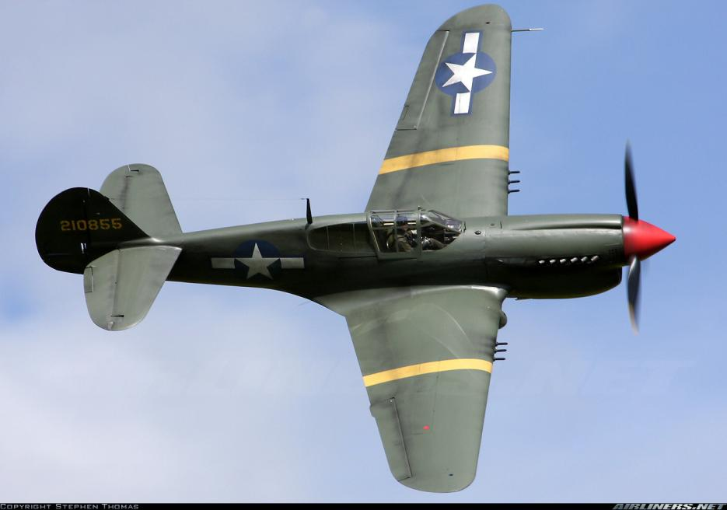
P-40 Warhawk by Tr4br.deviantart.com
P- 40 War Hawk

Slide 41
Yes, as I studied the Tuskegee Airmen
and those helping them pave their way,
I wanted to know and understand
how they overcame their many
OBSTACLES?
Here is what my research revealed...

Slide 42
Definition of Obstacle – Webster’s Dictionary–
…something that impedes ones progress,
something that offers resistance to
success, something interfering with the
completion of one’s goals.

Slide 43
(Obstacles) Realize that obstacles are not barriers to your goals, but opportunities for growth, challenges to enrich your self-confidence, and opportunities to master new skills.

Slide 44
A person having reached a goal without overcoming obstacles has learned nothing and accomplished even less.
Conquered obstacles are the only qualifying credentials of heroes and a measure of one's commitment and leadership.

Slide 45
As I studied the Tuskegee Airmen,
I wanted to understand how they
chose to BEHAVE, how did they
react to others, especially those
discriminating against them?

Slide 46
I learned that the Tuskegee Airmen
aviation training program was
started in 1941 by our government
as an experiment to fail, to show
once and for all that blacks were
incapable of flying aircraft.

Slide 47
Apparently many southern military leaders, congressmen and senators based their prejudice on the 1925 study ordered by the War Department involving the black man’s capability in war fare. The results of the study, concluded that blacks were lazy,
cowards, should be kept away from
complicated machinery like aircraft, be given only menial jobs under close
supervision, and never be given a position of command.

Slide 48
I further discovered that the Tuskegee
Airmen were insulted and degraded
with regularity in hopes they would
strike back in anger giving cause to
terminate the program.

Slide 49
However, the Tuskegee Airmen decided how they were going to behave, and they based their behavior on their values, on the type of person they wanted to be, not on how others behaved toward them.

Slide 50
The Tuskegee Airmen knew responding with insults to those demeaning them would make them demeaning as well.

Slide 51
Therefore, to those who treated them without dignity, they were not indignant.
To those showing them disrespect, they were not disrespectful.

Slide 52
To further validate their strength of character, they excelled beyond expectations for all believing them to be substandard.

Slide 53
Yes, as I studied the Tuskegee Airmen, I wanted to understand how they chose to BEHAVE. Here’s what my research revealed:

Slide 54
(Behavior) Govern yourself by never allowing another’s behavior to negatively influence your conduct. Your actions are always your responsibility; they are never another’s fault. Determine your behavior from your values, from the kind of person you want to be -- never from how others behave toward you.

Slide 55
As I studied the Tuskegee Airmen, I wanted to understand how they chose to instigate CHANGE; how did they altar or improve unacceptable situations?

Slide 56
I learned that after arriving in Africa from Alabama, the Tuskegee Airmen were assigned to the all white 33rd fighter group for actual combat training, but the 33rd refused to train them not wanting black pilots off their wing. Instead the 33 fighter squadron commander sent in fabricated reports about the Tuskegee Airmen’s incompetence.

Slide 57
How did the Tuskegee Airmen attempt to change these injustices?

Slide 58
When the Tuskegee Airmen’s endurance was questioned, their reply was to endure.
When the Tuskegee Airmen’s
reliability was scrutinized, they
answered with dependability
and trust.

Slide 59
They knew that creating less than excellent work for those believing them incompetent would only prove their critics correct.

Slide 60
I asked an adult student in my class, “How would you like to work for an employer that felt you were incompetent, stupid, and would never produce quality work?” The student told me any employer that treats his employees that way deserves what he gets, and he should expect poor output from his employees.

Slide 61
I informed the student that his behavior and performance in life was only up to him, not his employer, and he should not allow others to determine the quality of his character.

Slide 62
Yes, as I studied the Tuskegee Airmen, I wanted to know and understand how they chose to instigate CHANGE. Here’s what my research revealed:

Slide 63
(Change) Encourage positive change, not through criticism, but through your continuous achievements of excellence for all to witness. When criticized by others, offer continual examples of excellence as your only response.

Slide 64
As I studied the Tuskegee Airmen, I wanted to know and understand how they established trust, especially from those that disrespected them. Here’s what my research revealed:

Slide 65
The Army Air Corps was experiencing heavy B-17 and B-24 bomber losses. One bomber formation of 200 bombers lost 65 planes on one bombing mission.

Slide 66
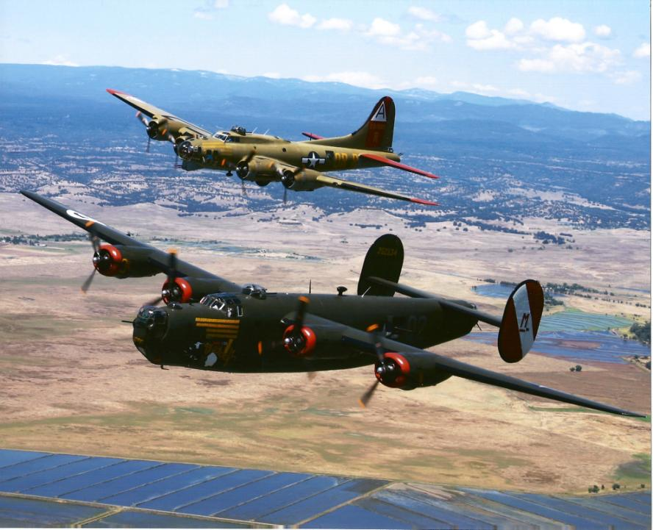
American Bombers Suffering Heavy Losses.
Lyonairmuseum.org top: Boeing B-17 Flying Fortress bottom: B-24 Liberator

Slide 67
The bombers were escorted by white fighter pilots, highly trained and very competent, but they wanted the honor of becoming an ACE – having shot down five enemy The Army Air Corps had a tradition of following an enemy all the way to its home land if necessary in order to shoot it down.

Slide 68
Who is guarding the bombers if their escorts fly away chasing the enemy?

Slide 69
Benjamin Davis Jr. was asked to escort bombers. Davis told his men – anyone leaving the bombing formation to chase a German fighter will be court marshaled and grounded. Any bomber that gets shot down, you best be shot down first.

Slide 70
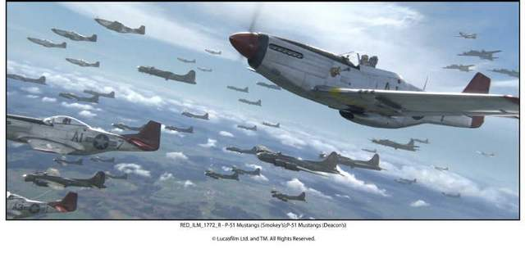

Slide 71
The Tuskegee Airmen showed up on time to rendezvous with the bombers. They stayed close to them and never left them by chasing an enemy fighter. They developed the bomber crew’s trust and confidence.

Slide 72
The Tuskegee Airmen escorted 11,583 bombers during 200 separate missions over the period of one year. They never lost a bomber because of a enemy fighter shooting it down.

Slide 73
The Tuskegee Airmen developed TRUST among the bomber pilots.

Slide 74
A bomber pilot I interviewed told me his bomber crew was comprised of Georgia and Alabama rednecks. “You know how these southern crackers felt about blacks,” he said.

Slide 75
When our bomber formation got to the rendezvous point, being the place where our fighter pilot escorts join the bombers, all my crew members got on their knees and prayed. “Did they pray for a successful bombing run?” I asked.

Slide 76
“No,” he replied. “Did they pray to be kept safe and free from harm on their mission?” I inquired. “No,” he replied. He then stated, “They prayed when their fighter escorts show up that they have red tails.”

Slide 77
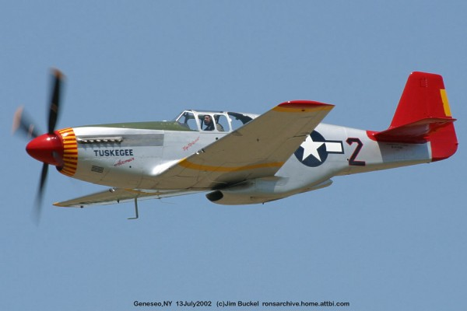
Tuskegee Airmen were asked to help escort our bombers.
They were given P-51 Mustang Fighters – Painted tails bright red for pride.

Slide 78
Yes, as I studied the Tuskegee Airmen, I wanted to know and understand how they established trust. Here’s what my research revealed:

Slide 79
(Trust) Honor all commitments and
obligations to everyone. Your pledge
should be as meaningful to a king as
to a beggar, for the value of a
commitment is determined from its
source, not to whom it is directed.

Slide 80
As I studied the Tuskegee Airmen, I wanted to know and understand how they maintain their SELF-ESTEEM while working under such adverse conditions; how did they know their self-worth while constantly being told they were incompetent?

Slide 81
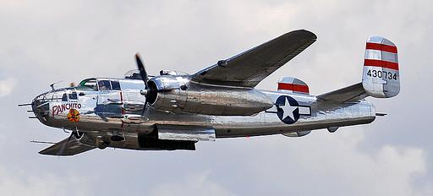
Forming the Tuskegee Airmen 477th MBG (Medium Bombardment Group)
Panchito B-25 Mitchel Bomber / flickr – photo sharing
B-25j Mitchell Bombers

Slide 82
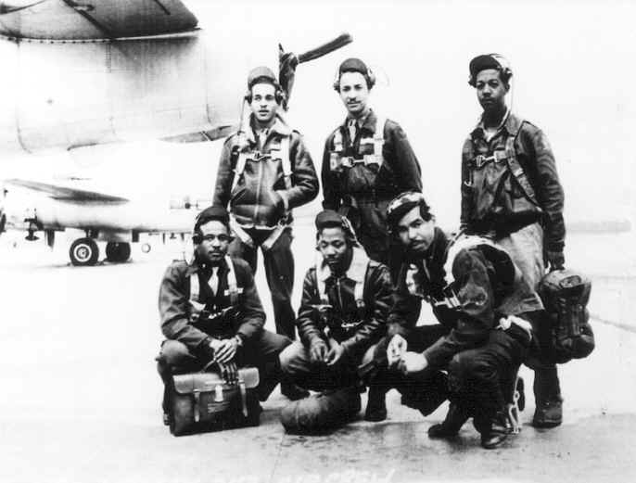
National Archives and Records
Tuskegee Airmen 477th MBG

Slide 83
Commander Selway of the 477th MBG was a bigot. He wanted the Tuskegee Airmen to fail. He refused to associate socially with men and kept them highly segregated. Selway wanted to show everyone how inadequate blacks could be.

Slide 84
To help insure their failure and low morale, the 477th MBG was moved from the Michigan base to Godman Army Field by Fort Knox, Kentucky. Godman Field was too small to train the 477th and their B-25 bombers. It had 1/7 the needed land area. It had 1/5 the needed supply of gasoline. It had ¼ the required hangar space. It had fewer runways and worse weather.

Slide 85
In town the Tuskegee Airmen were not allowed to enter many restaurants, movie theaters, laundromats, and other public facilities.

Slide 86
Clothing stores would sell clothes to the Tuskegee Airmen and Women, but would not allow them to try on the clothes or shoes beforehand nor return them if they didn’t fit. They claimed white customers would not buy the clothing if they were worn by blacks.

Slide 87
White officers were taking captured German prisoners to these restaurants and theaters for recreation. The Laundromats happily washed the German prisoner’s clothes. The United States Army Air Corps was giving more rights and privileges to captured Nazi prisoners than to our own black Tuskegee officers.

Slide 88
Colonel Selway then moved the entire 477th to Freeman Field in Seymour, Indiana to lower morale. Seymour, Indiana was a very prejudice town. There were very few restaurants, stores, and theaters would allow blacks. Sunset laws encouraged blacks to be off the streets before dark. The Tuskegee Airmen were not allowed to use the athletic facilities at their base. They were not allowed to enter the officer’s club even though they were officers.

Slide 89
When the Tuskegee Airmen tried to enter the officer’s club, 101 of them were arrested and confined to a prisoner-of-war camp at Fort Knox, Kentucky guarded by dogs and spot lights. While the Airmen were confined at Fort Knox, Nazi prisoners roamed the compound freely.

Slide 90
Folks, were taking about self-esteem here. How could any one have any self-esteem under these conditions?
The constant reminders from others
that the Tuskegee Airmen were second class citizens, that they were incompetent and incapable, and that the Tuskegee
Airmen would never succeed fell on
deaf ears. And thank God it did!

Slide 91
Yes, as I studied the Tuskegee Airmen, I wanted to know and understand how they maintain their SELF-ESTEEM while working under such adverse conditions; how did they know their self-worth while constantly being told they were incompetent? Here’s what my research found.

Slide 92
(Self-Esteem) Enhance your self-esteem, not from the opinions of others, but from your values, from your abilities, from your potential, from the compassionate causes you have chosen to embrace and the magnitudes of commitment you have expended toward their resolve.

Slide 93
The Tuskegee Airmen
Possibly the most remarkable group of individuals in recent history!
Trade Mark Tuskegee Airmen National
Prepared for Hiram College On-line Course

