Slide 1

Everyone wants to know:,
"Of what is the world made?"
and
"What holds all the “stuff” together?"

Slide 2

Many things in this world share the same characteristics?
Everything in our world, all things, are actually composed of only two fundamental bits of construction material.

Slide 3
The word "fundamental" is very important here.
By fundamental bits of construction material we mean objects that are as simple as they can get --structureless -- not made of anything smaller.
We will now continue our search for the most fundamental of all “stuff.”!

Slide 4
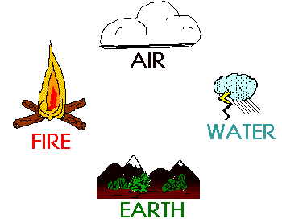
In ancient times, everyone thought that all “stuff” in the world was a made from only four elements:

Slide 5

In modern times, we know that all “stuff” is composed of more fundamental things than earth, water, air, and fire....

Slide 6

Around 1900, people knew about atoms, but believed they were tiny spheres.

Slide 7
Scientists soon discovered that atoms were not tiny spheres, but rather had a center called a nucleus.

Slide 8

Is the Nucleus Fundamental?
No, it is not!
Today, scientists know that the nucleus of an atom is composed of protons (p) and neutrons (n).

Slide 9
It was once believed that the atom consisted of three particles:
The electrons were negatively charged particles revolving around the nucleus much like the planets revolve around our sun.
The nucleus was composed of positively charged protons and neutrally charged neutrons.

Slide 10
For every negative electron circling around the nucleus, there is also one positive proton and one neutral neutron in the nucleus.
If the atom has one circling electron, then the nucleus has one proton and one neutron.

Slide 11
If the atom had 26 circling electrons, then the nucleus had 26 protons and 26 neutrons.
These are called “elements,” and there are 103 different elements that we currently know about.

Slide 12
Of the 118 elements, the first 92 occur naturally in nature while 93-118 are synthesized. Hydrogen is first with one electron, proton, and neutron.
Helium is second, with two electrons, protons, and neutrons.
Oxygen has eight electrons, protons, and neutrons.
Gold has 79 of them, etc.

Slide 13
The Periodic Table of Elements
Explore key information about the chemical elements through this periodic table
Group | 1 | 2 |  | 3 | 4 | 5 | 6 | 7 | 8 | 9 | 10 | 11 | 12 | 13 | 14 | 15 | 16 | 17 | 18
Period
1 | 1 H |  |  |  |  |  |  |  |  |  |  |  |  |  |  |  |  |  | 2 He
2 | 3 Li | 4 Be |  |  |  |  |  |  |  |  |  |  |  | 5 B | 6 C | 7 N | 8 O | 9 F | 10 Ne
3 | 11 Na | 12 Mg |  |  |  |  |  |  |  |  |  |  |  | 13 Al | 14 Si | 15 P | 16 S | 17 Cl | 18 Ar
4 | 19 K | 20 Ca |  | 21 Sc | 22 Ti | 23 V | 24 Cr | 25 Mn | 26 Fe | 27 Co | 28 Ni | 29 Cu | 30 Zn | 31 Ga | 32 Ge | 33 As | 34 Se | 35 Br | 36 Kr
5 | 37 Rb | 38 Sr |  | 39 Y | 40 Zr | 41 Nb | 42 Mo | 43 Tc | 44 Ru | 45 Rh | 46 Pd | 47 Ag | 48 Cd | 49 In | 50 Sn | 51 Sb | 52 Te | 53 I | 54 Xe
6 | 55 Cs | 56 Ba | * | 71 Lu | 72 Hf | 73 Ta | 74 W | 75 Re | 76 Os | 77 Ir | 78 Pt | 79 Au | 80 Hg | 81 Tl | 82 Pb | 83 Bi | 84 Po | 85 At | 86 Rn
7 | 87 Fr | 88 Ra | ** | 103 Lr | 104 Rf | 105 Db | 106 Sg | 107 Bh | 108 Hs | 109 Mt | 110 Ds | 111 Rg | 112 Cn | 113 Uut | 114 Uuq | 115 Uup | 116 Uuh | 117 Uus | 118 Uuo
*Lanthanoids |  |  | * | 57 La | 58 Ce | 59 Pr | 60 Nd | 61 Pm | 62 Sm | 63 Eu | 64 Gd | 65 Tb | 66 Dy | 67 Ho | 68 Er | 69 Tm | 70 Yb
**Actinoids |  |  | ** | 89 Ac | 90 Th | 91 Pa | 92 U | 93 Np | 94 Pu | 95 Am | 96 Cm | 97 Bk | 98 Cf | 99 Es | 100 Fm | 101 Md | 102 No

Slide 14
Everything we know of or can detect with our senses are made up from these elements - everything!!!!!

Slide 15
EVERYTHING!

Slide 16
EVERYTHING!
!!!
!!!
!!!
!!!
!!!
!!!
!!!
Got the Picture?

Slide 17
Well,
MAYBE NOT EVERYTHING!

Slide 18
Different combinations of these 103 elements merge to form compounds.
Sodium and chloride are elements, but when combined (or electrically bonded) they form sodium chloride, or table salt.

Slide 19
Hydrogen and oxygen are elements, but when two hydrogen atoms bond with one oxygen atom, we have H2O, or water.

Slide 20

Are Protons and Neutrons Fundamental?
No, they’re not fundamental either!
We now know that protons and neutrons aren't fundamental -- they are comprised of more fundamental particles called quarks.

Slide 21
Physicists now believe that the quarks and the electrons ARE fundamental.
(However, they’re still experimenting; they think that they’re not sure.) ??!!??

Slide 22
Are the electrons and quarks in gold the same as the ones in lead?
YES!
Are the electrons and quarks in water the same as the ones in copper?
YES!

Slide 23
YES!!!!!!!
You mean all of the elements that make up all things that our senses can detect are all made of the same quarks and electrons?
YES!!!!!!
YES!!!
YES
YES
YES!
YES!!!

Slide 24
HOW SMALL IS AN ATOM?
One drop of water contains one million million billion atoms!
If you drop a sharpened pencil, point first, onto a piece of paper, the resulting dot will have over one billion atoms.

Slide 25
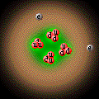
HOW SMALL IS AN ATOM?
If the protons and neutrons were the size of a BB…….,
then the electrons and quarks would be 2000 times smaller or about the diameter of a human hair.

Slide 26
And if the protons and neutrons were the size of the a BB……..
...the entire atom's diameter would be almost one mile across!!!!!

Slide 27
This means that all “stuff” everywhere is composed of mostly empty space!!!!!

Slide 28
What percentage of the volume of an atom is just empty space?
99.999999999%

Slide 29
How small is an atom?
If all the atoms in the earth had their electrons and quarks touching each other, the earth would be about the size of a basketball!

Slide 30
But this statement about the basketball is based on an old way of thinking that fails to realize electrons and quarks are really forms of energy, not marble-shaped particles.

Slide 31
How small is an atom?
If you were to drop 1/4 teaspoon of olive oil (20 drops) into a pond...
…it would shortly cover a surface area of more than 2,000 square feet!!!!
That’s the surface area of a tennis court!!!

Slide 32
And this 2,000 square foot film of olive oil would be about 5 atoms thick.

Slide 33
Would you like to see this olive oil experiment taking place?
OK, watch this video.

Slide 34
Now, it’s time to learn more about our atomic structure.
Let’s continue on our journey.

Slide 35
In addition, all the particles (protons, neutrons, quarks, and electrons) are constantly in motion.
This motion is temperature.
This motion is energy levels!!!!

Slide 36
While we know for sure that quarks and electrons are smaller than 10 to the power of (-18) meters, it is possible that they have no size at all. It is also possible that quarks and electrons are not fundamental but are composites of more fundamental particles.

Slide 37
In summary, we know that atoms are made of protons, neutrons, and electrons. Protons and neutrons are made of quarks, which are possibly made of more fundamental particles...

Slide 38
It is believed that electrons are just a negative electric field or charge.

Slide 39

The Old, Outdated, Atom Model: Protons & Neutrons in nucleus with surrounding electron fields.

Slide 40
Physicists have developed a theory called the Standard Model that attempts to describe all matter and forces in the
universe (except for gravity). Its elegance lies in the ability to explain hundreds of particles and complex interactions in terms of a few fundamental particles and interactions.

Slide 41
(1) Force Carrier Particles: Each type of fundamental force is "carried" by a force-carrier particle.

Slide 42
Force carrier particles for magnetic waves are called “photons.”
Force carrier particles for gravity are called “gravitons.”
We’ll talk more about these in a few minutes.

Slide 43
(2) Matter Particles: The Standard Model says that most matter particles we know of are actually composites of more fundamental particles called quarks. There is also another class of fundamental matter particles called leptons (an example of a lepton is the electron).

Slide 44
So, there are two kinds of particles: matter particles (like leptons and quarks) and particles that carry forces (like photons and gravitons).
Although these aren’t really particles like we think of matter (little beads of tiny “stuff”), but rather fields or levels of energy.

Slide 45
Then if everything that we can detect from our senses is actually made of empty space and energy fields,
…then all “stuff” is actually made of “non-stuff.”

Slide 46
Let me say that quietly again in case you were not paying attention.

Slide 47
…then all “stuff” is actually made of “non-stuff.”

Slide 48
Again...softly...

Slide 49
…then all “stuff” is actually made of “non-stuff.” !!!

Slide 50
Everything we can see, touch, hear, taste, or smell -- everything we can detect with our senses -- is made of lots and lots of empty space and the rest is all non-stuff!

Slide 51
Now, let’s get back to the standard model.

Slide 52
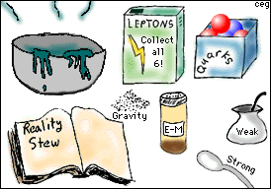
What makes the Standard Model so comprehensive is that all observed particles can be explained by:
6 types of leptons
6 types of quarks, and...
Force carrier particles

Slide 53
The first type of matter particles we will discuss are the leptons.
There are six leptons, three of which have electrical charge and three of which don't. The best known charged lepton is the electron (e).
The other two charged leptons are the muon and the tau, which are essentially electrons with a lot more mass. The charged leptons are all negative.

Slide 54
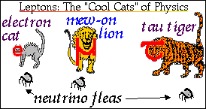
There are six leptons, three of which have an electrical charge and three of which do not.

Slide 55
The other three leptons are the very elusive neutrinos. They have no electrical charge and little, if any, mass. There is one type of neutrino for every type of electrically charged lepton.

Slide 56

Leptons, like independent lonely felines, can exist without the companionship of other particles.

Slide 57

Quarks, on the other hand, are only found in groups.
Like social elephants, quarks only exist in groups with other quarks.

Slide 58
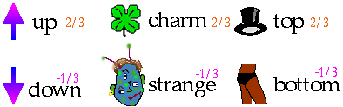
There are six quarks, but physicists usually talk about the three pairs of quarks: Up/Down, Charm/Strange, and
Top/Bottom.

Slide 59
Quarks have the unusual characteristic of having fractional electric charge of either 2/3 or -1/3, unlike the -1 charge of an electron and the +1 charge of the proton. Quarks also carry another type of charge called color charge.

Slide 60
Remember, quarks never hang out alone; instead, quarks will form composite particles called hadrons. The sum of the quarks’ electric charges in a hadron is always an integer number.

Slide 61
Baryons
Baryons are any hadron made of three quarks (qqq). For example, protons are 2 up quarks and 1 down quark (uud) and neutrons are 1 up and 2 down quarks (udd).

Slide 62

Mesons
Mesons contain one quark and one antiquark.

Slide 63
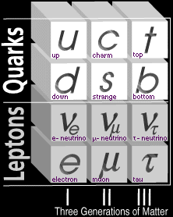

Slide 64
Notice that both quarks and leptons exist in 3 distinct sets. We call each of these sets a generation of matter particles. A generation is a set of one of each charge type of quark and lepton. Each generation tends to be heavier than the previous set.

Slide 65
Third generation quarks (top/bottom) and leptons (t-neutrino and tau) are larger than their second generation cousins. Also, third generation quarks and leptons only live a micro second. They are very unstable and immediately decay into second generation quarks and leptons.

Slide 66
Second generation quarks (charm/strange) and leptons (u-neutrino/muon) are also very unstable and they immediately decay into first generation quarks (up/down) and leptons (e-neutrino/electron).

Slide 67
All visible matter in the universe is made from the first generation of matter particles-
up and down quarks and electrons. Second and third generation particles are unstable, and decay into first generation particles. All the stable matter in the universe is made from first generation particles.

Slide 68
Some third and second generation particles only live for a billionth of a billionth of a second.
If their life is so short because they decay into first generation particles, how can scientists find them to study their behavior?

Slide 69
When physicist wants to use particles from Generation I to produce particles from Generation II and III, all they have to do is put the low-mass particles into an accelerator, give them a lot of kinetic energy (speed), and then collide them together.

Slide 70
During this collision, the particle's kinetic energy (from almost the speed of light) is converted into the formation of new massive particles. It is through this process that we can create massive unstable particles and study their properties.

Slide 71
These new, unstable particles from Generation II and III are created from the collision and immediately escape from the confines of the nucleus. Their escaping trails are photographed. Each particle has a different trail, thus they are identified.

Slide 72
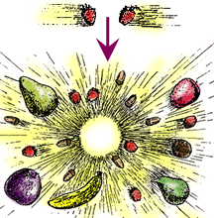
It is as if you stage a head-on collision between two strawberries and get several new strawberries, lots of tiny acorns, a banana, a few pears, an apple, a walnut, and a plum.

Slide 73

How can you take two small things and create many larger things from them?
By converting their speed (kinetic energy) into matter!
By converting their energy into material!

Slide 74
A neutron can be changed into a proton and in the process give off a created electron as an energy loss!!!

Slide 75
This video shows how particle acceleration is accomplished and the trails from escaping II and III Generation particles are photographed.

Slide 76
Now back to our discussion about the atom.

Slide 77
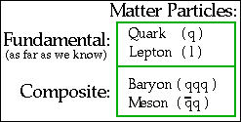
We have now discussed the matter particles described by the Standard Model.

Slide 78
We have answered the question,
"Of what is the world made?"
QUARKS and LEPTONS

Slide 79
That’s all there is: all matter, all earth, wind, fire, water, animals, highways, cars, TV sets, dogs, air, magazines, forests, mountains, grass, food, houses, furniture,
people, computers, boats, insects, fish, flesh and blood, wobbling weebles, crying children, spiders in the corner, junk mail, dirty diapers, Keebler Elves, everything: just quarks and leptons - nothing more.

Slide 80
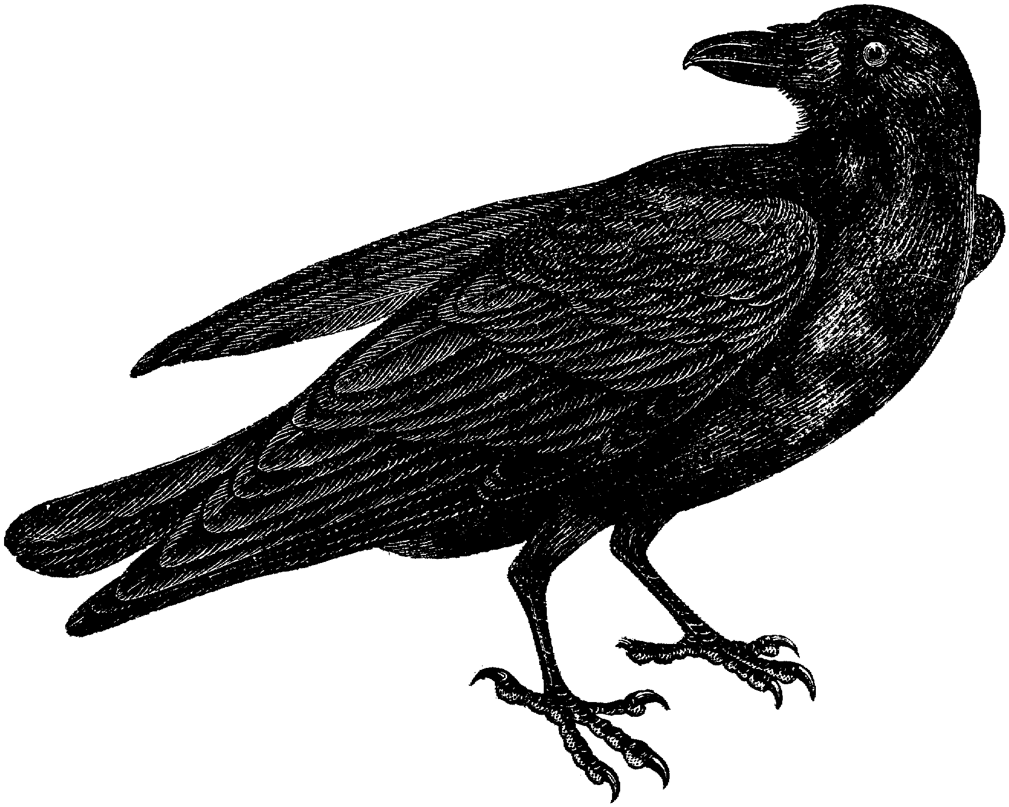
Just quarks and leptons
That’s all there is, “...and nothing more”
That’s all there is, “...forevermore.”
“Nothing More”

Slide 81
Now that we know what our universe is made of…….
Let’s find out what holds it together and makes it work.
It’s time to discuss the FORCES of nature, and there are only 4 of them.

Slide 82
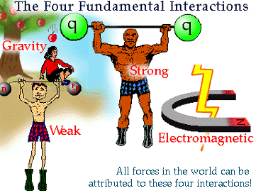
There are only 4 forces known to man

Slide 83

Gravitational force is perhaps the most familiar force to us, but it is not included in the Standard Model because its effects are so tiny in particle processes. Even though gravity acts on everything, it is a very weak force unless large masses are involved.

Slide 84
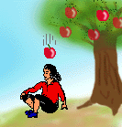
While physicists haven't discovered a carrier particle for gravity yet, they predict the existence of this particle and call it the "graviton."

Slide 85

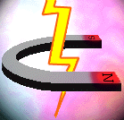
Many everyday forces, such as the force the floor exerts on your feet, are due to the electromagnetic forces in matter that resist displacement of atoms from their equilibrium position in a material.

Slide 86

It is necessary to understand that electrical charge (positive/negative) and magnetism (north/south) are different aspects of the same force -- electromagnetism. Oppositely charged objects, such as a proton and an electron, attract one another, while particles with the same charge repel each other.

Slide 87

If you take two magnets and bring the north poles close to each other, the magnets push each other away -- without touching each other! How is it possible to exert a force on something without touching it? It is easy to say that, "the magnets have an electromagnetic force field," but that still doesn't answer the question, what
IS the force that the magnets exert on each other?

Slide 88
The carrier particle of the electromagnetic force is the photon. Depending on their energy, they are called gamma rays, light, television, microwaves, radio waves, radar, etc.

Slide 89
The electromagnetic interaction is carried by photons.
Photons can be absorbed or radiated by any charged particle.
Photons have zero mass.
They always have the speed c = 300, 000, 000 m/s in a vacuum.

Slide 90
Because like charges repel each other, two electrons (each negatively charged) will never touch.
The force required to have two electrons touch does not exist.
The closer two electrons get to each other, the force repelling them increases exponentially.

Slide 91
You have never touched anything in your life.
If you cut yourself with a knife, the knife never touches you.
As you walk on the sidewalk, your shoes never touch the concrete.

Slide 92
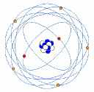
The negative outer electron force fields repel each other (like charges repel) so atoms never touch each other.
The atoms won’t touch!
Negative electrons repel each other!
_
_

Slide 93
Negative electrons and positive protons will attract each other.

Slide 94
Here's a question for you:
Atoms usually have equal numbers of protons and electrons. Therefore, they are electrically neutral since the positive
protons cancel the negative electrons.
What holds atoms together to make molecules, if most atoms have no electrical charge?

Slide 95

The Answer:
The charged parts of one atom can interact with the charged parts of another atom. This allows different atoms to bind together, an effect called the residual electromagnetic force.

Slide 97
Therefore, the electromagnetic force accounts for all of chemistry, and therefore all of biology, and therefore for life itself!

Slide 98
Did you get the impact of that last statement???? !!!!
Were you paying close attention???
Do you realize what was just said???

Slide 99
Let’s try this again………………

Slide 100
Therefore, the electromagnetic force accounts for all of chemistry, and therefore all of biology, and therefore for life itself!

Slide 101
“...the electromagnetic force accounts for all of life itself.” !!!!!!!

Slide 102
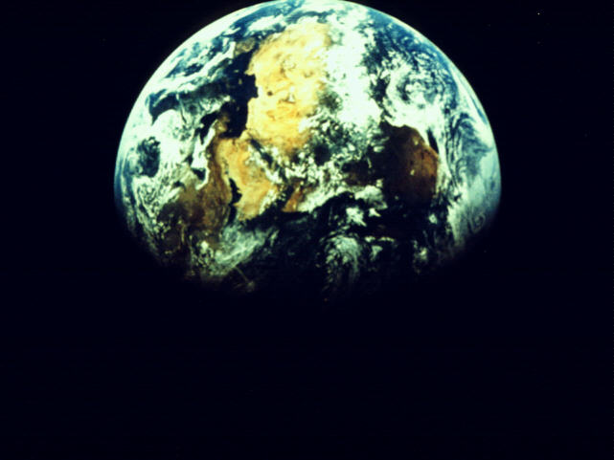
Amazing isn't it - all the wonderful structures of the world around you exist because protons and electrons have opposite charges!

Slide 103
Life as we know it, our senses, our sense of being, our awareness that we are here, our thoughts, our knowledge that we exist, and the perception of our surroundings are a result of the electromagnetic force.
All this “non-stuff” is energy.

Slide 104
IS YOUR SOUL ENERGY?
IS YOUR SPIRIT ENERGY?
ARE YOU BEGINNING TO REALIZE THE POSSIBLE IMPACT OF WHERE WE ARE GOING HERE?

Slide 105
Emotions and feelings are also a result of the electromagnetic force!
ANGER, PAIN, FRUSTRATION, STRESS, DISPARE, JEALOUSY, HATE, AND FEAR are a result of the electromagnetic force.

Slide 106
COMFORT, DESIRE, PASSION, LUST, SATISFACTION, SELF-ESTEEM, PRIDE, HAPPINESS, ENJOYMENT, LAUGHTER, AND LOVE are a result of electromagnetic force.

Slide 107
HUNGER, TIREDNESS, FATIQUE, SEXUAL DESIRE, HOPE, RAVENGE, ANXIOUNESS, ANTICIPATION, AND PLEASURE are a result of the electromagnetic force.

Slide 108
All feelings, all emotions, all sensations, all thoughts, all awareness of everything, all bodily functions, all our senses, all reproduction, all life energy, is a result of the electromagnetic force.

Slide 109
Because, the electromagnetic force accounts for all of chemistry, and therefore all of biology, and therefore for life itself…….
This same electromagnetic process takes place with the creation of a universe, a solar system, a volcano, a forest, a meadow, a flower, an insect, bacteria, living cells, or a thought.

Slide 110
That last statement is worth repeating………...

Slide 111
This same electromagnetic process takes place with the creation of a universe, a solar system, a volcano, a forest, a meadow, a flower, an insect, bacteria, living cells,
...or a thought.

Slide 112
We are comprised of energy!
Our thoughts are energy!
Our emotions are energy!
Our feelings are energy!
Our awareness of ourselves is energy!
Our body matter is energy!
Our life force is energy!
Energy CANNOT be destroyed!

Slide 113
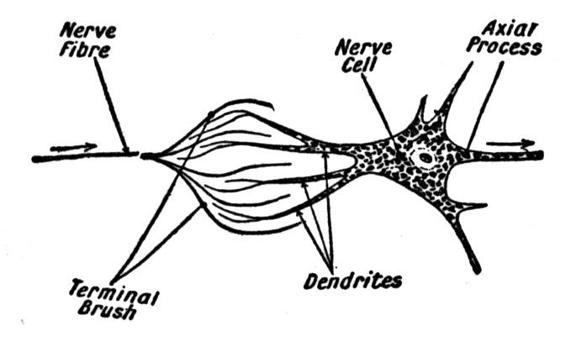
All of our senses, feelings, emotions, and bodily functions are controlled by electrical impulses sent along nerve cells and neurons.

Slide 114
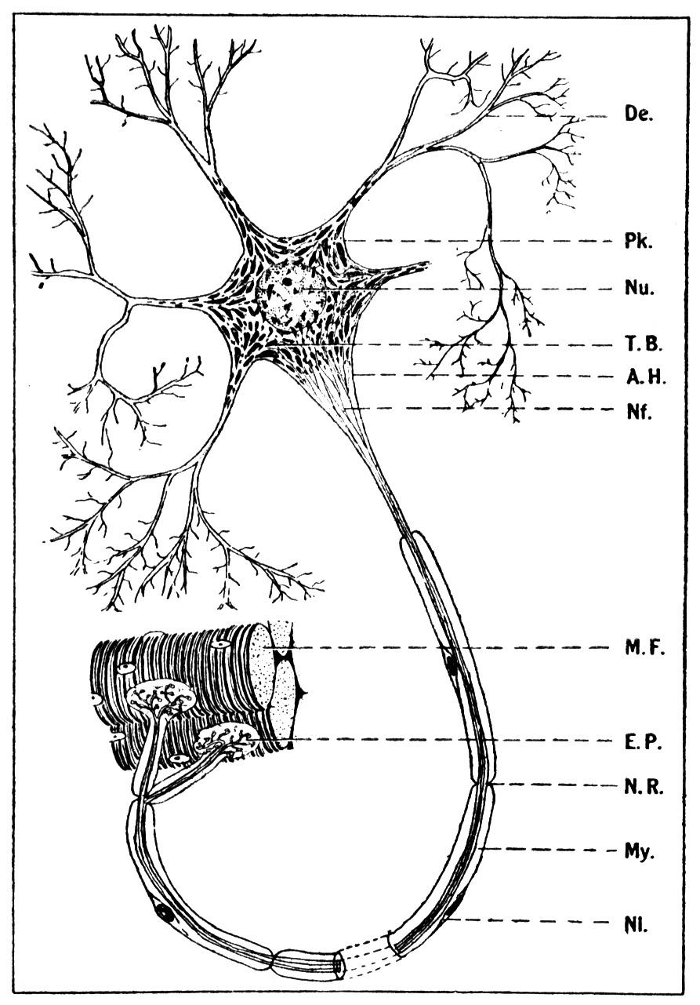
Neurons help us learn as we develop from childhood.
Neurons help us develop new abilities.

Slide 115
Neurons and other nerve cells help us learn to play the piano, help us develop into a better athlete, help us learn new skills by providing more and more electrical connections from our brain to our muscles, eyes, ears, balance, etc. as we learn these new abilities.

Slide 116
Neurons, when they are not functioning properly, are the cause of many illnesses and physical and mental handicaps.

Slide 117
WATCH THIS VIDEO ABOUT NEURONS, NERVE CELLS, AND HOW THEY WORK!

Slide 118
Now let’s continue our presentation about neurons.

Slide 119
There are and billions and billions of neurons in our brain and throughout our body.

Slide 120
Because of neurons and the electromagnetic force, human beings can drive a car, recite a poem, grow a baby, digest food, repair injuries, clean our blood of toxins, fight disease, kill bacteria, safeguard our children, deliver nourishment to our cells, be alert for danger, and plan a days events all at the same time!

Slide 121
All these processes and thousands more take place in our bodies simultaneously. The human brain and neurons cause 6 trillion electromagnetic impulses every second to direct the activities in our bodies and process our thoughts and desires.

Slide 122
I said 6 TRILLION electromagnetic impulses each SECOND!
How much is 6 trillion?
6 trillion green peas, if stacked end on end, would reach to the moon and back 50 times!!!
6 trillion seconds would be 190,259 years!!!!
6 trillion drops of water would be 23,437,500 gallons!!!

Slide 123
Electromagnetic pulses not only allow us to move our muscles, digest our food, speak, work, etc., but they are also responsible for...

Slide 124

...allowing whales to communicate over distances of 3000 miles…...

Slide 125

…allowing the Monarch butterfly to fly 1200 miles from Canada to Mexico each autumn navigating by the earth’s magnetic field, and...

Slide 126
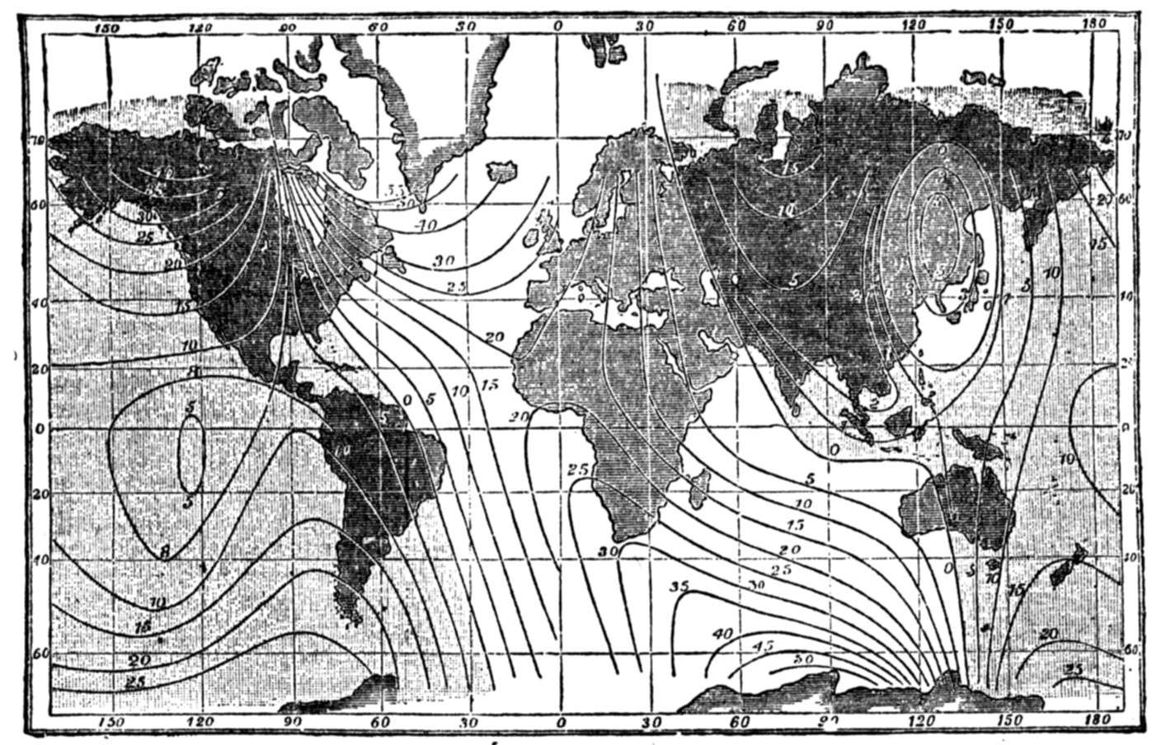

Slide 127
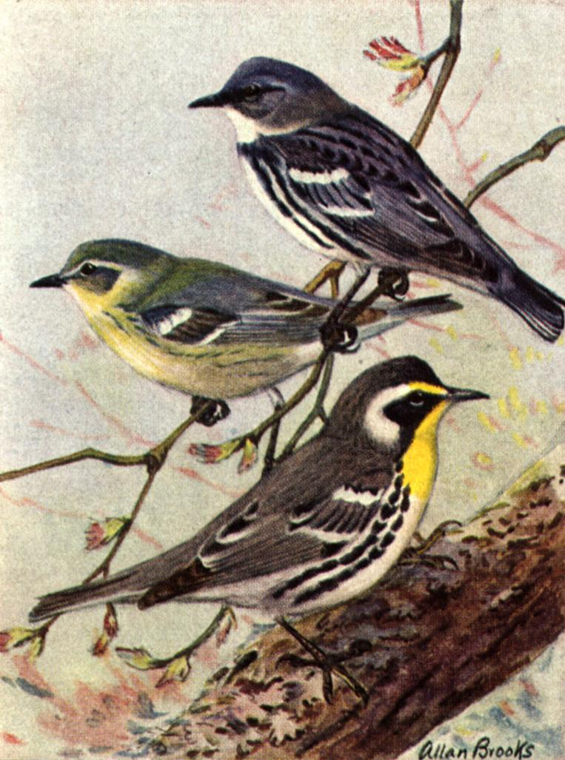
…to allow the Warbler to migrate each year from Toronto to South America navigating by the position of the stars. Each wing flap is comprised of millions of electromagnetic pulses to muscle cells, balance systems, eye observations, breathing, etc.

Slide 128
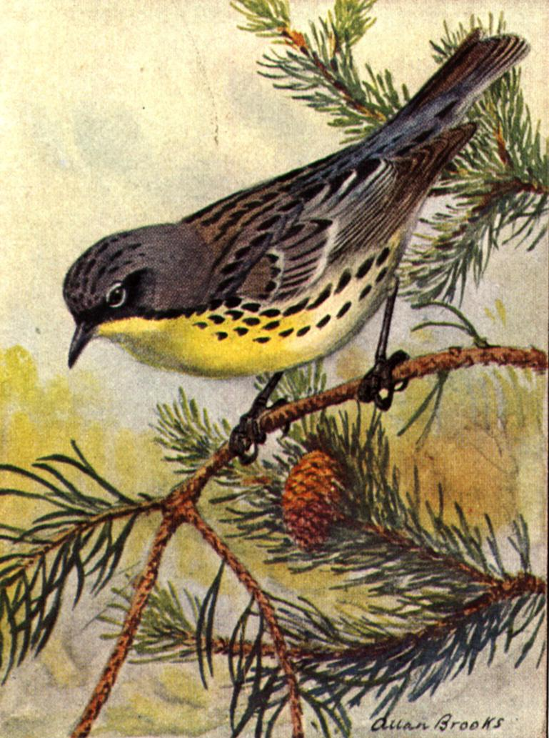
Three years in a row, the same banded warbler arrived in Mentor, Ohio, on the same bush, caught in the same net, 365 days from the previous year, on its way from Canada to South America.

Slide 129
…and each of the millions and trillions of electromagnetic pulses are only possible because opposite charges (electrons and protons) attract and like charges (electrons and electrons) repel each other.

Slide 130
Let’s briefly discuss……...
INTENT or EVOLUTION
Fish crawl out of sea?
Starfish fifth leg - 100,000 years.
Giraffe long neck?
Navigate by magnetic field?
Navigate by stars?
Bird fly?
Bat and dolphin sonar?

Slide 131
Something else that is astounding!
Matter cannot be created nor destroyed. All the atomic particles that were anywhere at the start of everything are still here! There are no more of them now than before. There are no fewer of them now than before.

Slide 132
All the atomic particles that make up your body have been around since the beginning of time.
They will be around forever!

Slide 133
Here’s another astounding fact!
Energy cannot be created nor destroyed. It simply changes form.

Slide 134
There is no more energy now than there was at the creation of time.
There is no less energy either.

Slide 135
The energy that fills your soul, your awareness of being, your spirit, your body, the energy that tells you you’re alive, has been around since the beginning of time.

Slide 136
The energy that fills your soul, your awareness of being, your spirit, your body, the energy that tells you you’re alive, will be around forever.

Slide 137
When you cut your grass, you transfer the energy from 200 million years of sunlight that turned shale and animal remains into oil. The oil was refined into gasoline and the gasoline’s stored energy is being transferred into heat to make your lawn mower cut your yard.

Slide 138
Therefore, the energy your lawn mower uses to cut your grass comes from the gasoline that comes from the oil that comes from 200 million years of sunshine that comes from the creation of our solar system that comes from the creation of the milky way galaxy that comes from the creation of the universe, etc, etc.

Slide 139
Energy cannot be created nor destroyed. It simply changes form.
Energy cannot be created! All the energy that ever was still exists!

Slide 140
Sometimes matter turns into energy!
Sometimes energy turns into matter!
Neither can be created or destroyed.
Is there really any difference between energy and matter?

Slide 141
We are comprised of energy!
Our thoughts are energy!
Our emotions are energy!
Our feelings are energy!
Our awareness of ourselves is energy!
Our body matter is energy!
Our life force is energy!
Energy CANNOT be destroyed!

Slide 142
So far, we have discussed gravitational force and electromagnetic force, two forces which have a major impact on our
everyday lives. There are two other interactions which we don't notice since their range of effect is not much larger than the size of an atom nucleus.

Slide 143
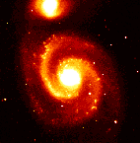
We depend on these two forces for the existence of the stuff from which the world is made, and for the decay processes that make some types of matter unstable. They impact the smallest objects in the universe and the largest.

Slide 144
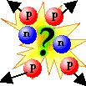
Consider this: what binds the nucleus?
We would expect an atom's nucleus to burst apart due to electromagnetic repulsion between the like charges of the protons. But, most atoms' nuclei are very stable!
What accounts for the energy required to counteract the electromagnetic repulsion?

Slide 145

It turns out that some particles (quarks and gluons) have a type of charge that isn't electromagnetic; rather, it is called color charge. The force between color-charged particles is very strong, earning it the name Strong Force. Because this force holds quarks together to form hadrons, its carrier particles are whimsically called gluons because they so successfully "glue" the quarks together.

Slide 146
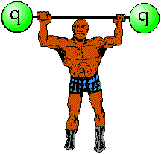
It is important to note that only quarks and gluons have color charge. Hadrons (such as protons and neutrons) are color neutral, as are leptons. For this reason, the strong force only acts on the really small level of quark interactions.

Slide 147

Quarks and gluons are color-charged particles. Just as electrically-charged particles interact by exchanging photons, color-charged particles exchange gluons in strong interactions. In so doing, these color-charged particles are often "glued" together.

Slide 148
If one of the quarks in a given hadron is pulled away from its neighbors, the color-force field "stretches” between that quark and its neighbors. In so doing, more and more energy is added to the color-force field as the quarks are pulled apart. At some point, it is energetically cheaper for the color-force field to "snap" into two new quarks. In so doing, energy is conserved because the energy of the color-force field is converted into the mass of the new quarks, and the color-force field can "relax" back to an unstretched state.

Slide 149
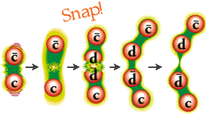
Quarks cannot exist individually because they must maintain a color-force field with other quarks.

Slide 150
The question still remains, what holds the nucleus together, if the strong force only acts to bind quarks together?

Slide 151

Hadrons are made of several color-charged quarks, so the color-charged quarks of one proton can "glue" themselves to the color-charged quarks of another proton, even though the protons themselves are color neutral. This is called the residualstrong interaction, and it is strong enough to overcome the electromagnetic repulsion between positive protons.

Slide 152

There are 6 kinds of quarks and 6 types of leptons. So why is it that all the stable matter of the universe is only made from the two least massive types of quarks, up and down, and the least massive charged lepton, the electron?

Slide 153

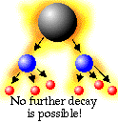
Weak interactions are responsible for the fact that all the more massive quarks and leptons decay to produce lighter quarks and leptons. When a particle decays, it disappears and in its place two or more particles appear. The sum of the masses of the produced particles is always less than the mass of the original particle. This is why stable matter around us contains only electrons and the lightest two quarks (up and down.)

Slide 154
Electromagnetic Charge:
Particles with electromagnetic charge attract particles with opposite electric charge, and repel particles with similar charges. The electromagnetic interaction has been unified with the weak interaction into the Electroweak interaction.

Slide 155
Color Charge:
Just as some particles can be electromagnetically charged, other particles have a different kind of charge called color charge. The strong interaction causes the attraction between color charged particles.

Slide 156
Flavor:
A particle's type is referred to as its "flavor." If a particle decays from one type to another it "changes flavor." When a down quark decays into an up quark it would be incorrect to say that the down quark suddenly ceased to be; instead, the down quark changed flavor.

Slide 158
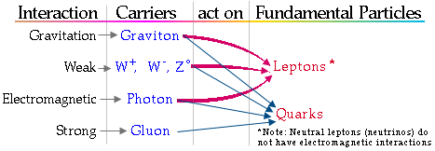

Slide 159
In conclusion……...
….what are the main points of this presentation?
What should you mentally take home with you from this talk?

Slide 160
Here they are……

Slide 161
All stuff is made of empty space and “non-stuff.”
All “non-stuff” is really energy!

Slide 162
This same electromagnetic process is necessary for the creation of a universe, a solar system, a volcano, a forest, a meadow, a flower, an insect, bacteria, living cells,
...or a thought.

Slide 163
We are comprised of energy!
Our thoughts are energy!
Our emotions are energy!
Our feelings are energy!
Our awareness of ourselves is energy!
Our body matter is energy!
Our life force is energy!
Energy CANNOT be destroyed!

Slide 165
There is no end…….
Thank you for your time.

Slide 166
baryon: BARE-ee-on
boson: BOZE-on
electron: e-LEC-tron (e-)
fermion: FARE-mee-on
gluon: GLUE-on
hadron: HAD-ron
kaon: KAY-on (K)
lepton: LEP-tahn
meson: MEZ-on
muon: MEW-on (µ)
neutrino: new-TREE-no
neutron: NEW-tron (n)
nuclear: NEW-klee-er
nucleus: NEW-klee-us
nucleon: NEW-klee-on
photon: FOE-tahn
pion: PIE-on
positron: PAUSE-i-tron (e+)
proton: PRO-tahn (p)
quark: KWORK (q)
tau: TAOW

