Slide 1
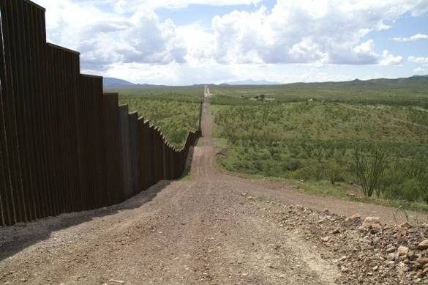
The USA/Mexico Border Wall Is it Good, Bad, or Ugly?
Hiram College Carol Donley & Roger Cram

Slide 2
Children in Detention in the United States

Slide 4
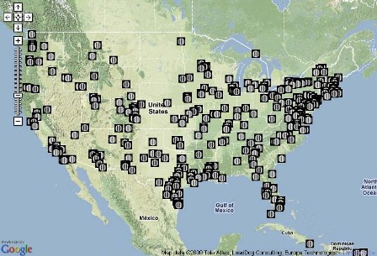
Immigration Detention Centers in the United States

Slide 5
Children immigrants Being Held Illegally by Our Government
https://www.youtube.com/watch?v=QZUTJM435hg

Slide 6
http://www.youtube.com/watch?v=lmIGeAaxfK0

Slide 7
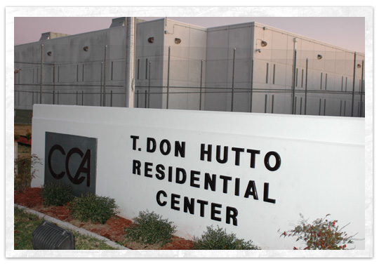
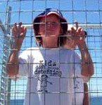
CHILDREN CONFINED- Immigrant Detention at Hutto
http://www.youtube.com/watch?v=HBCAgSCGM04

Slide 8
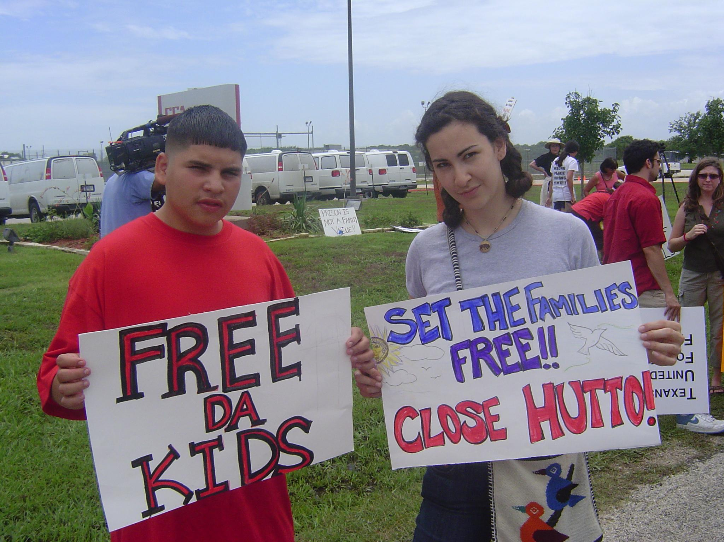

Slide 9
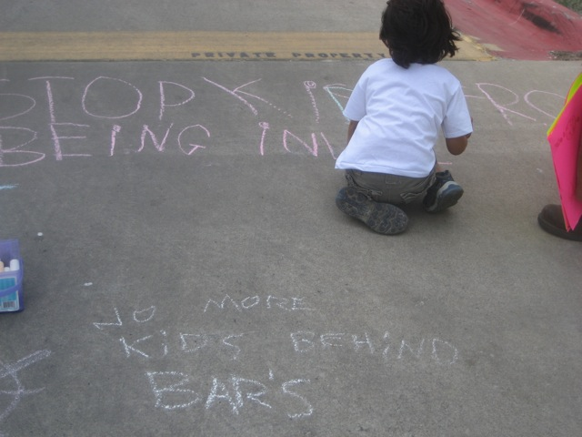

Slide 10
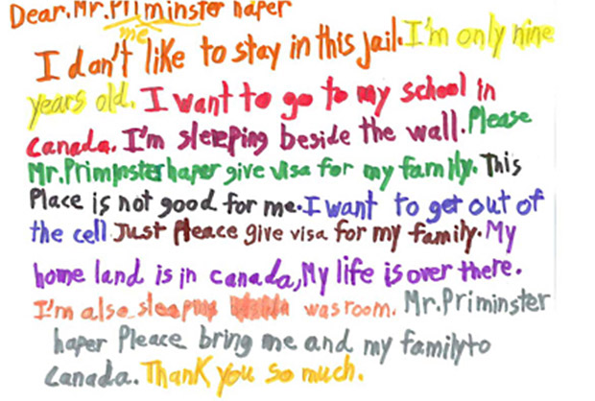

Slide 11
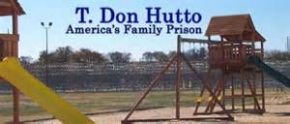

Slide 12
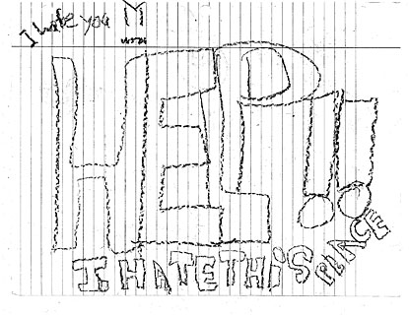

Slide 13
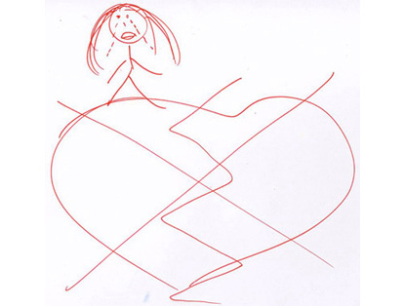
T. Don Hutto Residential Center in Williamson County, Texas

Slide 14
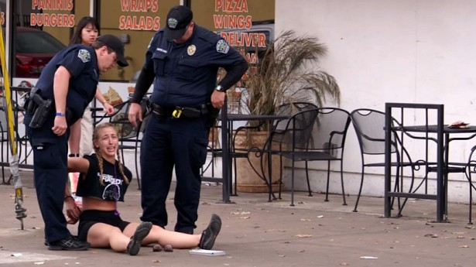
Police Arrest for Speeding 5 MPH over limit
http://www.youtube.com/watch?v=9xwq3oPIG88

Slide 15
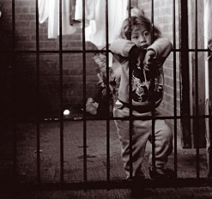
Border detention of children shames America
By Ruben Navarrette, CNN Contributor
updated 2:48 PM EDT, Thu June 12, 2014
http://www.cnn.com/2014/06/12/opinion/navarrette-immigrant-children/index.html

Slide 16
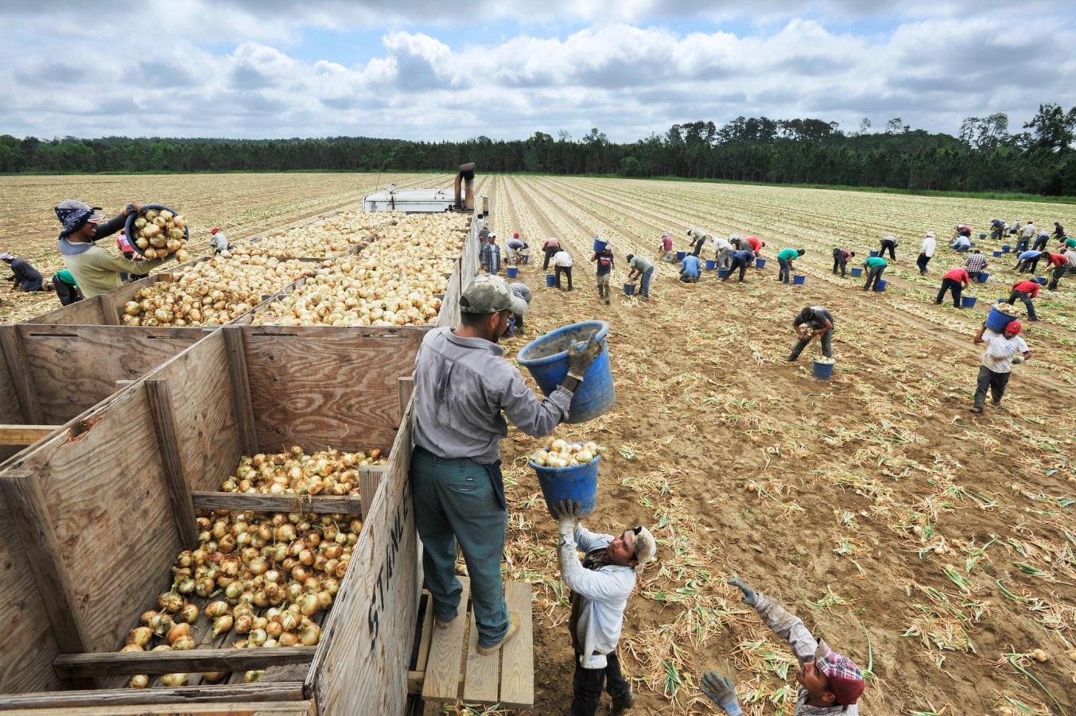
The United States Government is the Largest Employer of Undocumented (and Sometimes Documented) Immigrants in the Country!!!
http://www.youtube.com/watch?v=KWJxUbexVAk

Slide 17
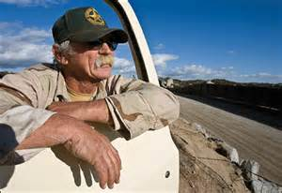
“Little Dog”
The Vigilante at Patriot Point
http://www.youtube.com/watch?v=QSgqmq6fY7o

Slide 18
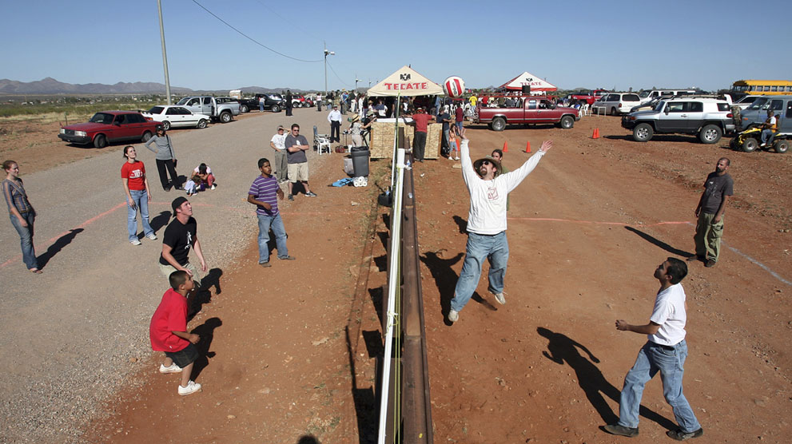

Slide 19
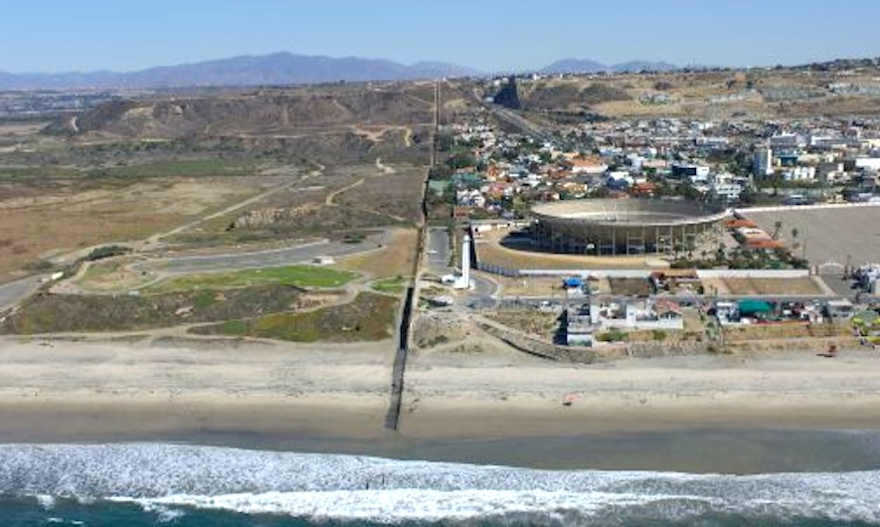

Slide 20
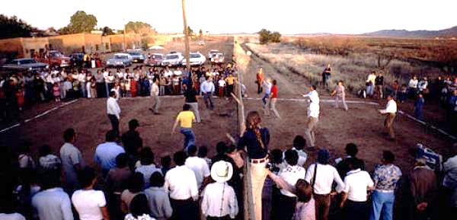

Slide 21
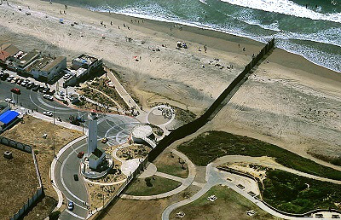

Slide 22
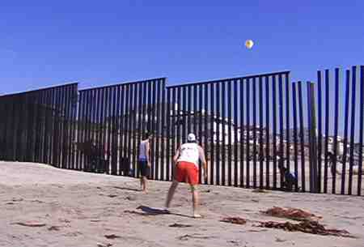

Slide 23
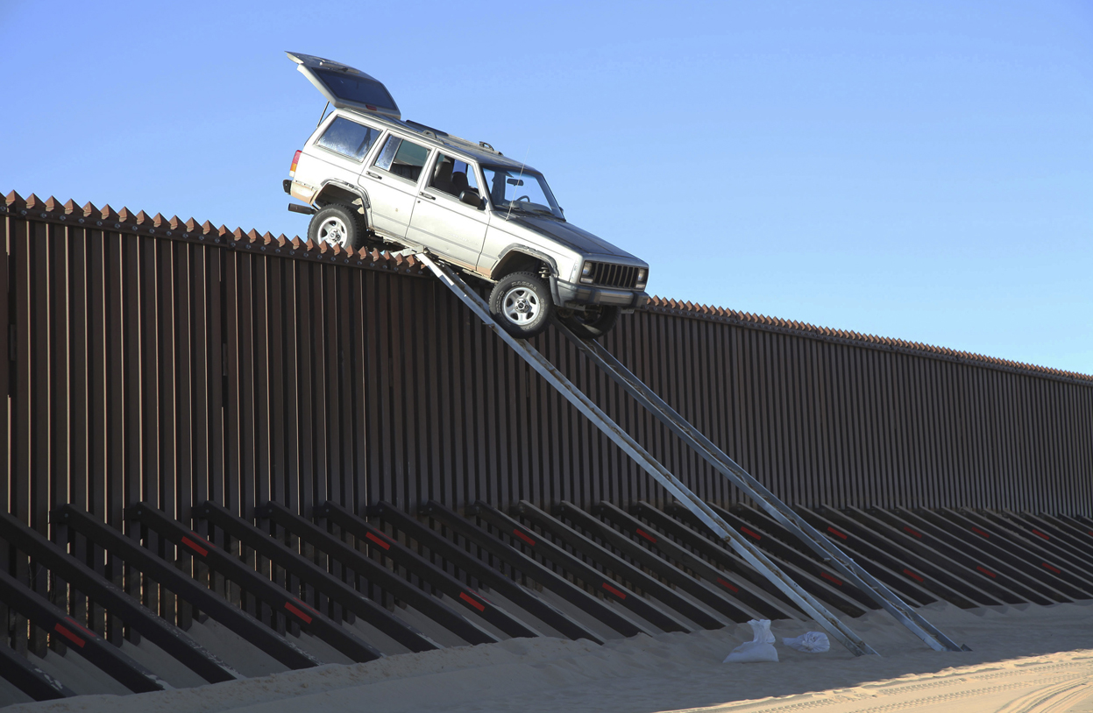

Slide 24
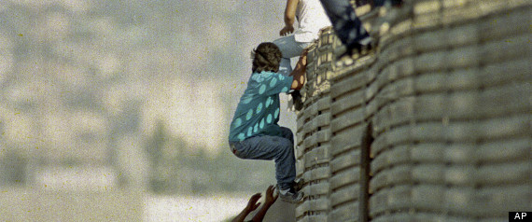
https://www.youtube.com/watch?v=XHjKBjM1ngw

Slide 25
Glenn Weyant plays the wall
SASABE, Ariz. — On a windy day in southern Arizona’s remote borderlands, Glenn Weyant had everything he needed to make music — a cello bow, a mallet and the miles-long fence dividing the United States and Mexico.
His method, like his music, was improvisational and low-tech: He inserted electronic equipment into an Altoids tin, turning it into a microphone. Weyant filled the tin with magnets and pressed it against the fence a few inches off the ground. Wires attached to the tin led to an amp and several effects pedals — the kind electric guitarists use — which allow him to manipulate sounds.
http://www.youtube.com/watch?v=iGfC0eRAFG4

Slide 26
Desert scrub, mesquite and sun-bleached rocks would serve as his audience; sometimes they do double duty as instruments.
“Nobody thought of the border wall as possibly anything other than something to separate people,” he said. “I transform it. I play it.”
For eight years, Weyant has tapped, banged and stroked the fence to produce haunting, sometimes ethereal, sounds in a region he has called the “de facto militarized zone.” Compositions can last a minute — or more than half an hour.
“I’m a border deconstructionist,” said Weyant, a 50-year-old Tucson resident. “I want to deconstruct preconceived notions. What I’m saying is you don’t need to be afraid of the wall. You have nothing to fear.”

Slide 28
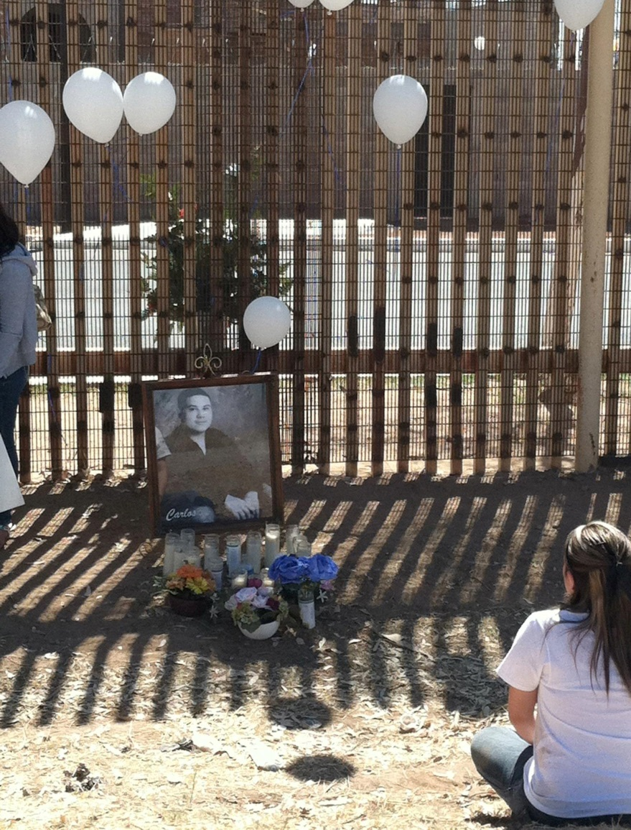
Where do we go from here?

