Slide 2
Human Trafficking
Slavery in the U.S.A.
United Methodist Church
Hillcrest
February 20, 2012
by Roger F. Cram
Notes:
I’m going to begin today’s presentation with a story:
A woman kept in domestic servitude in the United States for several years was rescued when a neighbor, noticing that she had a large tumor, offered to take the woman to the emergency room/health clinic [where will depend on who the presentation audience is]. Luckily, the health providers asked the right questions and realized the woman was a victim of human trafficking. As a result, they helped the woman escape her situation and receive the medical care she desperately needed. Her employers received 15-20 years in jail.
This is a success story because, first, the neighbor took the important step in bringing the woman to the emergency room/health clinic, and second, because the health providers examining the woman were able to look beneath the surface to probe whether or not she was a possible trafficking victim. Today, I’m going to discuss the important role health care providers play in identifying, and therefore, helping victims of human trafficking.

Slide 3
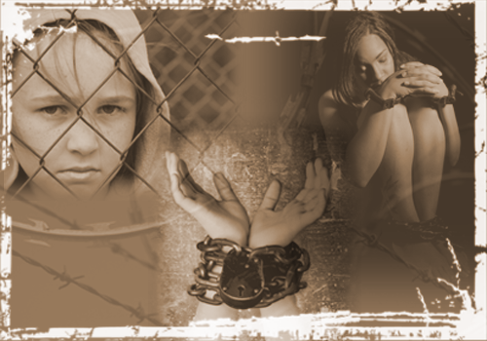
Human Trafficking Modern Day Slavery
Slavery in the U.S.A.
Notes:
I’m going to begin today’s presentation with a story:
A woman kept in domestic servitude in the United States for several years was rescued when a neighbor, noticing that she had a large tumor, offered to take the woman to the emergency room/health clinic [where will depend on who the presentation audience is]. Luckily, the health providers asked the right questions and realized the woman was a victim of human trafficking. As a result, they helped the woman escape her situation and receive the medical care she desperately needed. Her employers received 15-20 years in jail.
This is a success story because, first, the neighbor took the important step in bringing the woman to the emergency room/health clinic, and second, because the health providers examining the woman were able to look beneath the surface to probe whether or not she was a possible trafficking victim. Today, I’m going to discuss the important role health care providers play in identifying, and therefore, helping victims of human trafficking.

Slide 4
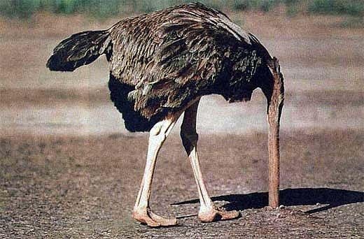
If some atrocities are so horrible that no one can even talk about them, then how are we ever going to stop them?
Notes:
When it comes to human trafficking, some people behave like an ostrich – out of sight, out of mind.

Slide 5
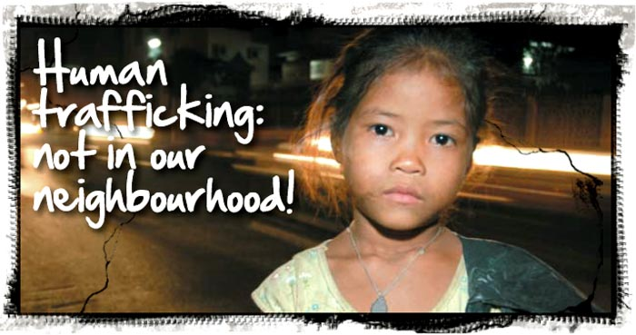
Not for Sale
Human Trafficking Statistics
By Monica Pena
Austin Times Staff, Texas

Slide 6
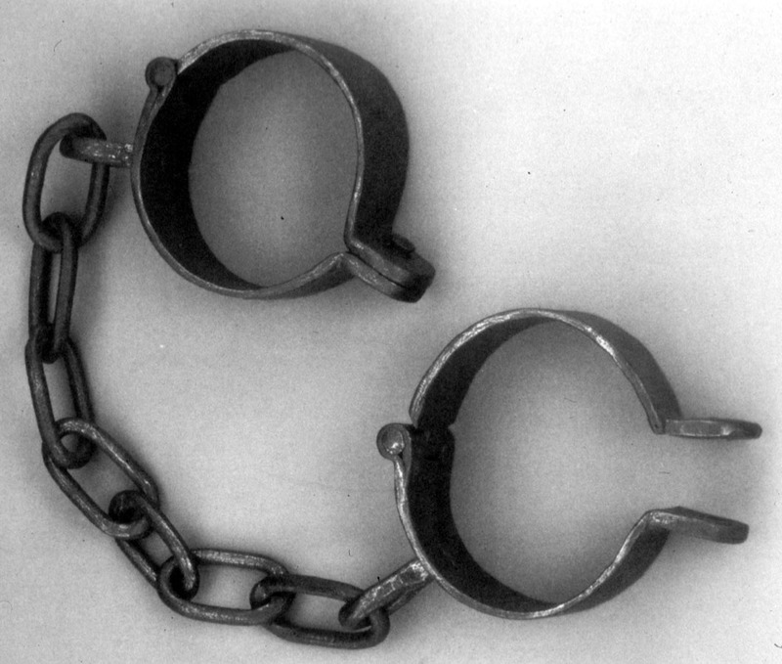
During the 450 years of the Atlantic slave trade, there were a total of 11,313,000 slaves in bondage over that entire time period.

Slide 7
 | Period (450 years) |  | Number of Slaves Accounted For |  |  | %
 | 1450-1600 |  | 409,000 |  |  | 3.6
 | 1601-1700 |  | 1,348,000 |  |  | 11.9
 | 1701-1800 |  | 6,090,000 |  |  | 53.8
 | 1801-1900 |  | 3,466,000 |  |  | 30.6
 | Total Slave Exports |  | 11,313,000 |  |  | 100.0
THE ATLANTIC SLAVE TRADE AND SLAVERY IN AMERICA
© 2007, 2008 Neil A. Frankel

Slide 8
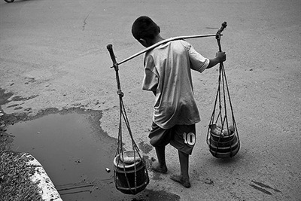
Today, now, at this moment, there are 27 million slaves barely living in the world!
Kevin Bales, President, Free the Slaves, Inc.
“Modern Slavery, The Secret World of 27 Million People”
Photo by Henri Ismail - World Press.com

Slide 9
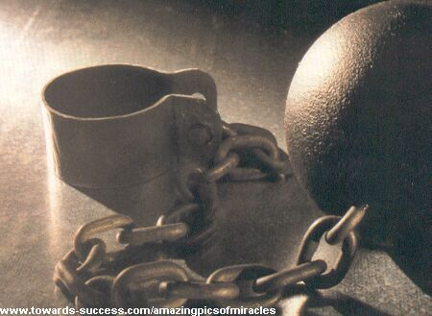
That is 238% more slaves alive NOW, this second, as were delivered from Africa during the entire 450 years of the transatlantic slave trade!

Slide 10
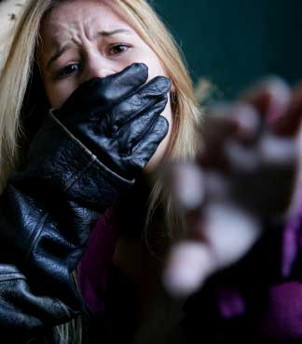
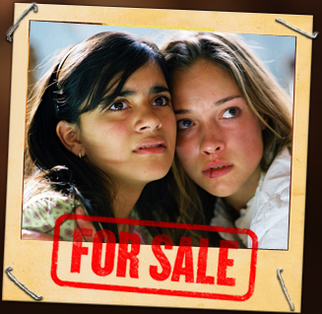
Slavery today is called
Human Trafficking

Slide 11
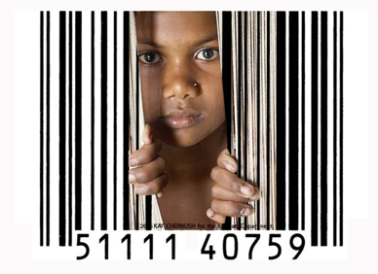
Slavery = people bought and sold and held against their will
Today we call it
“human trafficking”
US Department of Health and Human Services, ACF, Trafficking Campaign
Notes:
Human trafficking is a devastating human rights violation that takes place not only internationally, but also here in the United States. It is, indeed, a form of modern-day slavery.
Traffickers use force, fraud or coercion to enslave their victims into situations involving sexual exploitation or forced labor.
Human trafficking is the fastest growing criminal industry in the world today, often operated by organized crime syndicates.

Slide 12
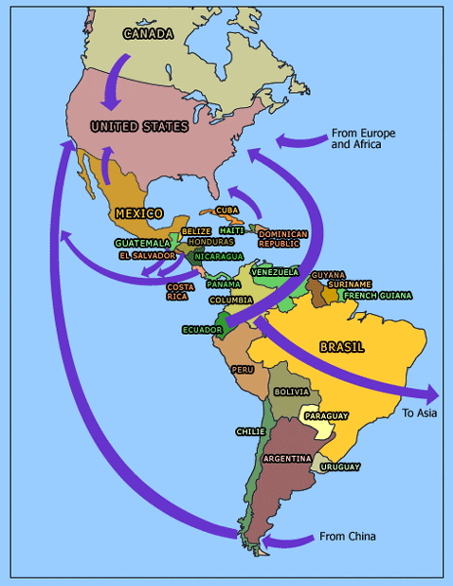
After drug dealing and weapon sales, human trafficking is the second largest criminal industry in the world, and it is the fastest growing.
PBS Map on Trafficking Patterns
US Department of Health and Human Services, ACF, Trafficking Campaign

Slide 13

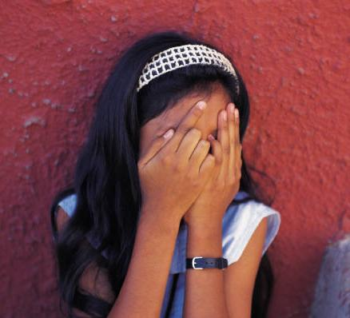
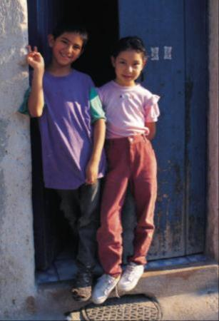
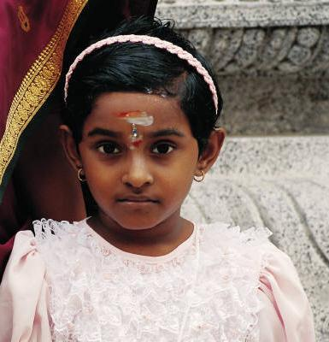
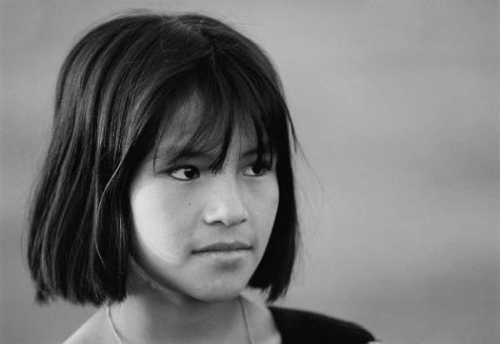
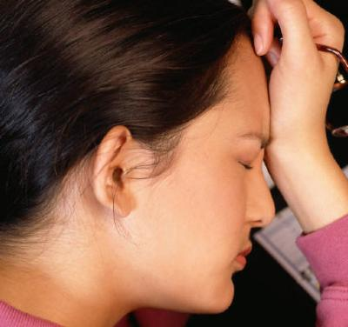

Human Trafficking is…
.
Recruitment
Harboring
Transportation
    Provision or
Obtaining of a person…
for a Commercial Sex Act or
Labor or Services…
through Force, Fraud or Coercion.

Slide 14
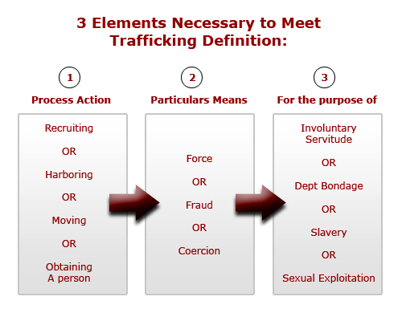

Slide 15
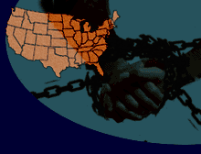
  Force:
  Rape, beatings, constraint,
  confinement, addiction to drugs;
  kidnapped from the streets,
  shopping malls, airports, bus
  stations
US Department of Health and Human Services, ACF, Trafficking Campaign
Notes:
Traffickers use force, fraud and coercion to traffic women, men and children.
Force involves the use of rape, beatings and confinement to control the victim. Forceful violence is used especially during the early stages of victimization, known as the ‘seasoning process,’ which is used to break the victims’ resistance to make them easier to control.
Fraud usually involves false offers of employment. For example, women and children will reply to advertisements promising jobs as waitresses, maids and dancers in other countries and are then forced into prostitution once they arrive at their destinations. Fraud may also involve promises of marriage or a better life, in general.
Coercion involves threats, debt-bondage and psychological manipulation. Traffickers often threaten victims with injury or death, or the safety of the victim’s family back home. Many trafficking victims are also controlled through debt-bondage, usually in the context of paying off transportation fees into the destination countries. Traffickers commonly take away the victims’ travel documents and socially isolate them to make escape more difficult. Victims often do not realize that it is illegal for traffickers to dictate how they have to pay off their debt. In many cases, the victims are trapped into a cycle of debt because they have to pay for all living expenses in addition to the initial transportation expenses. Fines for not meeting daily quotas of service or “bad” behavior are also used by some trafficking operations to increase debt. Most trafficked victims rarely see the money they are supposedly earning and may not even know the specific amount of their debt. Even if the victims sense that debt-bondage is unjust, it is difficult for them to find help because of language, social and physical barriers that keep them from obtaining assistance.

Slide 16

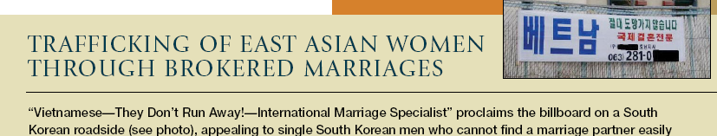
Fraud:
Includes false and deceptive
offers of employment,
marriage, and a better life.
US Department of Health and Human Services, ACF, Trafficking Campaign
Notes:
Traffickers use force, fraud and coercion to traffic women, men and children.
Force involves the use of rape, beatings and confinement to control the victim. Forceful violence is used especially during the early stages of victimization, known as the ‘seasoning process,’ which is used to break the victims’ resistance to make them easier to control.
Fraud usually involves false offers of employment. For example, women and children will reply to advertisements promising jobs as waitresses, maids and dancers in other countries and are then forced into prostitution once they arrive at their destinations. Fraud may also involve promises of marriage or a better life, in general.
Coercion involves threats, debt-bondage and psychological manipulation. Traffickers often threaten victims with injury or death, or the safety of the victim’s family back home. Many trafficking victims are also controlled through debt-bondage, usually in the context of paying off transportation fees into the destination countries. Traffickers commonly take away the victims’ travel documents and socially isolate them to make escape more difficult. Victims often do not realize that it is illegal for traffickers to dictate how they have to pay off their debt. In many cases, the victims are trapped into a cycle of debt because they have to pay for all living expenses in addition to the initial transportation expenses. Fines for not meeting daily quotas of service or “bad” behavior are also used by some trafficking operations to increase debt. Most trafficked victims rarely see the money they are supposedly earning and may not even know the specific amount of their debt. Even if the victims sense that debt-bondage is unjust, it is difficult for them to find help because of language, social and physical barriers that keep them from obtaining assistance.

Slide 17
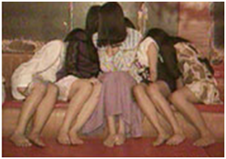
Coercion:
Threats of serious harm to, or physical restraint of, any person;
Any scheme, plan or pattern intended to cause victims to believe that failure to perform an act would result in restraint against them; or
Physical harm or death to a loved one; or
The abuse or threatened abuse of the
legal process.
US Department of Health and Human Services, ACF, Trafficking Campaign
Notes:
Traffickers use force, fraud and coercion to traffic women, men and children.
Force involves the use of rape, beatings and confinement to control the victim. Forceful violence is used especially during the early stages of victimization, known as the ‘seasoning process,’ which is used to break the victims’ resistance to make them easier to control.
Fraud usually involves false offers of employment. For example, women and children will reply to advertisements promising jobs as waitresses, maids and dancers in other countries and are then forced into prostitution once they arrive at their destinations. Fraud may also involve promises of marriage or a better life, in general.
Coercion involves threats, debt-bondage and psychological manipulation. Traffickers often threaten victims with injury or death, or the safety of the victim’s family back home. Many trafficking victims are also controlled through debt-bondage, usually in the context of paying off transportation fees into the destination countries. Traffickers commonly take away the victims’ travel documents and socially isolate them to make escape more difficult. Victims often do not realize that it is illegal for traffickers to dictate how they have to pay off their debt. In many cases, the victims are trapped into a cycle of debt because they have to pay for all living expenses in addition to the initial transportation expenses. Fines for not meeting daily quotas of service or “bad” behavior are also used by some trafficking operations to increase debt. Most trafficked victims rarely see the money they are supposedly earning and may not even know the specific amount of their debt. Even if the victims sense that debt-bondage is unjust, it is difficult for them to find help because of language, social and physical barriers that keep them from obtaining assistance.

Slide 18
Major Forms of Human Trafficking in the U.S.A.
Child Sex Trafficking
Adult Sex Trafficking
Debt Bondage Among Migrant Laborers
Involuntary Domestic Servitude
Forced Child/Adult Labor

Slide 19
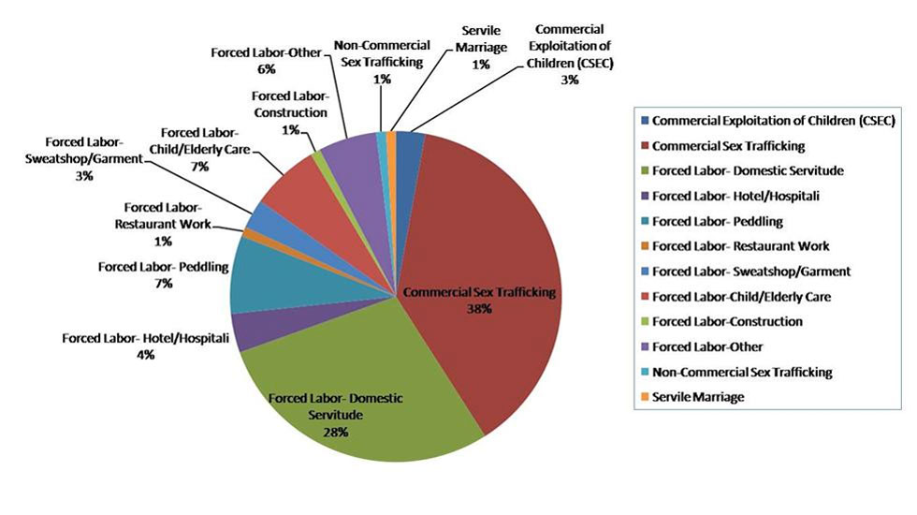
How are human slaves used and exploited in today’s society?

Slide 20

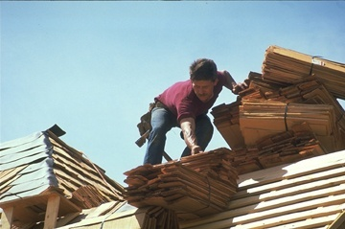
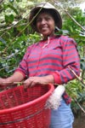
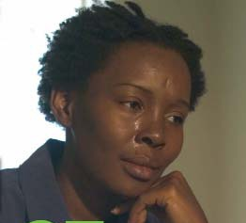
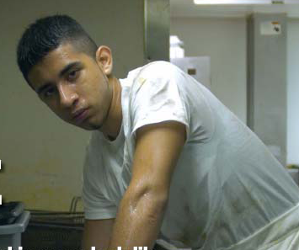
Working in nail salons
Construction workers
Often victims are working right in our midst. We may have walked past them or encountered them in ordinary situations.
Field & farm workers
Cleaning in hotels
Restaurant workers

Slide 21
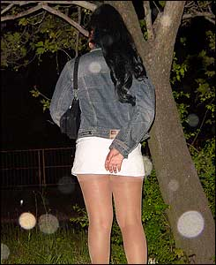
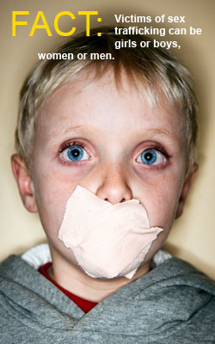

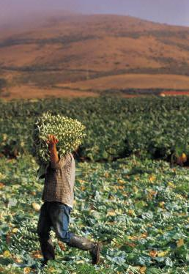
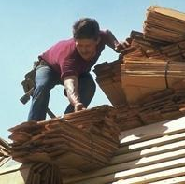
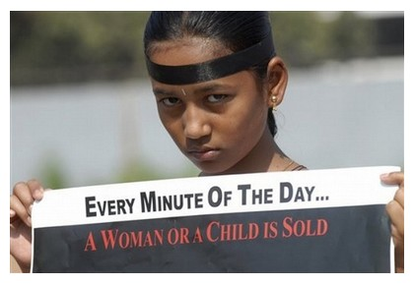
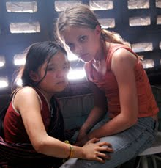
Victims can be found in domestic situations as nannies, truck stops, hotel maids, massage parlors, sweatshop factories, janitorial jobs, construction sites, farm work, gardeners, restaurants, nail salons, fishing boats, etc.
US Department of Health and Human Services, ACF, Trafficking Campaign

Slide 22
In the USA:
100,000 children and young women are sex trafficked every day.
12 is the average age of entry into pornography and prostitution in the U.S.
Pimps commonly sell minor girls for $400.00 an hour on America’s streets.
Source: Setting the Captives Free

Slide 23
In the USA:
Minors are sold an average of 10-15 times a day, 6 days a week, totaling between 9,360 and 14,040 sex acts a year (minimum of $3,744,000 a year).
The girls received none of the money.
Under 5% are boys.
Source: Setting the Captives Free

Slide 24
May be runaways, kids who have been abandoned, but many are lured or coerced by clever predators.
Traffickers are finding that American children are easier to recruit and sell than foreign victims because there is no need to cross the border.
In the USA:
Source: Setting the Captives Free

Slide 25
Nationally 450,000 children run away from home each year.
1 out of every 3 teens on the street will be lured toward prostitution within 38 hours of leaving home. Statistically, this means at least 150,000 children lured into prostitution each year.
In the USA:
Source: Setting the Captives Free

Slide 26
12 is the average age of entry into porn and prostitution, but their ages are often mislabeled.
The sale of child pornography has become a $3 billion dollar industry.
Over 100,000 websites offer child pornography.
55 percent of internet child pornography comes from the U.S.
Source: Setting the Captives Free

Slide 27
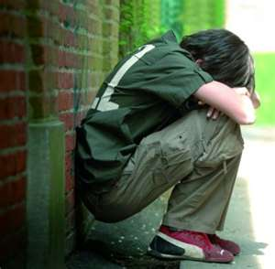
1 out of 5 pornographic images is of a child.
It is estimated that as many as 300,000 American children are working as prostitutes in the U.S.A.
In the USA:
One in 4 girls are sexually abused before they reach their 18th birthday.
Source: Setting the Captives Free

Slide 28
In the United States, there are over 100,000 slaves. Four of the main human trafficking route cities are Phoenix, Las Vegas, Columbus and Toledo. Up to 17,500 new slaves arrive in the U.S. annually.

Slide 29
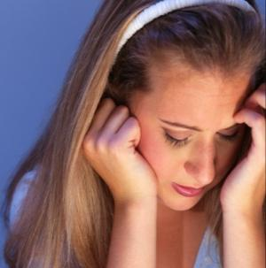
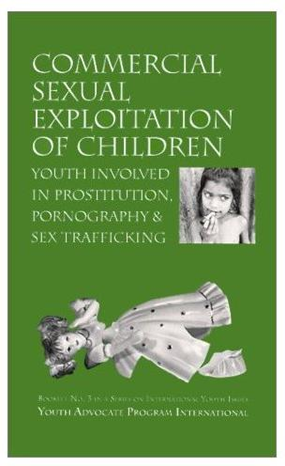
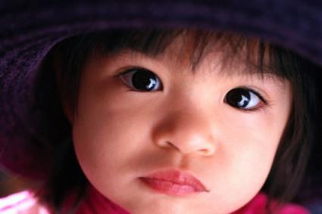
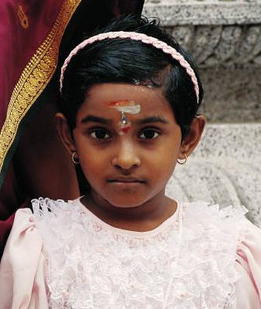
More than half the of victims
trafficked into United States
are thought to be Children.
Victims are about equally
women and men.**
US Department of Health and Human Services, ACF, Trafficking Campaign
Notes:
Human trafficking is an horrific international problem, with nearly a million victims trafficked across international borders annually
However, this is not just an international problem. Trafficking also takes place here in the United States. The U.S. State Department estimates that between 18,000 and 20,000 victims are trafficked into this country each year.
More than half of those trafficked into the United States are children, although many women and men are victims as well.
The majority of trafficking victims come to the United States from Asia, Central and South America, Russia, Eastern Europe and Canada (but also Africa and India).

Slide 30
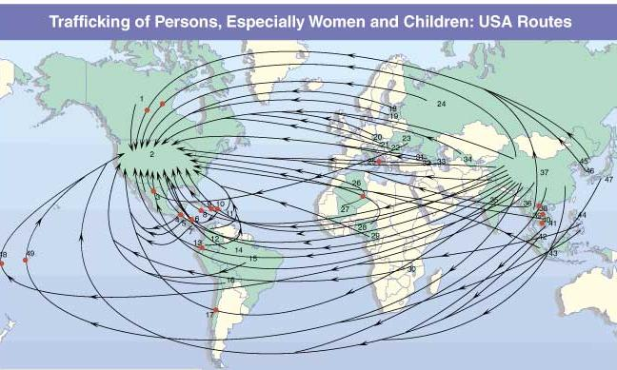
Victims can be trafficked into the U.S. from anywhere. Victims have come from, among other places,
Africa, Asia, India, Latin America, Eastern Europe, Russia and Canada.
Source: John Hopkins University, the Protection Project
Notes:
Human trafficking is an horrific international problem, with nearly a million victims trafficked across international borders annually
However, this is not just an international problem. Trafficking also takes place here in the United States. The U.S. State Department estimates that between 18,000 and 20,000 victims are trafficked into this country each year.
More than half of those trafficked into the United States are children, although many women and men are victims as well.
The majority of trafficking victims come to the United States from Asia, Central and South America, Russia, Eastern Europe and Canada (but also Africa and India).

Slide 31
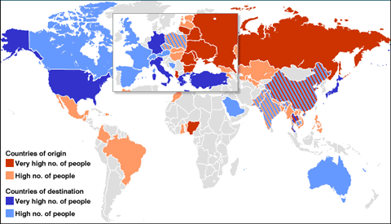

Slide 32
Who is enslaved in the United States?
Illegal immigrants from Mexico, El Salvador,
Honduras, Nicaragua.
The homeless
Runaways / castaways
Children and young adults kidnapped
from the streets, shopping malls, bus stations
Women, men, and children imported to the
United States with work visas having been
promised jobs. They end up in debt bondage.

Slide 33


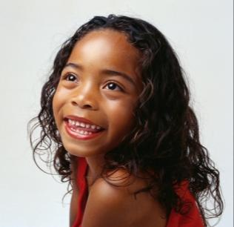
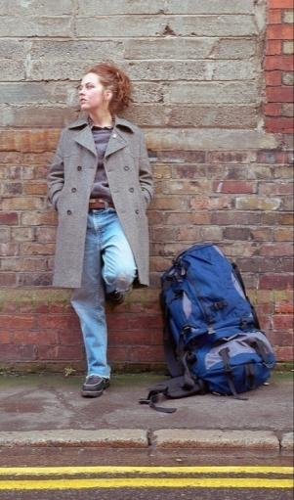
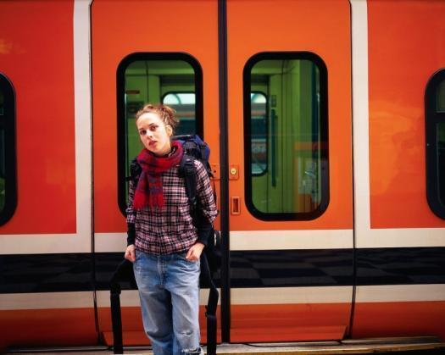
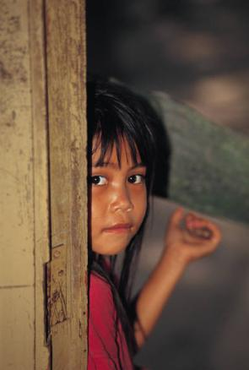
Who is at-risk to be trafficked?
Children
Vulnerable
women
Homeless and run-runaways
Immigrants
The disabled

Slide 34
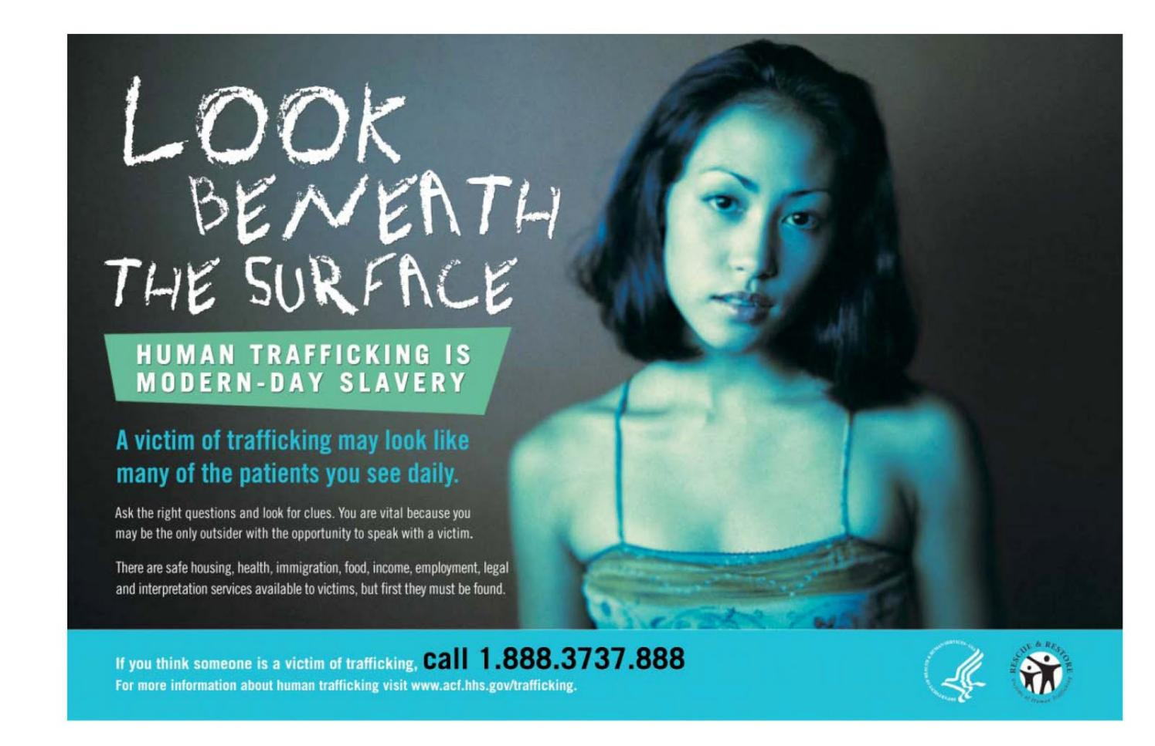

Slide 35
Atlanta, Georgia
Los Angeles
Jessie Foster

Slide 36
Smuggling Kidnapped People Into United States

Slide 37
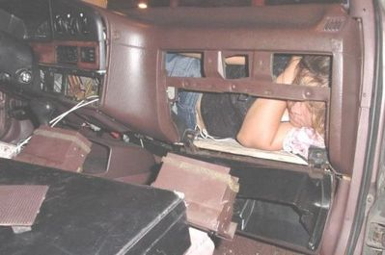
10News.com - San Diego News January 5, 2005
“A 10-year-old Mexican girl was found hidden inside a car's dashboard while it was undergoing an inspection Wednesday at the San Ysidro, California border crossing.”

Slide 38
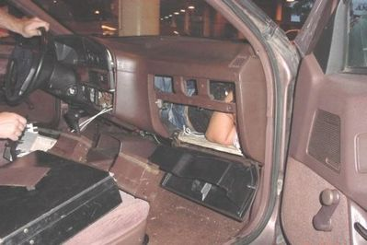
10News.com - San Diego News January 5, 2005
“…trapped under the dashboard and the front passenger seat of a 1988 white Toyota Camry. She was removed after officers worked for 30 minutes to partially remove the seat. She appeared to be in good condition.”

Slide 39
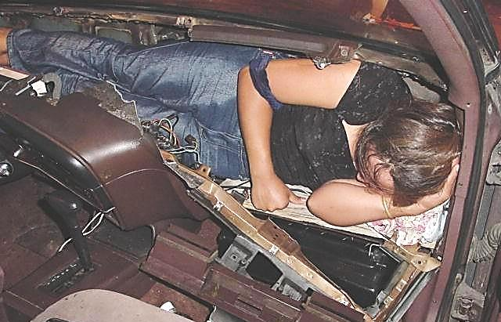
10News.com - San Diego News January 5, 2005

Slide 40
In a disturbing trend, the number of undocumented minors, including infants and youngsters, apprehended during fiscal year 2004 at ports of entry on the California/Mexico border climbed to 6,478, up almost 17 percent over the previous year.

Slide 41
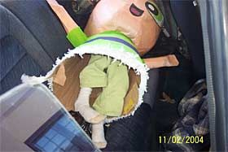
A 5-year-old girl found hidden inside a pinata in the back seat of a car being inspected at the San Ysidro border station in drew widespread media interest to the issue.
By Leslie Berestein
UNION-TRIBUNE STAFF WRITER November 12, 2004

Slide 42
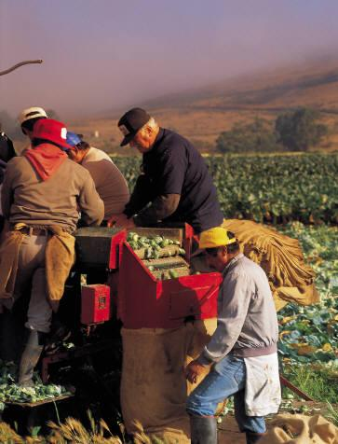
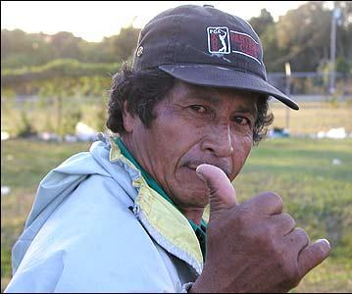
Let’s Look At Labor Trafficking: Using force, fraud or coercion to recruit, harbor, transport, obtain or employ a person for labor or services in involuntary servitude, peonage, debt bondage or slavery
US Department of Health and Human Services, ACF, Trafficking Campaign
Notes:
As defined by the Trafficking Victims Protection Act of 2000, there are primarily two categories of human trafficking: Sex Trafficking and Labor Trafficking.
Sex trafficking operations occur in highly visible venues such as street prostitution, as well as more underground locations such as closed-brothel systems that operate out of residential homes.
Sex trafficking also takes place in a variety of public and private locations such as massage parlors, spas, strip clubs and other fronts for prostitution. Victims may start off dancing or stripping in clubs and are often coerced into more exploitative situations of prostitution and pornography.
Labor trafficking/exploitation involves domestic servitude; sweatshop factories; construction sites; migrant agricultural work; the fishing industry; janitorial jobs; the food service, hotel and tourist industries; and panhandling.
It is important to clarify that the crime of trafficking actually occurs when the victim is exploited for sex or forced labor – not when the victim is moved from one location to another.
As health care providers, you may come in contact with victims of sex or labor trafficking, but may mistake them as willing participants. It’s vital to look beneath the surface when encountering these types of patients and ask yourself if they are potential victims forced into these situations. As victims, they desperately need your help and compassion.

Slide 43
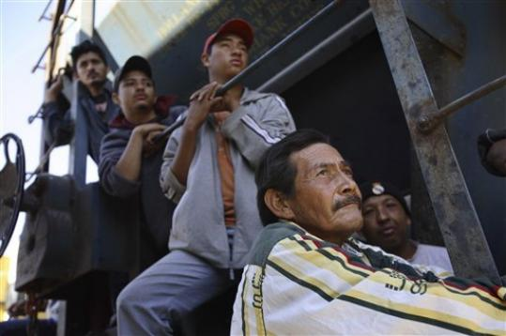
The Train of Death
The “Beast”

Slide 44
The “Beast” is a freight train traveling from Southern Mexico to the United States. Hundreds searching for a better life in the United States must hang on for their lives. When they fall asleep, they fall under the train severing their arms and legs.

Slide 45
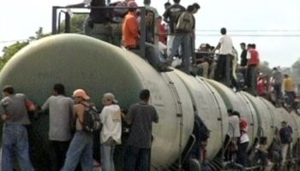

Slide 46



Slide 47

Over 50% of the immigrants on the “Beast” are women and children.

Slide 48

Only 20% of those riding the “Beast”
make it to the United States.

Slide 49

By DUDLEY ALTHAUS,
HOUSTON CHRONICLE
Updated 11:02 a.m., Sunday, August 21, 2011
“Migrant sympathizers…ease the way with a string of shelters along the length of Mexico, usually close to the rails or the border itself. …Opened 30 months ago beside the tracks, the shelter was intended to serve 60 migrants a night but often takes in as many as 100 or more.”

Slide 50


Slide 51


Slide 52
Immokalee, Florida
Migrant workers arrive from Mexico, Nicaragua,
Haiti, and Guatemala.
Population of 25,000 swells to 40,000
during the nine month harvest season.

Slide 53




Slide 54

Most migrant workers arrive with
the help of a coyote guide.

Slide 55

They wake up at 4:00 am and take migrant busses
to the fields. They sleep twelve to a room in
broken-down shacks. Each are charged $50.00 per
week for the shack.

Slide 56




Twelve migrant workers to a
room charged $50 per week each.

Slide 57

Picking tomatoes is brutal, bending over all day other than running with a 32 pound bucket of picked tomatoes and throwing it up to another worker. They are paid $25 per ton.

Slide 58

The price of $25 per ton has not changed in the past thirty years!

Slide 59

Farm labor is the only type of labor not covered by the
National Labor Relations Act of 1935. This act protects
workers, fixes fair wages, gives the right to organize,
and fixes health and safety rules.

Slide 60


Farm workers can be fired for
protesting, trying to organize,
or requesting better pay.

Slide 61
Just a few items produced or harvested by child slave labor…
Shoes, coffee, shrimp, Firestone, Nike sporting goods, cell phones, lap top computers, X-Boxes, Haynes underwear, 70% of all chocolate (Hersey & Nestle), Victoria Secret, Pakistan carpets, charcoal, chestnuts, peanuts, beef, cocoa, granite, gold, diamonds, copper, rice, cotton, bamboo, rubber, bricks, sesame seeds, beans, coal, wheat, tobacco, tilapia, sugar, timber, corn, sunflower seeds, clothing, embroidery, palm oil, iron, cement, toys, fireworks, decorations, electronics, rubies, nails, tomatoes.

Slide 62


Slide 63


Slide 64

The industrial city of Sialkot in Punjab province is internationally known for its sports goods. Sialkot's hand-stitched-ball industry, with nearly 50,000 stitchers, is a big business. Some 80% of the world's soccer balls are produced by Nike in this bustling commercial hub.

Slide 65




Slide 66

Children from Nike sweatshops

Slide 67



Slide 68

Child slave drying cocoa beans

Slide 69
Adult and Child Sex Trade in the United States

Slide 70

About Human Trafficking
Florida Coalition Against Human Trafficking

Slide 71

Florida Coalition Against Human Trafficking Ad Campaign

Slide 72

According to Runawayteens.org, “One in seven kids between the ages of 10 and 18 will run away at some point. There are 1 to 3 million runaway and homeless kids living on the streets in the United States."

Slide 73



After a child in the United States
runs away from home, the average
amount of time before she/he is
spotted by a child trafficker is...

Slide 74



…38 hours!

Slide 75

How do so many American children become victims?
American children are easy targets for sex traffickers.
The vulnerability is the child’s age.
Traffickers target locations that commonly attract youth like schools, malls, parks, even shelters and group homes—AND the Internet!

Slide 76


Slide 77


Slide 78


Slide 79

In the United States,
2300 people are
missing each and
every day.

Slide 80


Slide 81
One of the biggest human trafficking events in the United States is …

Slide 82


Slide 83
“While most of America is looking forward to watching to the showdown between the Green Bay Packers and the Pittsburgh Steelers, under-age girls are lured into the dangerous world of the multimillion dollar sex trade industry.”
A Celebration of Women
World HUB @ Wheel of Women Leaders That Care ADELE BUTLER – Women of Spirit: Human Trafficking Feb. 3, 2011

Slide 84



“…law enforcement agencies and advocacy groups rescued around 50 girls during the previous two Super Bowls.”
September 11, 2011
A Celebration of Women
World HUB @ Wheel of Women Leaders That Care ADELE BUTLER – Women of Spirit: Human Trafficking Feb. 3, 2011

Slide 85
Human trafficking and the Super Bowl
Add a comment
John Burger
, Dallas Human Trafficking Examiner
November 24, 2010 - Like this? Subscribe to get instant updates.
1 comment
0
Share
Print
Email
0
Share
Print
Email
Last week the Texas State Attorney General, Greg Abbott, announced he would be sending a dozen staff members from his human trafficking task force to assist local law enforcement in cracking down on human trafficking during the 2011 Super Bowl.
"The Super Bowl is one of the biggest human trafficking events in the United States," Abbott said.
During the 2009 Super Bowl in Tampa, Florida, the Florida State Department of Children and Families took in 24 minors who had been trafficked to the Tampa area as Sex Slaves for the Super Bowl. These were just the ones that were found.
In 2010. the Women's Funding Network found an increase of 80% in Craigslist sex ads during the Super Bowl. Craigslist recently shut down their "Adult Services" section after receiving over 10,000 petition signatures from the public and pressure from a number of State Attorney Generals.
Although no one knows exactly how many people will be trafficked to North Texas for the Super Bowl in February 2011, anti-trafficking organizations estimate it will be in the thousands.
Advertisement
This is partially due to the fact that the U.S. Department of Justice estimates that over 14,500 people are trafficked into the United States each year and 25% of all trafficked persons come through Texas.
According to a report by Shared Hope International, which investigates human trafficking in major cities, the Dallas Police Department, Child Exploitation/High Risk Victims & Trafficking Unit has created a unique and effective investigative tool to combat domestic minor sex trafficking. The Dallas Police Department, Child Exploitation/High Risk Victims & Trafficking Unit (CE/HRVTU) has developed an investigative tool to identify high risk victims (HRV) by flagging all minors who have run away from home four or more times in one year, as well as any minors that are repeat victims of sexual abuse or sexual exploitation. In 2007, CE/HRVTU identified 189 HRV cases 119 of which involved prostitution.
Of those High Risk Victims cases, 75% included felony charges specifically related to domestic minor sex trafficking.
A number of local organizations are joining in the effort to raise awareness and support ground work in recognizing and reporting human trafficking for the Super Bowl 2011. You can learn more about these groups and how you can help by clicking the links below.
Texas Anti-Trafficking Organizations:
Traffick 911
Free the Captives
Mosaic Family Services
Read all 64 pages of the full Dallas report by Shared Hope International
http://www.sharedhope.org/Portals/0/Documents/Dallas_PrinterFriendly.pdf
Stories about previous Super Bowls and Trafficking.
http://www.miamiherald.com/2010/02/05/1463956/volunteers-hope-to-rescue-child.html
http://humantrafficking.change.org/blog/view/the_results_are_in_sex_trafficking_at_the_superbowl
Suggested by the author:
25% of human trafficking victims enter through Texas
Preventing the potential for human trafficking events before Super Bowl
Dallas non-profit Mosaic Family Services is looking for volunteers for for their annual 5K run
Celebrities against slavery: Ashton Kutcher & Demi Moore
How I started my abolitionist journey
Human trafficking and the Super Bowl
Add a comment
John Burger
, Dallas Human Trafficking Examiner
November 24, 2010 -
“…the Texas State Attorney General, Greg Abbott, announced he would be sending a dozen staff members from his human trafficking task force to assist local law enforcement in cracking down on human trafficking during the 2011 Super Bowl.”
"The Super Bowl is one of the biggest human trafficking events in the United States," Abbott said.
John Burger, Dallas Human Trafficking Examiner November 24, 2010

Slide 86
There are many reasons why victims of trafficking cannot simply walk away from their exploitative situation:
Fear – Most victims have been coerced, threatened and abused.
Threats to family members in home country – Oftentimes traffickers threaten to abuse or murder family members if a victim refuses to work or attempts to run away.
Language and social barriers – Extremely limited contact with the outside world leaves many victims isolated and many times without any understanding of the language or their location.

Slide 87


Slide 88


A Western man negotiating for a young Thai girl (far right), who clutches the arm of her trafficker. After settling on a price, the man left with the girl, and the trafficker left with her payment. Photo courtesy of the U.S. State Department."

Slide 89
Child Sex Trafficking in the USA:
What Really Goes On
The average age a child becomes prostitute in the USA is 13 years old and it’s estimated that 293,000 children in the USA could be trafficked, with the vast majority being girls. Portland, Oregon has become a sex trafficking capital of the United States, but Atlanta, Houston, Toledo, New York City, Washington DC, Miami, San Francisco, Las Vegas, Kansas City and Los Angeles are competitors. It’s rife in every major city. According to the FBI, sex trafficking is the fastest-growing business of organized crime and the third-largest criminal enterprise in the world. The Good Men Project – December 11, 2011 By LE Eisenmenger

Slide 90
Portland, Oregon
http://abcnews.go.com/WNT/video/us-city-hotbed-child-sex-trafficking-abc-news-investigation-young-girls-prostitution-portland-oregon-sex-trade-sharon-alfonsi-11703700

Slide 91
How Do I Identify a Victim of Human Trafficking?
A victim: Has unexplained absences from school for a period of time, and is therefore a truant
Demonstrates an inability to attend school on a regular basis
Chronically runs away from home
Makes references to frequent travel to other cities
Exhibits bruises or other physical trauma, withdrawn behavior, depression, or fear
Lacks control over her or his schedule or identification documents
Is hungry-malnourished or inappropriately dressed (based on weather conditions or surroundings)
Shows signs of drug addiction
Additional signs that may indicate sex-related trafficking include:
Demonstrates a sudden change in attire, behavior, or material possessions (e.g., has expensive items)
Makes references to sexual situations that are beyond age-specific norms
Has a “boyfriend” who is noticeably older (10+ years)
Makes references to terminology of the commercial sex industry that are beyond age specific norms; engages in promiscuous behavior and may be labeled “fast” by peers
U.S. Department of Education – Office of Safe and Drug-Free Schools

Slide 92
Fear of police and immigration officials – Police corruption experienced in the victim's
home country is often exploited by traffickers who terrify their victims with stories of what
the police in the US may do to them.
The following pages tell true stories of what happens when community
members find slaves.
“
How can we find slaves in our
communities?
Watch for the following signs: The person might be a domestic worker, work in a restaurant, on a farm, in a shop, in a factory, or as a prostitute. The worker is likely to be enslaved if he or she:
Is working or being held against his or her will
Is not free to change employers
Does not control his or her earnings

Slide 93
Is unable to move freely or is being watched or followed
Is afraid to discuss him or herself in presence of others
Has been assaulted, or threatened with assault for refusing to work
Has been cheated into payment of debt upon arrival
Has had his or her passport or other documents taken away

Slide 95



Traffickers
Who are the pimps,
the traffickers?
What do they look like?

Slide 96

A stereotypical media-portrayed
“pimp” controlling modern
inner-city prostitutes

Slide 97







What do “pimps” look like engaged in human trafficking?

Slide 98
The Youth Sex Trade
Things You Need To Know
Prostitution is not only for money, but also
for food, drugs, shelter, or even a ride
Average age children are forced into
the sex trade is 14 years and as young as 8 years old
Youth forced into the sex trade face violence, rape, drugs, HIV, AIDS, pregnancies, lack of food and shelter,
and death.
Boys are victims as well as girls

Slide 99
Things Pimps Don’t Want You To Know
Pimps don’t care about the youth working for them.
Pimps use drugs, coercion, and violence to control their trafficked victims.
Youth forced into the sex trade live with daily violence. They are beaten by pimps and customers and are often killed. They are completely disposable with other victims easily obtainable.

Slide 100
Inside Bay Area
The Oakland Tribune
Dealers turning to sex business
Pimping provided many with inconspicuous way to make money in streets
By Barbara Grady, STAFF WRITER
Posted: 04/24/2008 02:42:15 AM PDT
Updated: 04/22/2009 06:47:53 AM PDT
OAKLAND – When selling crack cocaine became a tougher way to make money at the beginning of the decade because of increased police pressure, many drug dealers turned to pimping instead.
By selling young girls for sex, street hustlers were less likely to get caught. They didn't have to carry the commodity in their pocket or stash it in their homes, as they usually did with crack cocaine. They could use cell phones and laptop connections to the Internet to conduct business with customers while simply posing as boyfriends walking down the street with their girls….
""There is increased economic incentive promoting young men to become involved in pimping," the report said. "The lure of what is perceived as easy money is supported by easy access to a never ending supply of runaway, AWOL and throwaway youth — youth who are highly vulnerable, who have no way to meet their basic needs of food, shelter and human connection and who are invisible to society at large." …

Slide 101

Human Trafficking in Ohio

Slide 102

What is happening in Ohio?
Picture from Kathleen YS Davis, Human Trafficking and Modern Day Slavery in Ohio, 2006

Slide 103
The New Hotbed of Human Trafficking Is ... Ohio
“1800 people are trafficked in Ohio every year. This includes 800 immigrants who are exploited in commercial sex and factory work, as well as about 1000 American-born children who are forced into prostitution.”
Trafficking in Persons Study Commission

Slide 104
Why Does Ohio Support Human Trafficking?
“…weak laws on human trafficking, a growing demand for cheap labor, and Ohio's proximity to the Canadian border as the key reasons modern-day slavery thrives in the state.”
Toledo, Cleveland, Columbus, Dayton, and Cincinnati have interstate highways crossing the U.S.A.
Trafficking in Persons Study Commission

Slide 105

I-90
Boston to Seattle, WA
I-80
New York to California
I-70
Baltimore, MD to
Cove Fort, Utah
I-75
Northern Michigan to Miami, FL
I-74
Davenport, Iowa to
Greensboro, SC
I-77
Cleveland to
South Carolina
I-71
Cleveland to
Louisville, KY

Slide 106
“Ohio…a child sex trafficking ring that moved victims from truck stop to truck stop along the rust belt was busted. Most of the activity was centered in Toledo, Ohio, …” “…traffickers go where they can make money by selling their victims, and those places are small cities in Ohio…”
Amanda Kloer Change.org Editor - abolitionist.

Slide 107

Like many other states, Ohio has and continues to experience incidents of human trafficking in forms of forced labor and commercial sexual exploitation. Various factors and emerging evidence indicate that it is a source, transit ,and destination state for trafficked persons.
Kathleen YS Davis, Human Trafficking and
Modern Day Slavery in Ohio, 2006

Slide 108


Between 18,000 and 20,000 victims are trafficked into the United States annually.
Ohio woman to serve 1 year in trafficking case
December 17, 2010
COLUMBUS, Ohio (AP) — Federal prosecutors said Maria Terechina was a criminal who helped trick hundreds of Eastern European women into taking hotel jobs in Ohio they couldn't escape because Terechina took their passports and controlled where they lived and how they got around.
http://www.msnbc.msn.com/id/40724612/ns/world_news-europe/
Notes:
Human trafficking is an horrific international problem, with nearly a million victims trafficked across international borders annually
However, this is not just an international problem. Trafficking also takes place here in the United States. The U.S. State Department estimates that between 18,000 and 20,000 victims are trafficked into this country each year.
More than half of those trafficked into the United States are children, although many women and men are victims as well.
The majority of trafficking victims come to the United States from Asia, Central and South America, Russia, Eastern Europe and Canada (but also Africa and India).

Slide 109

Ohio Headlines
Ohio nail salon owner arrested in human trafficking case
November 23, 2010 The Columbus Dispatch
http://www.dispatch.com/live/content/local_news/stories/2010/11/23/ohio-nail-salon-owner-arrested-in-human-trafficking-case.html
FBI Cracks Down on Prostitution, Human Trafficking in Cleveland
Nov. 8, 2010 Fox 8 News
http://www.fox8.com/news/wjw-news-prostitution-human-trafficking-cleveland,0,7584379.story
Nail salons accused of human trafficking
August 18, 2010 The Columbus Dispatch
http://www.dispatch.com/live/content/local_news/stories/2010/08/18/human-trafficking.html

Slide 110
More Ohio Headlines
Sheriff fears brothel operation involves human trafficking (Cleveland, August 28, 2008, The Plain Dealer)
Pair imprisoned for running teen-prostitution ring (Garfield Hts, July 9, 2007, The Plain Dealer)
Ohio Man Arrested, Charged with Attempting to Purchase Two Children for Sexual Torture (July 25, 2007, News Release – Office of the Attorney General of Florida)
Slavery In Ohio: Coalition to combat human trafficking (July 31, 2007, The Columbus Dispatch) When a woman was jailed after a recent fight, authorities uncovered allegations of a more horrific crime. The young woman said she had been lured from her homeland for what she thought was a visit -- only to be forced into domestic servitude…

Slide 111



Ohio Trafficking in Persons Commission
Created July 2009

Slide 112
OHIO
Created two new criminal offenses:
  Trafficking in persons – Felony 2
  Ohio Revised Code 2905.32
  Unlawful conduct with respect to documents
  – Felony 3
  Ohio Revised Code 2905.33

Slide 113
OHIO
New law addresses labor and sex trafficking.
Defines Involuntary servitude:
“being compelled to perform labor or
services for another against one’s will.”
ORC 2905.31

Slide 114

Research and Analysis Subcommittee
Ohio Trafficking in Persons Study Commission
Report on the Prevalence of Human Trafficking in Ohio
February 2010
Factors Which May Increase Risk to Youth in Ohio
  Ohio’s weak response to child sex trafficking victims
  First responders in Ohio are unaware and unprepared and services are insufficient
  Customers who purchase youth are rarely prosecuted and traffickers suffer minimal consequences
  The high rates of vulnerable youth in Ohio.

Slide 115
Summary of Sub-Committee Findings and Recommendations:
Victim Services and Safe Locations sub-committee
In a survey of over 200 social service organizations, only five reported providing any human trafficking specific assistance. (10 beds in Ohio for rescued victims)
The sub-committee recommended a number of ways to fill the service gaps including:
Richard Cordray - Ohio Attorney General
Ohio Trafficking In Persons Study Commission
2010 Year End Report December 15, 2010

Slide 116
Train “what to look for” in detecting human trafficking:
Police
Firemen
Housing Inspectors
Health Inspectors
Zoning Inspectors
Plumbers
Electricians
Train students about human trafficking:
Elementary schools
Junior High School
High School
College

Slide 117

Victim Assistance and Safe Locations Subcommittee
Ohio Trafficking in Persons Study Commission
Summary of Key Findings - June 2010
Overwhelming lack of education re: identification, needs of trafficked persons and response protocols.
Not enough Ohio service providers equipped to meet specific needs of HT victims.
Two types of barriers:
Provider and client based.
Need multidisciplinary collaboration
to effectively meet needs of
trafficked persons in Ohio.

Slide 118
State Laws Against Human Trafficking
Criminal Provisions 45 States
Victim Protection 22 States
Law Enforcement Training 12 States
Statewide Task Force on Trafficking 13 States
Trafficking Research Commission 14 States
U.S. Policy Alert on Human Trafficking, Summary of U.S. Political Activity – August 2010 Polaris Project
Notes:
118

Slide 119
Do you want to live in a world, country, or state where child slavery, murder, torture, and rape are out of control?

Slide 120
Well, you do live
in such a world!

Slide 121
We Need To Get Our Heads
Out Of The Sand!

Slide 122

We need to address these horrors, get
our face out the sand, and start putting teeth into our efforts.

Slide 123


Slide 124


Thank you---

Slide 125

Getting Victims of Human Trafficking the Help They Need
1.888.3737.888
This hotline will help you:
  Determine if you have encountered victims of human trafficking
  Identify local community resources to help victims
  Coordinate with local social service organizations to help protect and serve victims so they begin process of restoring their lives
.
Call local police if victim is at risk of imminent harm
www.acf.hhs.gov/trafficking
Notes:
I’m going to begin today’s presentation with a story:
A woman kept in domestic servitude in the United States for several years was rescued when a neighbor, noticing that she had a large tumor, offered to take the woman to the emergency room/health clinic [where will depend on who the presentation audience is]. Luckily, the health providers asked the right questions and realized the woman was a victim of human trafficking. As a result, they helped the woman escape her situation and receive the medical care she desperately needed. Her employers received 15-20 years in jail.
This is a success story because, first, the neighbor took the important step in bringing the woman to the emergency room/health clinic, and second, because the health providers examining the woman were able to look beneath the surface to probe whether or not she was a possible trafficking victim. Today, I’m going to discuss the important role health care providers play in identifying, and therefore, helping victims of human trafficking.

