Slide 1
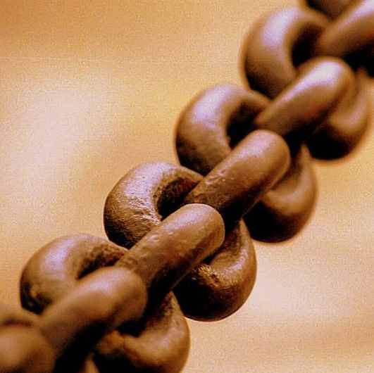
Barriers For Effective Law Enforcement of Human Trafficking
Ohio and Federal Laws by
Roger F. Cram
Hiram College

Slide 2
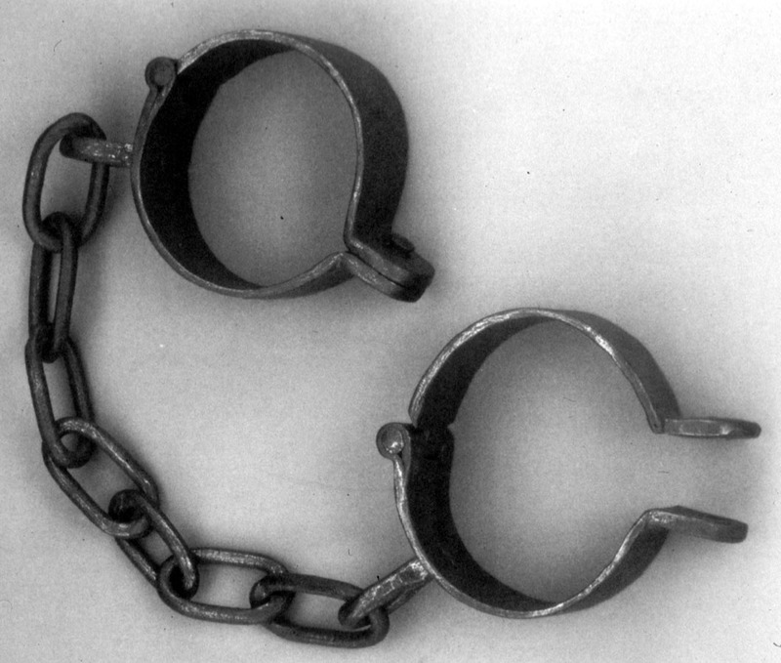
During the 450 years of the Atlantic slave trade, there were a total of 11,313,000 slaves in bondage over that entire time period.

Slide 3
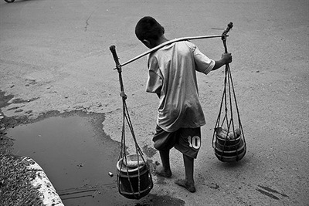
Today, now, at this moment, there are 27 million slaves barely living in the world!
Kevin Bales, President, Free the Slaves, Inc.
“Modern Slavery, The Secret World of 27 Million People”
Photo by Henri Ismail - World Press.com

Slide 4
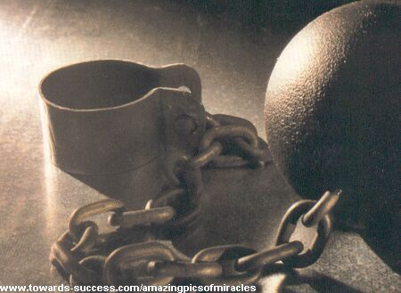
That is more than twice as many slaves alive NOW than were seized from Africa during the entire 450 years of the transatlantic slave trade!

Slide 5
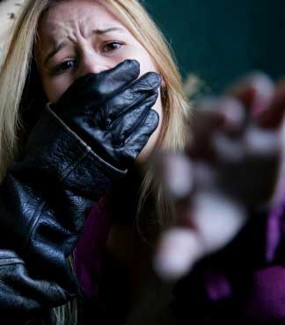

Slavery today is called
Human Trafficking

Slide 6
How Do Today’s Slaves Differ From
Those In the Transatlantic Slave Trade?
Today’s Slaves | Transatlantic Slave Trade
1. Very inexpensive, slaves are stolen or abducted. | 1. Slaves cost by today’s standards $30,000.
2. No need to protect investment, so slaves are neglected, starved, beaten, killed. When they are sick or injured, they are killed or discarded because replacements are plentiful. | 2. Slave owner had to care for the slave as a monetary investment by providing housing, food, medical care.
3. No ownership, slavery is illegal. Slaves are hidden and difficult to locate. | 3. Slaves are owned and registered and kept out in the open used as a measure on one’s wealth.

Slide 7
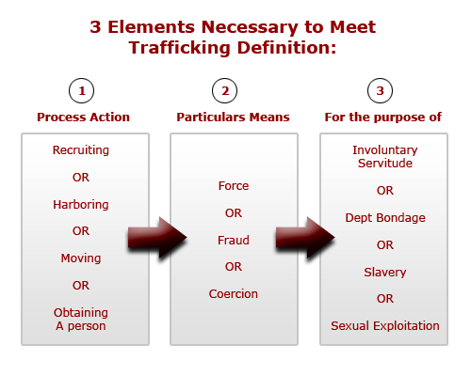

Slide 8
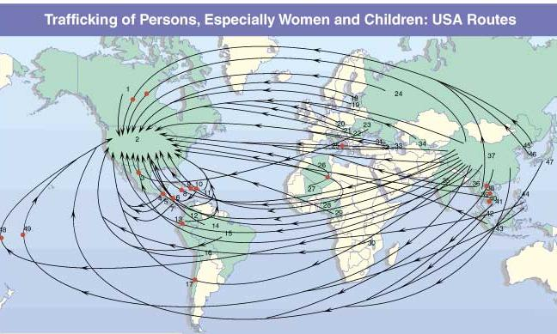
Victims can be trafficked into the U.S. from anywhere. Victims have come from, among other places,
Africa, Asia, India, Latin America, Eastern Europe, Russia and Canada.
Source: John Hopkins University, the Protection Project
Notes:
Human trafficking is an horrific international problem, with nearly a million victims trafficked across international borders annually
However, this is not just an international problem. Trafficking also takes place here in the United States. The U.S. State Department estimates that between 18,000 and 20,000 victims are trafficked into this country each year.
More than half of those trafficked into the United States are children, although many women and men are victims as well.
The majority of trafficking victims come to the United States from Asia, Central and South America, Russia, Eastern Europe and Canada (but also Africa and India).

Slide 9
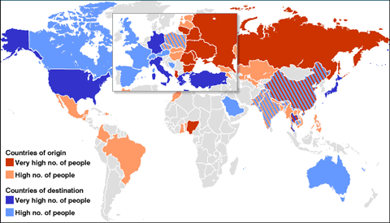

Slide 11
Who is enslaved in the United States?
Illegal immigrants from Mexico, El Salvador,
Honduras, Nicaragua.
The homeless
Runaways / castaways
Children and young adults kidnapped
from the streets, shopping malls, bus stations
Women, men, and children imported to the
United States with work visas having been
promised jobs. They end up in debt bondage.

Slide 12

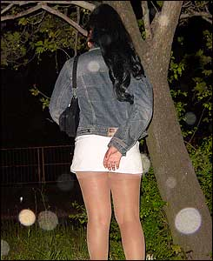
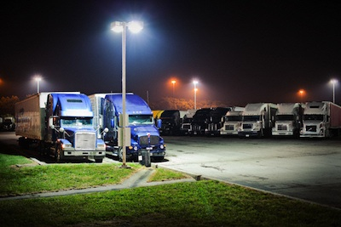
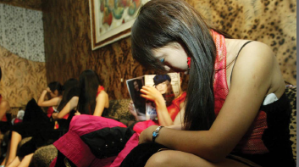
Victims can be found working in massage parlors, brothels, strip clubs, escort services, on the streets, truck stops.
US Department of Health and Human Services, ACF, Trafficking Campaign

Slide 13
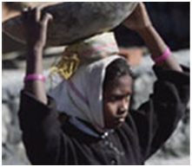
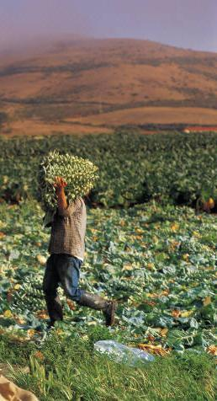



Victims can be found in domestic situations as nannies, hotel maids, sweatshop factories, janitorial jobs, construction sites, farm work, gardners, restaurants, nail salons, fishing boats
US Department of Health and Human Services, ACF, Trafficking Campaign

Slide 14
Signs to look for concerning human trafficking:
Person is shy, looking down when talking, not looking at you, seems afraid
Another person answers questions for the victim
They avoid questions, are very uneasy
Are there visibly signs of abuse?
Are their movements controlled by another?
Eat an early breakfast in a restaurant. Then return and eat a late dinner. Are the same cooks there? Busboys? Waitresses?

Slide 15
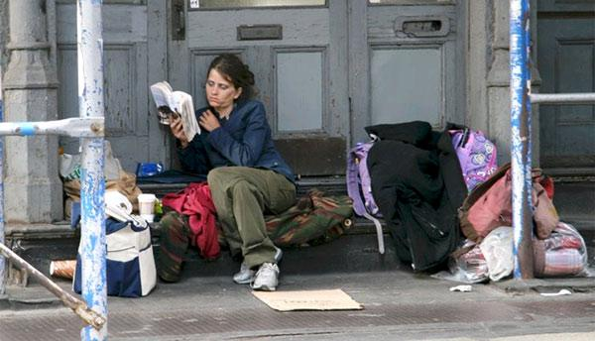

Slide 16
According to Runawayteens.org, “One in seven kids between the ages of 10 and 18 will run away at some point. There are 1 to 3 million runaway and homeless kids living on the streets in the United States."

Slide 17
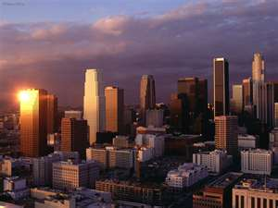
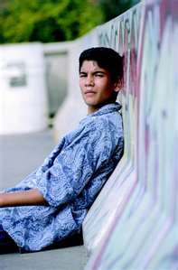
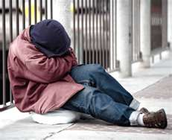
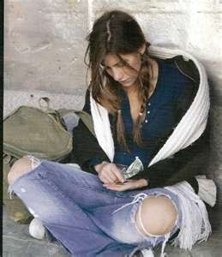

Slide 18
In the City of Los Angeles alone, over 4,000 new children find the streets every year.

Slide 19

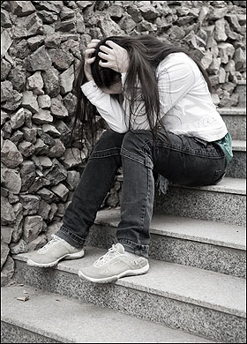
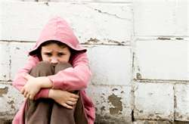

Slide 20
After a child in the United States runs away from home, the average
amount of time before she/he is spotted by a child trafficker is...

Slide 21

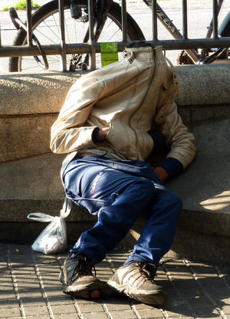
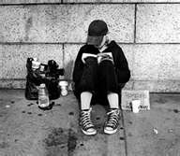
…38 hours!

Slide 22
The Youth Sex Trade
Things You Need To Know
Prostitution is not only for money, but also
for food, drugs, shelter, or even a ride
Average age children are forced into
the sex trade is 14 years and as young as 8 years old
Youth forced into the sex trade face violence, rape, drugs, HIV, AIDS, pregnancies, lack of food and shelter, and death.
Boys are victims as well as girls

Slide 23
Things Pimps Don’t Want You To Know
Pimps don’t care about the youth working for them; they are simply a tool to make money.
Pimps use drugs, coercion, and violence to control their trafficked victims.
Youth forced into the sex trade live with daily violence. They are beaten by pimps and customers and are often killed. They are completely disposable with other victims easily obtainable.

Slide 24
In the USA:
100,000 children and young women are sex trafficked every day.
12 is the average age of entry into pornography and prostitution in the U.S.
Pimps commonly sell minor girls for $400.00 an hour on America’s streets.
Source: Setting the Captives Free

Slide 25
In the USA:
Minors are sold an average of 10-15 times a day, 6 days a week, totaling between 9,360 and 14,040 sex acts a year (minimum of $3,744,000 a year).
The girls received none of the money.
Under 5% are boys.
Source: Setting the Captives Free

Slide 26
May be runaways, kids who have been abandoned, but many are lured or coerced by clever predators.
Traffickers are finding that American children are easier to recruit and sell than foreign victims because there is no need to cross the border.
In the USA:
Source: Setting the Captives Free

Slide 27
Nationally 450,000 children run away from home each year.
1 out of every 3 teens on the street will be lured toward prostitution within 38 hours of leaving home. Statistically, this means at least 150,000 children lured into prostitution each year.
In the USA:
Source: Setting the Captives Free

Slide 28
12 is the average age of entry into porn and prostitution, but their ages are often mislabeled.
The sale of child pornography has become a $3 billion dollar industry.
Over 100,000 websites offer child pornography.
55 percent of internet child pornography comes from the U.S.
Source: Setting the Captives Free

Slide 29
1 out of 5 pornographic images is of a child.
It is estimated that as many as 300,000 American children are working as prostitutes in the U.S.A.
In Kansas this year, many trafficked slaves, age 30 to 80, including handicapped and mentally ill, were enslaved as farm workers.
All were Caucasian.
Source: Setting the Captives Free

Slide 30

Florida Coalition Against Human Trafficking Ad Campaign

Slide 31
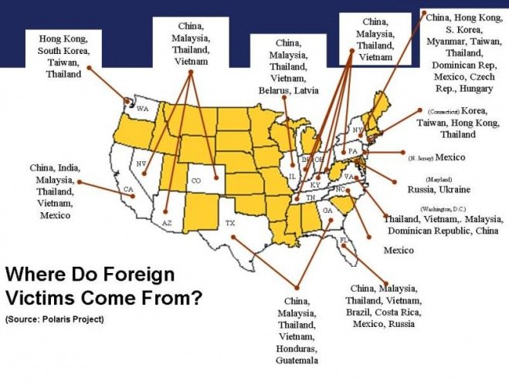

Slide 32
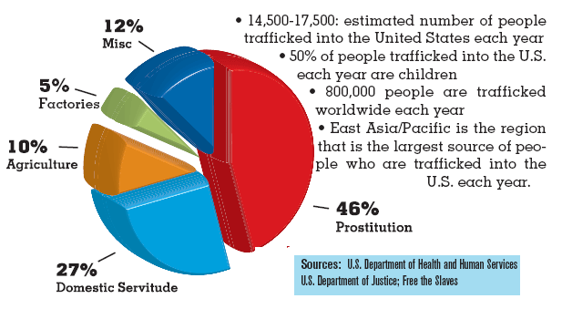

Slide 33
The New Hotbed of Human Trafficking Is ... Ohio
“1800 people are trafficked in Ohio every year. This includes 800 immigrants who are exploited in commercial sex and factory work, as well as about 1000 American-born children who are forced into prostitution.”
Trafficking in Persons Study Commission

Slide 34
Why Does Ohio Support Human Trafficking?
“…weak laws on human trafficking, a growing demand for cheap labor, and Ohio's proximity to the Canadian border as the key reasons modern-day slavery thrives in the state.”
Toledo, Cleveland, Columbus, Dayton, and Cincinnati have interstate highways crossing the U.S.A.
Trafficking in Persons Study Commission

Slide 35
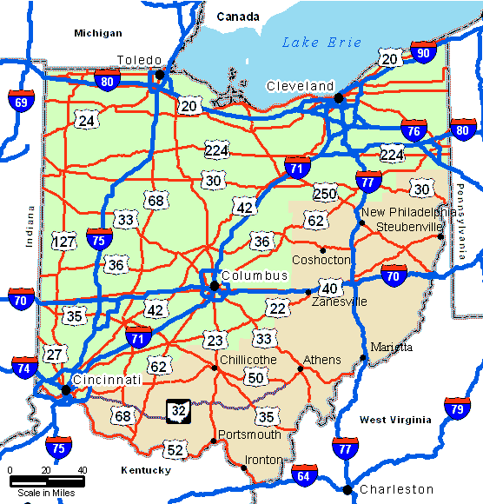
I-90
Boston, MA to Seattle, WA
I-80
New York to California
I-70
Baltimore, MD to
Cove Fort, Utah
I-75
Northern Michigan to Miami, FL
I-74
Davenport, Iowa to
Greensboro, SC
I-77
Cleveland to
South Carolina
I-71
Cleveland to
Louisville, KY

Slide 36
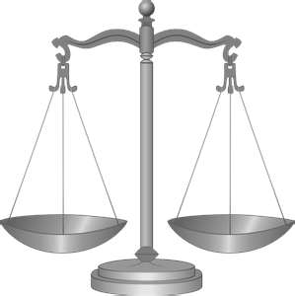
Investigating Human Trafficking
Laws of the Land

Slide 37
The Fourth Amendment to the U.S. Constitution:
“The right of the people to be secure in their persons, houses, papers, and effects, against unreasonable searches and seizures, shall not be violated, and no Warrants shall issue, but upon probable cause, supported by Oath or affirmation, and particularly describing the place to be searched, and the persons or things to be seized.

Slide 38
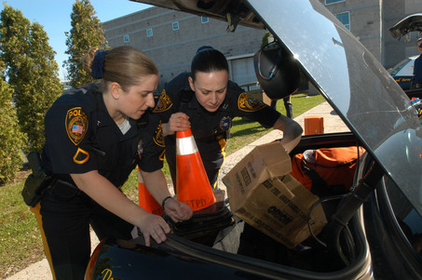
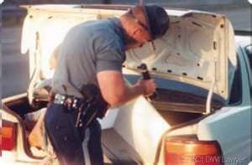

Search and Seizure

Slide 39

Police May Search
Probable Cause
Consent to search
In Plain View
Incidental to An Arrest
Exigent Circumstances
Stop and Frisk
Curtilage
Open fields
Motor Vehicles
Border Search

Slide 40
Probable Cause
Probable cause is an officer's reasonable belief of a certain fact. The law only requires the officer's belief to be reasonable, based on everything within the officer's knowledge. Probable cause is an objective standard based on the facts known and observed by the officer.

Slide 41
Search
An officer has probable cause to search if the facts and circumstances known to the searching officer justify the officer's reasonable belief that the area to be searched contains evidence or instruments of a crime.

Slide 42
Mapp v. Ohio, 367 U.S. 643 (1961), was a landmark case in criminal procedure, in which the United States Supreme Court decided that evidence obtained in violation of the Fourth Amendment, which protects against "unreasonable searches and seizures," may not be used in criminal prosecutions in state courts, as well as federal courts.

Slide 43
Consent
Main article: Consent search
If a party gives consent to a search, a warrant is not required, even if the party is unaware of their right to refuse to cooperate. There are exceptions and complications to the rule, and whether an individual has the right to consent to a search of another's property.

Slide 44
Plain view
Main article: Plain view doctrine
If an officer is lawfully present, he may seize objects that are in "plain view". However, the officer must have probable cause to believe that the objects are contraband.
Gun under car seat, Alasko fan & Brown radio.

Slide 45
Searches incident to arrest – search of a person Permitting searches incident to an arrest without warrant—has been applied in American law. The justification for such a search is to prevent the arrested individual from destroying evidence or using a weapon against the arresting officer. The decision suggested that any area within the "immediate control" of the arrestee could be searched.

Slide 46
Exigent circumstance – requiring immediate action or aid; urgent
Exigent circumstances arise when the law enforcement officers have reasonable grounds to believe that there is an immediate need to protect their lives, the lives of others, their property, or that of others, the search is not motivated by an intent to arrest and seize evidence, and there is some reasonable basis, to associate an emergency with the area or place to be searched.

Slide 47
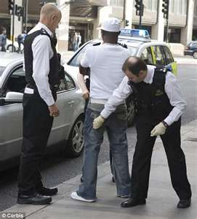
Stop and Frisk

Slide 48
Terry v. Ohio, Stop and Frisk: A police officer may stop and frisk a suspect without probable cause to arrest, if the police officer has a reasonable suspicion that the person has committed, is committing, or is about to commit a crime and has a reasonable belief that the person "may be armed and presently dangerous." For their protection, police may perform a surface search of a person’s outer clothing for weapons if they have reasonable suspicion the person stopped is armed.

Slide 49
Curtilage: search of house surrounding area
While open fields are not protected by the Fourth Amendment, the curtilage, or outdoor area immediately surrounding the home, is protected. Courts have treated this area as an extension of the house and as such subject to all the privacy protections afforded a person’s home (unlike a person's open fields) under the Fourth Amendment. However, courts have held aerial surveillance of curtilage not to be included in the protections from unwarranted search. Helicopters - Bolita slips at sewer connection - FLA

Slide 50

Open Fields

Slide 51
Open fields
Main article: Open fields doctrine
Similarly, "open fields" such as pastures, open water, and woods may be searched without a warrant, on the grounds that conduct occurring therein would have no reasonable expectation of privacy.

Slide 52
In Oliver v. United States, 466 U.S. 170 (1984), the police ignored a "no trespassing" sign and a fence, trespassed onto the suspect's land without a warrant, followed a path for hundreds of feet, and discovered a field of marijuana. The Supreme Court ruled that no search had taken place, because there was no privacy expectation regarding an open field.

Slide 53
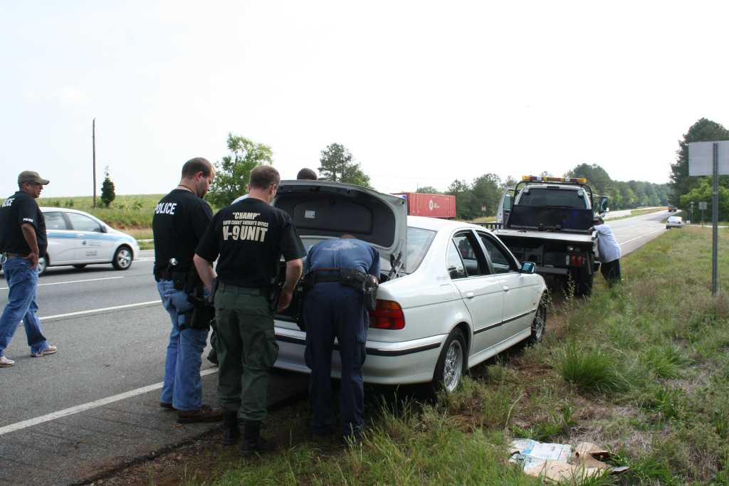

Slide 54
The motor vehicle exception allows an officer to search a vehicle without a warrant as long as he or she has probable cause to believe that evidence or contraband is located in the vehicle.
Plain View inside car - flashlight

Slide 55
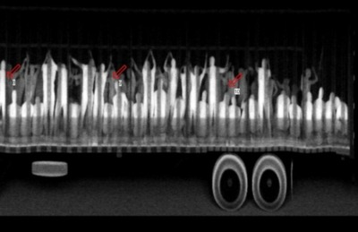
513 illegal migrant workers found as
authorities x-rayed semi truck.

Slide 56
The x-ray photo says it all: more than 500 migrants packed into trucks like sardines, as many as 4 people per 1 square meter, some crouching, others standing and holding onto ropes from the truck's rooftop. The reality of human smuggling brutally exposed in the migrant's subhuman travelling conditions.
The 513 migrants, many suffering from dehydration from the perilous journey from Guatemala, were intercepted in two trailer trucks at a checkpoint in Mexico's southern Chiapas state where the x-ray was taken.

Slide 57
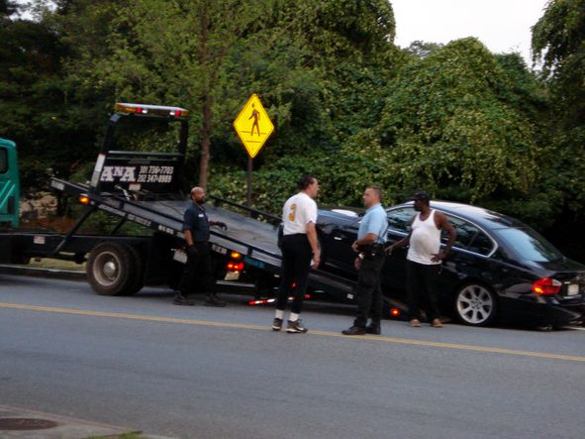

Slide 58
Inventory of towed car
Person arrested in car
Driving While Drunk
Active Warrant
Police officer inventories car to establish a
record of belongings in the car for the
protection of the suspect.
Belongings, wallet, money, jewelry, weapons, children in the trunk

Slide 59
You are a police officer. You pulled over a vehicle on suspicion because the driver was suspiciously cruising neighborhoods known for drugs and child sex trafficking. You are standing outside the car talking to the driver.
You cannot search the car other than “plain sight” by looking into the car.
You cannot search the trunk. You cannot take the car apart looking for drugs or trafficked children. You do not have probable cause to do so.

Slide 60
While talking to the driver, you hear a tapping sound. You ask the driver to shut off the car’s engine, turn off the stereo. You still hear a tapping sound. The driver acts nervous. You ask the driver if he hears the tapping sound. He says, “No.” You are not sure where the tapping sound is coming from. You do not have grounds for an arrest. You ask the driver to get out of the car and open the trunk. You now have reasonable grounds to do so. The trunk is empty.

Slide 61
The tapping sound gets louder. You now also hear a sound like muffled crying. Your reasonable suspicion, reasonable grounds to believe a crime has been committed, increases. Although these sounds can be produced by a kitten or cell phone left open.
In order to prevent your suspects escape, you call for more police officers to assist guarding the driver.

Slide 62
You sit in the suspects car. The tapping and muffled crying seems to be coming from inside the dashboard. The radio is off. The CD player and GPS are off.
You still do not have grounds for arrest, but you now have reasonable grounds to take the car apart, much more authority than looking into the trunk, and much, much more authority than the plain view sight search.

Slide 63
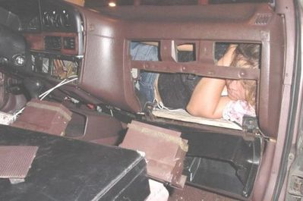
10News.com - San Diego News January 5, 2005
“A 10-year-old Mexican girl was found hidden inside a car's dashboard while it was undergoing an inspection Wednesday at the San Ysidro, California border crossing.”

Slide 64
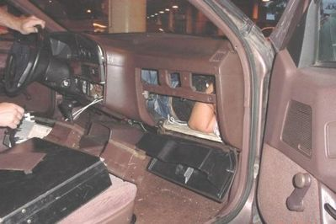
10News.com - San Diego News January 5, 2005
“…trapped under the dashboard and the front passenger seat of a 1988 white Toyota Camry. She was removed after officers worked for 30 minutes to partially remove the seat. She appeared to be in good condition.”

Slide 65
This was an actual case at the border crossing located at United States and San Ysidro, Mexico. Instead of hearing a tapping sound, the police officer actually noticed the girl’s foot hanging down under the dashboard. This is more than suspicion or probable cause to believe, but creates reasonable grounds not only to extend the search but cause an immediate arrest.

Slide 66
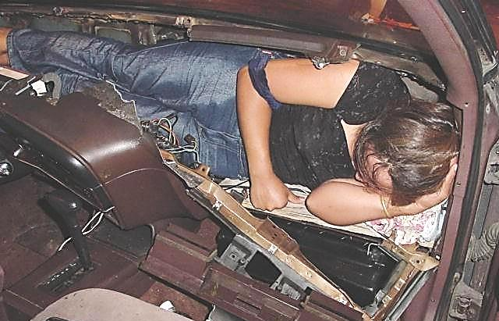
10News.com - San Diego News January 5, 2005

Slide 67
In a disturbing trend, the number of undocumented minors, including infants and youngsters, apprehended during fiscal year 2004 at ports of entry on the California/Mexico border climbed to 6,478, up almost 17 percent over the previous year.

Slide 68
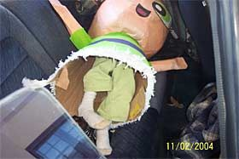
A 5-year-old girl found hidden inside a pinata in the back seat of a car being inspected at the San Ysidro border station in November drew widespread media interest to the issue.
By Leslie Berestein
UNION-TRIBUNE STAFF WRITER November 12, 2004

Slide 69
“The girl's mother also was found, curled up inside the car's trunk, and the girl's brother, who is about 9 years old, was found underneath the collapsible back seat. "Officers began to take the piñatas out of the back seat, and one of the several pinatas in the car seemed to be much heavier than the others," said Vince Bond, a spokesman for U.S. Customs & Border Protection. "This one had a little girl of approximately 4 or 5 years of age inside it."
By Leslie Berestein
UNION-TRIBUNE STAFF WRITER
November 12, 2004

Slide 70
The motor vehicle exception does not only apply to automobiles. The U.S. Supreme Court in California v. Carney found the motor vehicle exception to apply to a motor home. The court did however, make a distinction between readily mobile motor homes and parked mobile homes.

Slide 71
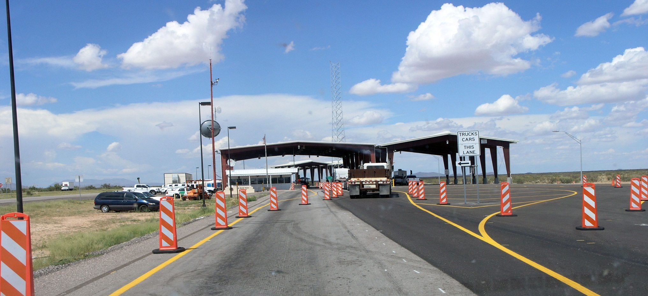
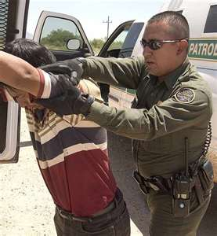
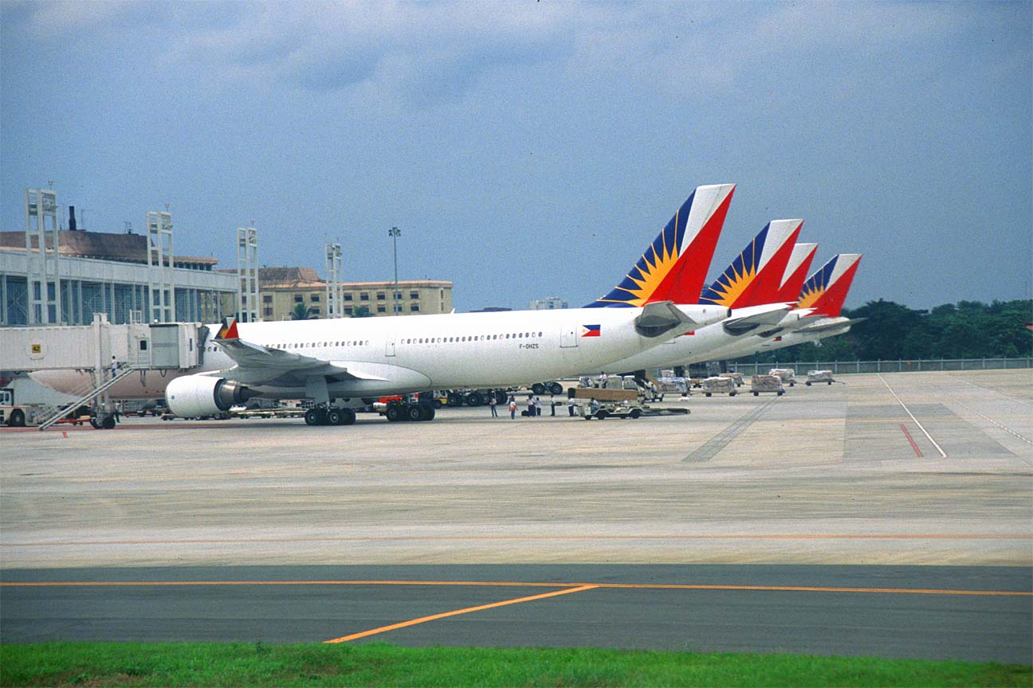

Slide 72
Border search exception
Main article: Border search exception
Searches conducted at the United States border or the equivalent of the border (such as an international airport) may be conducted without a warrant or probable cause subject to the "border-search" exception. Most border searches may be conducted entirely at random, without any level of suspicion, pursuant to U.S. Customs and Border Protection plenary search authority.

Slide 73
However, searches that intrude upon a traveler's personal dignity and privacy, such as strip and body cavity searches, must be supported by "reasonable suspicion."

Slide 74
The U.S. Courts of Appeals for the Fourth and Ninth circuits have ruled that information on a traveler's electronic materials, including personal files on a laptop computer, may be searched at random, without suspicion.

Slide 75
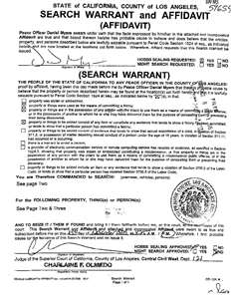

Slide 76
Standard for Warrants
A valid warrant serves the same function as probable cause, establishing a basis for a legal search or seizure. Issuance of a warrant requires that the officer present evidence of probable cause for the search or seizure before an impartial magistrate. The magistrate then determines whether the evidence suffices to meet the probable cause standard, and if it does, he issues the warrant.

Slide 77
Rules of Evidence
THE FOUR TYPES OF EVIDENCE.
There are four traditional types of evidence: real, demonstrative, documentary, and testimonial.
GENERAL RULES OF ADMISSIBILITY.
The basic prerequisites of admissibility are relevance, materiality, and competence.

Slide 78
To be relevant, a particular item of evidence need not make the fact for which it is offered certain, or even more probable than not. All that is required is that it have some tendency to increase the likelihood of the fact for which it is offered.
Evidence is material if it is offered to prove a fact that is at issue in the case.
Its competence is established by showing that it really is what it is supposed to be. Proving that real or other evidence is what it purports to be is called authentication.

Slide 79
Chain of Custody
Evidence must show an unbroken chain of custody from the time the evidence was first found. This practice authenticates the evidence and prevents the introduction of false evidence.

Slide 80
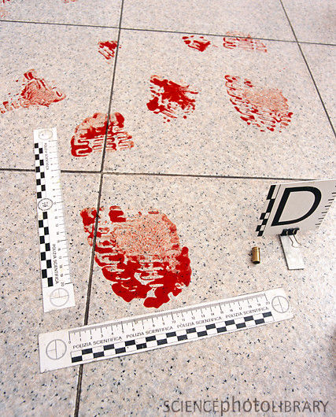

Slide 81
Example
If the state wishes to introduce evidence of drugs seized at a crime scene, the prosecution must show an unbroken chain of custody beginning with the officer who seized the materials, through the officers who transported the evidence, through the clerk who logged the evidence into storage and ending with the officers who checked it out of evidence and are presenting it in court. If there is a break in this chain, the evidence cannot be used.

Slide 82
Chain of custody involves tracking evidence that comes up in a court trial from the time it is collected until it is presented and aims to show it has not been tampered with in the meantime. It is one of three ways used to authenticate real (or physical) evidence in court, according to the Federal Rules of Evidence. A chain of custody affidavit documents the evidence's collection, transportation and storage.

Slide 83


Slide 84
Physical evidence is handled by a number of people, including investigators, technicians, forensic specialists and storage clerks. How these people maintain the evidence placed in their hands and how well they keep a record of its movements will determine whether it will be accepted in court.

Slide 85



Slide 86
The rapid expansion in forensic technology requires new protocols for evidence containing DNA, blood pathogens, drugs and digital data. New protocols and procedures have been created concerning the materials used for containers, temperatures and other storage conditions that make the old box in the evidence locker seem primitive.

Slide 87
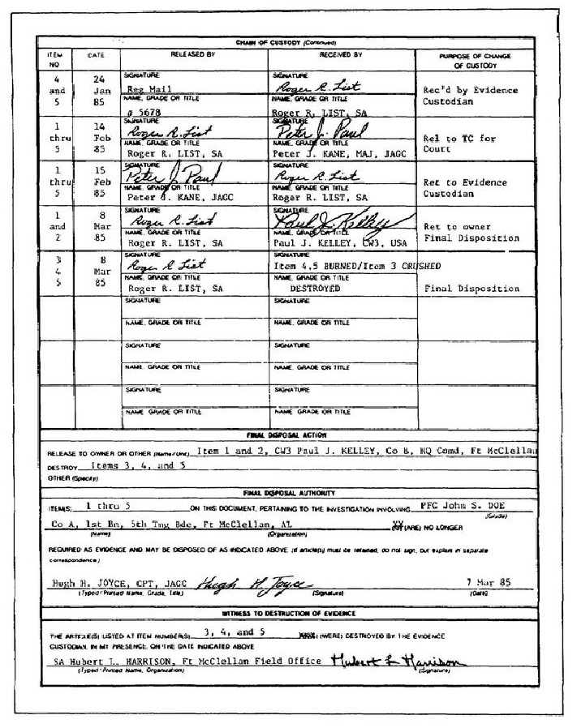

Slide 88
Documenting Evidence
One of the primary uses of a chain of custody report is to document evidence in the course of an investigation. Chain of custody reports detail the presence of evidence and are used to document when the evidence was collected, where it was found, who discovered the evidence and who was responsible for its collection. Without the use of a chain of custody report, it is not possible to establish proof of how and when the evidence was collected.

Slide 89
TESTIMONIAL EVIDENCE.
Testimonial evidence is the most basic form of evidence and the only kind that does not usually require another form of evidence as a prerequisite for its admissibility. It consists of what is said in the court at the proceeding in question by a competent witness.
4. He must be able to communicate what he perceived.
Abused trafficked children, abused foreign females,
Those afraid their relatives will be killed if they talk.

Slide 90
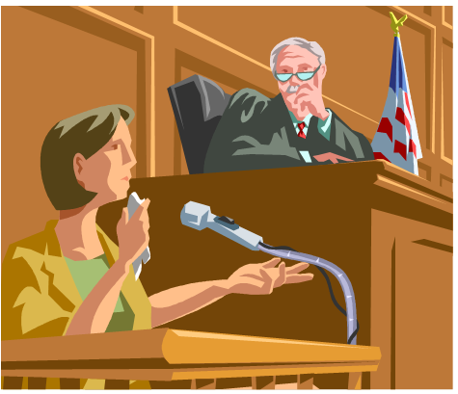

Slide 91
How Does the Testimony Evidence Rule Apply to Human Trafficking?
A 13 year old girls is a sex slave servicing
15 men a day
She is regularly beaten by johns as well as her trafficker
She is kept high on drugs and alcohol
to keep her submissive
She is in desperate need of physiological counseling
She is recused at 17 years of age

Slide 92
In general, a witness is competent if he/she meets four requirements:
Must, with understanding, take the oath or a substitute.
Must have personal knowledge about the subject of his/her testimony. In other words, the witness must have perceived something with his/her senses that is relevant to the case.
3. Must remember what he/she perceived.

Slide 93


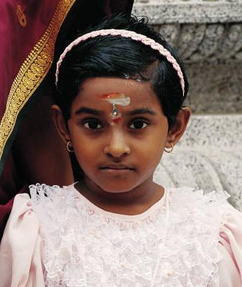

More than half the of
Victims trafficked into
United States are thought
to be Children. Victims are
about equally women and
men.
US Department of Health and Human Services, ACF, Trafficking Campaign
Notes:
Human trafficking is an horrific international problem, with nearly a million victims trafficked across international borders annually
However, this is not just an international problem. Trafficking also takes place here in the United States. The U.S. State Department estimates that between 18,000 and 20,000 victims are trafficked into this country each year.
More than half of those trafficked into the United States are children, although many women and men are victims as well.
The majority of trafficking victims come to the United States from Asia, Central and South America, Russia, Eastern Europe and Canada (but also Africa and India).

Slide 94
One of the biggest human trafficking events in the United States is …

Slide 95


Slide 96
“While most of America is looking forward to watching to the showdown between the Green Bay Packers and the Pittsburgh Steelers, under-age girls are lured into the dangerous world of the multimillion dollar sex trade industry.”
A Celebration of Women
World HUB @ Wheel of Women Leaders That Care ADELE BUTLER – Women of Spirit: Human Trafficking Feb. 3, 2011

Slide 97
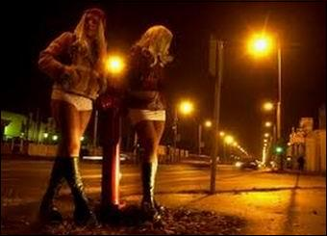
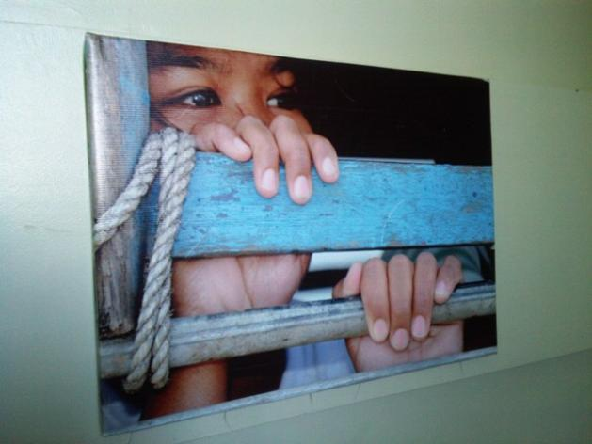

“…law enforcement agencies and advocacy groups rescued around 50 girls during the previous two Super Bowls.”
September 11, 2011
A Celebration of Women
World HUB @ Wheel of Women Leaders That Care ADELE BUTLER – Women of Spirit: Human Trafficking Feb. 3, 2011

Slide 98
Human trafficking and the Super Bowl
Add a comment
John Burger
, Dallas Human Trafficking Examiner
November 24, 2010 - Like this? Subscribe to get instant updates.
1 comment
0
Share
Print
Email
0
Share
Print
Email
Last week the Texas State Attorney General, Greg Abbott, announced he would be sending a dozen staff members from his human trafficking task force to assist local law enforcement in cracking down on human trafficking during the 2011 Super Bowl.
"The Super Bowl is one of the biggest human trafficking events in the United States," Abbott said.
During the 2009 Super Bowl in Tampa, Florida, the Florida State Department of Children and Families took in 24 minors who had been trafficked to the Tampa area as Sex Slaves for the Super Bowl. These were just the ones that were found.
In 2010. the Women's Funding Network found an increase of 80% in Craigslist sex ads during the Super Bowl. Craigslist recently shut down their "Adult Services" section after receiving over 10,000 petition signatures from the public and pressure from a number of State Attorney Generals.
Although no one knows exactly how many people will be trafficked to North Texas for the Super Bowl in February 2011, anti-trafficking organizations estimate it will be in the thousands.
Advertisement
This is partially due to the fact that the U.S. Department of Justice estimates that over 14,500 people are trafficked into the United States each year and 25% of all trafficked persons come through Texas.
According to a report by Shared Hope International, which investigates human trafficking in major cities, the Dallas Police Department, Child Exploitation/High Risk Victims & Trafficking Unit has created a unique and effective investigative tool to combat domestic minor sex trafficking. The Dallas Police Department, Child Exploitation/High Risk Victims & Trafficking Unit (CE/HRVTU) has developed an investigative tool to identify high risk victims (HRV) by flagging all minors who have run away from home four or more times in one year, as well as any minors that are repeat victims of sexual abuse or sexual exploitation. In 2007, CE/HRVTU identified 189 HRV cases 119 of which involved prostitution.
Of those High Risk Victims cases, 75% included felony charges specifically related to domestic minor sex trafficking.
A number of local organizations are joining in the effort to raise awareness and support ground work in recognizing and reporting human trafficking for the Super Bowl 2011. You can learn more about these groups and how you can help by clicking the links below.
Texas Anti-Trafficking Organizations:
Traffick 911
Free the Captives
Mosaic Family Services
Read all 64 pages of the full Dallas report by Shared Hope International
http://www.sharedhope.org/Portals/0/Documents/Dallas_PrinterFriendly.pdf
Stories about previous Super Bowls and Trafficking.
http://www.miamiherald.com/2010/02/05/1463956/volunteers-hope-to-rescue-child.html
http://humantrafficking.change.org/blog/view/the_results_are_in_sex_trafficking_at_the_superbowl
Suggested by the author:
25% of human trafficking victims enter through Texas
Preventing the potential for human trafficking events before Super Bowl
Dallas non-profit Mosaic Family Services is looking for volunteers for for their annual 5K run
Celebrities against slavery: Ashton Kutcher & Demi Moore
How I started my abolitionist journey
Human trafficking and the Super Bowl
Add a comment
John Burger
, Dallas Human Trafficking Examiner
November 24, 2010 -
“…the Texas State Attorney General, Greg Abbott, announced he would be sending a dozen staff members from his human trafficking task force to assist local law enforcement in cracking down on human trafficking during the 2011 Super Bowl.”
"The Super Bowl is one of the biggest human trafficking events in the United States," Abbott said.
John Burger, Dallas Human Trafficking Examiner November 24, 2010

Slide 99

During the 2009 Super Bowl in Tampa, Florida, the Florida State Department of Children and Families took in 24 minors who had been trafficked to the Tampa area as Sex Slaves for the Super Bowl. These were just the ones that were found.
John Burger, Dallas Human Trafficking Examiner November 24, 2010

Slide 100
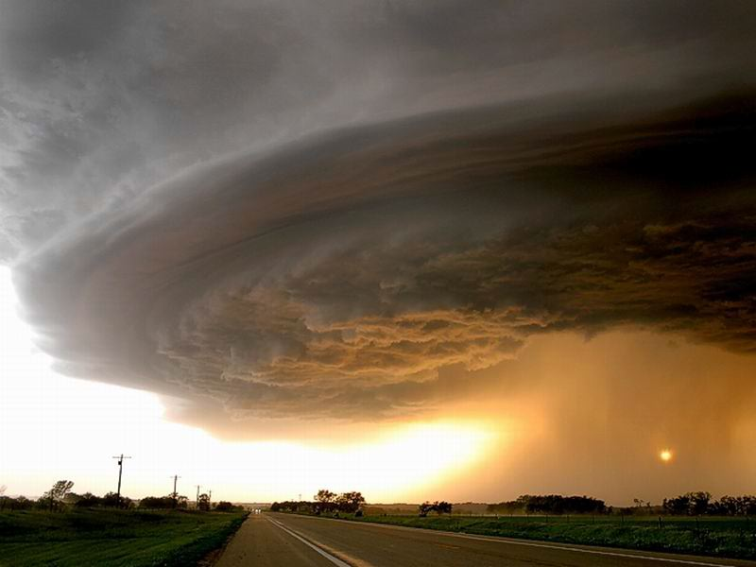
Hurricane Katrina

Slide 101
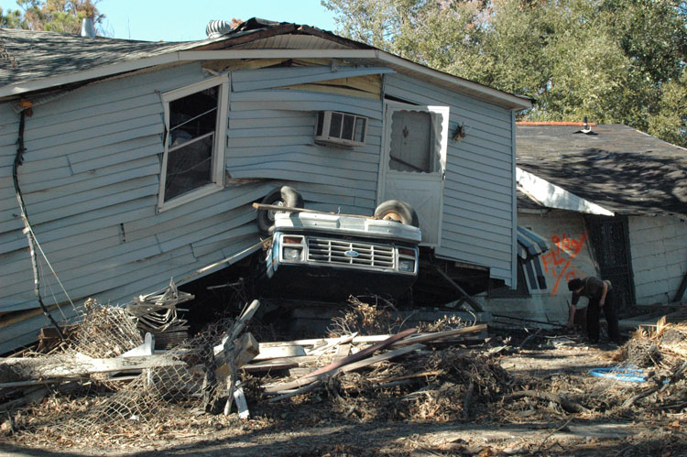

Slide 102
Thousands of laborers were needed to rebuild New Orleans and repair storm damage. Opportunists wasted no time bringing in undocumented “illegal” laborers.
President Bush inadvertently encouraged a breeding ground for labor violations by relaxing labor standards by suspension of the Davis-Bacon Act, something that requires contractors to pay prevailing wages on government contracts. The requirement that laborers had to fill out employment eligibility forms was also suspended allowing undocumented laborers to be hired and paid practically nothing.

Slide 103
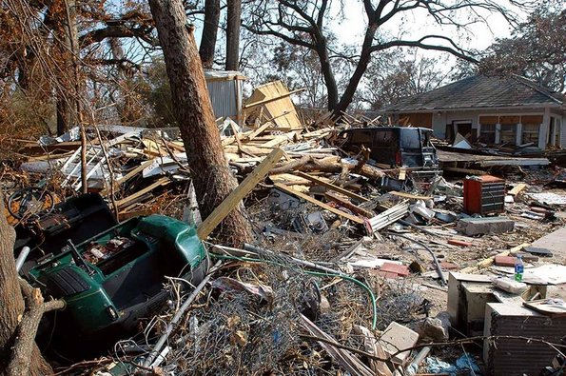

Slide 104
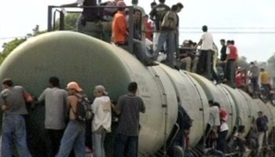
Train of Death Known as
“The Beast”

Slide 105
A freight train traveling from Southern Mexico
to the United States, hundreds searching for a better life must hang on for their lives. When they fall asleep, they fall under the train severing arms and legs.

Slide 106



Slide 107




These fallen victims were lucky!

Slide 108

Only 20% of those riding the “Beast”
make it to the United States.

Slide 109

So far this year, over 500 have died
trying to get to our country.

Slide 110

Over 50% of the immigrants on the
“Beast” are women and children.

Slide 111

"We've got to go through the mountains, there are lots of trees and the police don't see us. That's where the gangs wait for us. Sometimes they already know the time that we are going to cross over. That's where they wait for us and they kill us, or hurt us, or steal our money."

Slide 112



Slide 113



Slide 114
Immokalee, Florida
Migrant workers arrive from Mexico, Nicaragua,
Haiti, and Guatemala.
Population of 25,000 swells to 40,000
during the nine month harvest season.

Slide 115




Slide 116

Most migrant workers arrive with
the help of a coyote guide.

Slide 117

They wake up at 4:00 am and take migrant busses
to the fields. They sleep twelve to a room in
broken-down shacks. Each are charged $50.00 per
week for the shack.

Slide 118




Twelve migrant workers to a
room charged $50 per week each.

Slide 119

Picking tomatoes is brutal, bending over all day other than running with a 32 pound bucket of picked tomatoes and throwing it up to another worker. They are paid $25 per ton.

Slide 120

The price of $25 per ton has not changed in the past thirty years!

Slide 121

The National Labor Relations Act of 1935 protects
workers, fixes fair wages, gives the right to organize,
and fixes health and safety rules. Farm labor and domestic
servants are the only type of labor not covered by this act.

Slide 122


Farm workers can be fired for
protesting, trying to organize,
or requesting better pay.

Slide 123



McDonalds, Subway, Taco Bell, Burger King, Shop Rite, Kroger, Wal-Mart, Publix, and Costco are setting the prices for migrant workers because they are so huge they can set the price they are willing to pay for tomatoes.

Slide 124

All these companies were asked to pay 1 cent more for a pound of tomatoes to help raise the migrant worker’s pay barely to minimum wage. All refused, but eventually agreed after years of bad publicity and threatened law suits. Burger King was the most reluctant and held out the longest.

Slide 125


Slide 126





Slide 127


Slide 128

Diplomatic Immunity

Slide 129
Diplomatic immunity is a form of legal immunity and a policy held between governments that ensures that diplomats are given safe passage and are considered not susceptible to lawsuit or prosecution under the host country's laws (although they can be expelled). It was agreed as international law in the Vienna Convention on Diplomatic Relations (1961)

Slide 130



Traffickers
Who are the pimps,
the traffickers?
What do they look like?

Slide 131

A stereotypical media-portrayed
“pimp” controlling modern
inner-city prostitutes

Slide 132







What do “pimps” look like engaged in human trafficking?

Slide 133

OHIO
In December 2010, Ohio became the 45th state to make human trafficking a criminal offense.
Remaining 5 states:
HI, MA, SD, WV, WY

Slide 134
OHIO
Created two new criminal offenses:
  Trafficking in persons – Felony 2
  Ohio Revised Code 2905.32
  Unlawful conduct with respect to documents
  – Felony 3
  Ohio Revised Code 2905.33

Slide 135
OHIO
New law addresses labor and sex trafficking.
Defines Involuntary servitude:
“being compelled to perform labor or
services for another against one’s will.”
ORC 2905.31

Slide 136
OHIO
“Compelled” to engage in sexual activity for hire “does not require that compulsion be openly displayed or physically exerted” - State must prove “that the victim’s will was overcome by force, fear, duress, or intimidation.” ORC 2905.32 (B)
Compelling Prostitution (O.R.C. 2907.21)
Uses definition of “compelled” above
Increases penalty to
Felony 2 if victim is 16-17 years and
Felony 1 if the victim is under 16 years

Slide 137



Ohio Trafficking in Persons Commission
Created July 2009

Slide 138


“…Ohio has a growing immigrant population… Undocumented migrants are at increased risk for trafficking and exploitation, and in Ohio about 800 of them were found exploited in factories, agriculture, constriction sites, and brothels.”

Slide 139







Research and Analysis Subcommittee
Ohio Trafficking in Persons Study Commission
Report on the Prevalence of Human Trafficking
in Ohio
February 2010
Foreign Born Persons in Ohio
At risk for labor and/or sex trafficking 3,437
Trafficked into labor or sex trade in Ohio 783
American Youth in Ohio (ages 12-17)
At risk for sex trafficking 2,879
Trafficked into sex trade 1,078

Slide 140
“...Create a new offense to punish those who confiscate identification documents to further human trafficking.
Richard Cordray - Ohio Attorney General
Ohio Trafficking In Persons Study Commission
2010 Year End Report December 15, 2010

Slide 141
Summary of Sub-Committee Findings and Recommendations:
Victim Services and Safe Locations sub-committee
In a survey of over 200 social service organizations, only five reported providing any human trafficking specific assistance.
The sub-committee recommended a number of ways to fill the service gaps including:
Richard Cordray - Ohio Attorney General
Ohio Trafficking In Persons Study Commission
2010 Year End Report December 15, 2010

Slide 142

Victim Assistance and Safe Locations Subcommittee
Ohio Trafficking in Persons Study Commission
Summary of Key Findings - June 2010
Overwhelming lack of education re: identification, needs of trafficked persons and response protocols.
Not enough Ohio service providers equipped to meet specific needs of HT victims.
Need multidisciplinary collaboration
to effectively meet needs of
trafficked persons in Ohio.

Slide 143
Train “what to look for” in detecting human trafficking:
Police
Firemen
Housing Inspectors
Health Inspectors
Zoning Inspectors
Plumbers
Electricians
Train students about human trafficking:
Elementary schools
Junior High Schools
High Schools
Colleges

Slide 144

State Laws Against Human Trafficking
Criminal Provisions 45 States
Victim Protection 22 States
Law Enforcement Training 12 States
Statewide Task Force on Trafficking 13 States
Trafficking Research Commission 14 States
U.S. Policy Alert on Human Trafficking, Summary of U.S. Political Activity – August 2010 Polaris Project
Notes:
144

Slide 145
Summary of Barriers to Effective Law Enforcement
Need better and more frequent training for law
enforcement officers
Need education and awareness of human
trafficking for our children and adults
Lack of service organizations trained to help
human trafficking victims
Weak laws or lack of laws covering human
trafficking
Better coordination of law enforcement agencies
working together against human trafficking
Diplomatic Immunity

Slide 146
7. Lack of respect for women in our society, movies, music, and culture
8. Need severe penalties for human trafficking child sex customers
9. No schools required by the courts for arrested John’s
10. Human trafficking victims are afraid for the safety of themselves and their families; therefore, they frequently will not cooperate with authorities.
11. Slow court judicial process where trails of traffickers often occur a year or longer after arrest. Victims / witnesses often can not be cared for that long.

Slide 147
12. Lack of laws to punish those who confiscate identification documents to further human trafficking
13. Lack of trauma trained therapists and attorneys available to assist victims.
14. Poor awareness among the general public and key professionals regarding human trafficking
15. Lack of awareness of professionals who might come in contact with human trafficking: firemen, health inspectors, zoning inspectors, plumbing and electrical inspectors, Post Office delivery employees, contractors

Slide 148
Human trafficking is a problem of poor economics.
Dry up the customer, eliminate the demand for the
sex trade, and the sex traffickers will be out of
business.
The customers must suffer harsh penalties.
Who are the child sex customers? Who can afford
$400 per hour to have sex with a child? I think we
will be shocked if we find out.

Slide 149
“…1000 American children who were forced into commercial sex in Ohio over the course of a single year.” “…enough men in Ohio were willing to pay to rape a child to make trafficking …kids profitable and worth the risk. If each of those children had sex with 5 men per night, 6 nights a week, that’s over 150,000 sex acts per year. Potentially, that's 150,000 men who are buying sex with trafficked children in Ohio.”
Amanda Kloer Change.org Editor - abolitionist.

Slide 150
Who can afford to pay $400 an
hour to rape a 10-year old girl?
The homeless cannot afford this
The poor cannot afford this
College students cannot even afford their books
Females usually do not purchase such services

Slide 151
Children do not purchase these
services
Who is left?
Wealthy criminals? Yes, they qualify.
Successful male professionals, yes,
they definitely qualify.

Slide 152
Does this mean some of our business leaders, our doctors, our lawyers, our politicians, our scientists, our entrepreneurs, our athletes, our educators, our musicians and actors – are some of them child sex trafficking customers?

Slide 153
What Can Men and Boys Do To Stop Human Trafficking?
Challenge the glamorization of pimps in our country.
Realize that prostitution is not a victimless crime.
Don’t patronize strip clubs
Don’t consume pornography
55% of the world’s pornography comes from the
United States.
Tackle male chauvinism and sexism on line
End sex tourism
Talk to men about men’s issues emphasizing non-
violence, social justice, peaceful crisis management
Ending violence against women
Create the support of John’s Schools
Raise our male children to fight oppression and respect
other’s rights

Slide 154
Do you want to live in a world, country, or state where child slavery, murder, torture, and rape are out of control?

Slide 155
Well, you do live
in such a world!

Slide 156

We Need To Get Our Heads Out Of The Sand!

Slide 157

We need to address these horrors, get
our face out the sand, and start putting teeth into our efforts.

Slide 158


Getting Victims of Human Trafficking the Help They Need
1.888.3737.888
.
Notes:
I’m going to begin today’s presentation with a story:
A woman kept in domestic servitude in the United States for several years was rescued when a neighbor, noticing that she had a large tumor, offered to take the woman to the emergency room/health clinic [where will depend on who the presentation audience is]. Luckily, the health providers asked the right questions and realized the woman was a victim of human trafficking. As a result, they helped the woman escape her situation and receive the medical care she desperately needed. Her employers received 15-20 years in jail.
This is a success story because, first, the neighbor took the important step in bringing the woman to the emergency room/health clinic, and second, because the health providers examining the woman were able to look beneath the surface to probe whether or not she was a possible trafficking victim. Today, I’m going to discuss the important role health care providers play in identifying, and therefore, helping victims of human trafficking.

Slide 159


Slide 160


Thank you---

