Slide 1
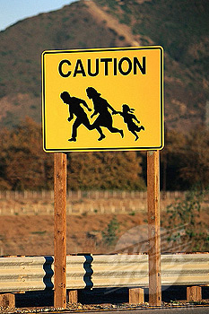
Hiram College
Human Trafficking
The “Beast” and Immokalee, Florida
They come to the United States from Mexico, Honduras, Costa Rica, Nicaragua, Guatemala, El Salvador, Belize, and other Central America locations.

Slide 2
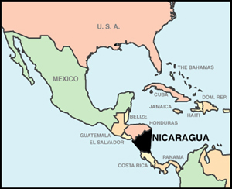

Slide 3
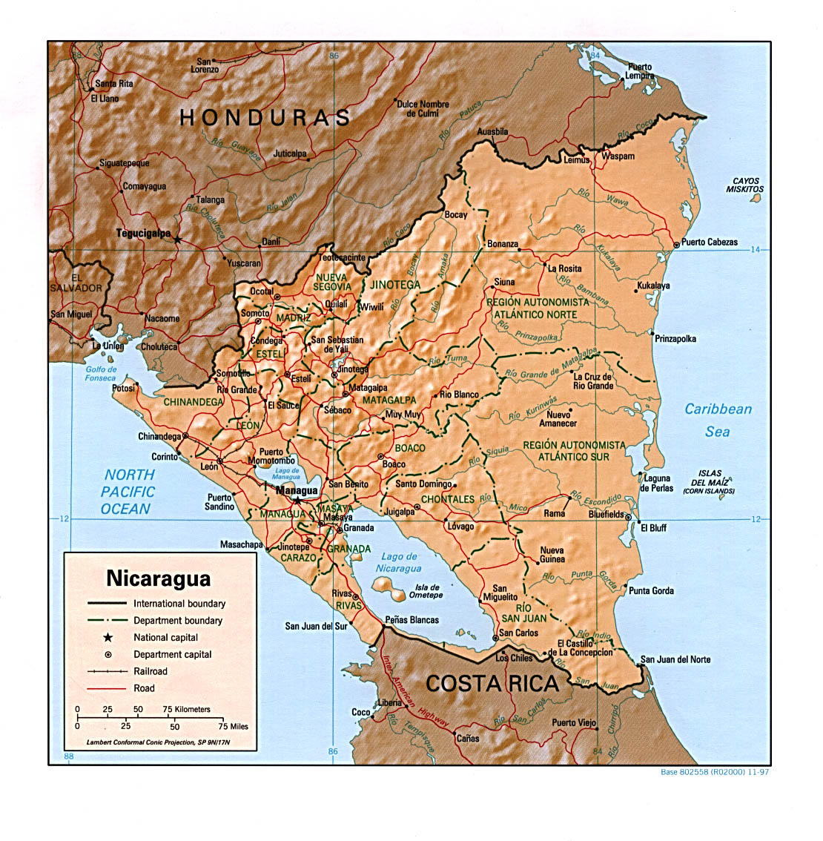

Slide 4
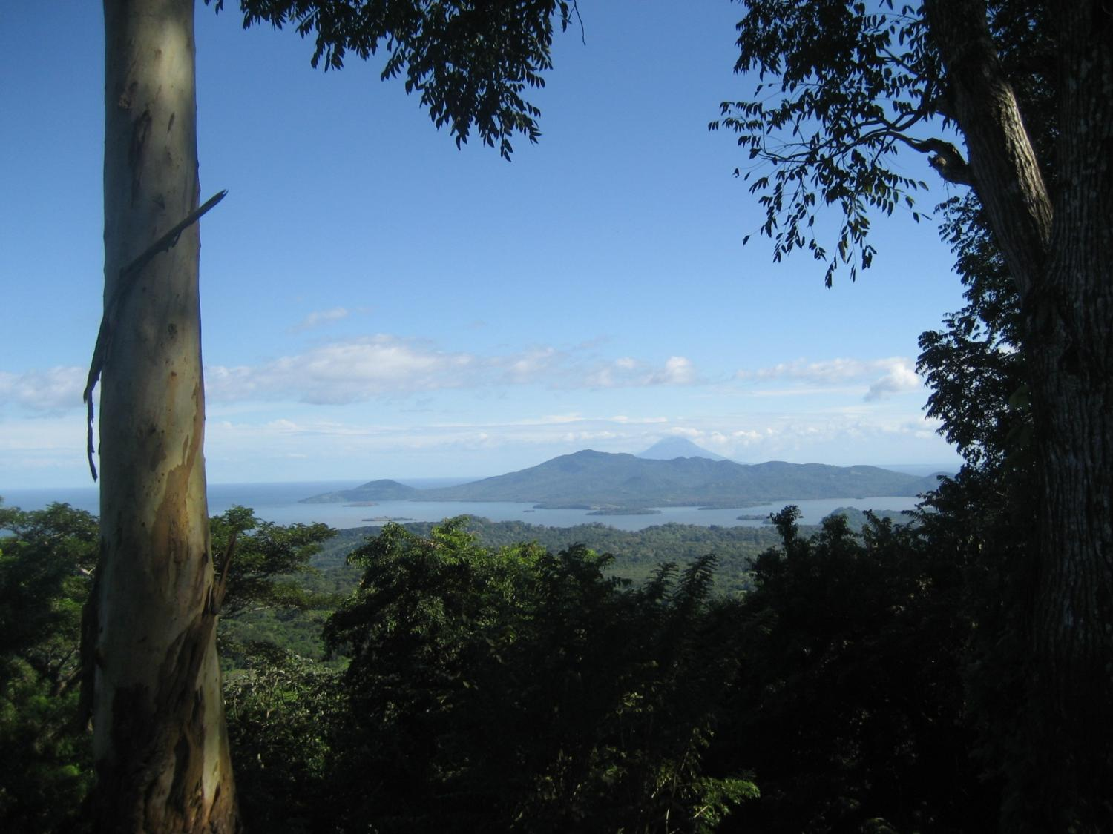

Slide 5
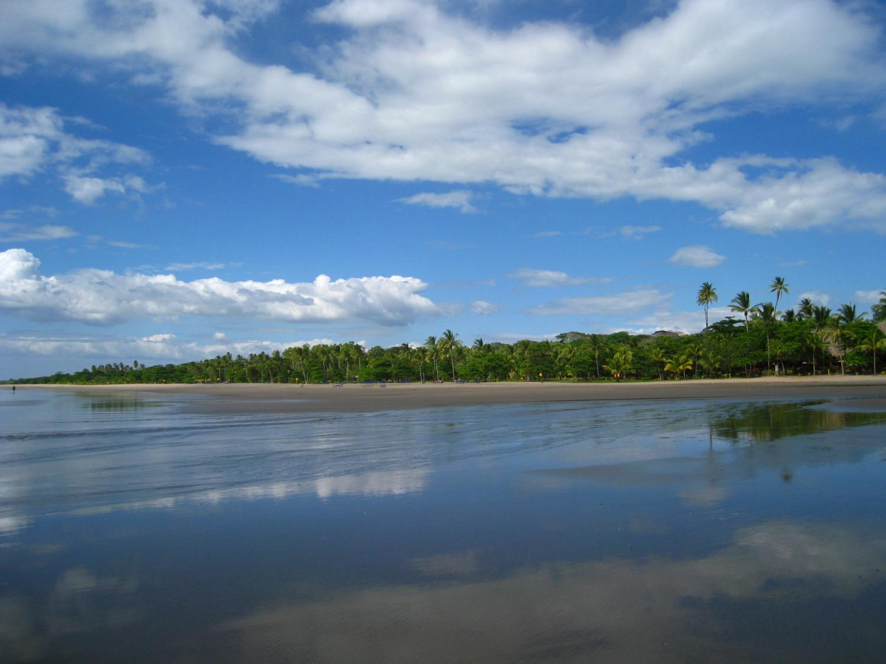

Slide 6
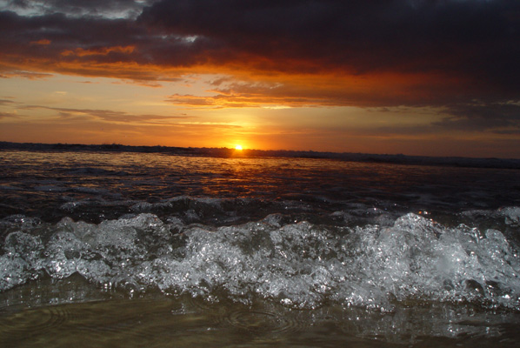

Slide 7
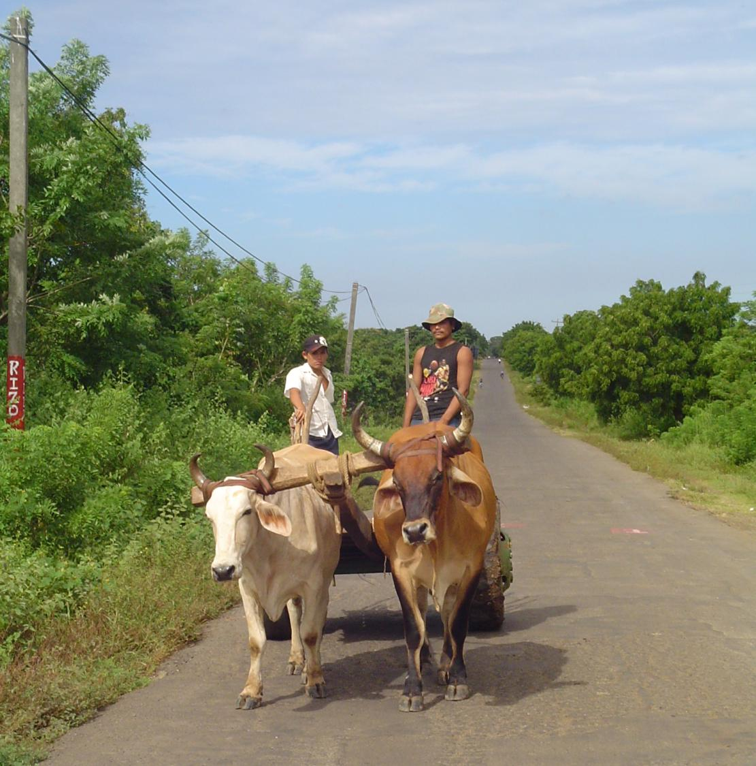

Slide 8
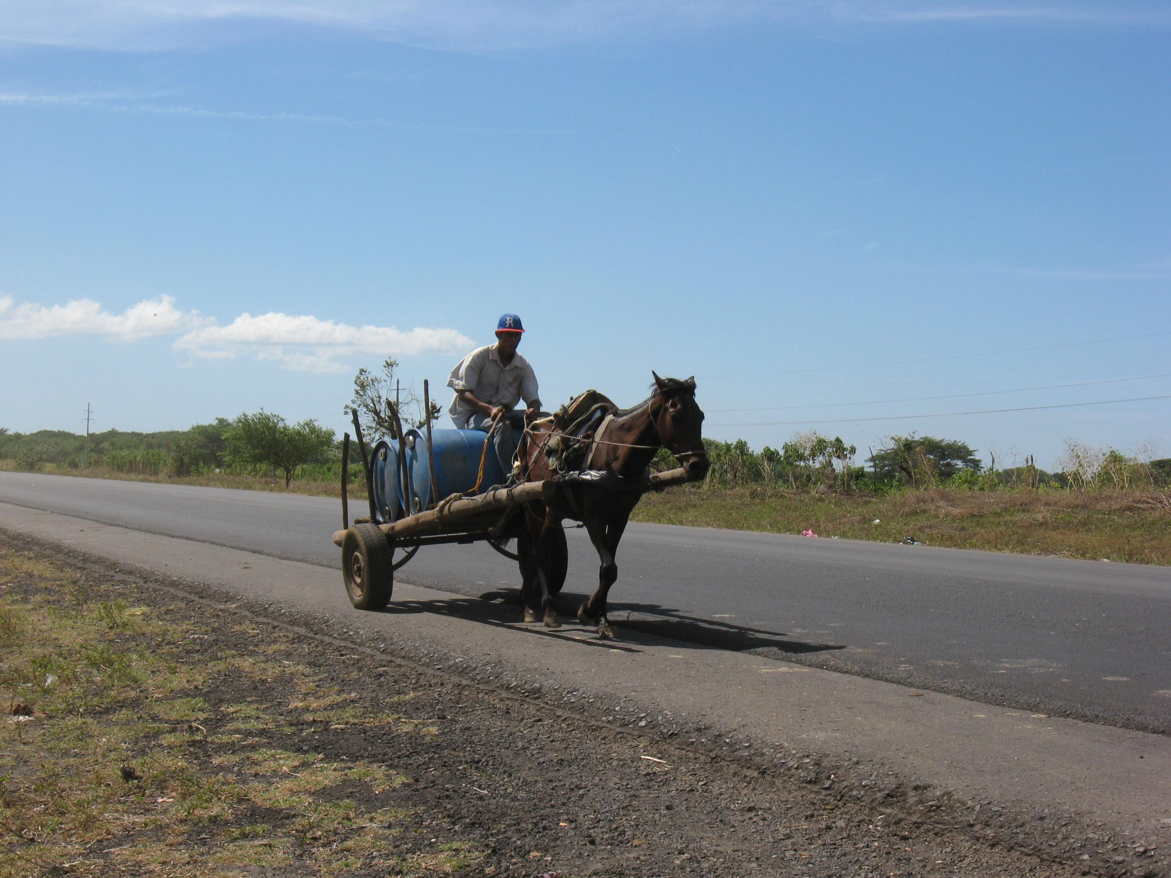

Slide 9
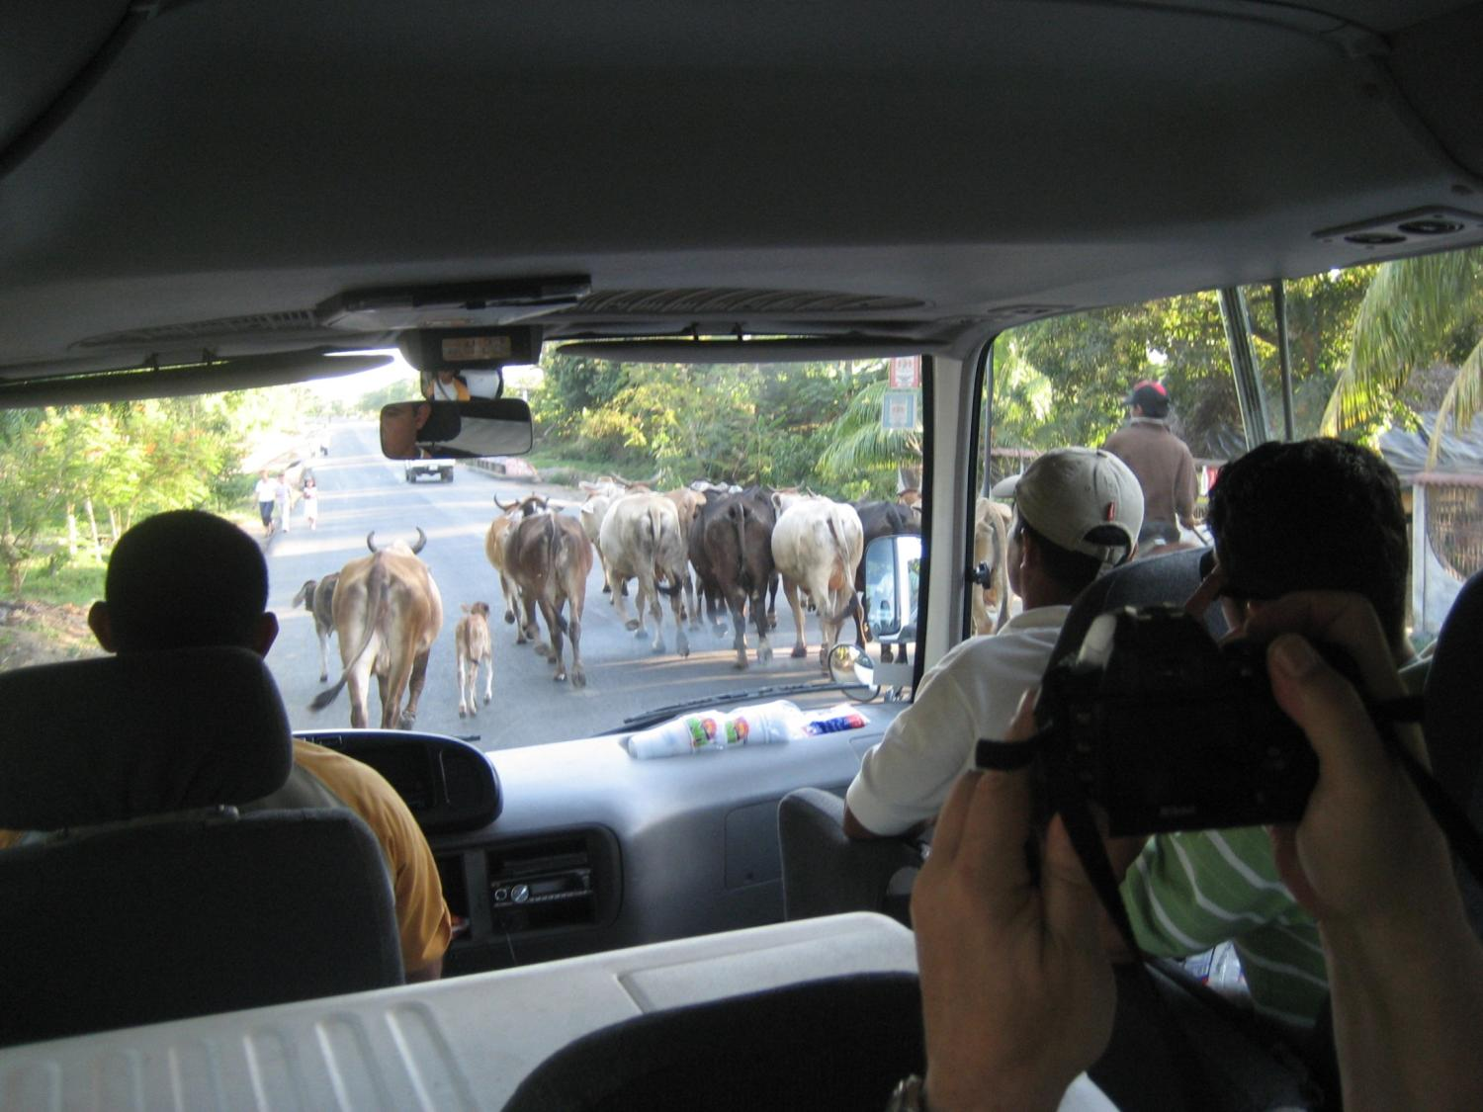

Slide 10
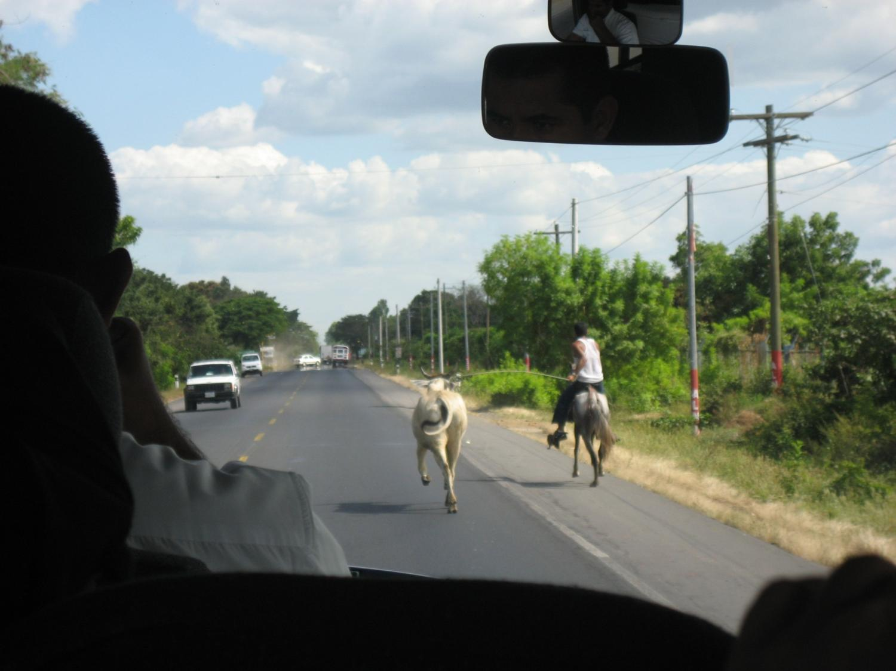
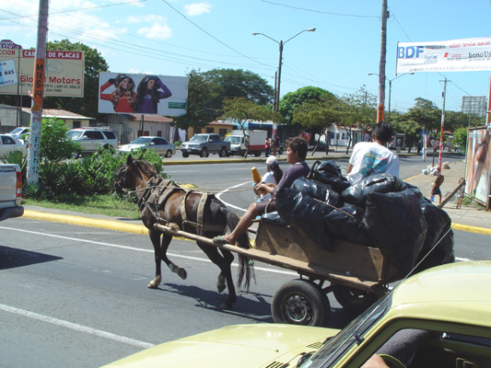

Slide 11
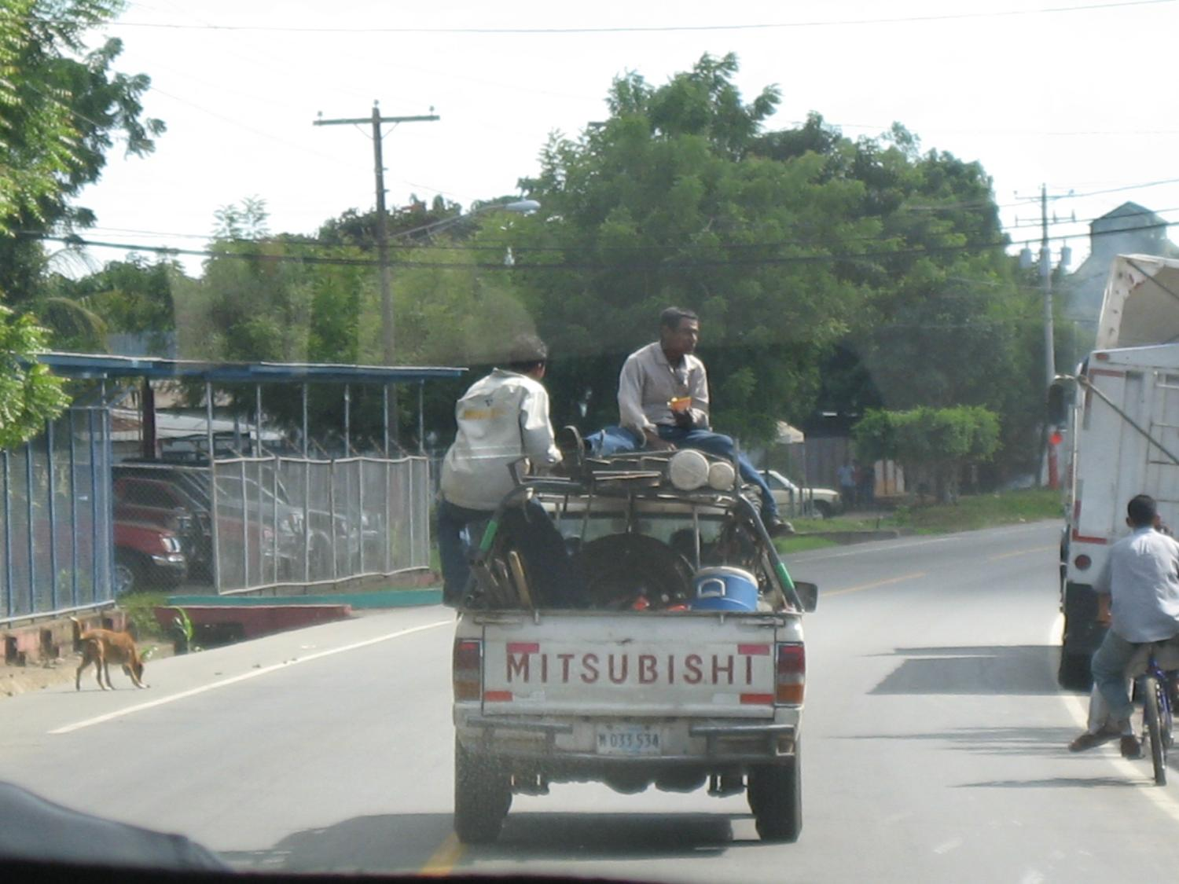

Slide 12
EMPLOYMENT –
WHY NICARAGANS GO NORTH

Slide 13
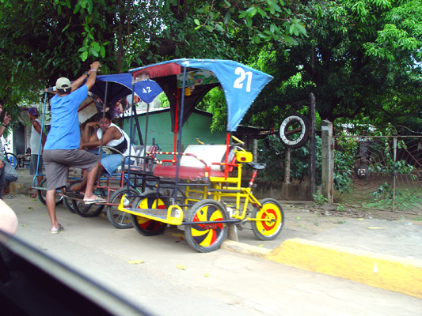

Slide 14
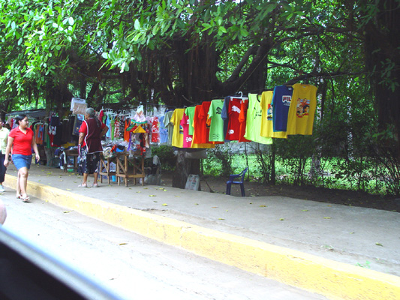

Slide 15
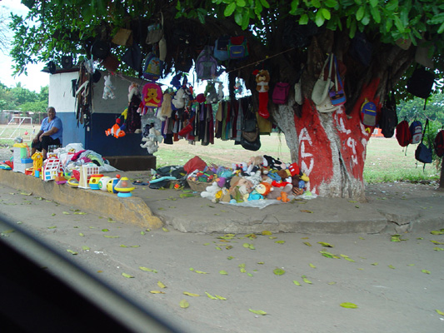

Slide 16
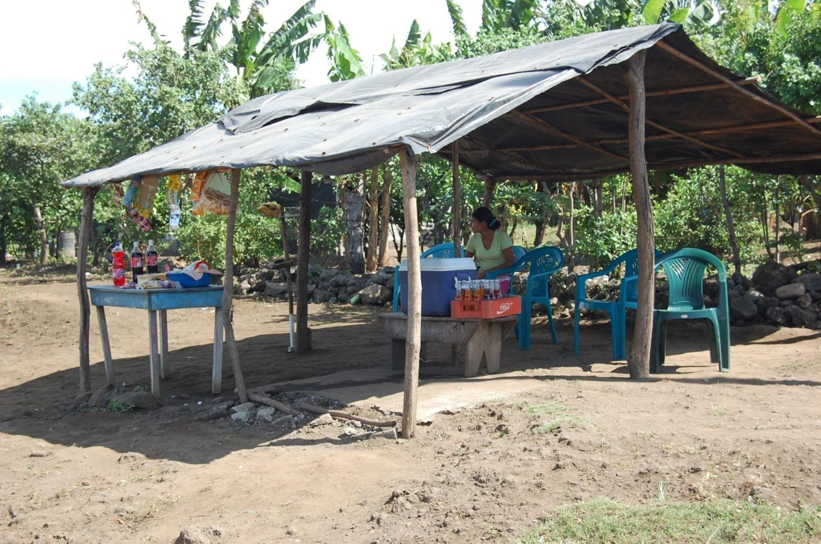

Slide 17
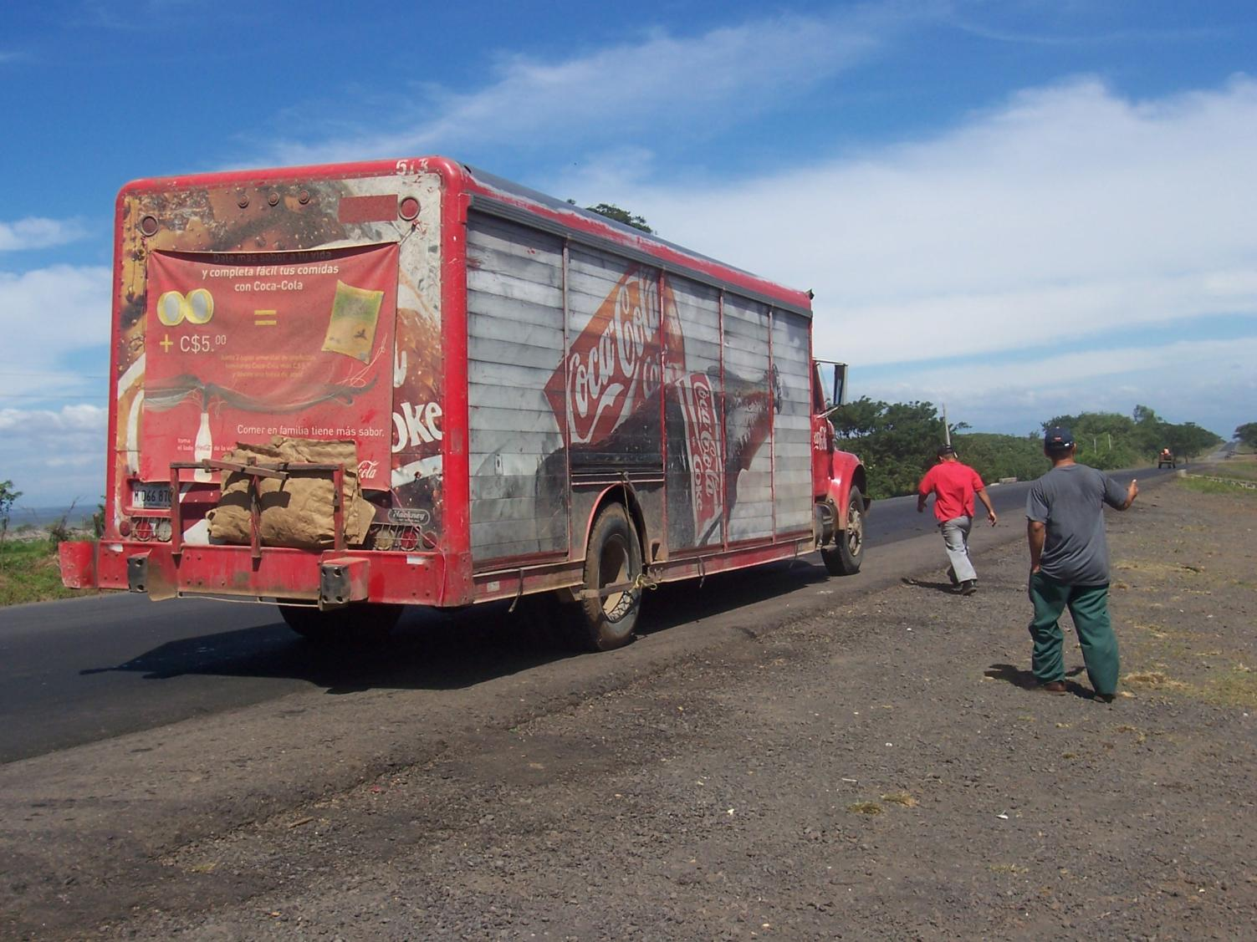

Slide 18
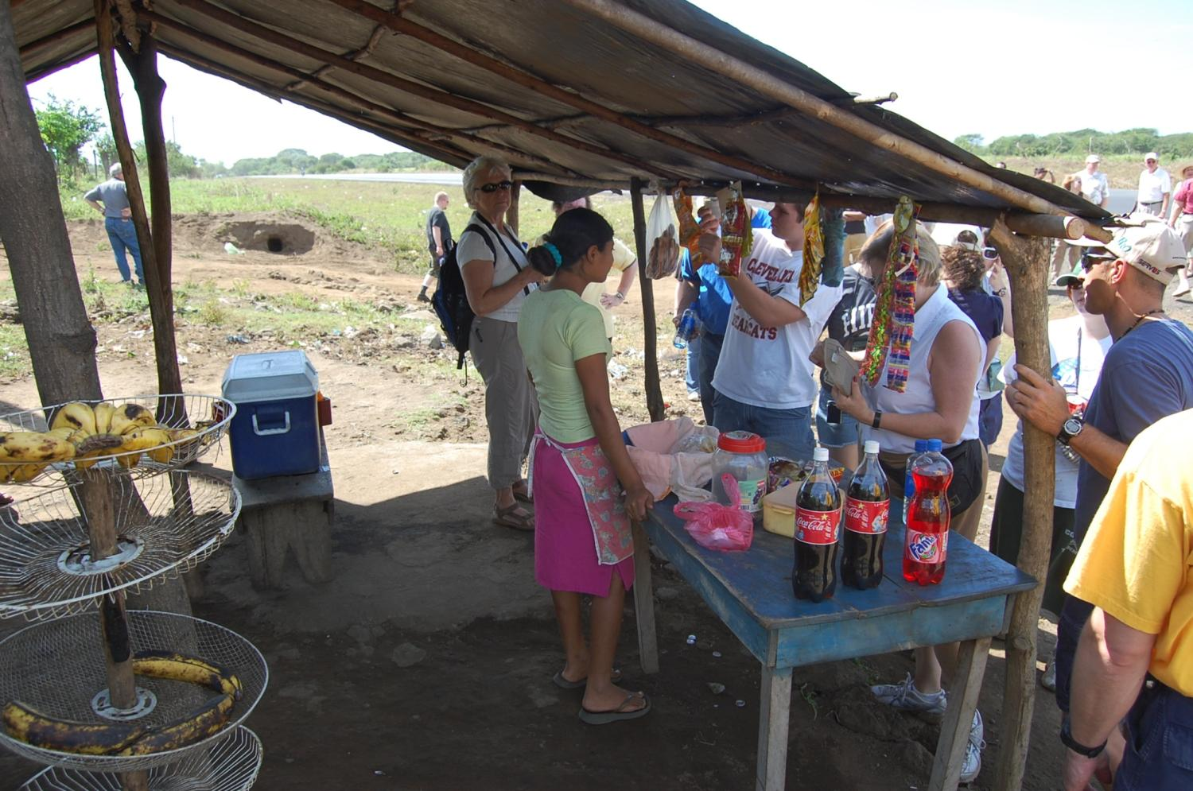

Slide 19
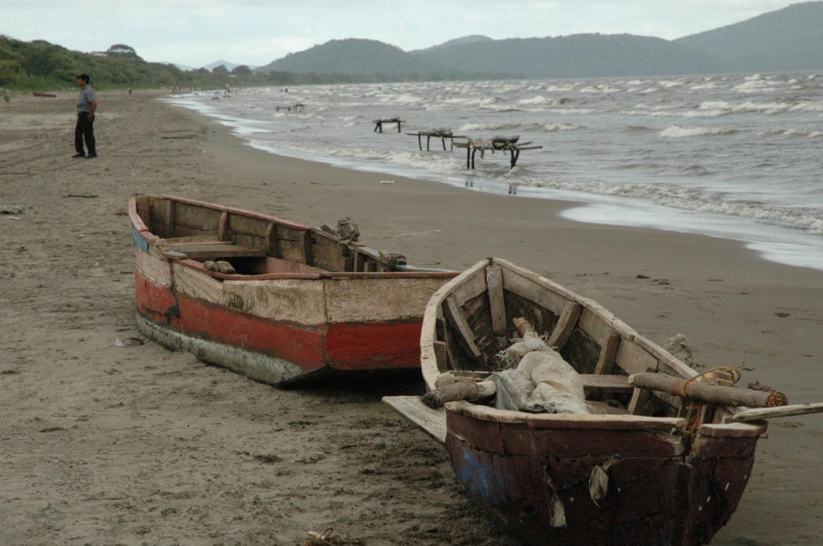

Slide 20
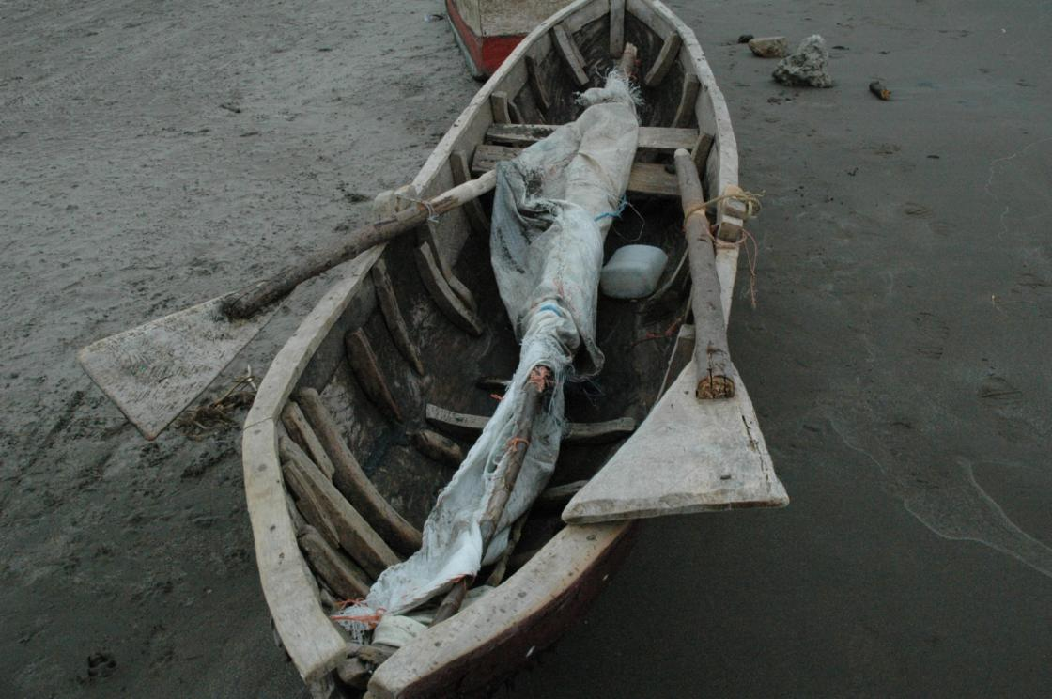

Slide 21
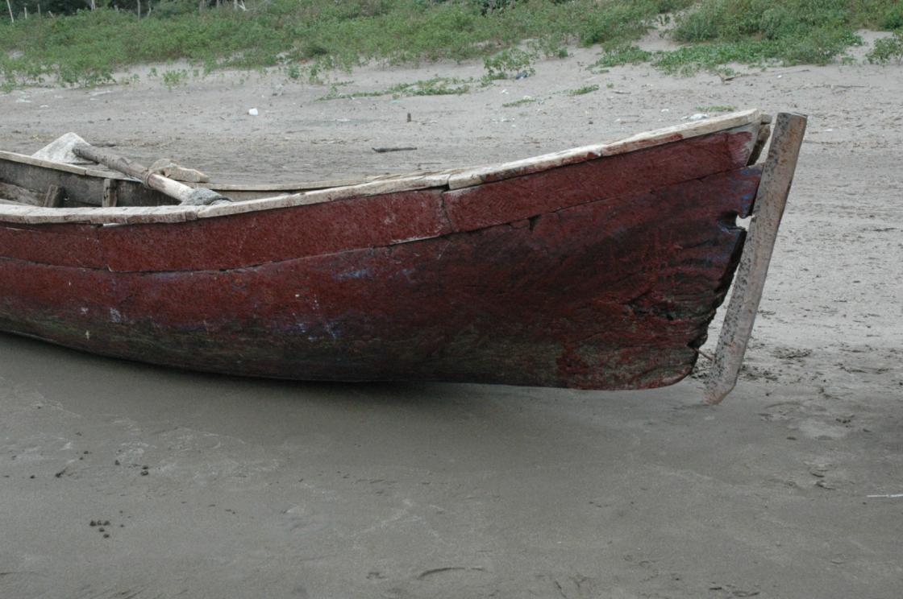

Slide 22
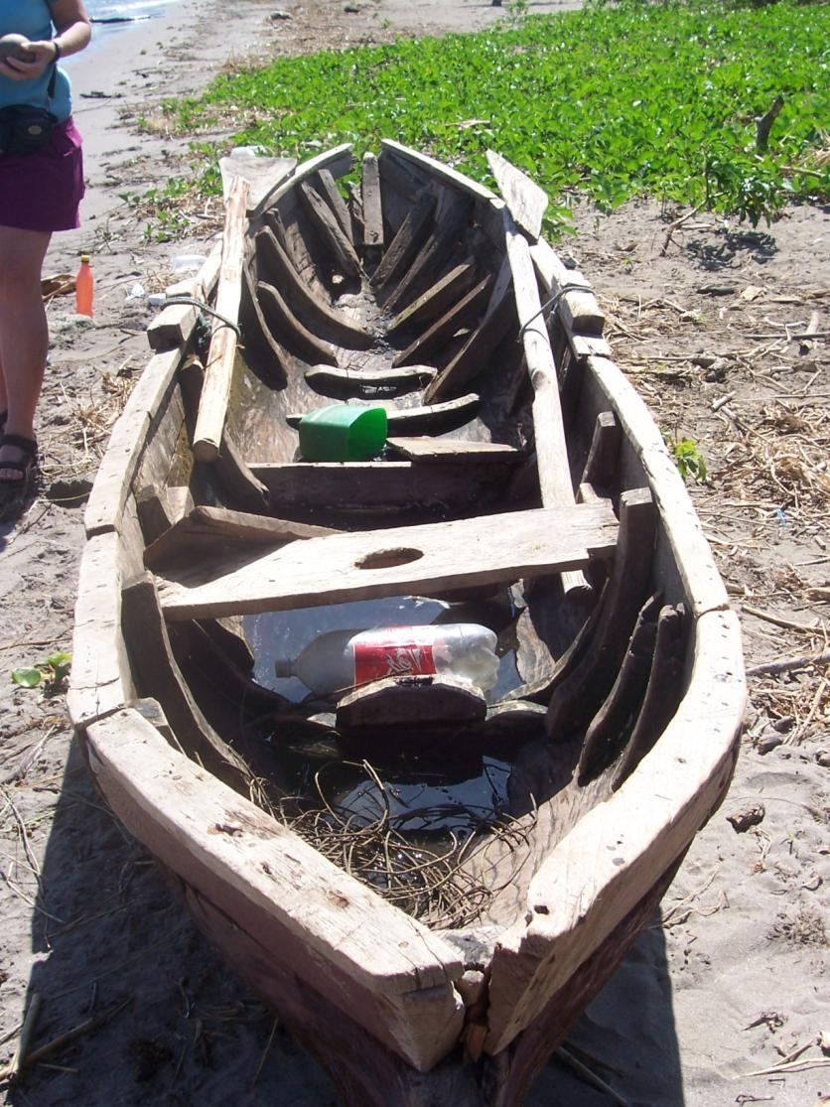

Slide 23
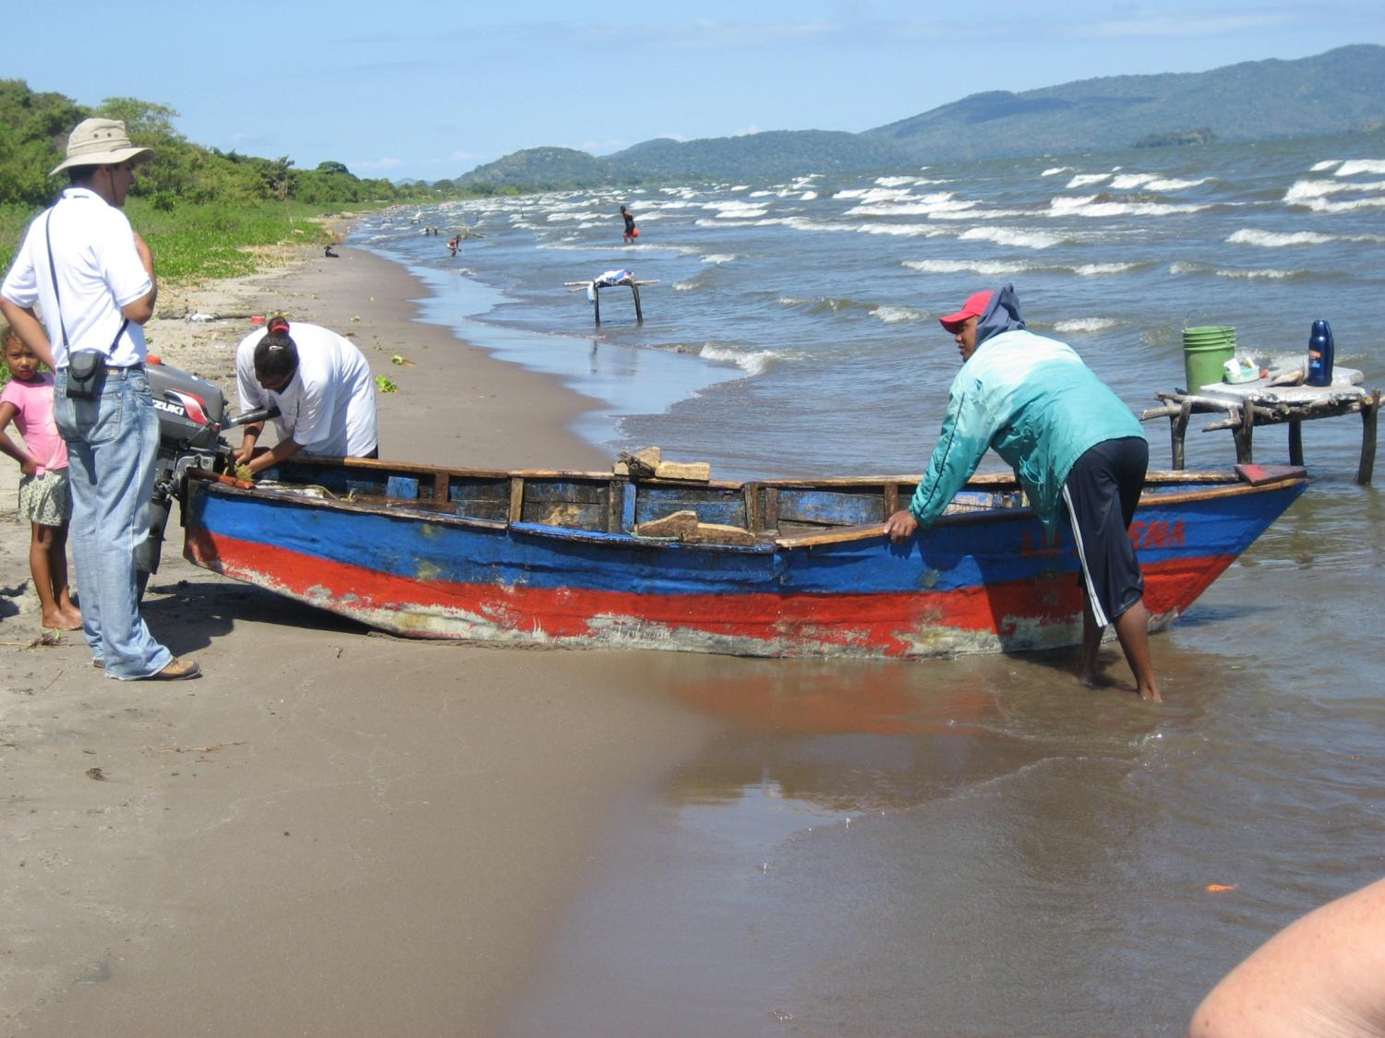

Slide 24
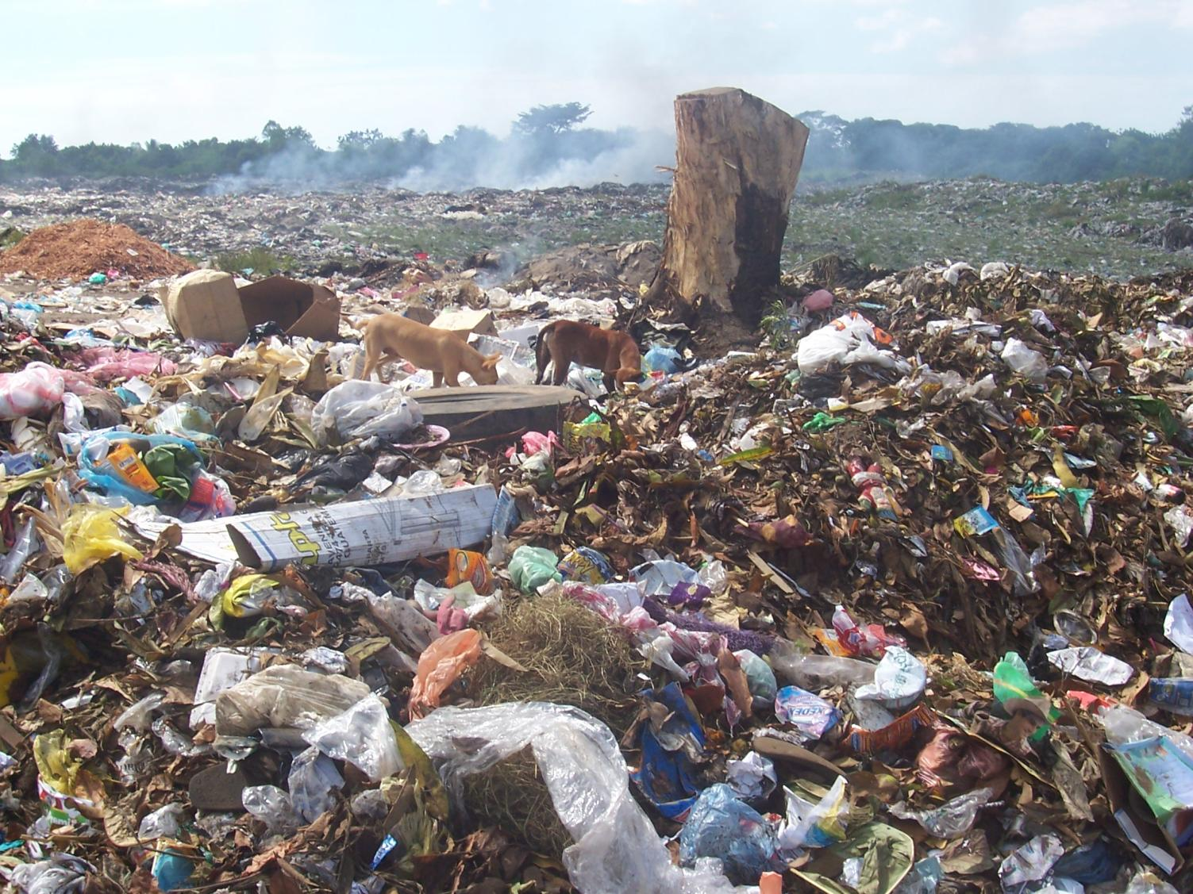

Slide 25
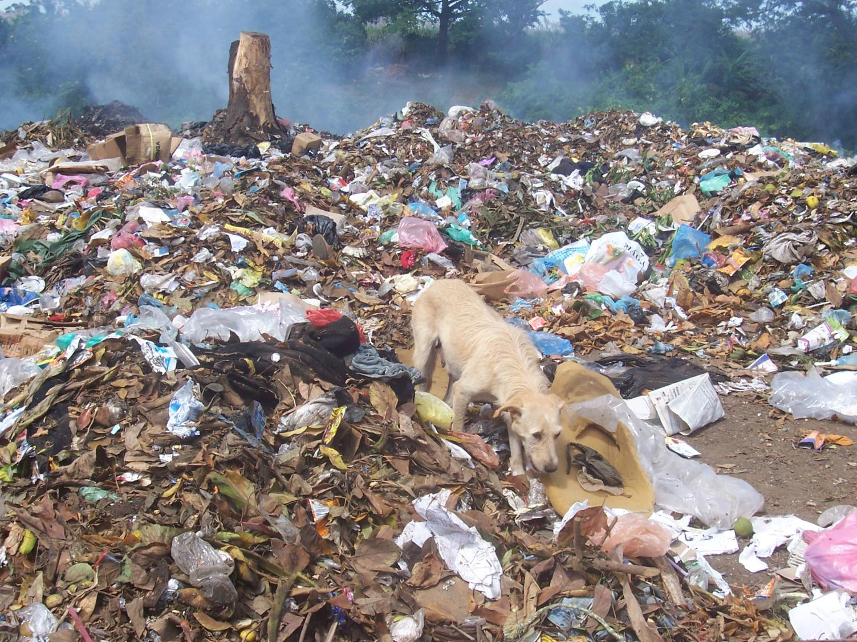

Slide 26
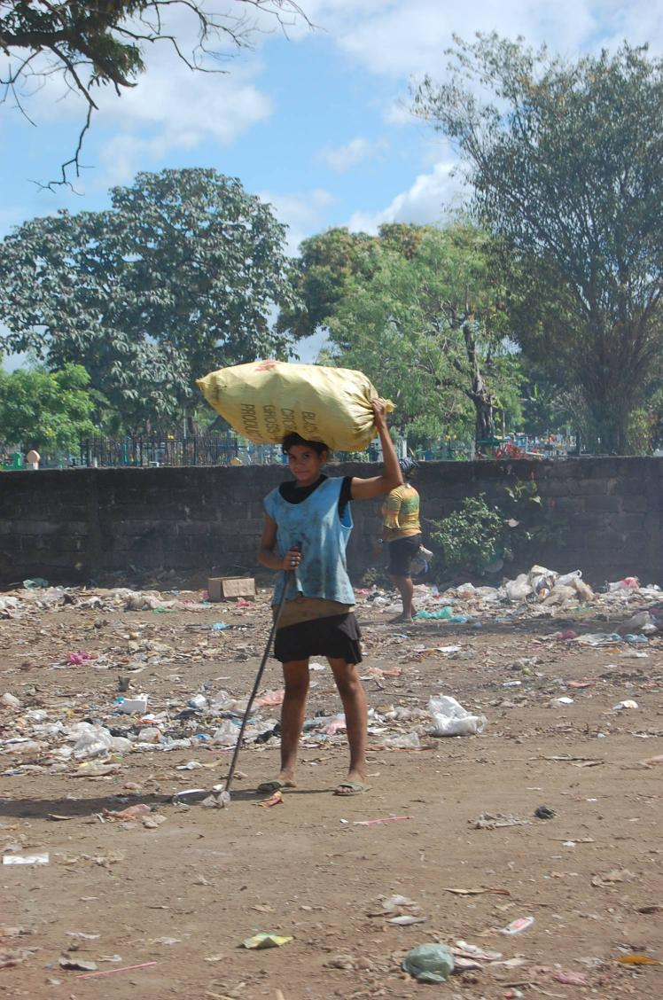

Slide 27
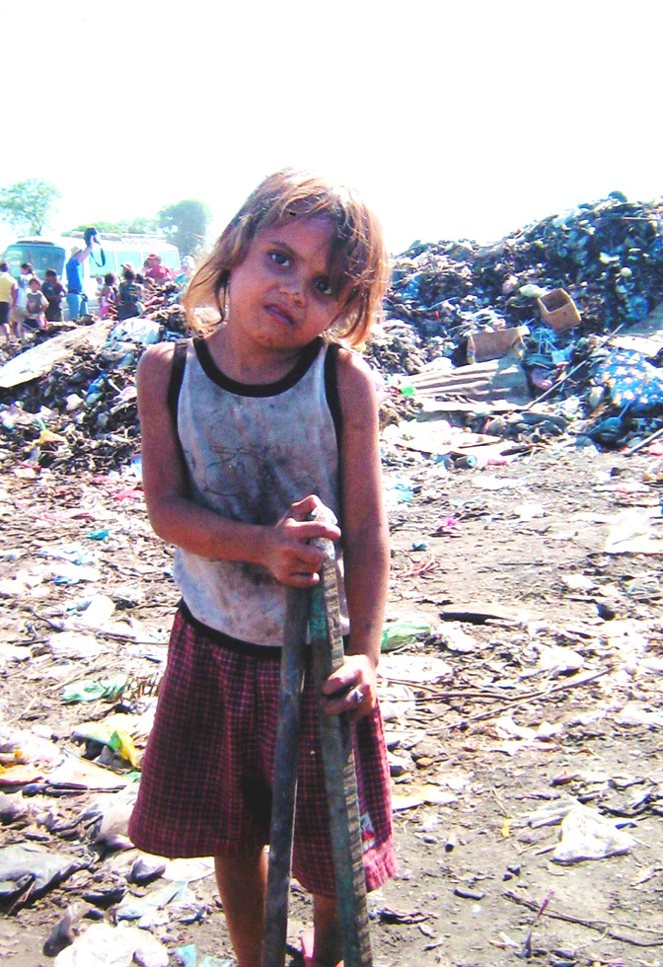

Slide 28
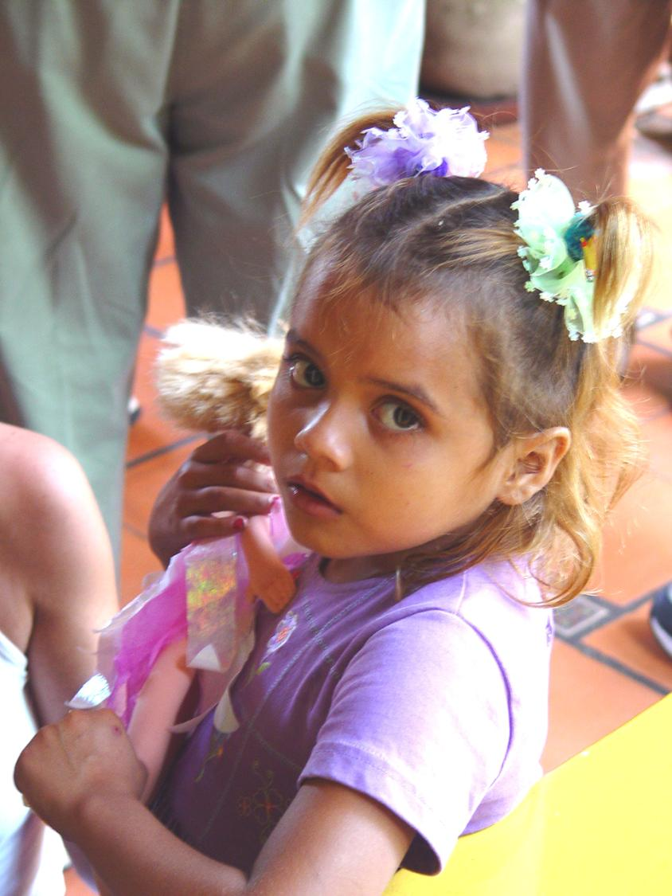

Slide 29
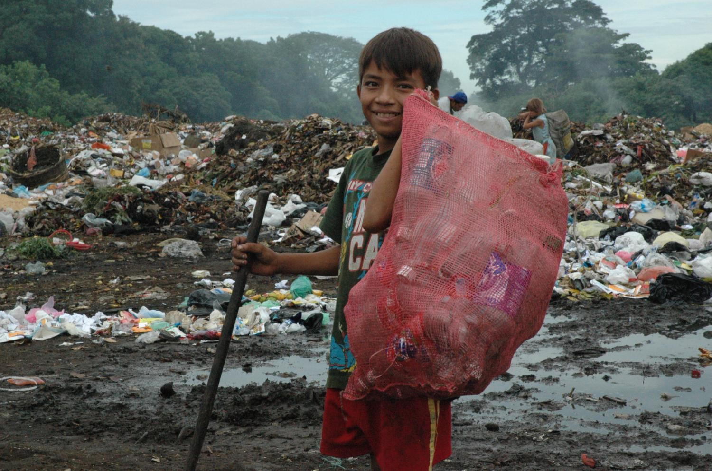

Slide 30
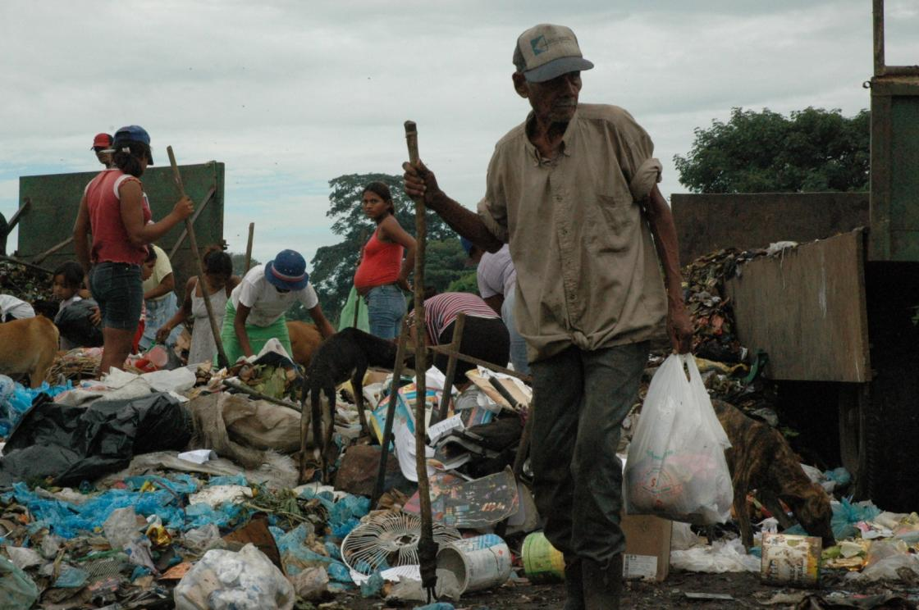

Slide 31
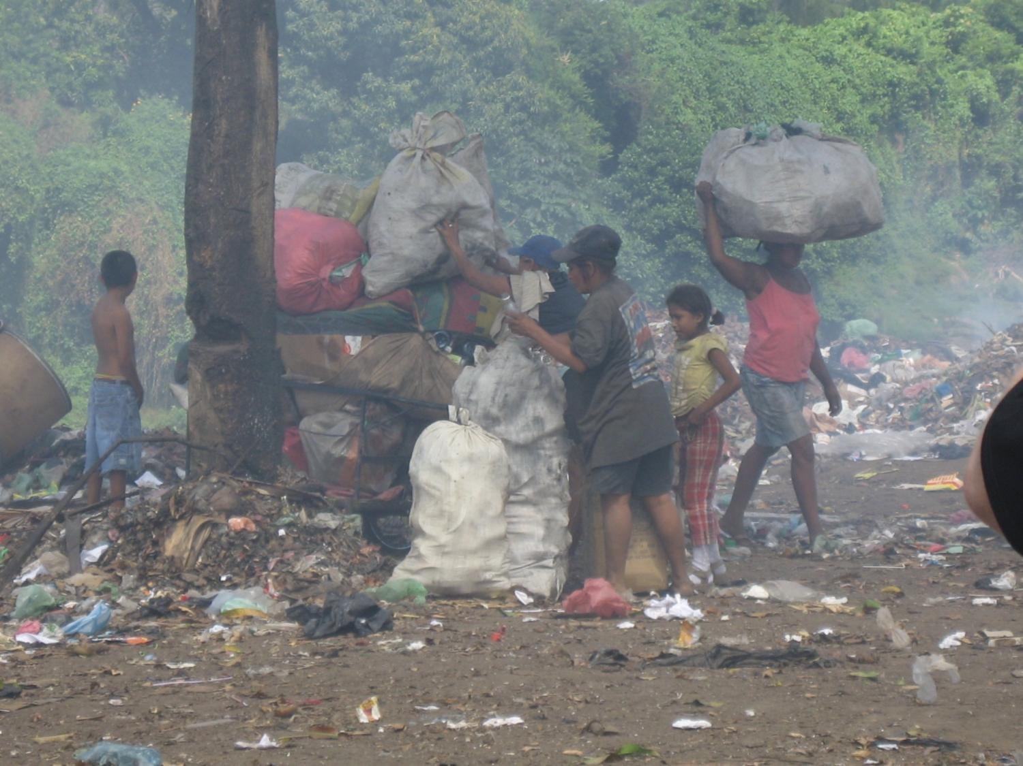

Slide 32
HOUSING –
WHY NICARAGUANS GO NORTH

Slide 33
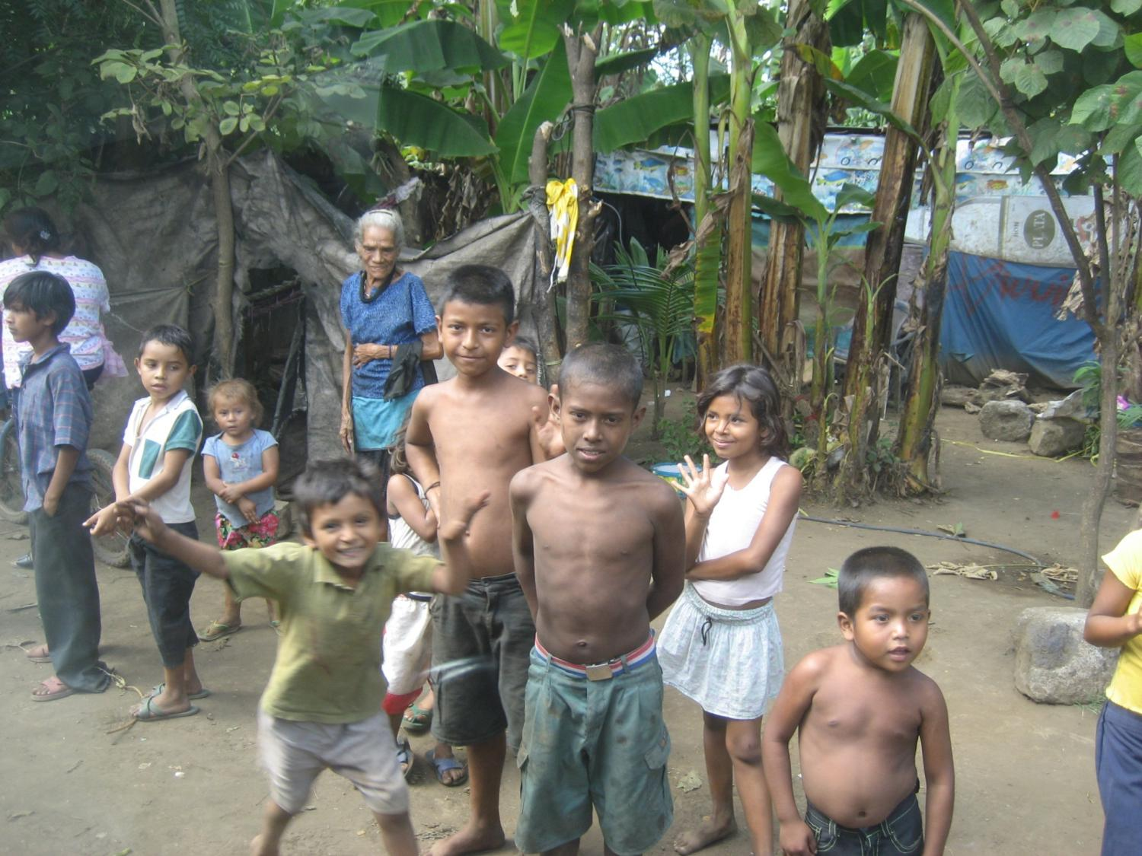

Slide 34
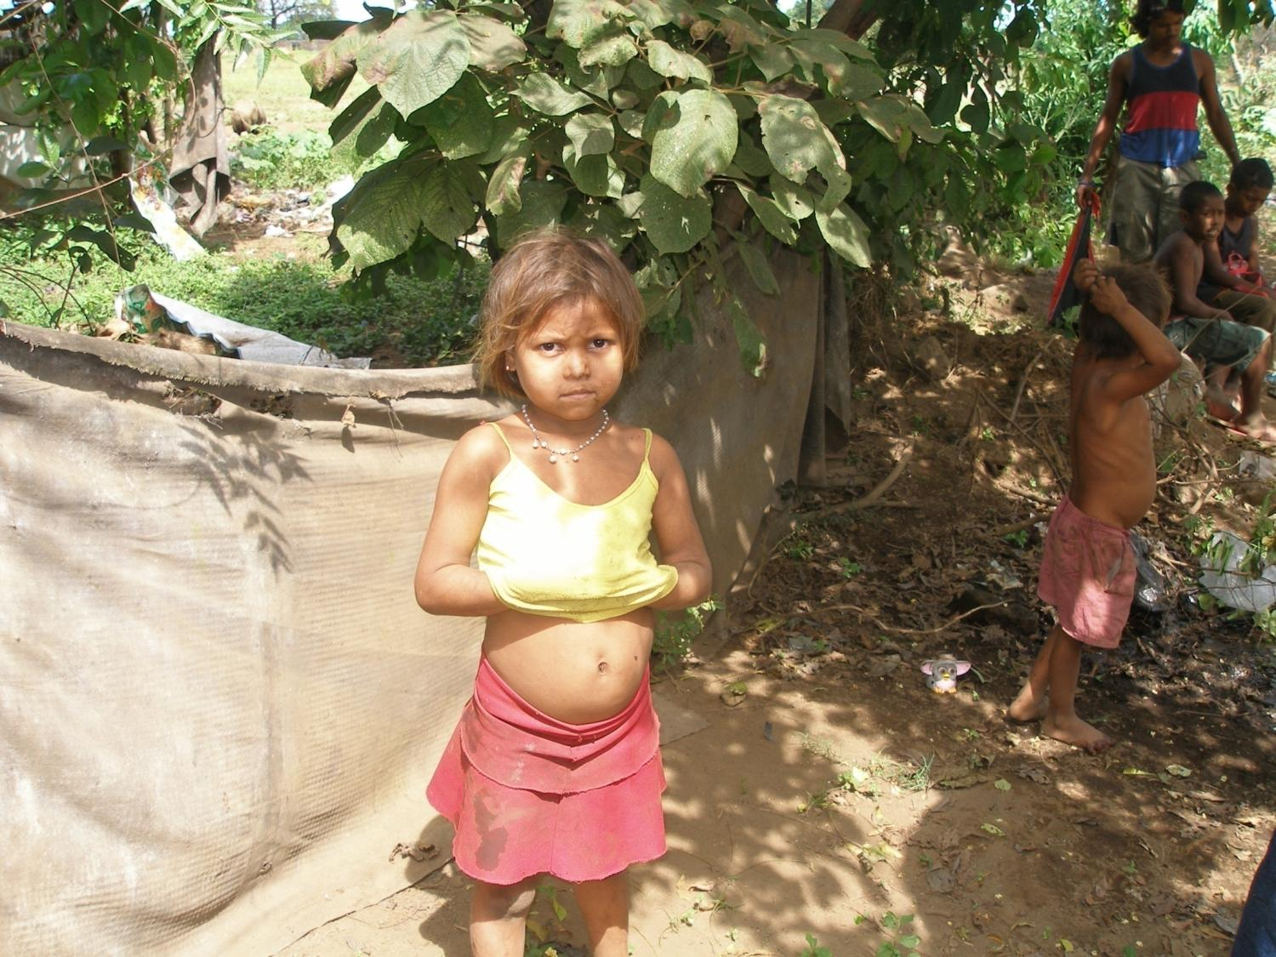

Slide 35
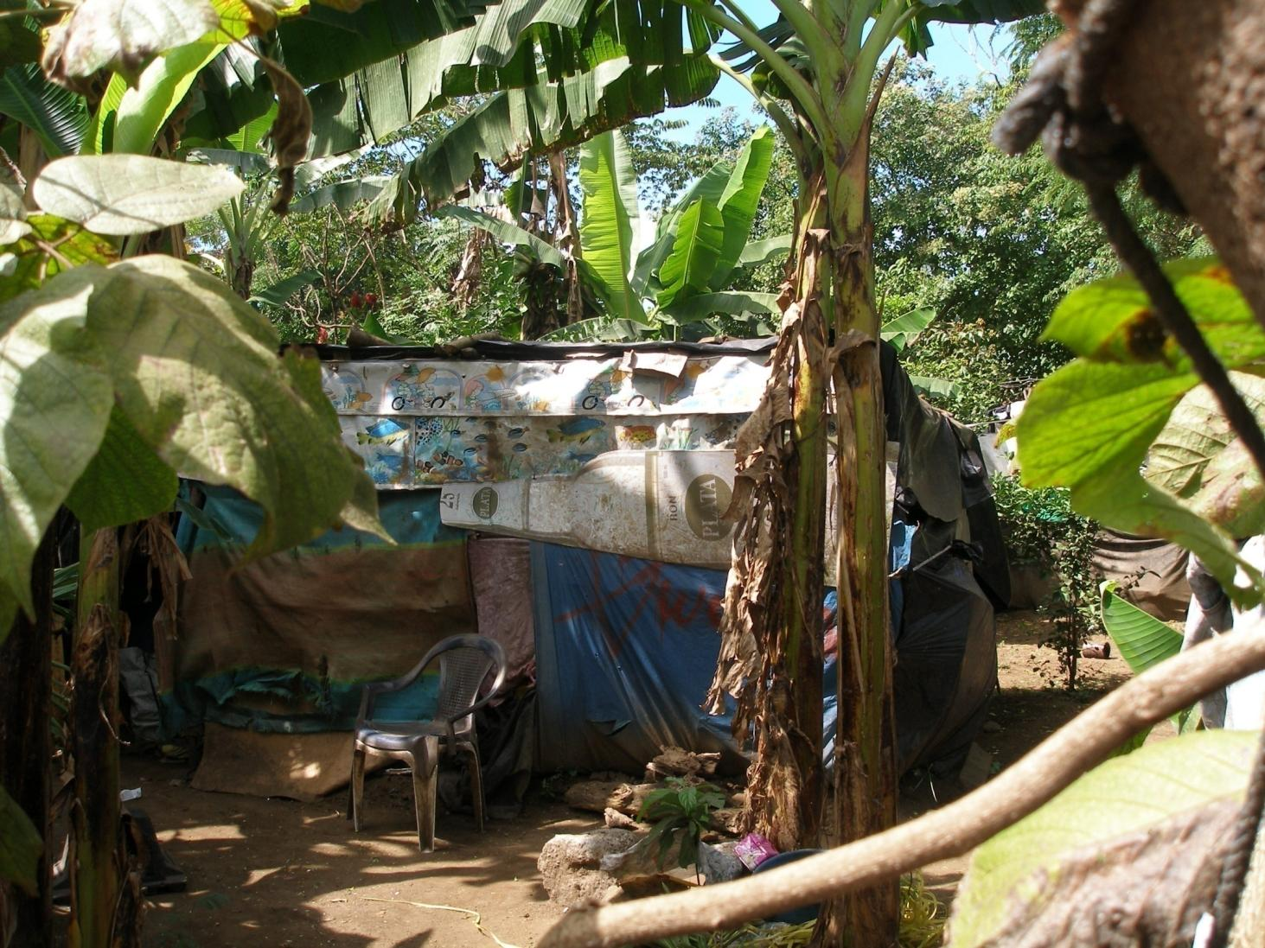

Slide 36
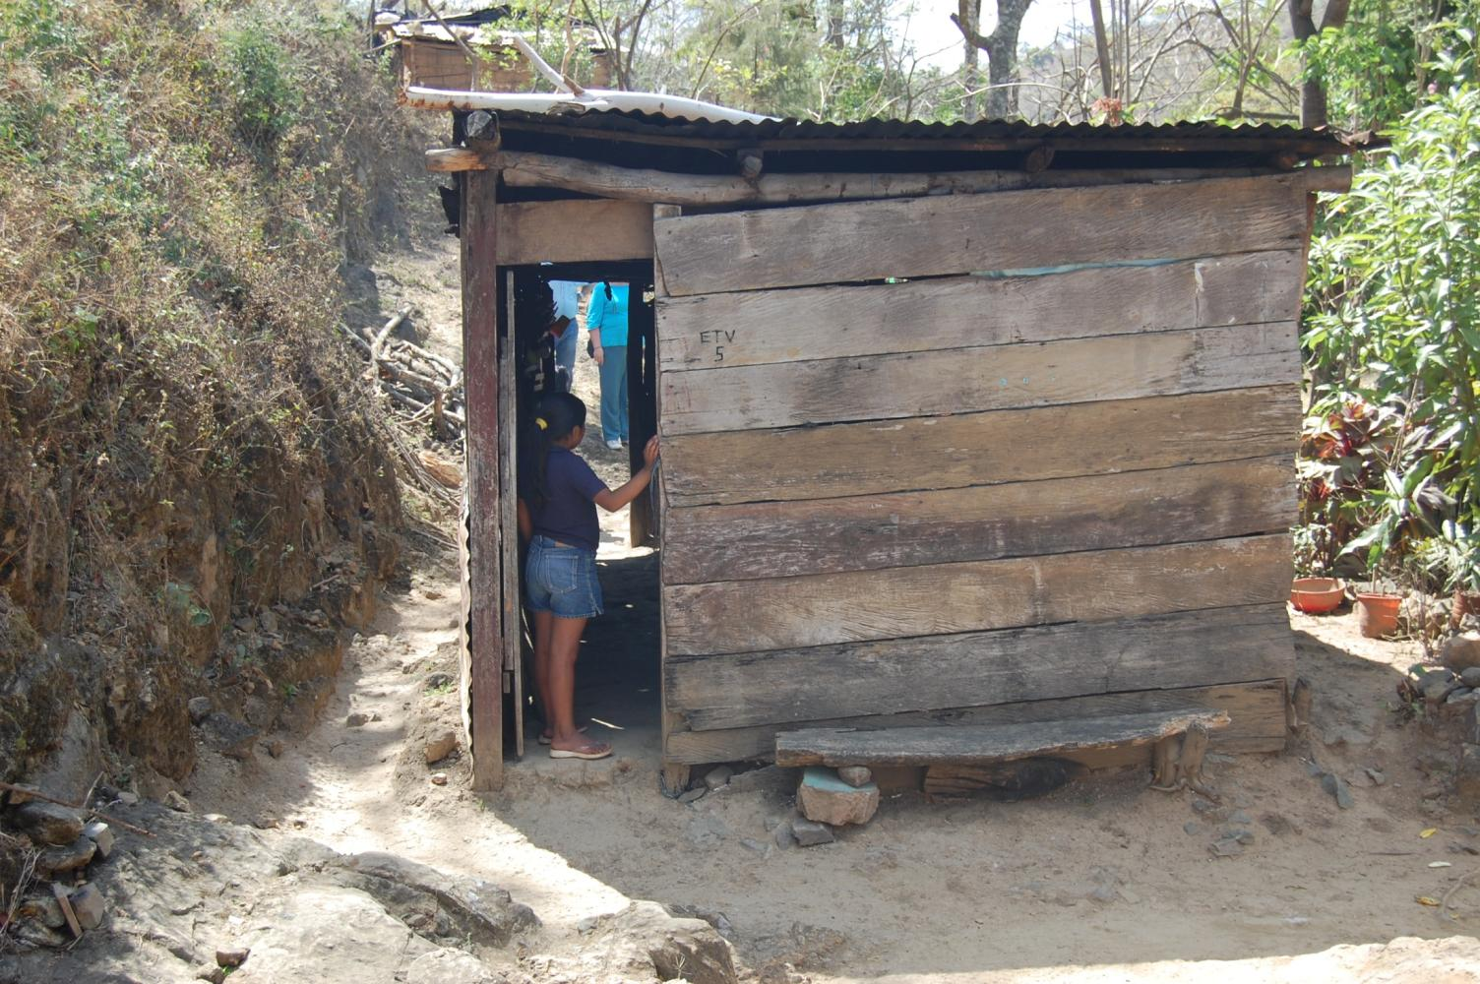

Slide 37
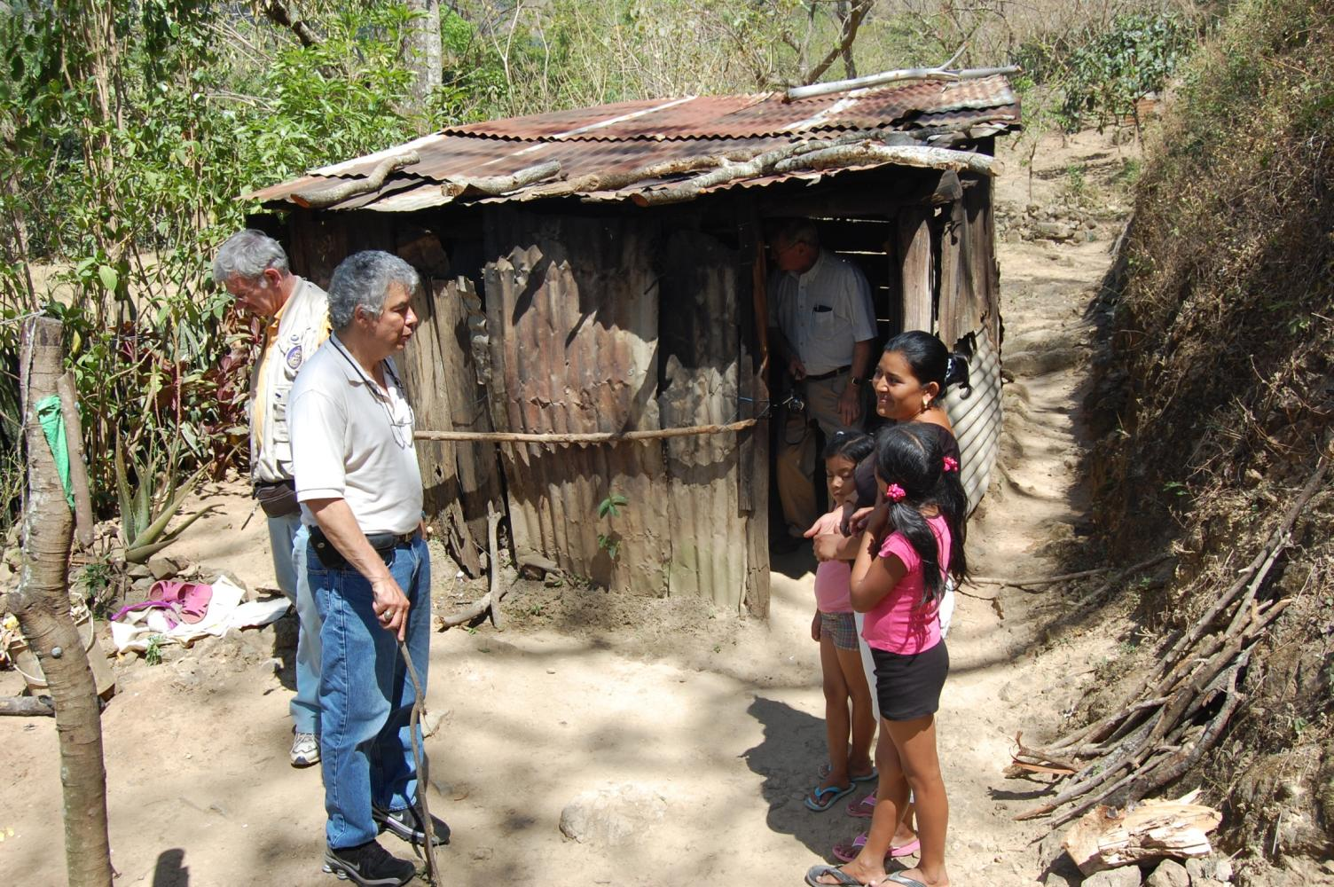

Slide 38
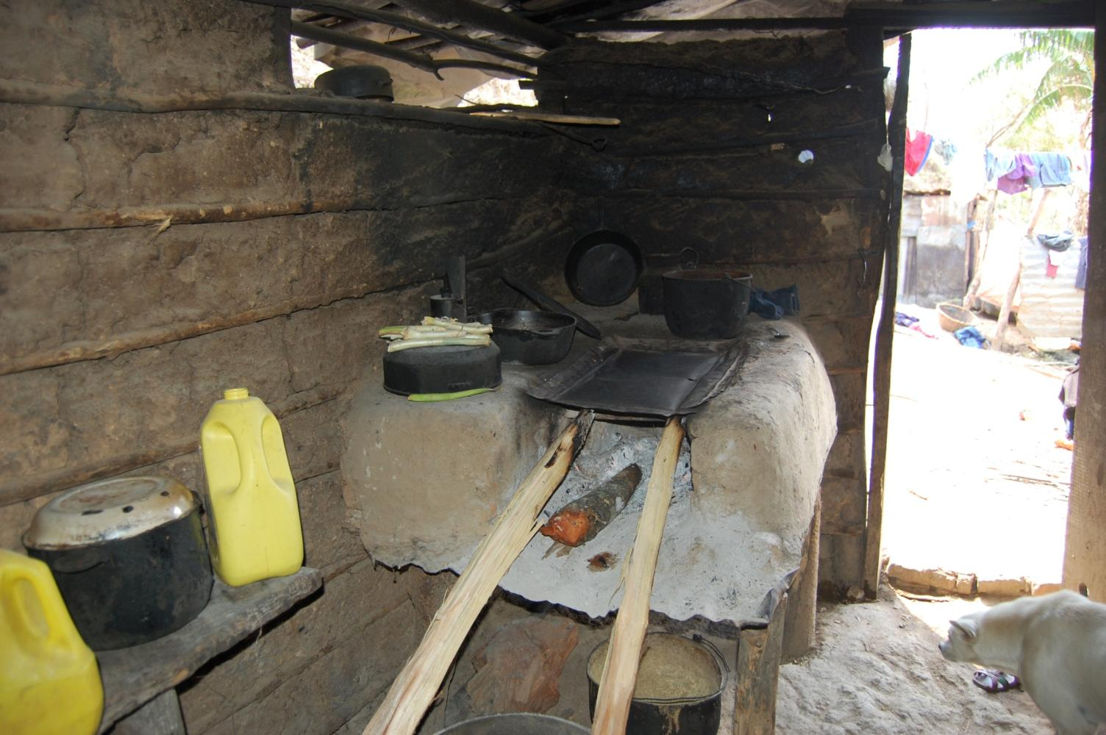

Slide 39
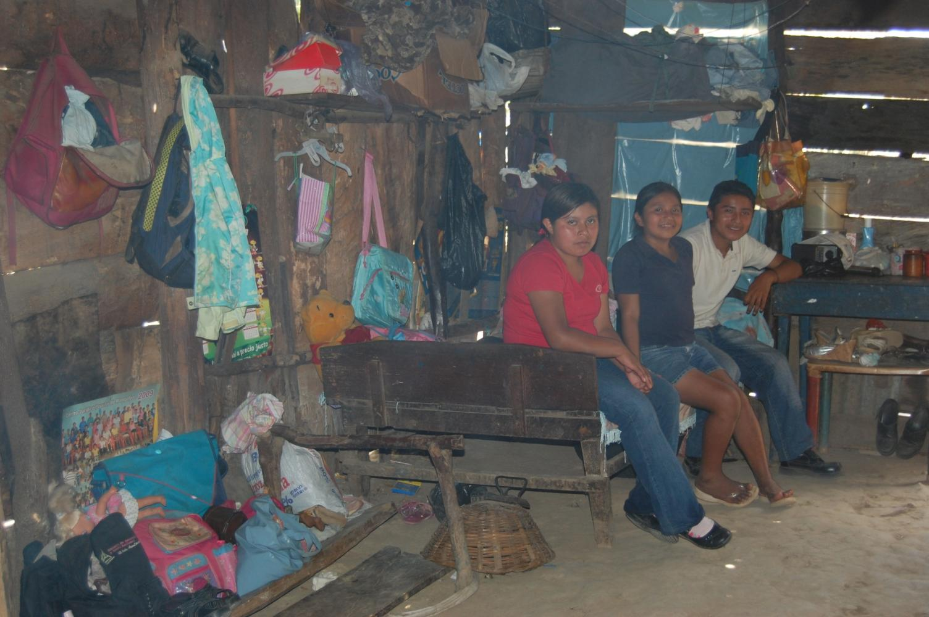

Slide 40
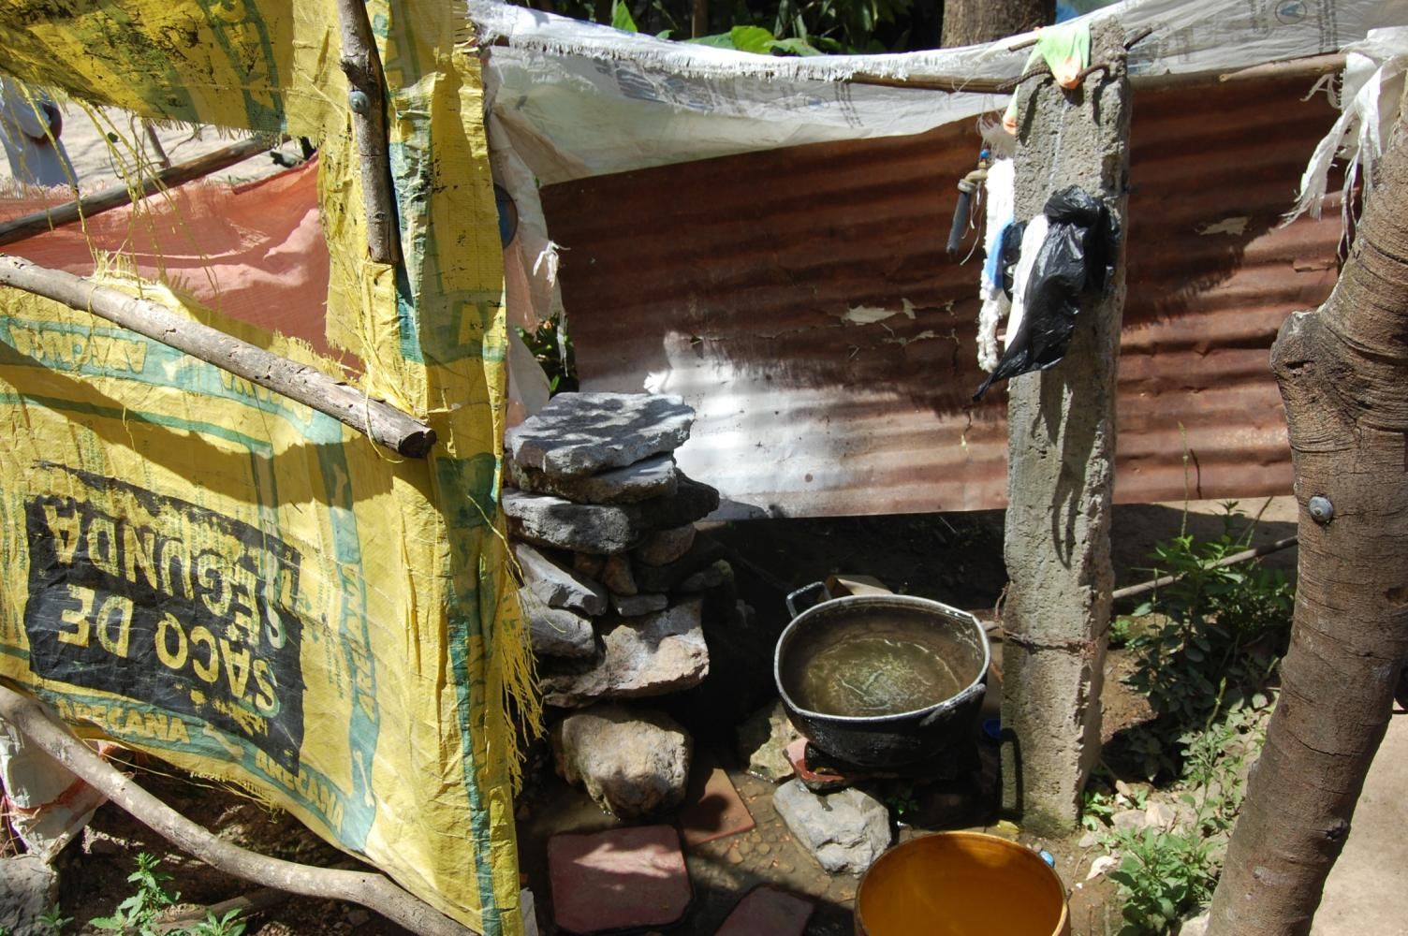

Slide 41
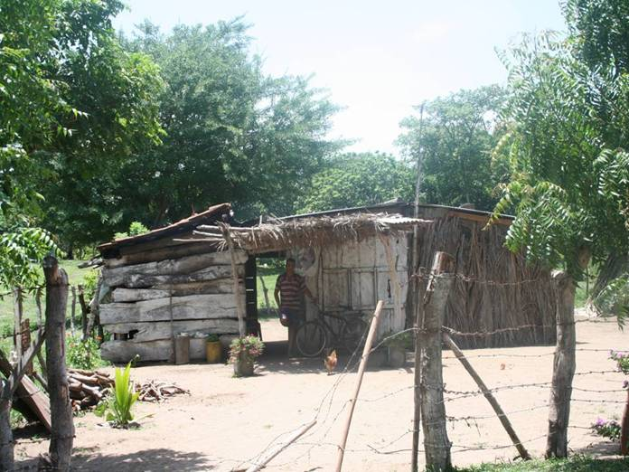

Slide 45
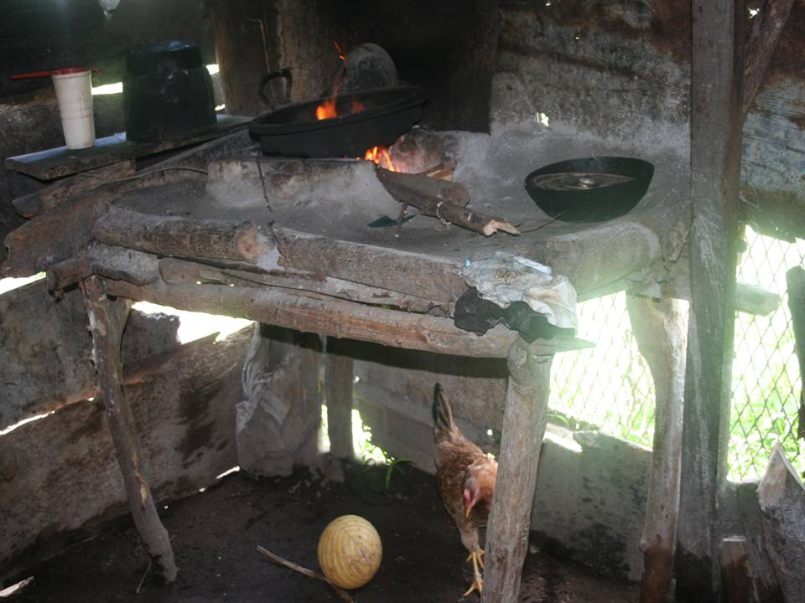

Slide 46
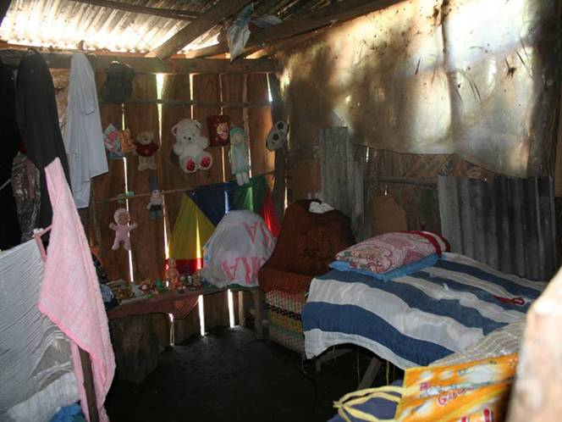

Slide 47
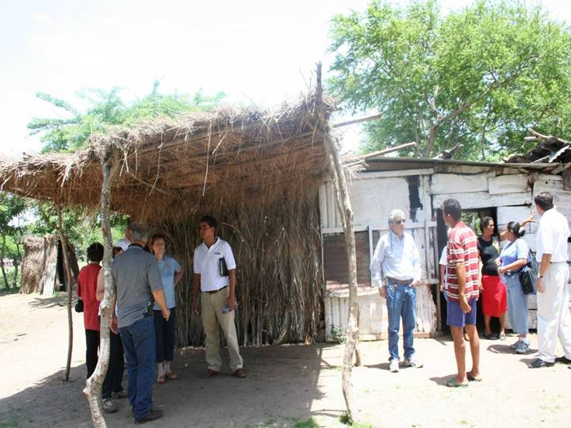

Slide 48
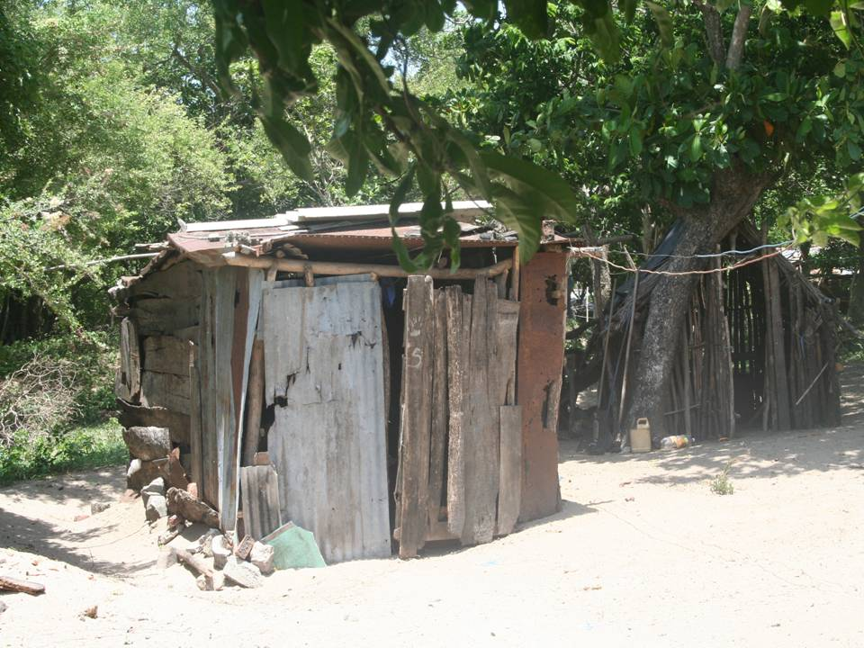

Slide 49
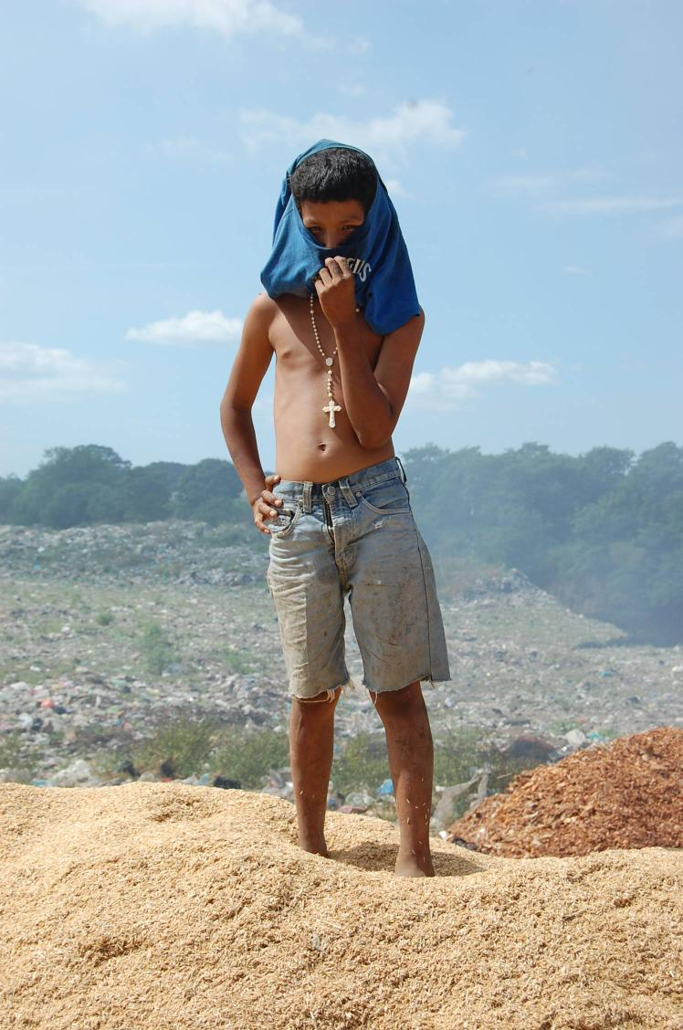

Slide 50
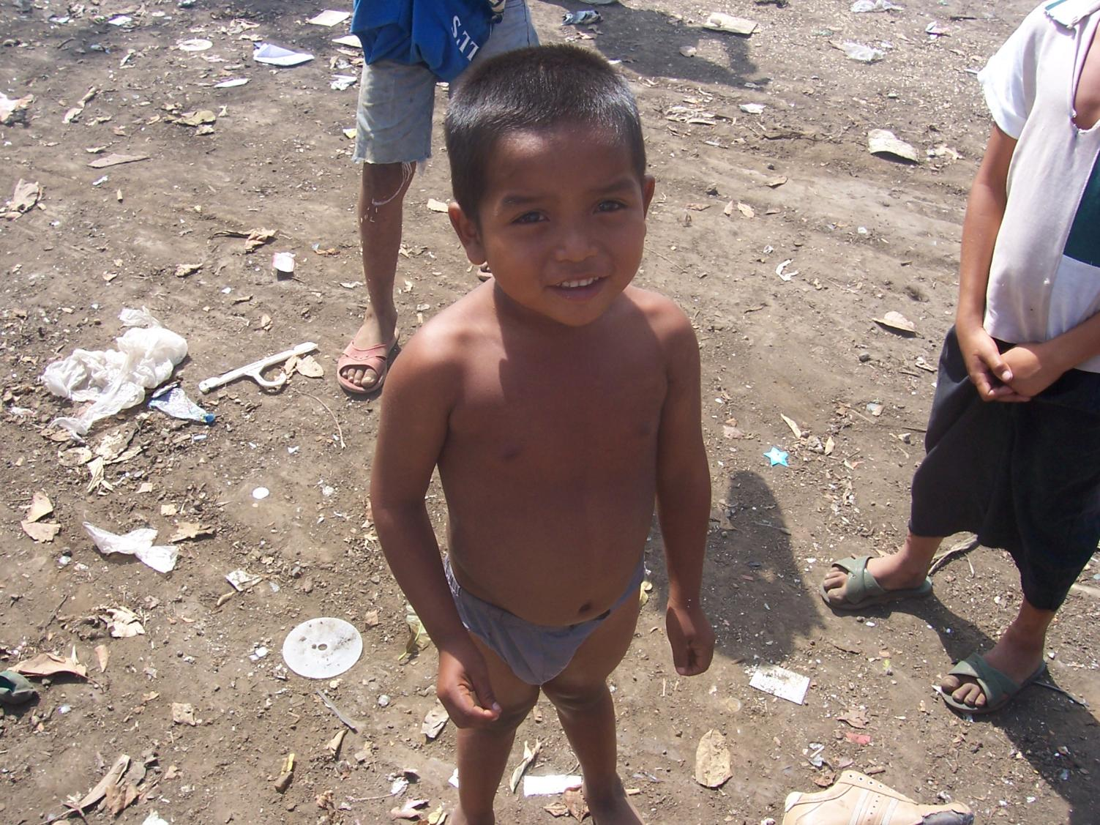

Slide 51
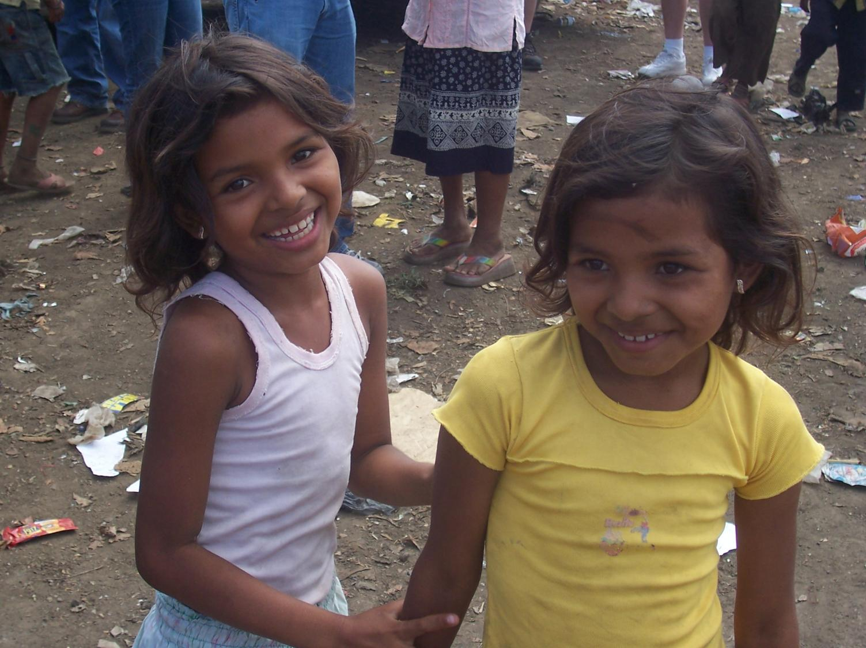

Slide 52
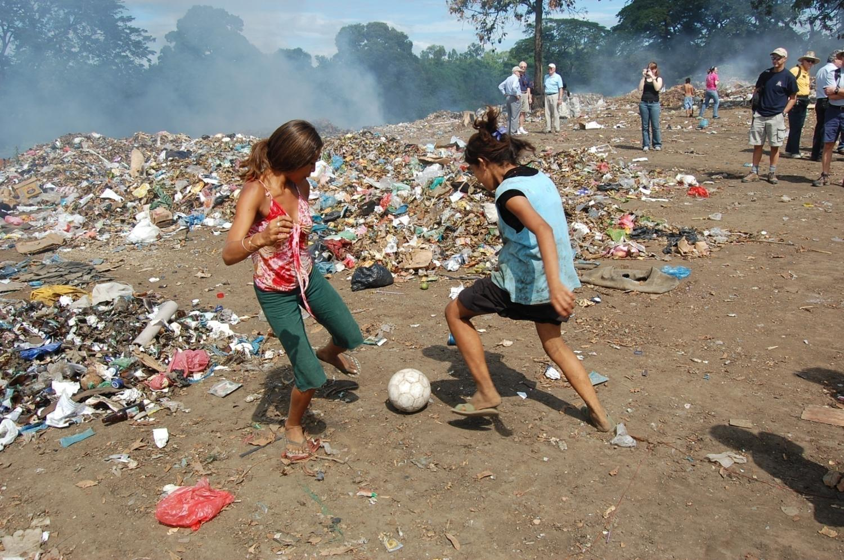

Slide 53
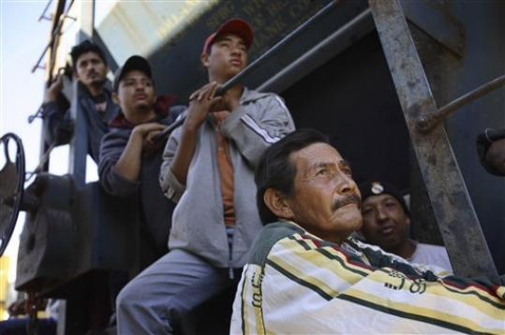
The Train of Death The “Beast”

Slide 54
The “Beast” is a freight train traveling from Southern Mexico
to the United States. Hundreds searching for a better life in the United States must hang on for their lives. When they fall asleep, they fall under the train severing their arms and legs.

Slide 55
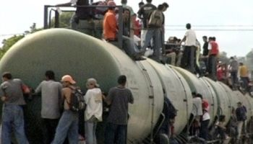

Slide 56
Migrants on the “Beast” face a phalanx of shakedowns by police, starvation wages paid by Mexican employers, and kidnapping by gangsters who ransom them to relatives in the United States. As U.S. border enforcement intensifies, more migrants seek the services of smugglers controlled by Mexico's crime syndicates.
Gangland gunmen last August abducted and massacred 72 migrants near San Fernando, some 90 miles south of the Rio Grande at Brownsville.
A Catholic priest claimed 60 other migrants disappeared last month in Veracruz state at the hands of the same gang, the Zetas.
By DUDLEY ALTHAUS, HOUSTON CHRONICLE Sunday, August 21, 2011

Slide 58
Over 50% of the immigrants on the “Beast” are women and children.

Slide 59
Only 20% of those riding the “Beast”
make it to the United States.

Slide 61
By DUDLEY ALTHAUS, HOUSTON CHRONICLE
Updated 11:02 a.m., Sunday, August 21, 2011
“Migrant sympathizers…ease the way with a string of shelters along the length of Mexico, usually close to the rails or the border itself. …Opened 30 months ago beside the tracks, the shelter was intended to serve 60 migrants a night but often takes in as many as 100 or more.”

Slide 64
"We've got to go through the mountains, there are lots of trees and the police don't see us. That's where the gangs wait for us. Sometimes they already know the time that we are going to cross over. That's where they wait for us and they kill us, or hurt us, or steal our money."

Slide 65
Orange means protection
Travelling down a dirt track on the Mexican side of the border and a mere 30 kilometers south of the Guatemalan hostel is a bright orange jeep. The driver, Frances Aceves, is wearing a bright orange uniform - the color symbolizes protection. Aceves is from Grupo Beta, an organization the Mexican government set up in 1990 to ensure that the human rights of the thousands of illegal immigrants are respected.

Slide 67
Fifty Migrants Kidnapped From the “Beast.” 2 minutes
http://www.portaldenoticias.com/video/yt-mXghurFH58A
The Train of Death – the “Beast.” 11 minutes
http://www.youtube.com/watch?v=wU9Uc7mxDSY
Gangs Attack and Murder Those On the Train of Death – 16 minutes
http://www.youtube.com/watch?v=fHDsyOpuyNw&feature=related

Slide 68
Farm Workers in the United States
Child Agricultural Labor
http://www.youtube.com/watch?v=NfEtO00DSvI

Slide 69
Immokalee, Florida
Migrant workers arrive from Mexico, Nicaragua, Haiti, and Guatemala.
Population of 25,000 swells to 40,000 during the nine month harvest season.

Slide 74
Debt Bondage
What is bonded labor?
Bonded labor - or debt bondage - is probably the least known form of slavery today, and yet it is the most widely used method of enslaving people. A person becomes a bonded laborer when their labor is demanded as a means of repayment for a loan. The person is then tricked or trapped into working for very little or no pay, often for seven days a week. The value of their work is invariably greater than the original sum of money borrowed.

Slide 75
Most migrant workers arrive with the help of a coyote guide.

Slide 76
They wake up at 4:00 am and take migrant busses to the fields. They sleep twelve to a room in broken-down shacks.
Each are charged $50.00 per week for the shack.

Slide 77
Posted by Forest on 16 January 2012
Enter Collier county, Florida. A classic tale of two towns. On the one hand you have Naples, the nation’s second-wealthiest metropolitan area. On the other, Immokalee, dubbed by Barry Estabrook (of Tomatoland) the "tomato capital of the United States of America". …they produce like 90% of the fresh domestic tomatoes consumed in winter/spring months in the US… What are they, the nation's third wealthiest metropolitan area?". Well, believe it or not, despite keeping us rolling in tomatoes for the better half of each year, Immokalee is not one of the nation's wealthiest metropolitan areas. Indeed, with a per capita income of around $8,500 you would be hard pressed to find the words "wealthy" and "Immokalee" used in all but the most ironic of conjunctions.

Slide 78
Posted by Forest on 16 January 2012
The series above is my attempt to capture a day in the life of these workers in Immokalee, from the 4am wakeup, to the long walk to drop kids off at a nursery (for which they might pay as much as half their day's wages), to the hours spent waiting on the bus and being shuttled back and forth to the fields (unpaid), to the muggy trudging of the rows deftly filling and rushing buckets to the waiting trucks in the hope of garnering a piece rate increase that will bump them over the minimum wage, another dirty exhausted bus ride back, the trudge home to a crowded trailer ...to wake up another morning and repeat…

Slide 82
Picking tomatoes is brutal, bending over all day other than running with a 32 pound bucket of picked tomatoes and throwing it up to another worker. They are paid $25 per ton.

Slide 83
The price of $25 per ton has not changed in the past thirty-two years!

Slide 97
Farm labor is the only type of labor not covered by the National Labor Relations Act of 1935. This act protects workers, fixes fair wages, gives the right to organize, and fixes health and safety rules.

Slide 103
Farm workers can be fired for protesting, trying to organize, or requesting better pay.

Slide 104
Immokalee Workers Linked to Slavery – 5 minutes
http://www.youtube.com/watch?v=w_RA39VJfdc

Slide 105
McDonalds, Subway, Taco Bell, Burger King, Shop Rite, Wal-Mart, and Costco are setting the prices for migrant workers because they are so huge they can set the price they are willing to pay for tomatoes.

Slide 106
All these companies were asked to pay 1 cent more for a pound of tomatoes to help raise the migrant worker’s pay barely to minimum wage. All refused, but eventually agreed after years of bad publicity and threatened law suits.

Slide 110
January 18, 2013

Slide 112
January 18, 2013

Slide 117
Lucas Benitez of the Coalition of Immokalee Workers, explains the living situation inside a trailer where eight farmworkers live. The rent for the trailer, which has no air conditioning or heat is $320 a week. Prominent members of the food community took a walking tour of Immokalee to see the conditions of migrant farmworkers on March 4, 2009. An article in the March issue of Gourmet magazine named Immokalee "ground zero for modern slavery" prompting a sustainable food delegation to come to the migrant community. Greg Kahn/Staff

Slide 118
Prominent members of the food community take a walking tour of Immokalee to see the conditions of migrant farm workers on March 4, 2009. An article in the March issue of Gourmet magazine named Immokalee "ground zero for modern slavery" prompting a sustainable food delegation to come to the migrant community. Greg Kahn/Staff

Slide 119
A home sits empty where migrant workers were beaten, threatened, chained, and locked inside a trailer while being forced to work in the fields to pay off their rent debt. The two owners of the home, Cesar and Geovanni Navarrete, pled guilty to the charges and were sentenced to 12 years in federal prison. Prominent members of the food community took a walking tour of Immokalee to see the conditions of migrant farmworkers on March 4, 2009. An article in the March issue of Gourmet magazine named Immokalee "ground zero for modern slavery" prompting a sustainable food delegation to come to the migrant community. Greg Kahn/Staff

Slide 120
January 18, 2013

Slide 121
Migrant Life in Immokalee, Florida
IMMOKALEE, FLORIDA - March 2006 - Roomates from various parts of Mexico prepare dinner in their trailer rented weekly in Immokalee, Florida. Eight men are squeezed into three rooms. They pay $1,000 a month for the trailer. (Photo by Susana Raab)

Slide 122
Migrant Life in Immokalee, Florida
Immokalee, Florida - A bathroom in a trailer occupied by 8 undocumented, Hispanic migrant workers. They pay a combined total of $1000 in rent a month to their landlord. (Photo by Susana Raab)

Slide 123
Photo by DAVID AHNTHOLZ, Naples Daily News
Abel Cuello Jr., Bacilio Cuello, and Herman Covarrubias used physical and psychological threats to keep 24 Immokalee field workers in this run-down trailer for two months in 1999. The workers were constantly watched by trio and locked at night in the trailer on Sanctuary Road in Corkscrew Swamp.

Slide 125
Our Government Officials Learn
About Farm Migrant Slavery
http://www.youtube.com/watch?v=cLzFJPAcqW0

Slide 130
Photo by GREG KAHN
Protestors line U.S. 41 in front of Publix supermarket across from the Coastland Center on Oct. 17, 2009 during an hour-long protest. The Coalition of Immokalee Workers and other area groups protested low wages and unsafe working conditions for tomoato pickers in Southwest Florida. They are urging Publix to sign a code of conduct, which other businesses such as McDonald's, Subway Burger King and others have done. Greg Kahn/Staff

Slide 131
http://ciw-online.org/

Slide 132
http://www.bing.com/videos/search?q=migrant+workers+immokalee+florida&view=detail&mid=6CB15BC21DABCFA076296CB15BC21DABCFA07629&first=0&FORM=LKVR30

Slide 134
Joe Parker
student worker
ICW

