Slide 1
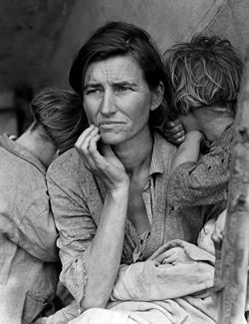
Hiram College
Immigration and Border Crossings
Immigration / Refugee Heroes
Migrant Mother, taken by Dorothea Lange in 1936

Slide 2
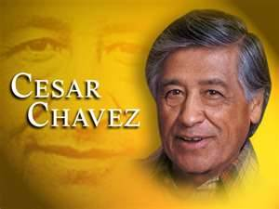

Slide 3
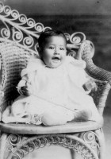
Cesar was born on March 31, 1927.
Cesar grew up in Arizona; the small adobe home, where Cesar was born, and was later swindled from them by Anglos.

Slide 4
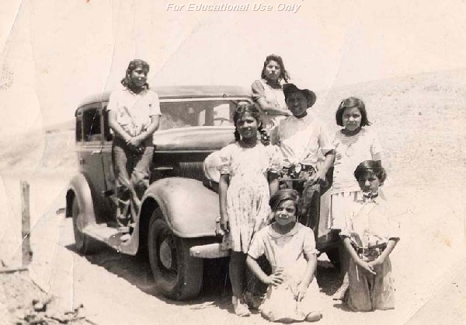
In 1938 he and his family moved to California, but returned to Arizona several months later.

Slide 5
They settled in San Jose and lived in the barrio called Sal Si Puedes ­"Get Out If You Can." Cesar thought the only way to get out of the circle of poverty was to work his way up and send the kids to college. He and his family worked in the fields of California.

Slide 6
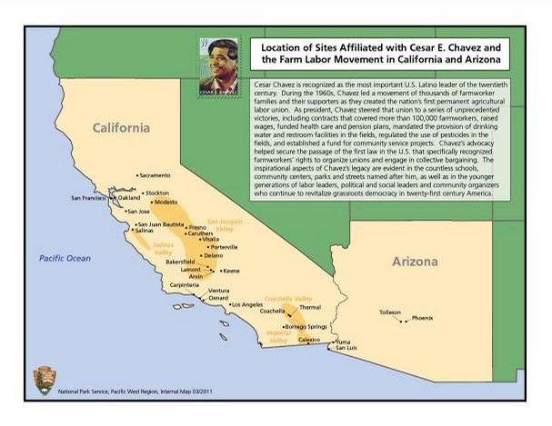

Slide 7
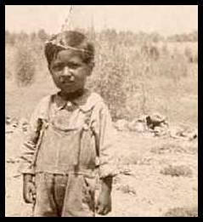

Slide 8
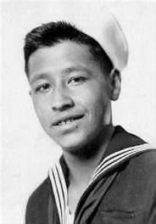
In 1944 he joined the Navy at the age of seventeen. He served two years and in addition to discrimination, he experienced strict regimentation.

Slide 9
After serving in the Navy during WWII, Chavez returned to the mainland to marry his sweetheart and begin the transition from field worker to advocate. He began working with a community-based movement seeking to empower Mexican Americans through voting and community mobilization. Chevez worked on electoral issues, police brutality, low pay, discrimination, physical abuse, exposure to toxins and poor education. Chávez left the community-based movement in order to devote his full attention to the agricultural worker.

Slide 10
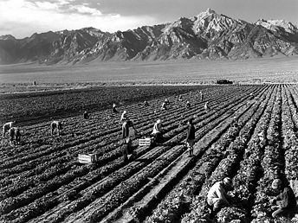
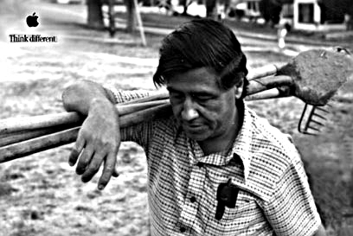

Slide 11
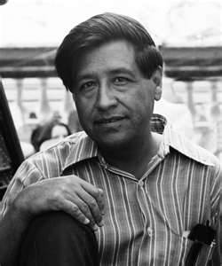
Agricultural workers are exempt from the standards of the National Labor Relations Board - regulations which protected workers’ rights to unionize, fair wages, safe working conditions, etc. Before working on solutions the farm worker’s faced, Chávez had to first establish their right to form a union. Chavez created the National Farm Workers Association. After years of hard work, Chávez had some 1200 Mexican-American families in the NFWA. Still, no formal contracts with employers existed.

Slide 12
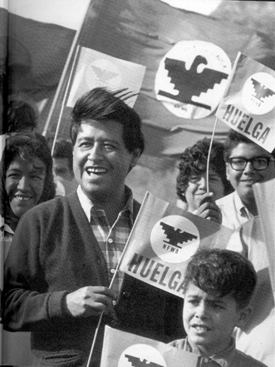
In 1965, the Agricultural Workers Organizing Committee (AWOC)decided to strike in Delano, California, where they worked picking grapes. Timing their grape strike at the time of the September harvest, Chávez’ NFWA had to make the decision to support the strike or not. The result was the merging of the two unions into the United Farm Workers (UFW). Chávez became the union’s president, a position he held for the rest of his life.
http://www.youtube.com/watch?v=rj4ya_Gyq80

Slide 13
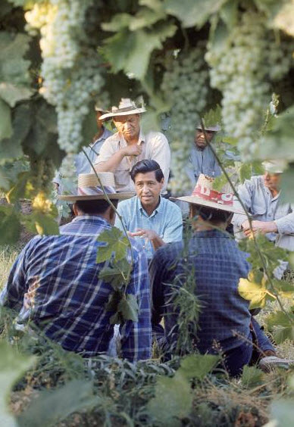
And, in those first days at the helm, the famous Delano Grape Strike began. It lasted for some five years.

Slide 14
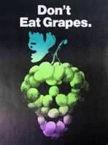
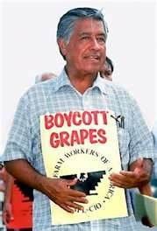

Slide 15
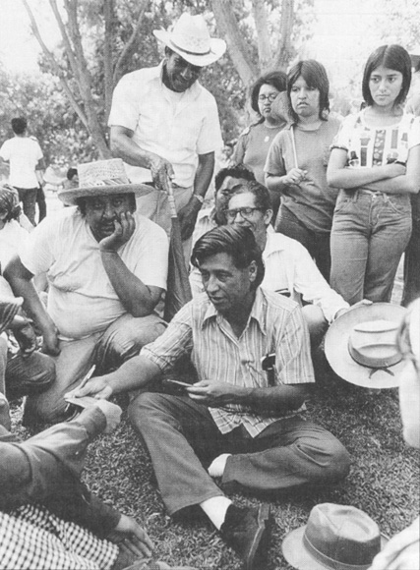
Chávez fought for the rights of workers with his very body and soul.

Slide 17
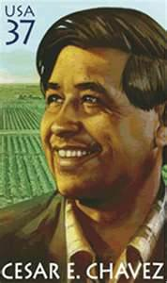

Slide 18
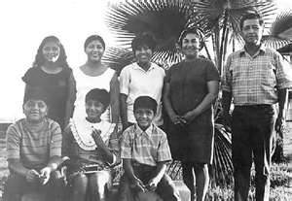
http://www.youtube.com/watch?v=NzbL3X68TEI&feature=related

Slide 19
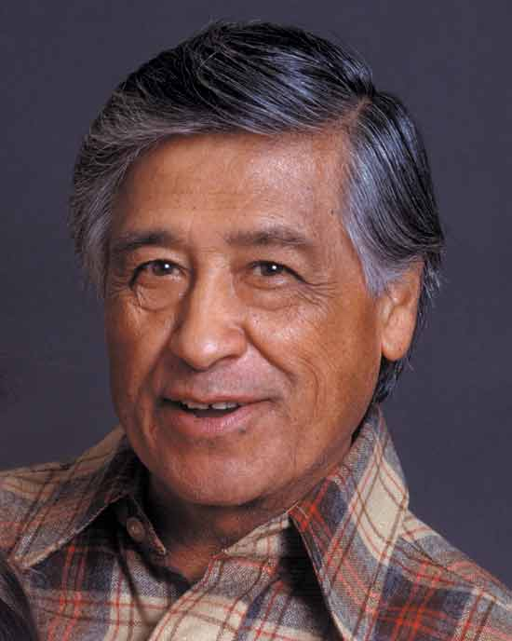

Slide 20
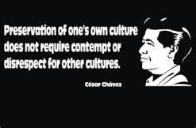
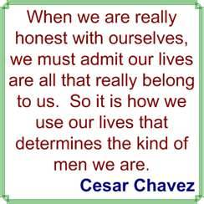

Slide 21
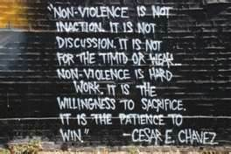
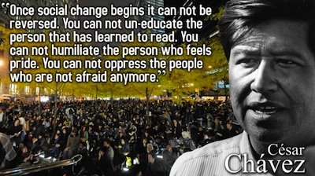

Slide 22
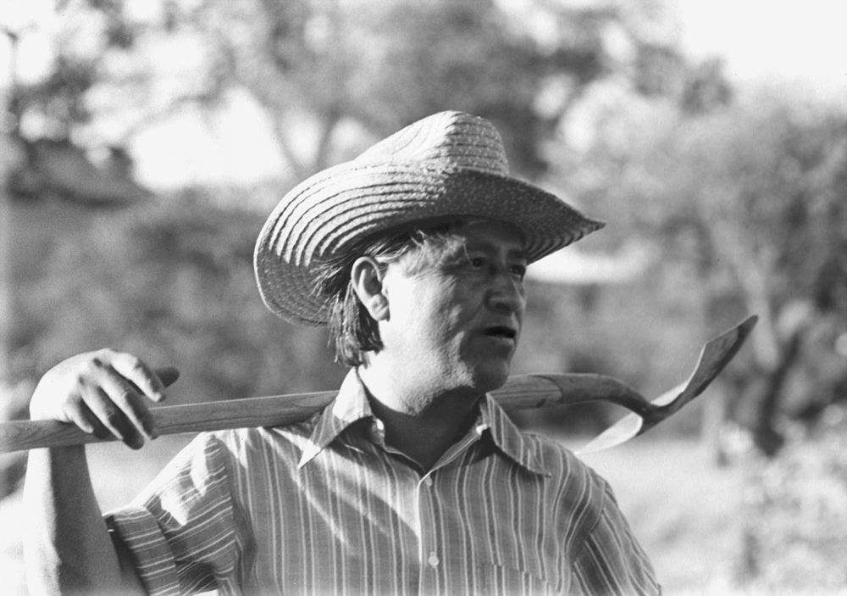
Due to his repeated use of hunger strikes (taken from Gandhi), his work in the fields, and his unyielding work on behalf of others, he died in 1993.

Slide 23
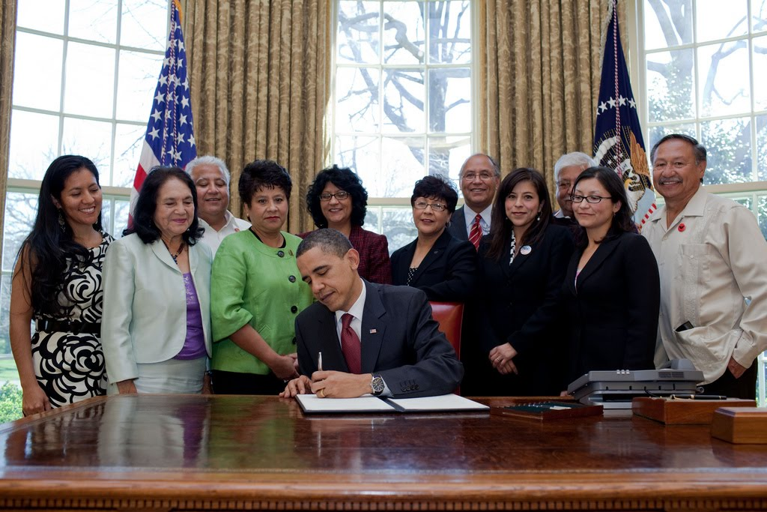
March 31
Cesar Chavez Day

Slide 24
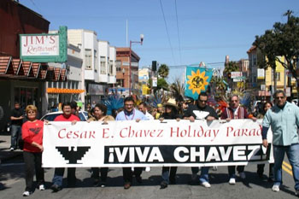
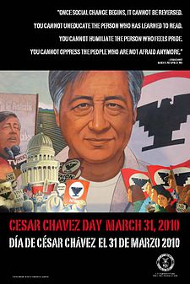
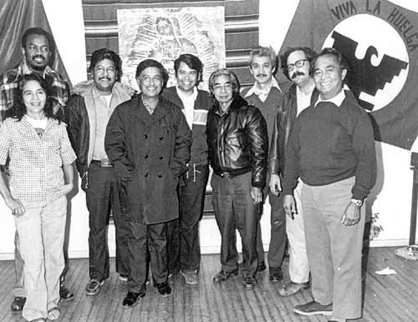

Slide 25
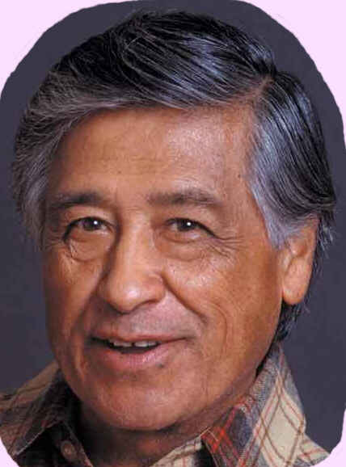
Preservation of one's own culture does not require contempt or disrespect for other cultures. Cesar Chavez

Slide 26
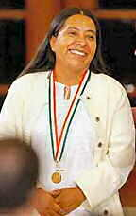
The Train of Death “The Beast” and Olga Sanchez

Slide 27
A freight train leaves Arriaga in Chiapas, Mexico heading northbound for the United States.
It is called, “The Beast”

Slide 28
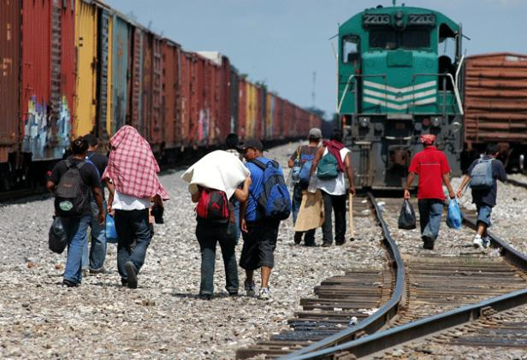

Slide 29
Thousands of poor migrants from Mexico, Guatemala, Honduras, El Salvador and Nicaragua ride on top of the box cars seeking a better life in the United States. 50% of these migrants are children and women.

Slide 30
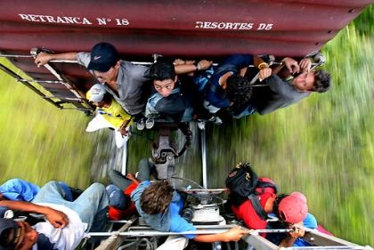

Slide 31
These desperate people must stay awake for days hanging on to their small space on the train. If they fall asleep, they fall off the train and get caught under the wheels loosing arms, legs, and often their lives.

Slide 32
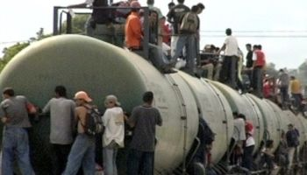

Slide 33
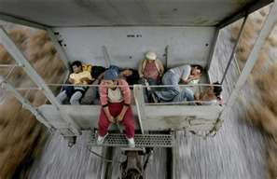

Slide 34
When the train stops, these vulnerable people are robbed, raped, and killed by gangs and corrupt police waiting for them.
Many are kidnapped and later found dead. Some migrants have families back home wire what money they have to Western Union stations along the route.

Slide 35
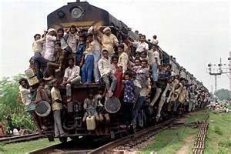

Slide 36
Over half of these migrants are women and minors. Last year, seventy migrants were killed by these ruthless gangs. Hundreds are raped. Although thousands ride the “Beast” each year, less than 20% successfully make it to the United States. Hundreds fall from the train severing arms and legs.

Slide 37
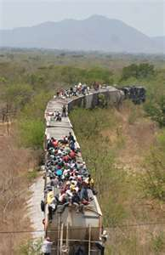
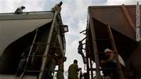

Slide 38
Olga Sanchez, known as the Mother Teresa of Mexico, started walking the train tracks over 20 years ago rescuing those that have fallen from and train and picking up their severed arms and legs.

Slide 39
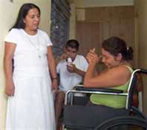
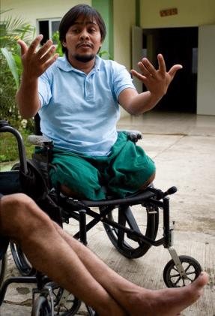

Slide 40
Olga Sanchez has turned her modest home into a clinic and shelter to help those injured on the train. Her home is filled with crutches and wheel chairs. Doctors come to operate on those who have fallen prey to the BEAST.

Slide 41
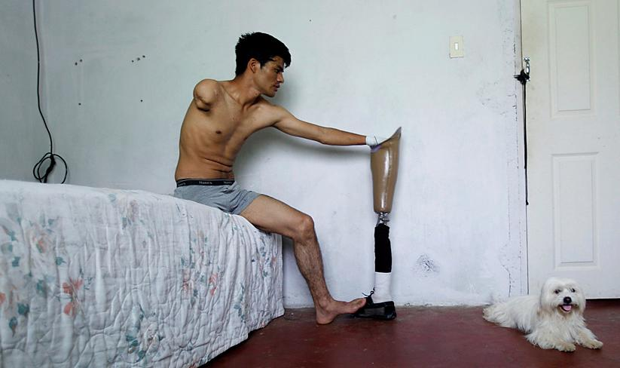
Jose Hernandez, 24, held his prosthetic leg in El Progreso, Honduras. Many migrants are injured yearly on the crowded “train of death” from falls. (Edgard Garrido/Reuters)

Slide 42
Olga Sanchez has rescued over 8,000 migrants. She houses them, feeds them, provides schooling, and medical care. She wants each one to leave her hospital with prosthetic limb which cost $4,000 each. Olga goes begging door-to-door to raise this money in addition to selling cakes that she bakes at the clinic.

Slide 43
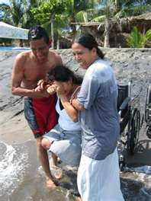
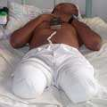
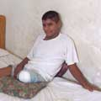

Slide 44
Last year over 500 migrant died trying to get to the United States.
In 2004, Olga Sanchez received Mexico’s National Prize for Human Rights.

Slide 45
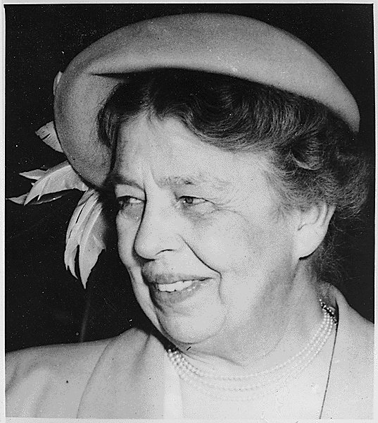
When will our consciences grow so tender that we will act to prevent human misery rather than avenge it? Eleanor Roosevelt

Slide 46
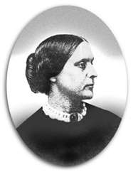
The older I get, the greater power I seem to have to help the world; I am like a snowball -- the further I am rolled the more I gain. Susan B. Anthony

Slide 47
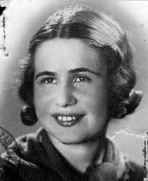
Irena Sendler
Sources: http://www.auschwitz.dk/Sendler.htm Irena Sendler, and An Unsung Heroine; Life in a Jar, the Irena Sendler Project

Slide 48
In 1942 the Germans had herded some 500,000 Polish Jews into a 16-block area that came to be known as the Warsaw Ghetto. The Ghetto was sealed and the Jewish families ended up behind its walls, only to await certain death.
Starvation and disease, especially typhoid, were endemic.

Slide 49
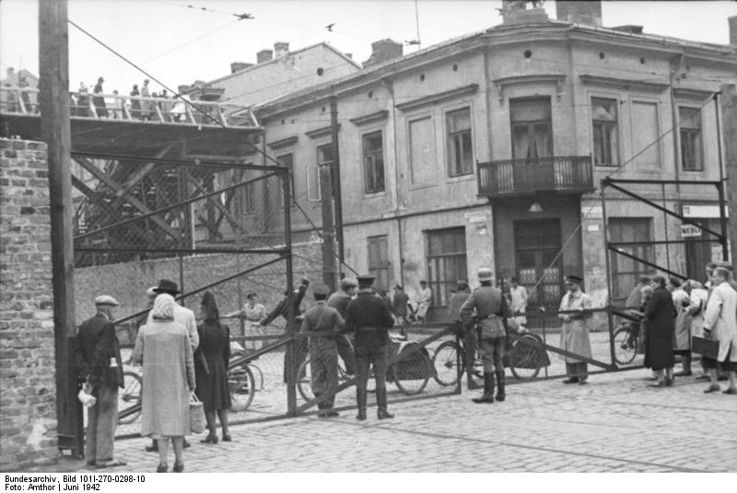

Slide 50
Irena Sendler was so appalled by the conditions that she joined Zegota, the Council for Aid to Jews, organized by the Polish underground resistance movement. Irena was one of its first recruits and directed the efforts to rescue Jewish children from the Warsaw Ghetto.

Slide 51
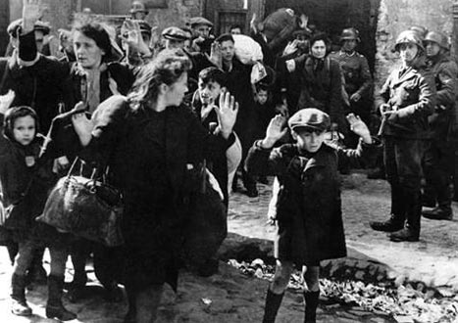

Slide 52
To enter the Ghetto legally, Irena managed to be issued a pass from Warsaw's Epidemic Control Department. She dressed as a nurse and visited the Ghetto daily, and brought food, medicines and clothing. She decided to smuggle out the Jewish children before they were sent to the death Treblinka camp.

Slide 53
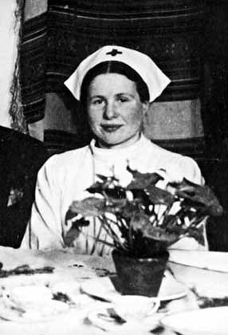

Slide 54
Irena was sent into the ghetto with food, clothes and medicine, including a vaccine against typhoid. The ultimate destination of many of the Jews, including the children, was the Treblinka death camp, Irena decided to try to save as many children as possible.

Slide 55
Using the codename “Jolanta”, and wearing a Star of David armband to identify herself with the Jewish population, Irena Sendler became part of this escape network.

Slide 56
Some children were taken out in gunnysacks or body bags. Some were buried inside loads of goods. A mechanic took a baby out in his toolbox. Some kids were carried out in potato sacks, others were placed in coffins carrying the dead.

Slide 57
The children who were taken by Irena Sendler were given new identities and placed with sympathetic families, orphanages and hospitals. Those who were old enough to talk were taught Christian prayers and how to make the sign of the Cross, so that their Jewish heritage would not be suspected.

Slide 58
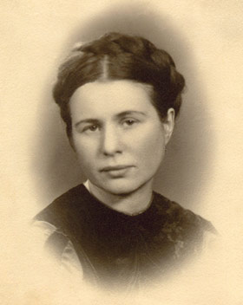

Slide 59
She recruited helpers from the Social Welfare Department was able to issue hundreds of false documents with forged signatures for the children. Irena Sendler successfully smuggled almost 2,500 Jewish children to safety and gave them temporary new identities. "Can you guarantee they will live?“ the distraught parents pleaded! “No,” Irena stated, “I can only guarantee they will die if they stay.”

Slide 60
The children were given false identities and placed in homes, orphanages and convents.
Irena Sendler kept a list of the names of all the children she saved, in the hope that she could one day reunite them with their families.

Slide 62
On the night of October 20 1943 Irena Sendler’s house was raided by the Gestapo, and her immediate thought was to get rid of the list: “I wanted to throw it out of the window but couldn’t, the whole house was surrounded by Germans. So I threw it to my colleague and went to open the door.

Slide 63
The Nazis took Irena Sendler to the Pawiak prison, where she was tortured; although her legs and feet were broken, and her body left permanently scarred, she refused to betray her network of helpers or the children whom she had saved. Finally, she was sentenced to death. She escaped thanks to Zegota, one of whose members bribed a guard to set her free.

Slide 64
Despite her torture, Irena would not divulge the location of her secret list containing all the children’s names she had rescued, where she had taken them, and who their parents were. The list was hidden in a jar buried next to an apple tree across from Nazi headquarters.

Slide 65
The Nazi guard took Irena to a forest where she was to be executed, but instead the guard left her on the forest floor where she was later rescued by members of Zegota.

Slide 66
After the war she attempted to keep her promise to reunite the children with their families. Most of the parents, however, had been gassed at Treblinka.

Slide 67
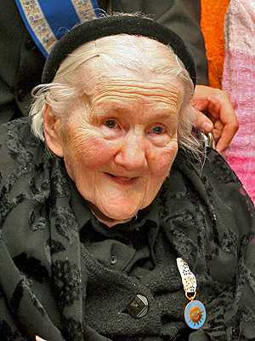

Slide 68
Irena Sendler was awarded Poland's highest distinction, the Order of White Eagle in Warsaw on Monday Nov. 10, 2003.
In 2008 she was nominated for the Nobel Peace Prize, eventually won by Al Gore.

Slide 69
Irena died on May 11, 2008
She was 98 Years Old

Slide 70
I learned that courage was not the absence of fear, but the triumph over it. The brave man is not he who does not feel afraid, but he who conquers that fear. Nelson Mandela

Slide 71
I have learned over the years that when one's mind is made up, this diminishes fear; knowing what must be done does away with fear. Rosa Parks

Slide 72
The Archbishop of El Salvador Oscar Romero

Slide 73
In October, 1979, military officers and civilian leaders ousted the right-wing government of El Salvador and formed a revolutionary junta.

Slide 75
By 1980, the resulting genocidal war in El Salvador was claiming the lives of 3000 men, women, and children per month.
Government death squads raided peasant villages killing at will. Dead bodies clogged the streams, and tortured bodies were thrown in garbage dumps and into the open streets of the capitol as a warning to others.

Slide 76
With one exception, all the Salvadoran bishops, out of fear, sided with the junta government and turned their backs on Romero.

Slide 77
Arch Bishop Oscar Romero, alone, was now the only voice fighting for the rights of the poor.

Slide 78
Romero, broadcasting from his own radio station said, “You people who make your living off the poor, who earn your money by torturing and exploiting the destitute, you now have only me to contend with.”
But if you kill me too, as you are trying to do, I will come back in the hearts of my people. There will then be thousands of me fighting for the poor.

Slide 79
On March 24, 1980, while giving mass in a small chapel located in a cancer hospital for the poor, Oscar Romero was shot and killed as he was praying for the death squad soldiers who were torturing and killing thousands of peasants.

Slide 81
On March 30, 1980, Archbishop Oscar Romero’s funeral was attended by more than 250,000 people in public protest of his murder. Some believing this to be the largest protest in the history of Latin America. He has risen in the hearts of his people.

Slide 82
The greatest glory in living lies not in never falling, but in rising every time we fall.
Nelson Mandela

Slide 83
A strong nation, like a strong person, can afford to be gentle, firm, thoughtful, and restrained… It's a weak nation, like a weak person, that must behave with bluster and boasting and rashness and other signs of insecurity. Jimmy Carter

Slide 84
One man cannot hold another man down in the ditch without remaining down in the ditch with him. Booker T. Washington

Slide 85
Meet Laura Germino

Slide 86
Meet Laura Germino
Co-founder of the Collation of Immokalee Workers
Laura Germino is a co-founder of the Coalition of Immokalee Workers (CIW) and subsequently co-founded the National Freedom Network USA and the Freedom Network Training Institute, which trains law enforcement and nongovernmental organization personnel in identifying and assisting victims of trafficking.

Slide 87
A leader in the fight From the Naples Daily News January 31, 2006
"Laura Germino, right, coordinator of the anti-slavery campaign for the Coalition of Immokalee Workers, talks to Coalition members, students, and religious allies during a training meeting at the Coalition offices in Immokalee. During the meeting, the group talked about developing a code of conduct for the agricultural industry aimed at creating zero tolerance for slavery in the field. The Coalition of Immokalee Workers has been a leader in the movement to end modern-day slavery in the United States." Photo by Tracy Buolian, Naples Daily News

Slide 88
In 2005, the coalition ended its boycott of Taco Bell after its parent company, Yum! Brands, agreed to require its suppliers to pay tomato pickers a penny more a pound. As part of the settlement, Yum! Brands has pledged to work toward improving worker conditions.
A leader in the fight From the Naples Daily News January 31, 2006

Slide 89
"The slavery operations that we have assisted in bringing to justice, mostly in agriculture, are multistate and can involve hundreds of workers being held against their will through the use of armed guards, informants with cell phones and coercion," Germino said. A leader in the fight From the Naples Daily News January 31, 2006

Slide 90
As a result of the coalition's continuing boycott, Taco Bell has rewritten its code of conduct to say the company won't tolerate the use of forced labor or physical intimidation of farm workers. "Taco Bell, as a result of the campaign, has now formally established a 'zero tolerance' policy against slavery," Germino said. A leader in the fight From the Naples Daily News January 31, 2006
http://www.youtube.com/watch?v=VURs-rsi_KQ

Slide 91
The Trader Joe's CA Truth Tour ended with a bang this weekend with powerful protests in two of the Bay Area's most storied communities!
Tour wraps up with powerful Bay Area finale! Days Six and Seven of the Trader Joe's CA Truth Tour July 16-17, 2011
…the CIW tour crew and farm worker allies old and new made their presence felt in the heart of Berkeley, while on Sunday, a finale march, pictured above, made its way (quite literally!) through the streets of San Francisco's historic Mission District. Coalition of Immokalee Workers July 2011

Slide 92
…the CIW was informed by police that a delegation of farm workers and consumers would not be permitted to deliver a letter to the store's manager outlining the reasons for their protest. In fact, according to the police, Trader Joe's had requested that anyone who stepped onto their property be immediately arrested.
Coalition of Immokalee Workers July 2011
http://www.youtube.com/watch?v=0B3WEYi_TNg&feature=relmfu

Slide 93
“It’s an incredible honor,” said Germino, co-founder of the Coalition of Immokalee Workers (CIW), a community-based group composed primarily of immigrants who organized in 1993 to bring fair wages and labor practices to the agricultural fields of Florida. Posted: 07.01.2010 BY LAURA DODSON

Slide 94
As most visitors to this site know, the CIW's own Laura Germino was honored last week -- along with eight other international anti-slavery activists -- by Secretary of State Hillary Clinton for her exemplary efforts in the fight against modern-day slavery in the United States.

Slide 95
Silence in the face of injustice is complicity with the oppressor. Ginetta Sagan

Slide 96
A person is a person because he recognizes others as persons.
Bishop Desmond Tutu

