Slide 1
Search and Seizure Police and Border Patrol Authorities Ohio and Federal Laws by Roger F. Cram Hiram College

Slide 2
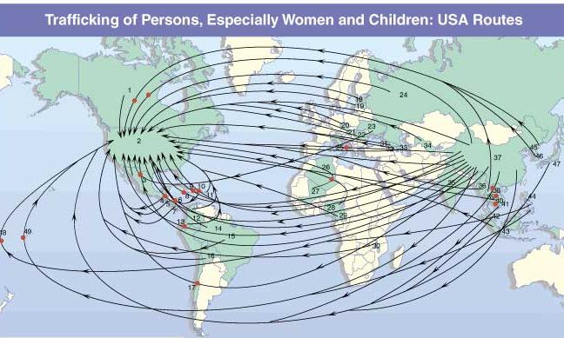
Victims can be trafficked into the U.S. from anywhere. Victims have come from, among other places,
Africa, Asia, India, Latin America, Eastern Europe, Russia and Canada.
Source: John Hopkins University, the Protection Project
Notes:
Human trafficking is an horrific international problem, with nearly a million victims trafficked across international borders annually
However, this is not just an international problem. Trafficking also takes place here in the United States. The U.S. State Department estimates that between 18,000 and 20,000 victims are trafficked into this country each year.
More than half of those trafficked into the United States are children, although many women and men are victims as well.
The majority of trafficking victims come to the United States from Asia, Central and South America, Russia, Eastern Europe and Canada (but also Africa and India).

Slide 3
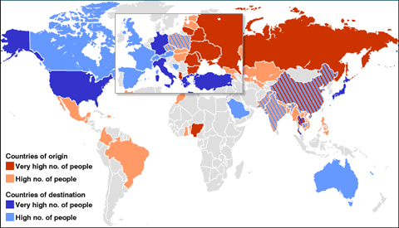

Slide 4
How Do Undocumented People Get into the United States?
Illegal immigrants come from Mexico, El Salvador, Honduras, Nicaragua, Guatemala, etc.
Smugglers
Coyotes
Wetbacks – they swim the rivers
Hidden in cars, trucks, busses, packages
Women, men, and children imported to the United States with work visas having been
promised jobs. They end up in debt bondage.

Slide 5
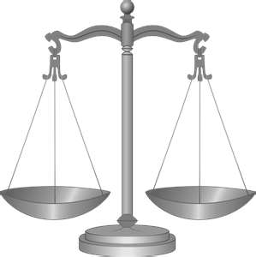
Search and Seizure
Laws of the Land

Slide 6
The Fourth Amendment to the U.S. Constitution:
“The right of the people to be secure in their persons, houses, papers, and effects, against unreasonable searches and seizures, shall not be violated, and no Warrants shall issue, but upon probable cause, supported by Oath or affirmation, and particularly describing the place to be searched, and the persons or things to be seized.

Slide 7
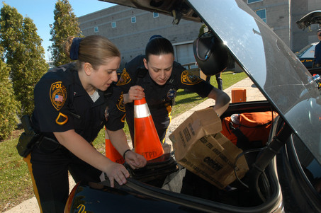
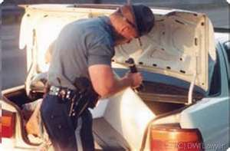
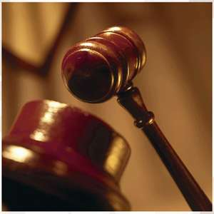
Search and Seizure

Slide 8
Police May Search
Probable Cause
Consent to search
In Plain View
Incidental to An Arrest
Exigent Circumstances
Stop and Frisk
Curtilage
Open fields
Motor Vehicles
Border Search

Slide 9
Probable Cause
Probable cause is an officer's reasonable belief of a certain fact. The law only requires the officer's belief to be reasonable, based on everything within the officer's knowledge. Probable cause is an objective standard based on the facts known and observed by the officer.

Slide 10
Search
An officer has probable cause to search if the facts and circumstances known to the searching officer justify the officer's reasonable belief that the area to be searched contains evidence or instruments of a crime.

Slide 11
Mapp v. Ohio, 367 U.S. 643 (1961), was a landmark case in criminal procedure, in which the United States Supreme Court decided that evidence obtained in violation of the Fourth Amendment, which protects against "unreasonable searches and seizures," may not be used in criminal prosecutions in state courts, as well as federal courts.

Slide 12
Consent
Main article: Consent search
If a party gives consent to a search, a warrant is not required, even if the party is unaware of their right to refuse to cooperate. There are exceptions and complications to the rule, and whether an individual has the right to consent to a search of another's property.

Slide 13
Plain view
Main article: Plain view doctrine
If an officer is lawfully present, he may seize objects that are in "plain view". However, the officer must have probable cause to believe that the objects are contraband. Gun under car seat, Alasko fan & Brown radio.

Slide 14
Searches incident to arrest – search of a person Permitting searches incident to an arrest without warrant—has been applied in American law. The justification for such a search is to prevent the arrested individual from destroying evidence or using a weapon against the arresting officer. The decision suggested that any area within the "immediate control" of the arrestee could be searched.

Slide 15
Exigent circumstance – requiring immediate action or aid; urgent
Exigent circumstances arise when the law enforcement officers have reasonable grounds to believe that there is an immediate need to protect their lives, the lives of others, their property, or that of others, the search is not motivated by an intent to arrest and seize evidence, and there is some reasonable basis, to associate an emergency with the area or place to be searched.

Slide 16
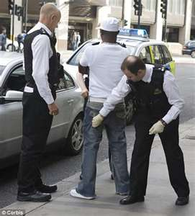
Stop and Frisk

Slide 17
Terry v. Ohio, Stop and Frisk: A police officer may stop and frisk a suspect without probable cause to arrest, if the police officer has a reasonable suspicion that the person has committed, is committing, or is about to commit a crime and has a reasonable belief that the person "may be armed and presently dangerous." For their protection, police may perform a surface search of a person’s outer clothing for weapons if they have reasonable suspicion the person stopped is armed.

Slide 18
Curtilage: search of house surrounding area
While open fields are not protected by the Fourth Amendment, the curtilage, or outdoor area immediately surrounding the home, is protected. Courts have treated this area as an extension of the house and as such subject to all the privacy protections afforded a person’s home (unlike a person's open fields) under the Fourth Amendment. However, courts have held aerial surveillance of curtilage not to be included in the protections from unwarranted search. Helicopters - Bolita slips at sewer connection - FLA

Slide 19
Open Fields

Slide 20
Open fields
Main article: Open fields doctrine
Similarly, "open fields" such as pastures, open water, and woods may be searched without a warrant, on the grounds that conduct occurring therein would have no reasonable expectation of privacy.

Slide 21
In Oliver v. United States, 466 U.S. 170 (1984), the police ignored a "no trespassing" sign and a fence, trespassed onto the suspect's land without a warrant, followed a path for hundreds of feet, and discovered a field of marijuana. The Supreme Court ruled that no search had taken place, because there was no privacy expectation regarding an open field.

Slide 22
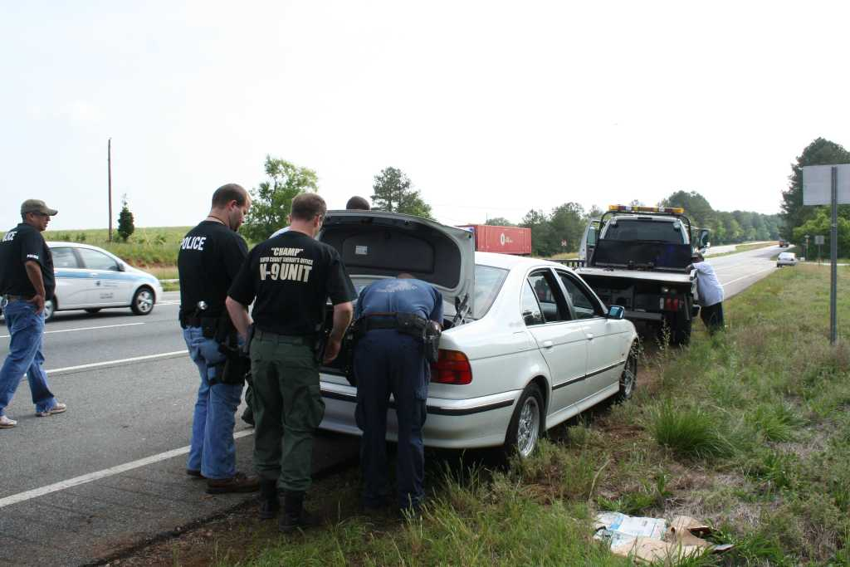

Slide 23
The motor vehicle exception allows an officer to search a vehicle without a warrant as long as he or she has probable cause to believe that evidence or contraband is located in the vehicle. Plain View inside car - flashlight

Slide 24
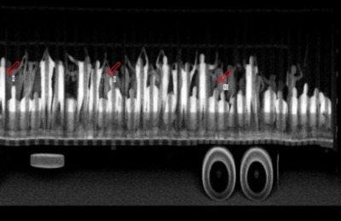
513 illegal migrant workers found as authorities x-rayed semi truck.

Slide 25
The x-ray photo says it all: more than 500 migrants packed into trucks like sardines, as many as 4 people per 1 square meter, some crouching, others standing and holding onto ropes from the truck's rooftop. The reality of human smuggling brutally exposed in the migrant's subhuman travelling conditions.
The 513 migrants, many suffering from dehydration from the perilous journey from Guatemala, were intercepted in two trailer trucks at a checkpoint in Mexico's southern Chiapas state where the x-ray was taken.

Slide 26
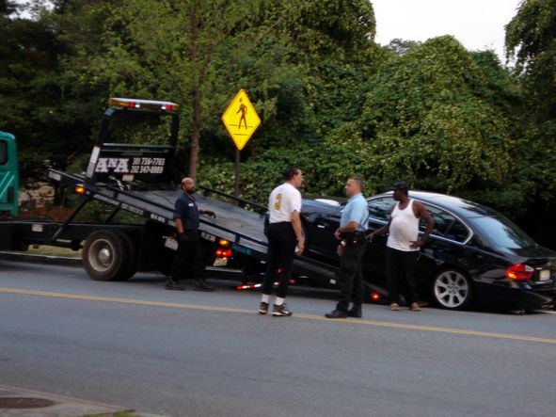

Slide 27
Inventory of towed car
Person arrested in car
Driving While Drunk
Active Warrant
Police officer inventories car to establish a
record of belongings in the car for the
protection of the suspect.
Belongings, wallet, money, jewelry, weapons, children in the trunk

Slide 28
You are a police officer. You pulled over a vehicle on suspicion because the driver was suspiciously cruising neighborhoods known for drugs and child sex trafficking. You are standing outside the car talking to the driver.
You cannot search the car other than “plain sight” by looking into the car.
You cannot search the trunk. You cannot take the car apart looking for drugs or trafficked children. You do not have probable cause to do so.

Slide 29
While talking to the driver, you hear a tapping sound. You ask the driver to shut off the car’s engine, turn off the stereo. You still hear a tapping sound. The driver acts nervous. You ask the driver if he hears the tapping sound. He says, “No.” You are not sure where the tapping sound is coming from. You do not have grounds for an arrest. You ask the driver to get out of the car and open the trunk. You now have reasonable grounds to do so. The trunk is empty.

Slide 30
The tapping sound gets louder. You now also hear a sound like muffled crying. Your reasonable suspicion, reasonable grounds to believe a crime has been committed, increases. Although these sounds can be produced by a kitten or cell phone left open.
In order to prevent your suspects escape, you call for more police officers to assist guarding the driver.

Slide 31
You sit in the suspects car. The tapping and muffled crying seems to be coming from inside the dashboard. The radio is off. The CD player and GPS are off.
You still do not have grounds for arrest, but you now have reasonable grounds to take the car apart, much more authority than looking into the trunk, and much, much more authority than the plain view sight search.

Slide 32
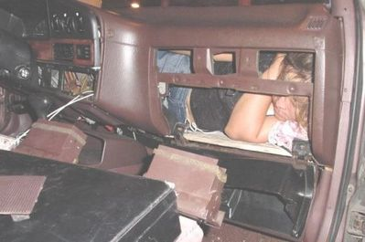
10News.com - San Diego News January 5, 2005
“A 10-year-old Mexican girl was found hidden inside a car's dashboard while it was undergoing an inspection Wednesday at the San Ysidro, California border crossing.”

Slide 33
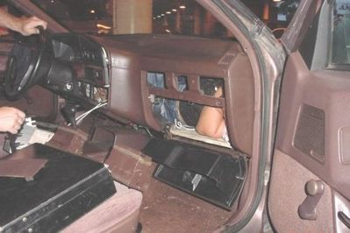
10News.com - San Diego News January 5, 2005
“…trapped under the dashboard and the front passenger seat of a 1988 white Toyota Camry. She was removed after officers worked for 30 minutes to partially remove the seat. She appeared to be in good condition.”

Slide 34
This was an actual case at the border crossing located at United States and San Ysidro, Mexico. Instead of hearing a tapping sound, the police officer actually noticed the girl’s foot hanging down under the dashboard. This is more than suspicion or probable cause to believe, but creates reasonable grounds not only to extend the search but cause an immediate arrest.

Slide 35
10News.com - San Diego News January 5, 2005

Slide 36
In a disturbing trend, the number of undocumented minors, including infants and youngsters, apprehended during fiscal year 2004 at ports of entry on the California/Mexico border climbed to 6,478, up almost 17 percent over the previous year.

Slide 37
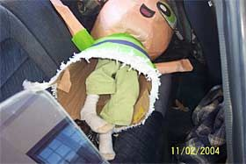
A 5-year-old girl found hidden inside a pinata in the back seat of a car being inspected at the San Ysidro border station in November drew widespread media interest to the issue.
By Leslie Berestein UNION-TRIBUNE STAFF WRITER November 12, 2004

Slide 38
“The girl's mother also was found, curled up inside the car's trunk, and the girl's brother, who is about 9 years old, was found underneath the collapsible back seat. "Officers began to take the piñatas out of the back seat, and one of the several piñatas in the car seemed to be much heavier than the others," said Vince Bond, a spokesman for U.S. Customs & Border Protection. "This one had a little girl of approximately 4 or 5 years of age inside it."
By Leslie Berestein UNION-TRIBUNE STAFF WRITER
November 12, 2004

Slide 39
The motor vehicle exception does not only apply to automobiles. The U.S. Supreme Court in California v. Carney found the motor vehicle exception to apply to a motor home. The court did however, make a distinction between readily mobile motor homes and parked mobile homes.

Slide 40
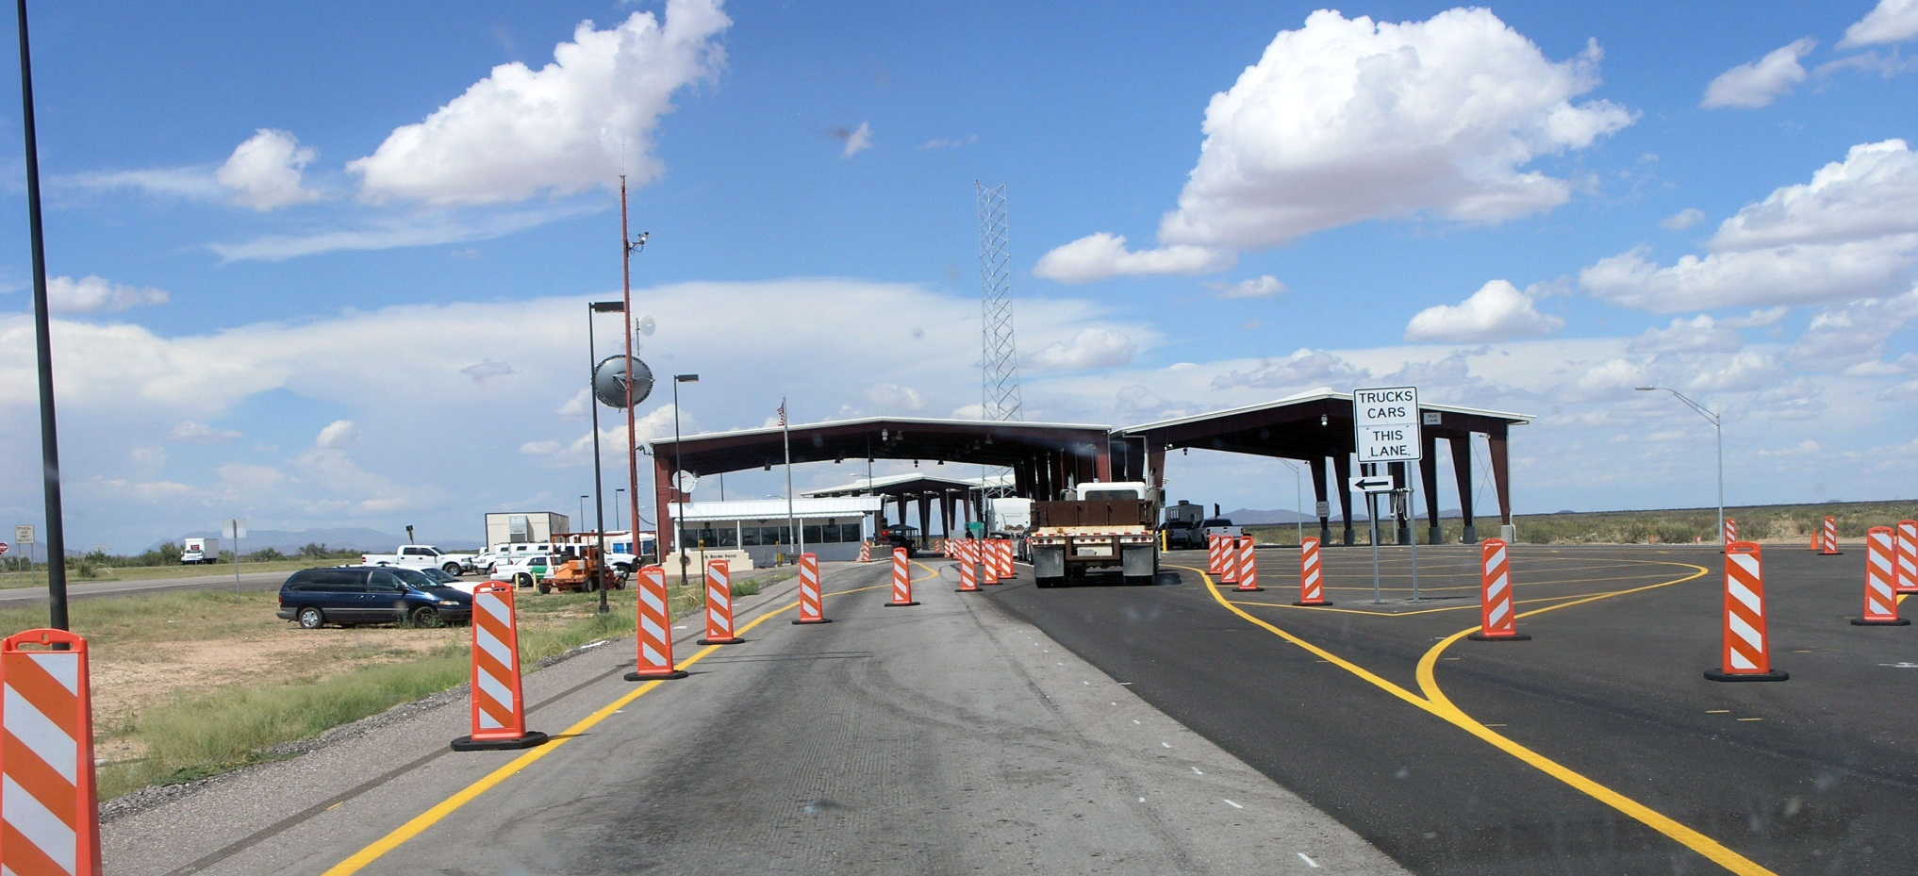
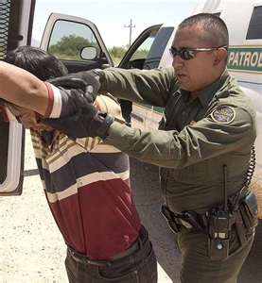
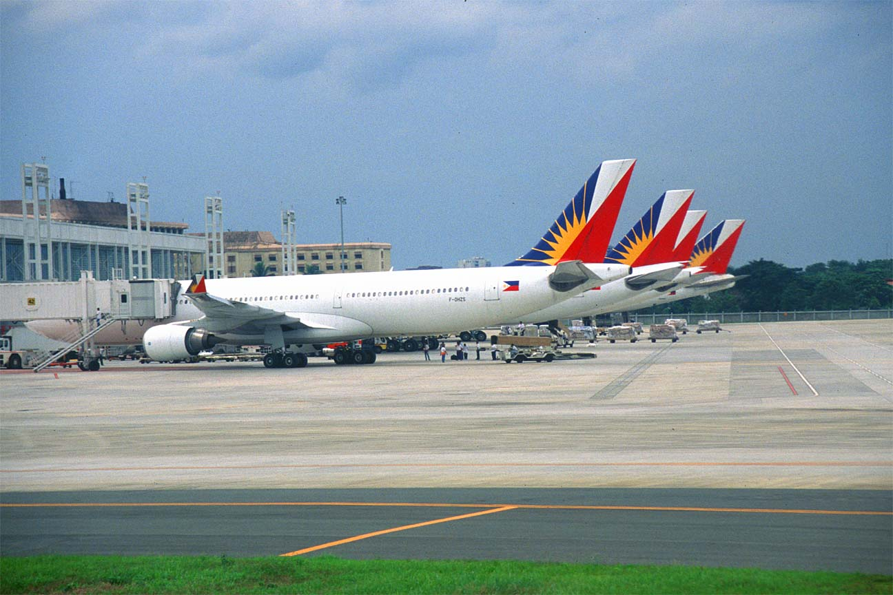

Slide 41
Border search exception
Main article: Border search exception
Searches conducted at the United States border or the equivalent of the border (such as an international airport) may be conducted without a warrant or probable cause subject to the "border-search" exception. Most border searches may be conducted entirely at random, without any level of suspicion, pursuant to U.S. Customs and Border Protection plenary search authority.

Slide 42
However, searches that intrude upon a traveler's personal dignity and privacy, such as strip and body cavity searches, must be supported by "reasonable suspicion."

Slide 43
The U.S. Courts of Appeals for the Fourth and Ninth circuits have ruled that information on a traveler's electronic materials, including personal files on a laptop computer, may be searched at random, without suspicion.

Slide 44
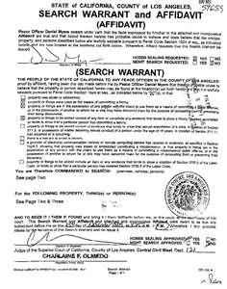

Slide 45
Standard for Warrants
A valid warrant serves the same function as probable cause, establishing a basis for a legal search or seizure. Issuance of a warrant requires that the officer present evidence of probable cause for the search or seizure before an impartial magistrate. The magistrate then determines whether the evidence suffices to meet the probable cause standard, and if it does, he issues the warrant.

Slide 46
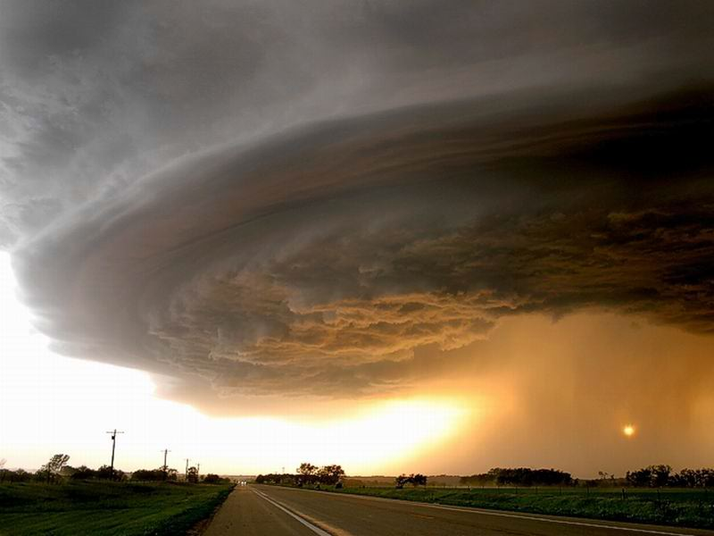
Hurricane Katrina

Slide 47
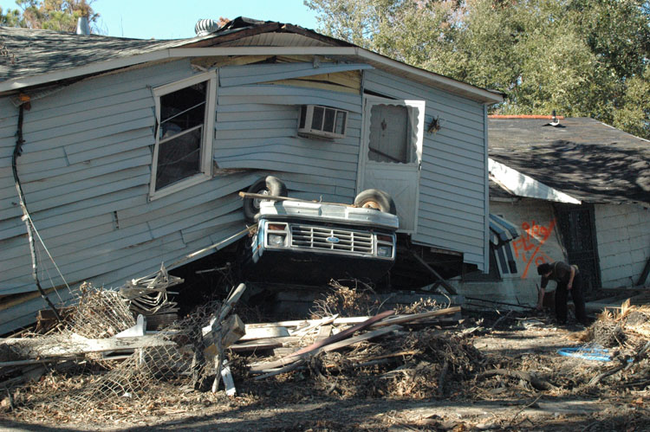

Slide 48
Thousands of laborers were needed to rebuild New Orleans and repair storm damage. Opportunists wasted no time bringing in undocumented “illegal” laborers.
President Bush inadvertently encouraged a breeding ground for labor violations by relaxing labor standards by suspension of the Davis-Bacon Act, something that requires contractors to pay prevailing wages on government contracts. The requirement that laborers had to fill out employment eligibility forms was also suspended allowing undocumented laborers to be hired and paid practically nothing.

Slide 49
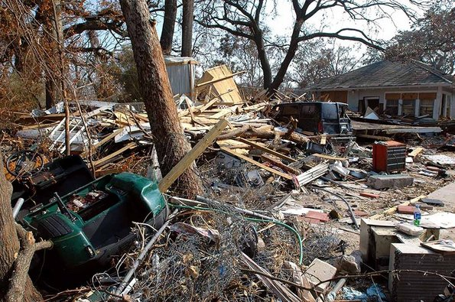

Slide 50
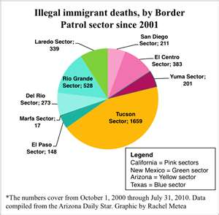
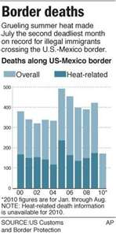

Slide 51
Thank you---

