Slide 1
Hiram College Border Crossings Drugs, Tunnels, and the Cartels

Slide 2
Cartel: an international syndicate formed to regulate prices
or output; a coalition of political or special-interest groups
having a common cause (drugs, crime, kidnapping, trafficking)
Synonyms: multinational, gang, monopoly
Coup d’ etat: a sudden and decisive action in politics especially
one resulting in a change of government illegally or by force
Synonyms: revolution, anarchy, insurgency, overthrow, mutiny,
insurrection
Junta: A small group ruling a country especially immediately after
a coup d’etat and before a legally constituted government has been
placed in power
Syndicate: a group combination or association of gangsters
controlling organized crime in one geographical region

Slide 3
Who are the Mexican Gangs?
What are the Cartels?
How do they smuggle drugs and people into the United States?
Who to they affect migrants
trying to enter the United States?
http://www.youtube.com/watch?v=q_EdihbSUeM

Slide 4
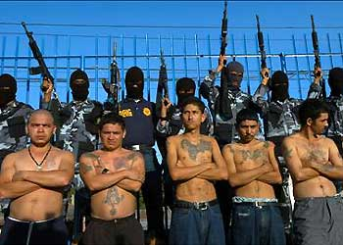
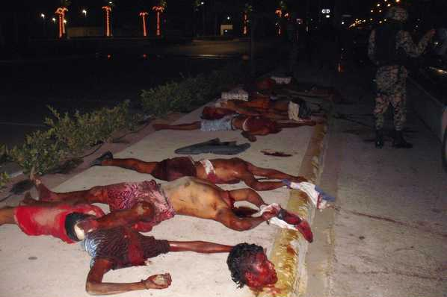
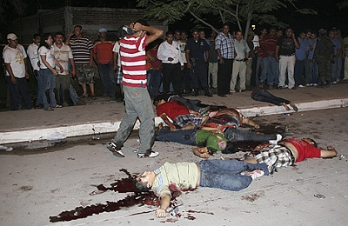
When the “beast” stops, the refugees riding the train are often raped, robbed, beaten, kidnapped,
and killed by local police and by thugs from the Zetas.
Who are the Zetas?

Slide 5
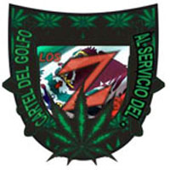
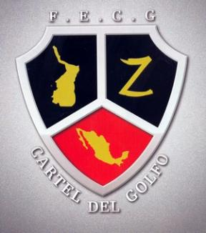
Areas of Operation:
Colombia, Guatemala, Italy, Mexico, U.S., and Venezuela.
Los Zetas were founded in 1998 by then leader of the Gulf Cartel, Osiel Cardenas Guillen, to be the enforcement specialists of the Gulf Cartel to control adversaries and maintain contested territories. The original members of the organization were former members of Grupo Aeromovil de Fuerzas Especiales (GAFES), the Mexican Special Forces equivalent… Los Zetas…began to contract out for other drug trafficking organizations in 2008 before gaining autonomy from the Gulf Cartel and other DTO's completely in 2009. Los Zetas are considered to be one of the seven Mexican Drug organizations that dominate the culture. (ISVG) Violent Extremism – a comprehensive resource on violent extremist organizations

Slide 6
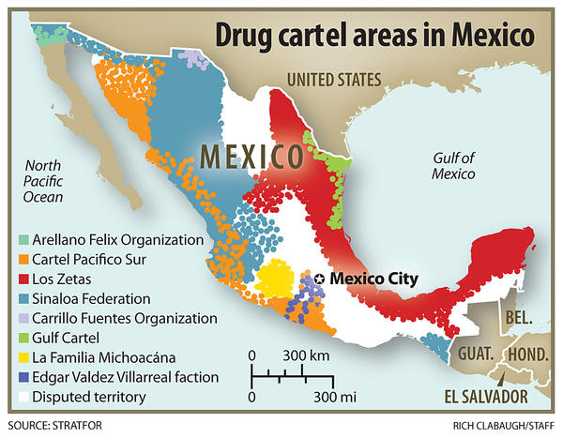

Slide 7
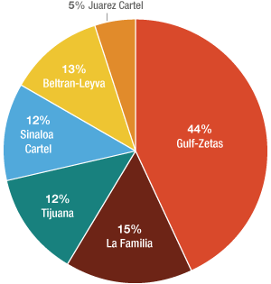

Slide 8
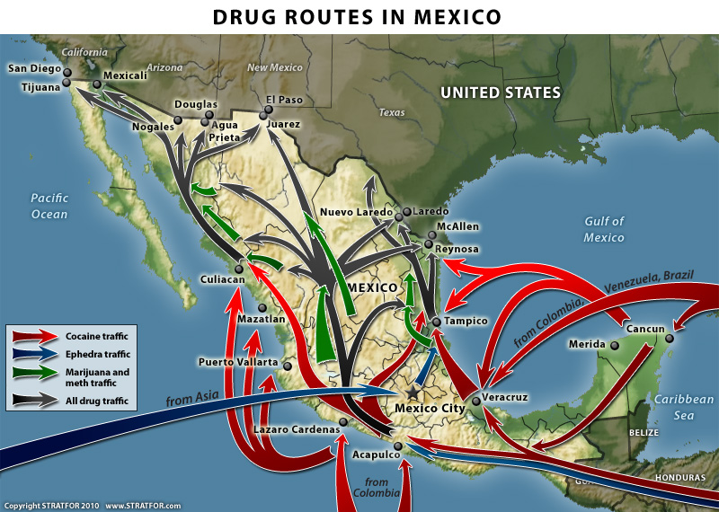

Slide 9
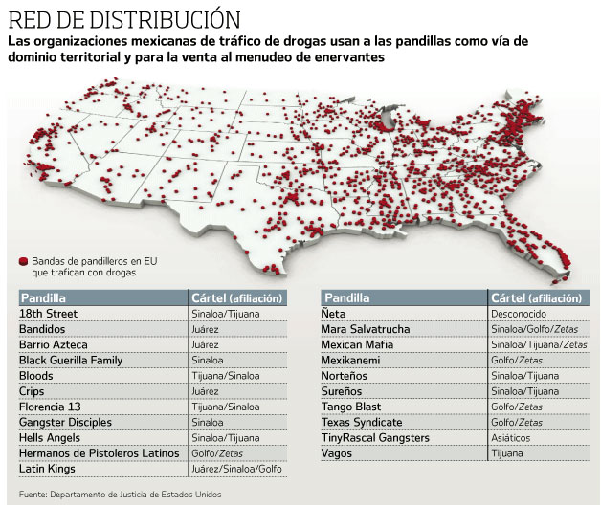

Slide 10
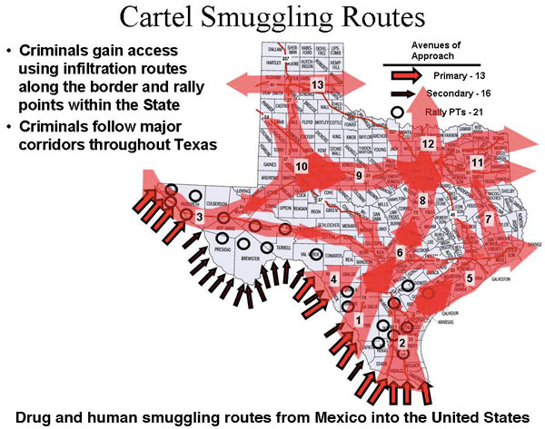

Slide 11
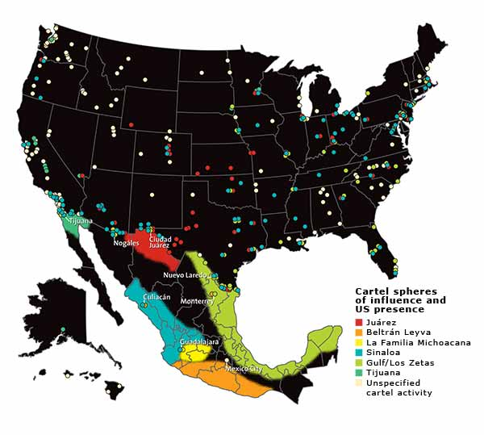

Slide 12
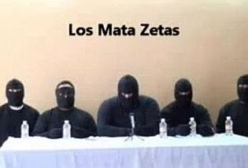
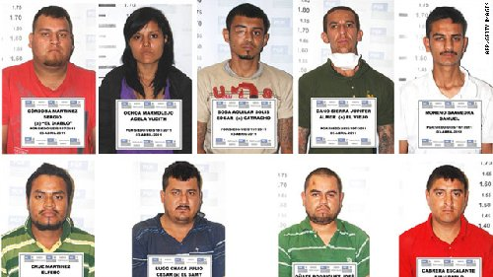
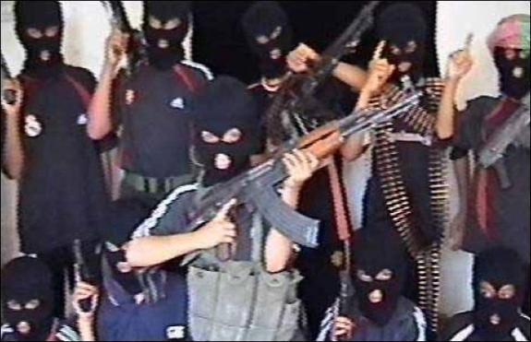
Mexican Drug Cartels Fight Each Other
http://www.youtube.com/watch?v=Vykq1fm8hmo

Slide 13
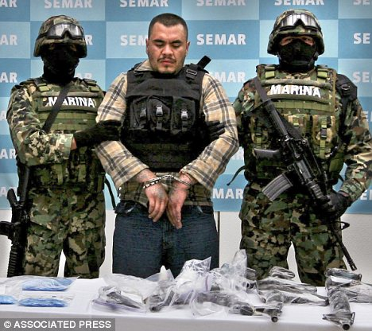

Slide 16
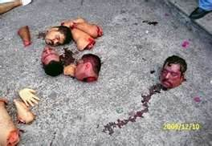
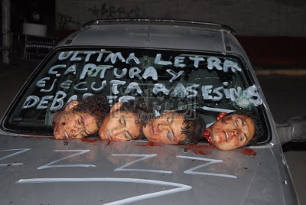

Slide 17
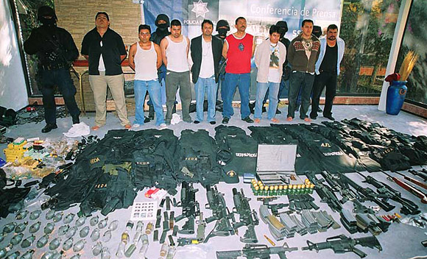

Slide 18
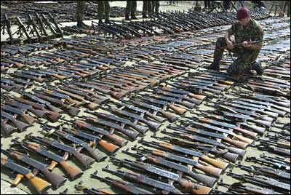

Slide 19
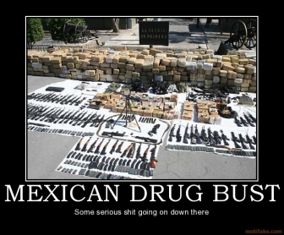

Slide 20
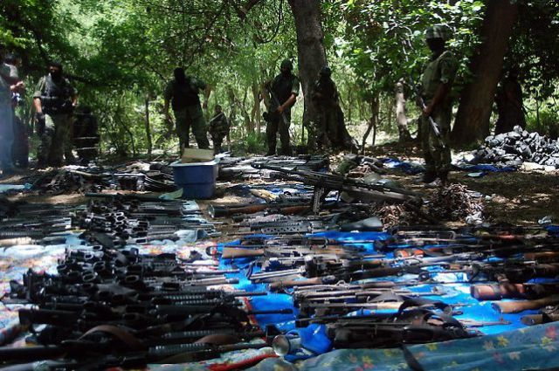

Slide 21
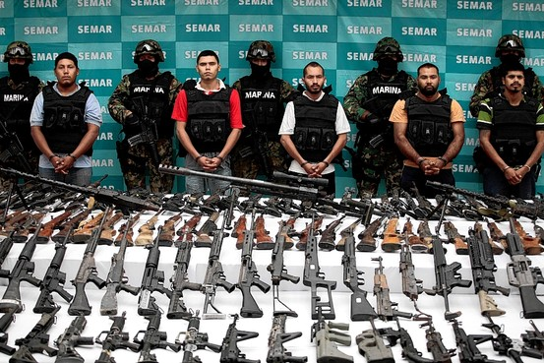

Slide 22
Tunnels for Drugs and Migrant Workers

Slide 23
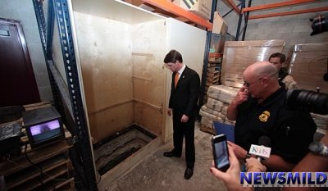

Slide 24
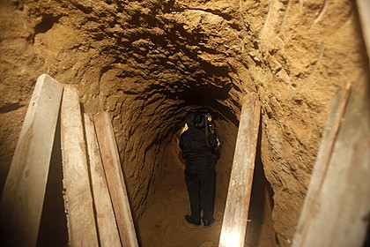
The secret tunnel discovered near the US-Mexico border in Tijuana, Mexico. Photo: AP October 29, 2009

Slide 25
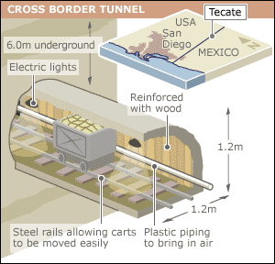
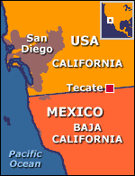
The US authorities have found a sophisticated drug smuggling tunnel approximately 1,000 feet (300 metres) long beneath the border with Mexico.
US officials said that although tunnels had been found between the two countries before, this one was unusually elaborate, equipped with rails, electric lighting, and a ventilation system. BBC News February 28, 2002

Slide 26
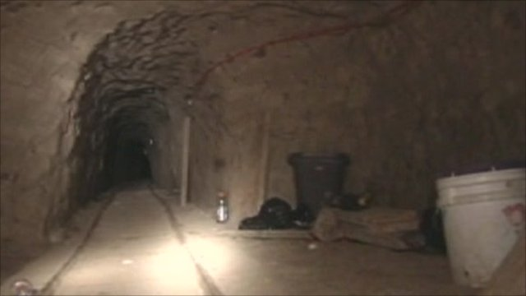
Inside a drug smuggling tunnel on the US-Mexico border – 3 minutes
BBC - 8 December 2010 Last updated at 13:38 ET
http://www.bbc.co.uk/news/world-latin-america-11952794

Slide 27
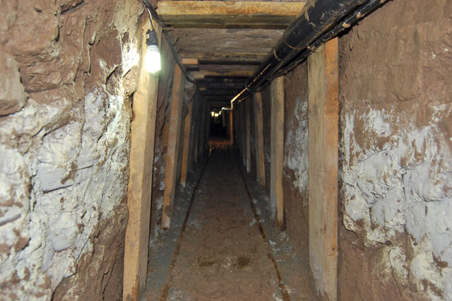
Cops Find Smuggling Tunnel Underneath U.S.-Mexico Border
Authorities in Arizona say they’ve found a 250-foot-long unfinished smuggling tunnel underneath the U.S.-Mexico border that has electricity, water pumps and ventilation.
Written by Associated Press on May 10, 2011 5:45 am

Slide 28
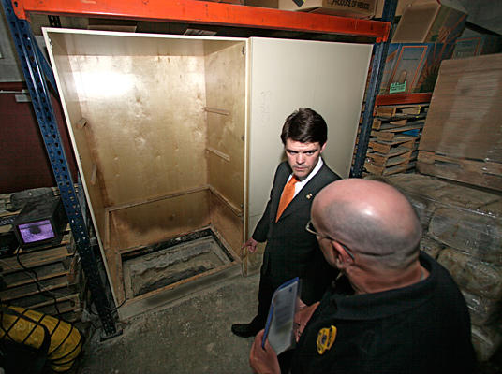
John Morton (l.), the director of Immigration and Customs Enforcement, points out the opening of a 600-yard tunnel to Joe Garcia, assistant agent in charge for Homeland Security Investigations, in a warehouse where 20 tons of marijuana were seized in Otay Mesa, Calif., on Nov. 3, 2011.

Slide 29
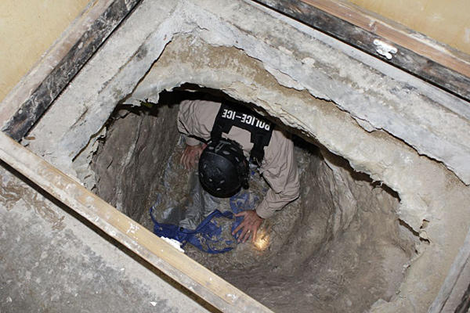
A federal agent crawls through a 600-yard tunnel discovered in a warehouse along the border between the United States and Mexico in Otay Mesa, a suburb of San Diego, Calif., on Nov. 3, 2011. Agents recovered more than 20 tons of marijuana during overnight searches of the tunnel, the border patrol said in a news release.

Slide 30
John Morton (l.), director of US Immigration and Customs Enforcement, looks at blocks of marijuana inside a warehouse near the Mexican border where a 600-yard tunnel between the US and Mexico was found, along with 20 tons of marijuana, in Otay Mesa, Calif., on Nov. 3, 2011.

Slide 31
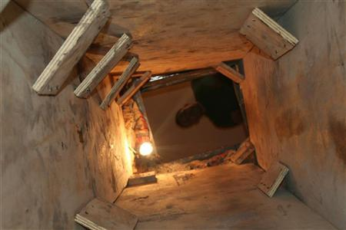
By Tim Gaynor TUCSON, Arizona | Tue Nov 22, 2011 7:25pm EST
The U.S. Border Patrol said the 319-foot long tunnel was discovered on Monday. It measured three feet wide by two feet tall, and ran for 100 feet into Mexico at a depth of about 20 feet.
It was chiseled through solid rock and was equipped with electricity, lighting, water pumps, and held up by support beams and plywood shoring, the Border Patrol's Tucson sector said in a news release.
The tunnel was the third discovered running under the porous U.S.-Mexico border in less than a week, and the 21st illicit passageway found beneath the streets of Nogales in the past two years.

Slide 32
Border Wars: City Under Siege : MON JAN 11 9P et/pt – 3 minutes :
http://www.youtube.com/watch?v=qmL2SQhEoUc

