Slide 1
Featuring 25 drawings in charcoal, conte crayons, and pastels, this handbook pairs portraits of people who live and work along the U.S.–Mexico border with bilingual poems that have been inspired by each of the drawings. A testimony to the people of the Rio Grande Valley, these drawings and poems capture their spirit, their quest for happiness, and their struggles to overcome economic hardship. This remarkable book highlights characters such as the "young street musician," the "six-year-old street vendor," and the "wise woman with rings." Compassionate and aesthetically compelling, this record raises awareness about social and cultural issues associated with border life, such as education, literacy, and poverty, and fosters cross-cultural understanding.
Featuring 25 drawings in charcoal, conte crayons, and pastels, this handbook pairs portraits of people who live and work along the U.S.–Mexico border with bilingual poems that have been inspired by each of the drawings. A testimony to the people of the Rio Grande Valley, these drawings and poems capture their spirit, their quest for happiness, and their struggles to overcome economic hardship. This remarkable book highlights characters such as the "young street musician," the "six-year-old street vendor," and the "wise woman with rings." Compassionate and aesthetically compelling, this record raises awareness about social and cultural issues associated with border life, such as education, literacy, and poverty, and fosters cross-cultural understanding.
http://www.youtube.com/watch?v=vhdFXRj6szE&hd=1

Slide 2
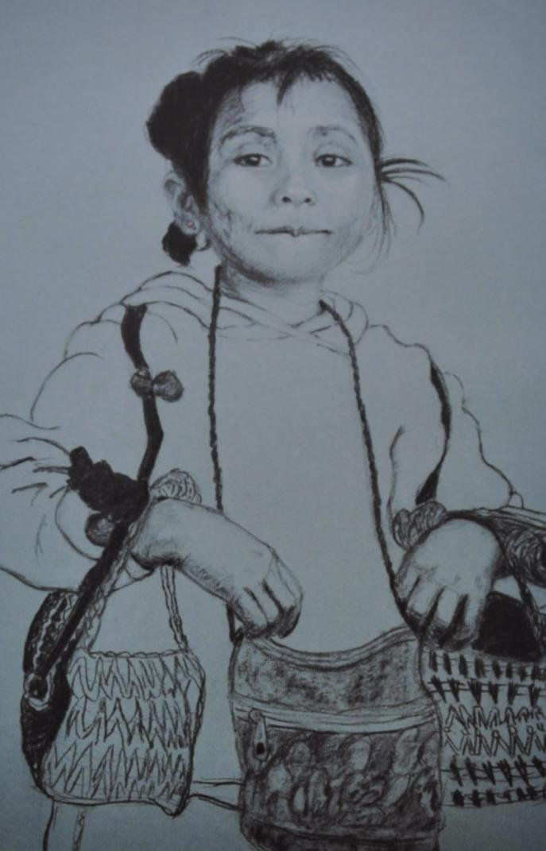
Borderlines: Drawing Border Lives Copyrighted © 2010 by Steven P Schneider and Reetka Schneider

Slide 3
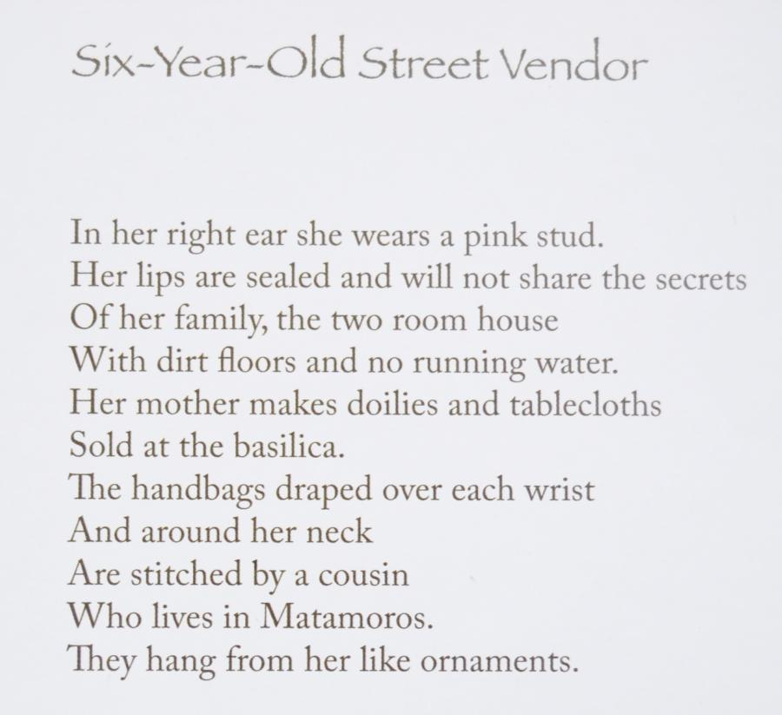

Slide 5
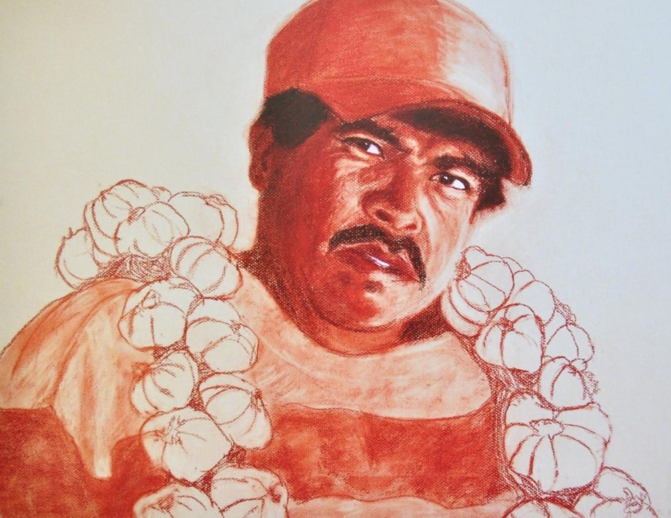
Borderlines: Drawing Border Lives Copyrighted © 2010 by Steven P Schneider and Reetka Schneider

Slide 6
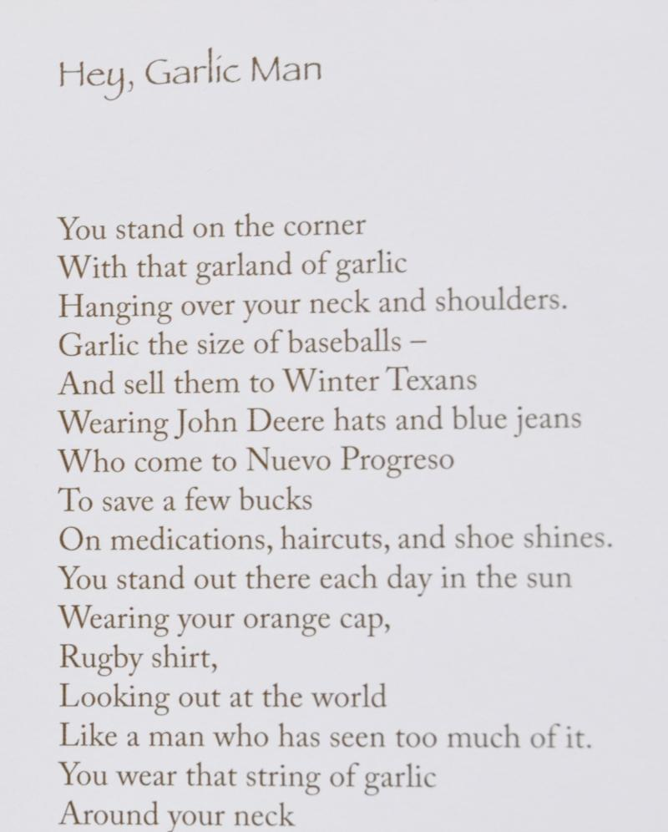

Slide 7
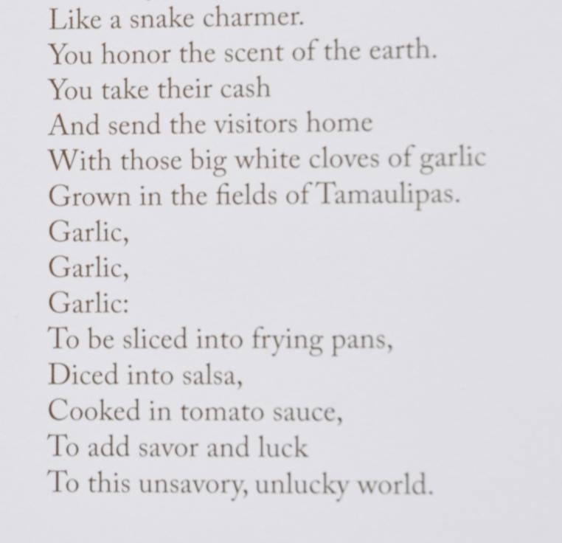

Slide 8
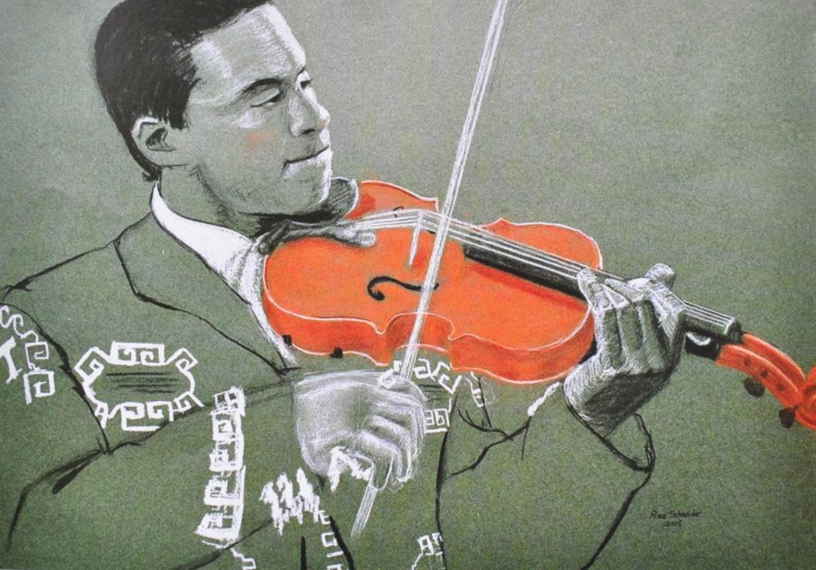
Borderlines: Drawing Border Lives Copyrighted © 2010 by Steven P Schneider and Reetka Schneider

Slide 9
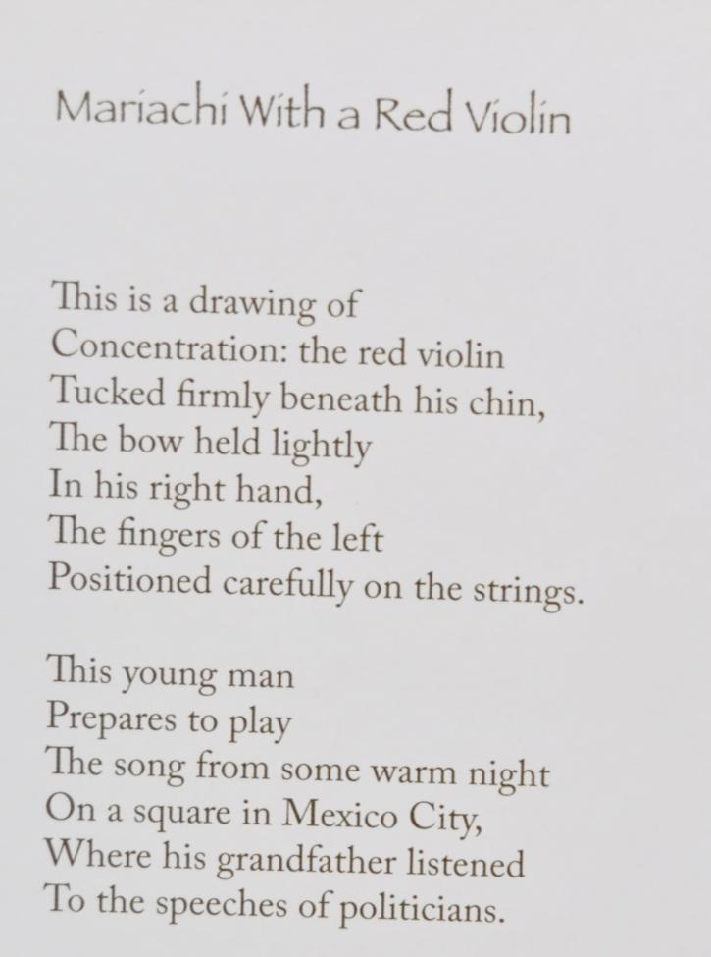

Slide 10
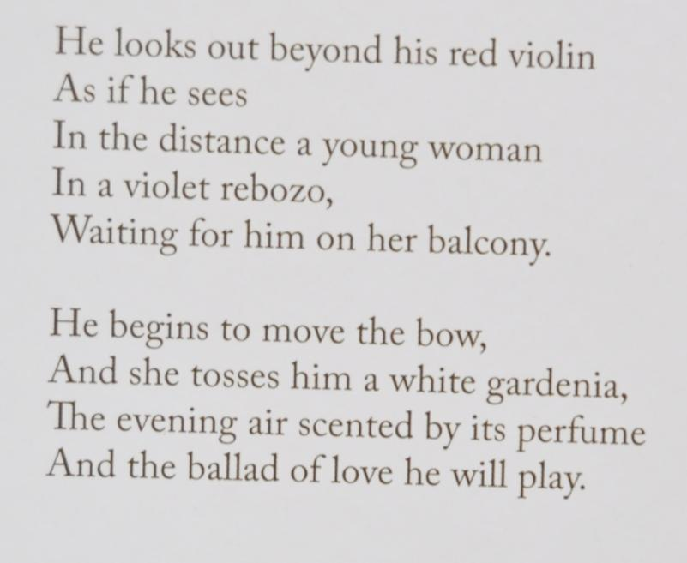

Slide 11
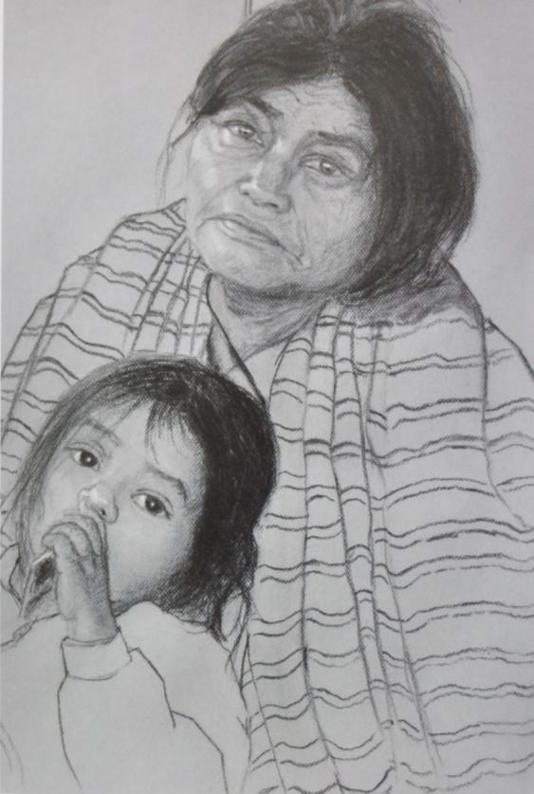
Borderlines: Drawing Border Lives Copyrighted © 2010 by Steven P Schneider and Reetka Schneider

Slide 12
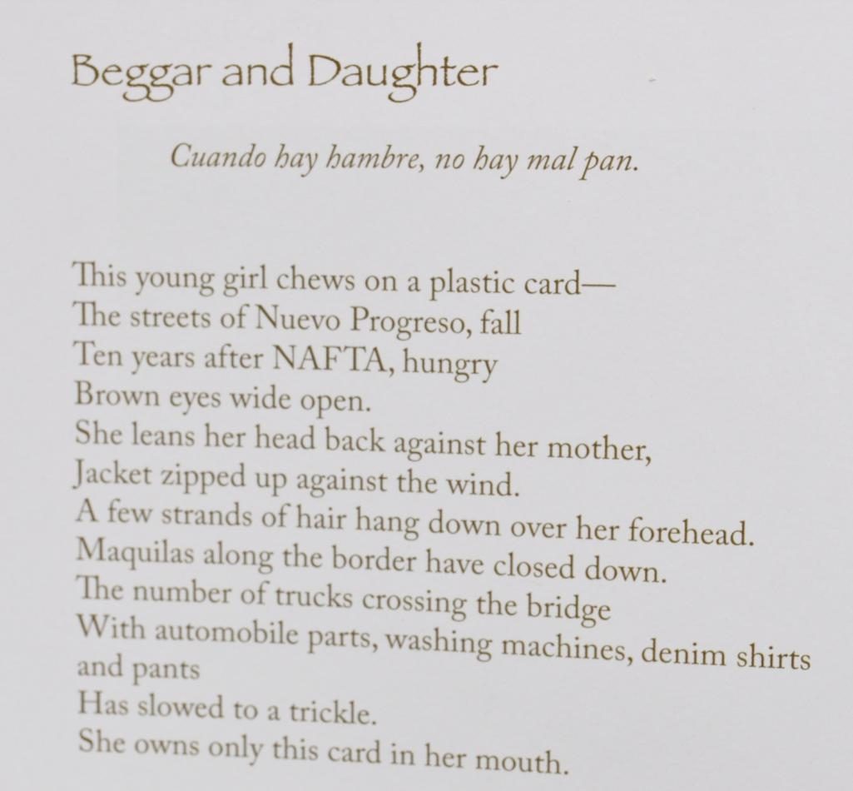

Slide 13
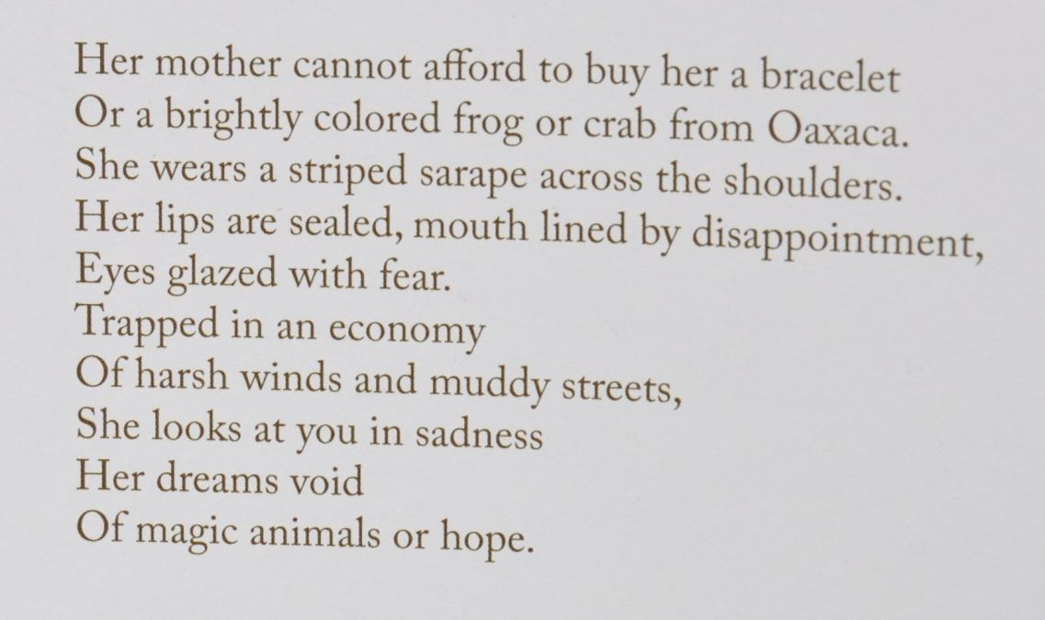

Slide 14
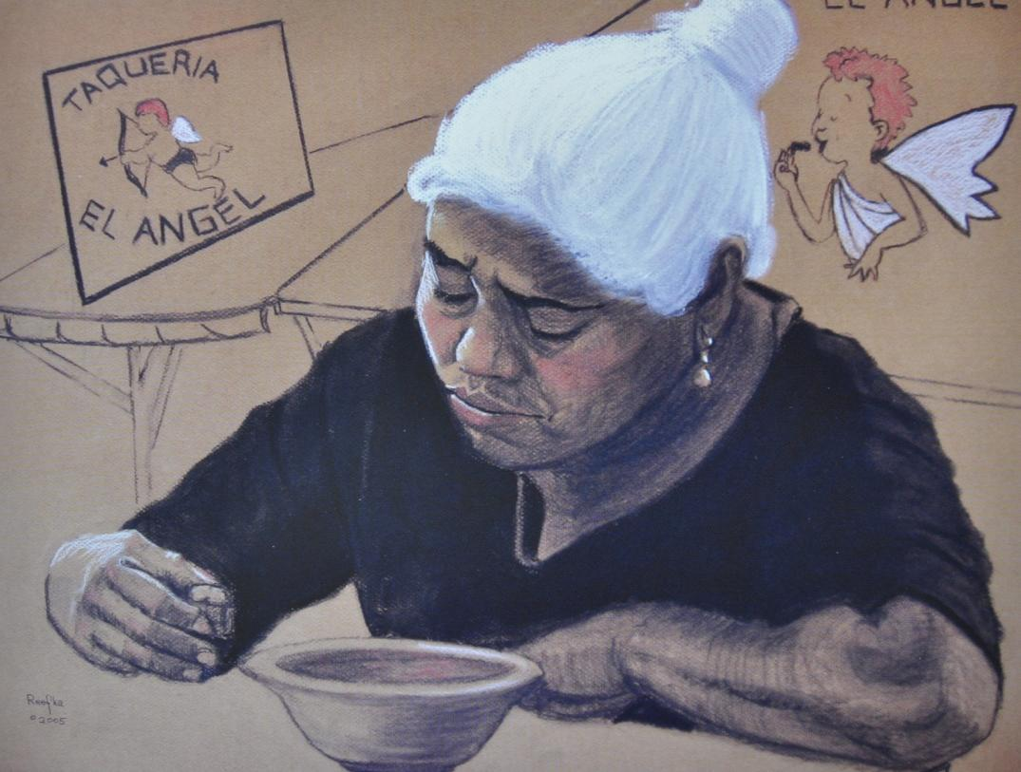
Borderlines: Drawing Border Lives Copyrighted © 2010 by Steven P Schneider and Reetka Schneider

Slide 15
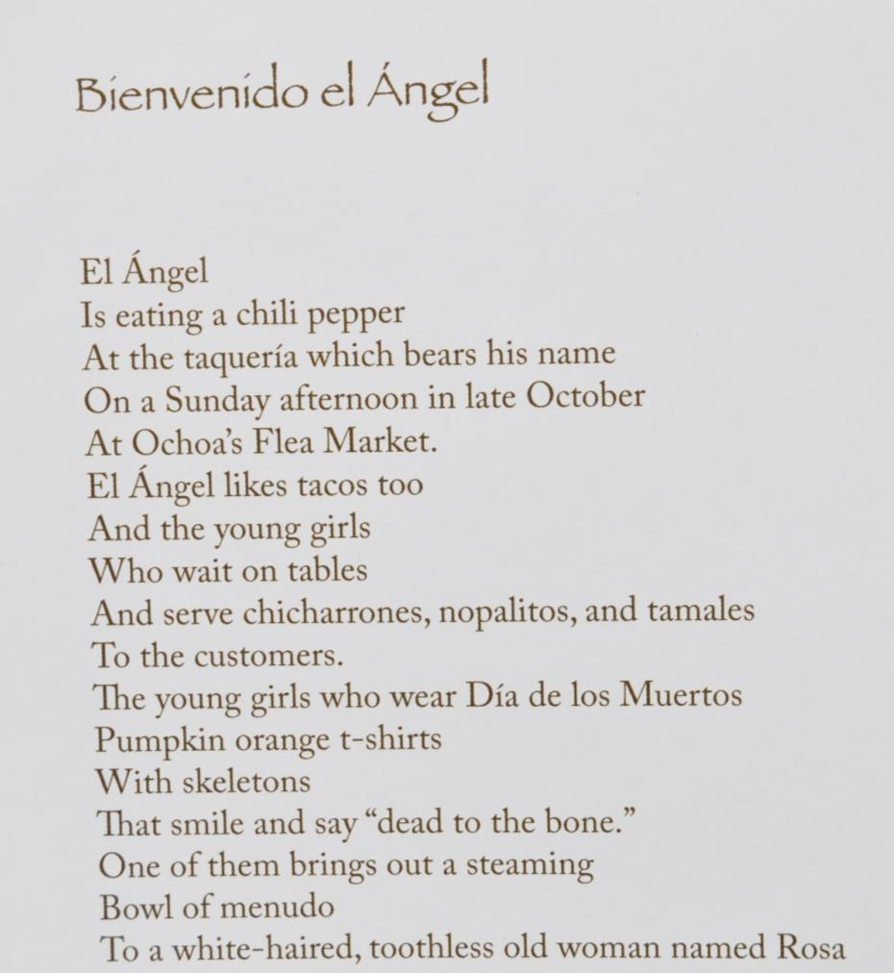

Slide 16
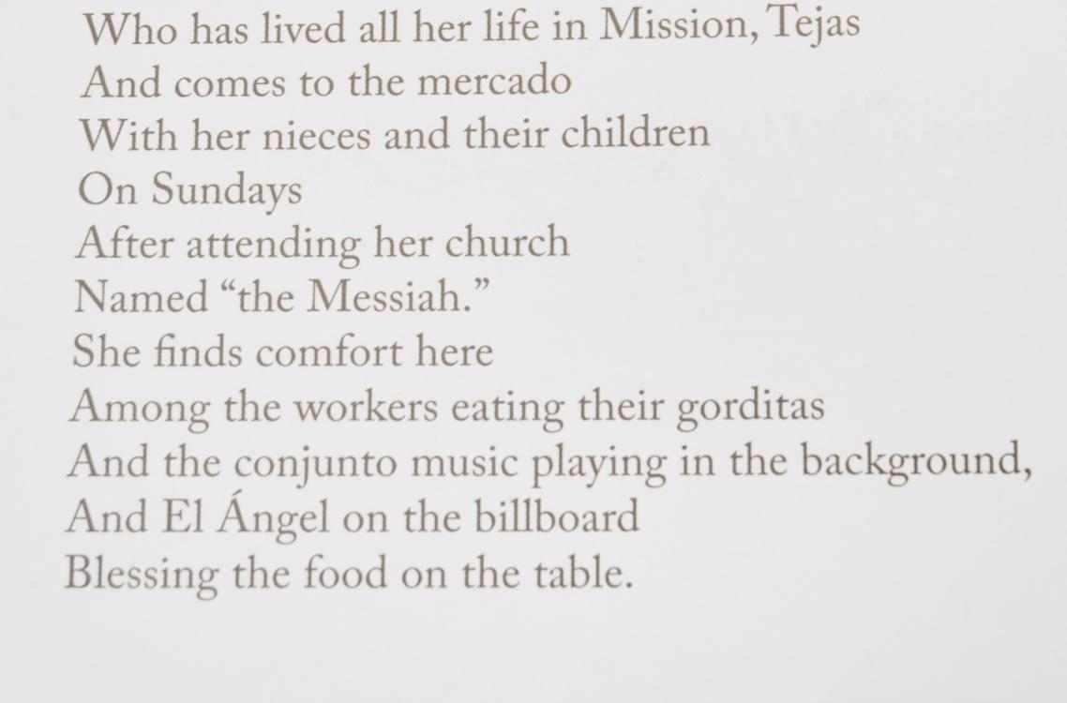

Slide 17
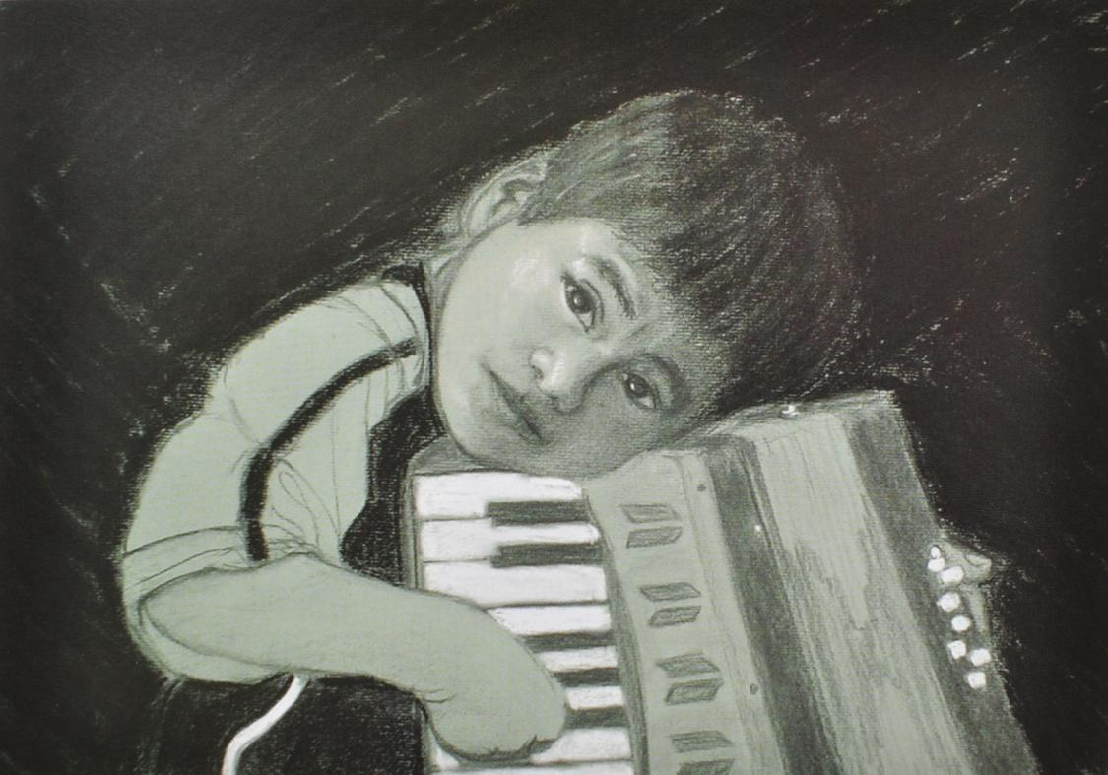
Borderlines: Drawing Border Lives Copyrighted © 2010 by Steven P Schneider and Reetka Schneider

Slide 18
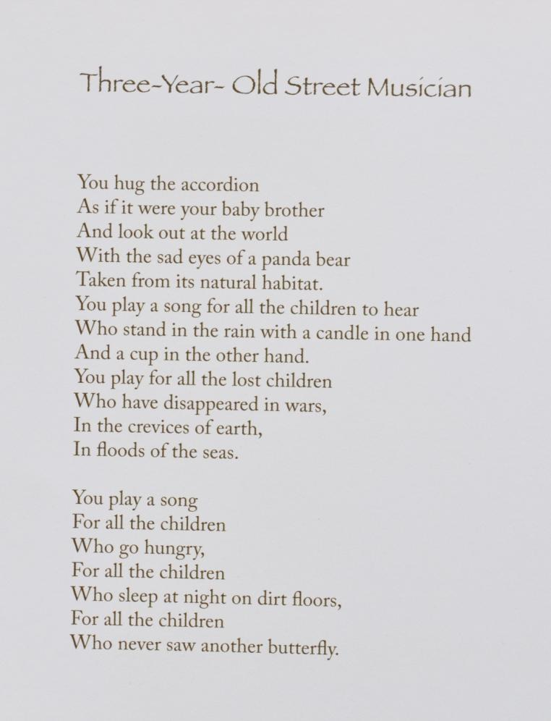

Slide 19
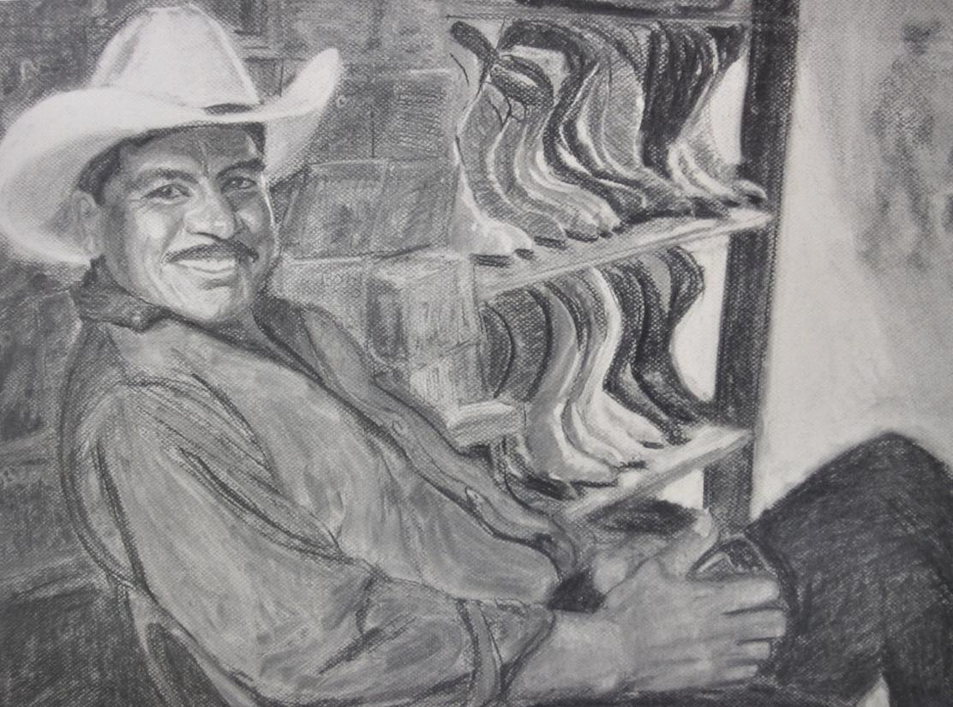
Borderlines: Drawing Border Lives Copyrighted © 2010 by Steven P Schneider and Reetka Schneider

Slide 20
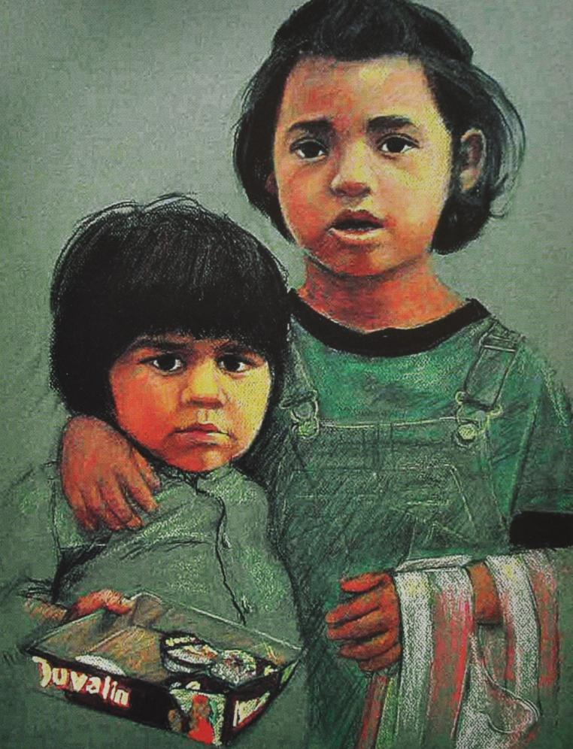
Borderlines: Drawing Border Lives Copyrighted © 2010 by Steven P Schneider and Reetka Schneider

Slide 21
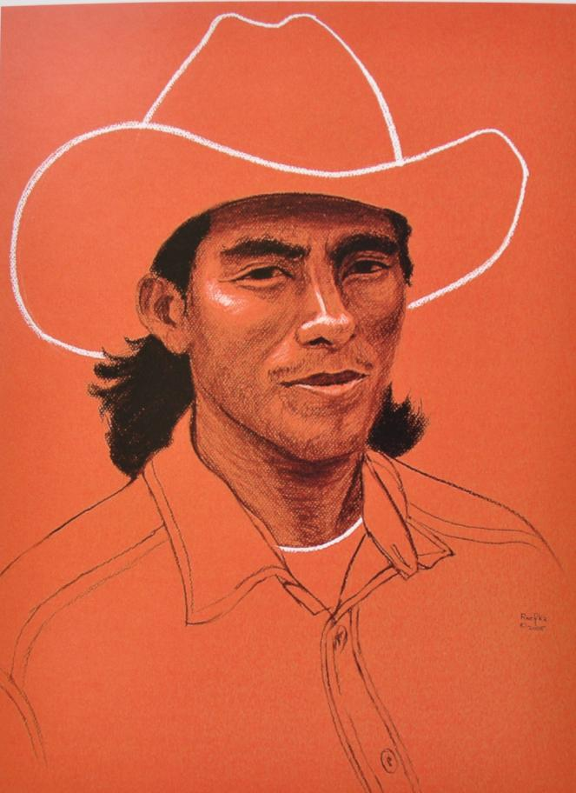
Borderlines: Drawing Border Lives Copyrighted © 2010 by Steven P Schneider and Reetka Schneider

Slide 22
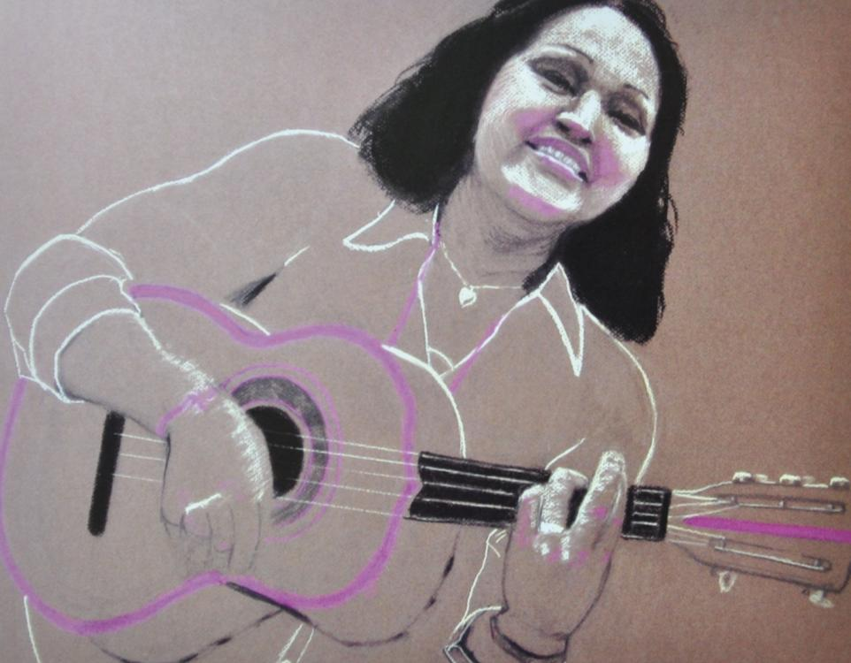
Borderlines: Drawing Border Lives Copyrighted © 2010 by Steven P Schneider and Reetka Schneider

Slide 23
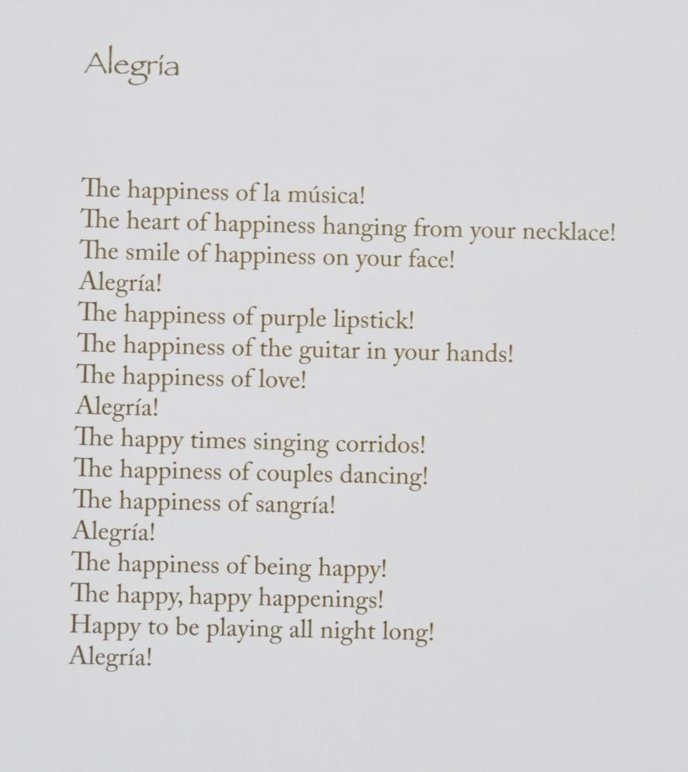

Slide 24
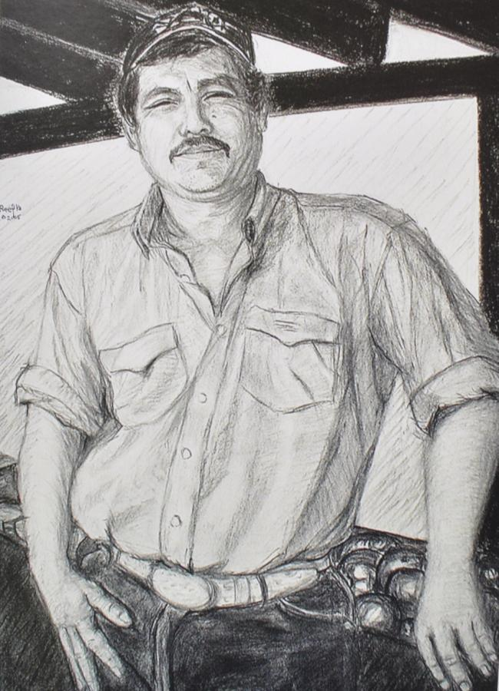
Borderlines: Drawing Border Lives Copyrighted © 2010 by Steven P Schneider and Reetka Schneider

Slide 25
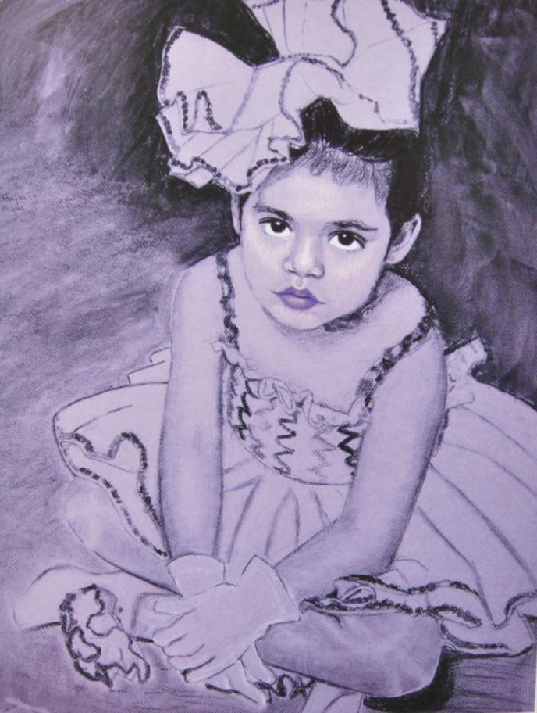
Borderlines: Drawing Border Lives Copyrighted © 2010 by Steven P Schneider and Reetka Schneider

Slide 26
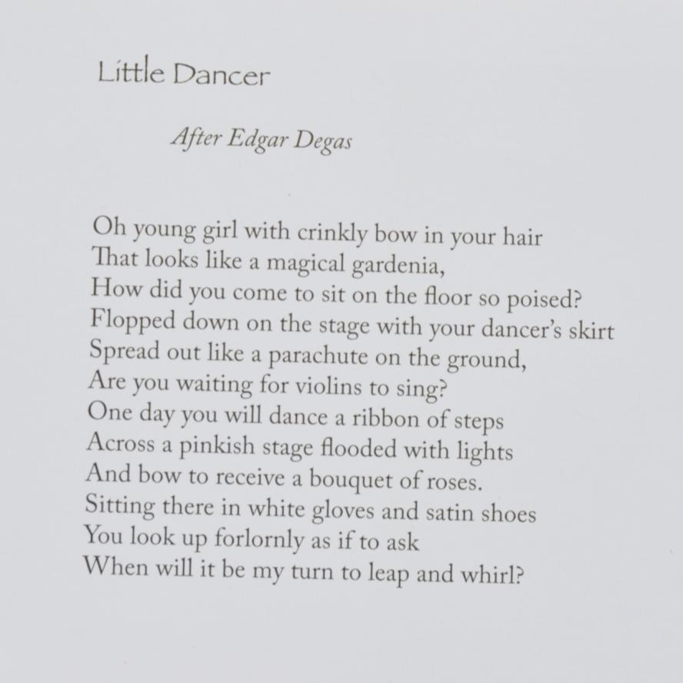

Slide 27
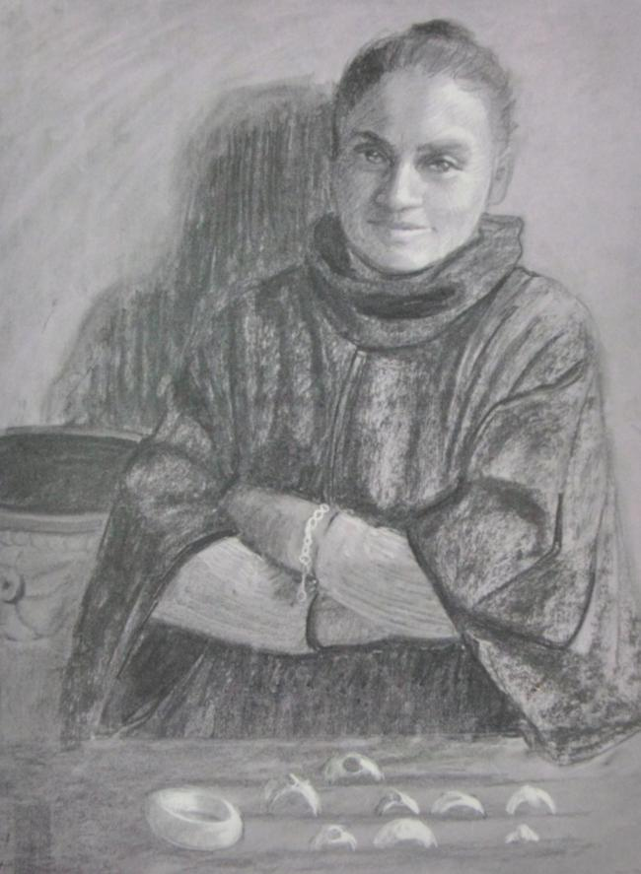
Borderlines: Drawing Border Lives Copyrighted © 2010 by Steven P Schneider and Reetka Schneider

Slide 28
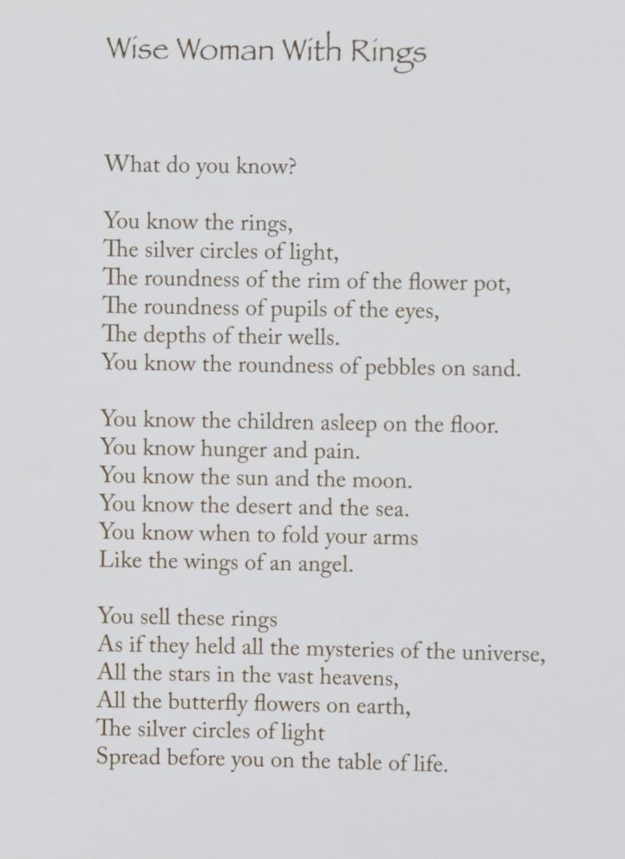

Slide 29
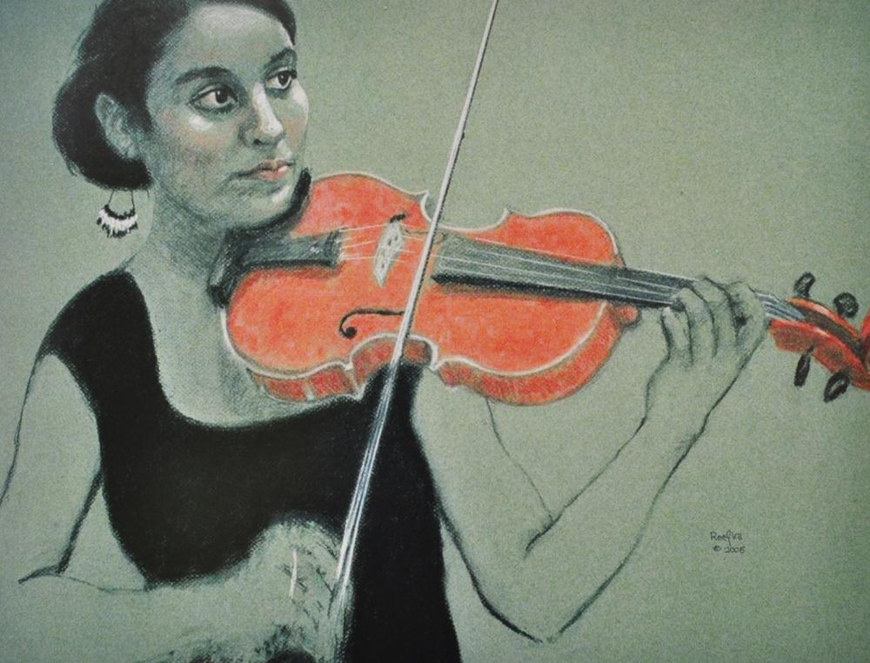
Borderlines: Drawing Border Lives Copyrighted © 2010 by Steven P Schneider and Reetka Schneider

Slide 31
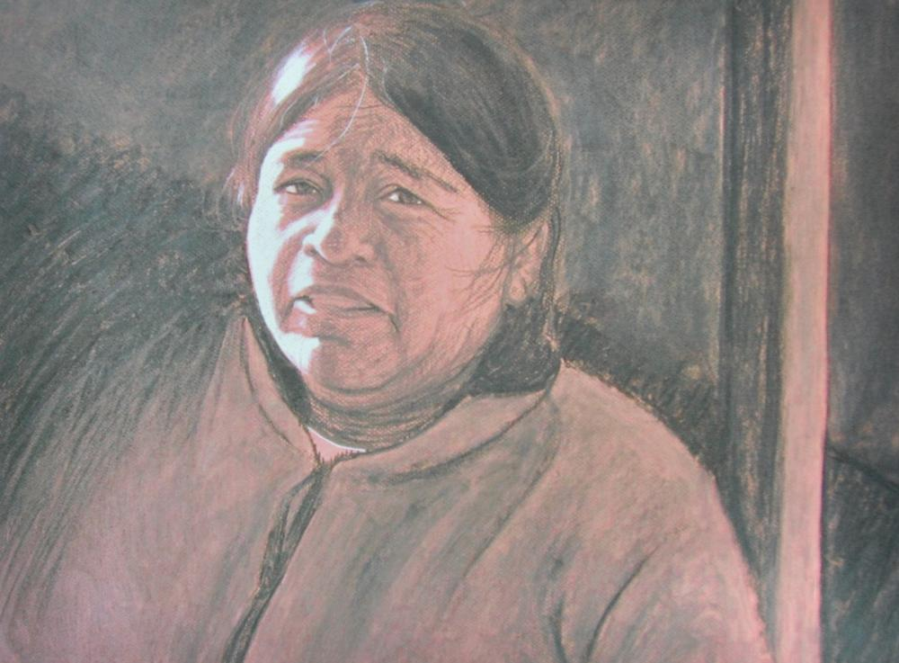
Borderlines: Drawing Border Lives Copyrighted © 2010 by Steven P Schneider and Reetka Schneider

Slide 32
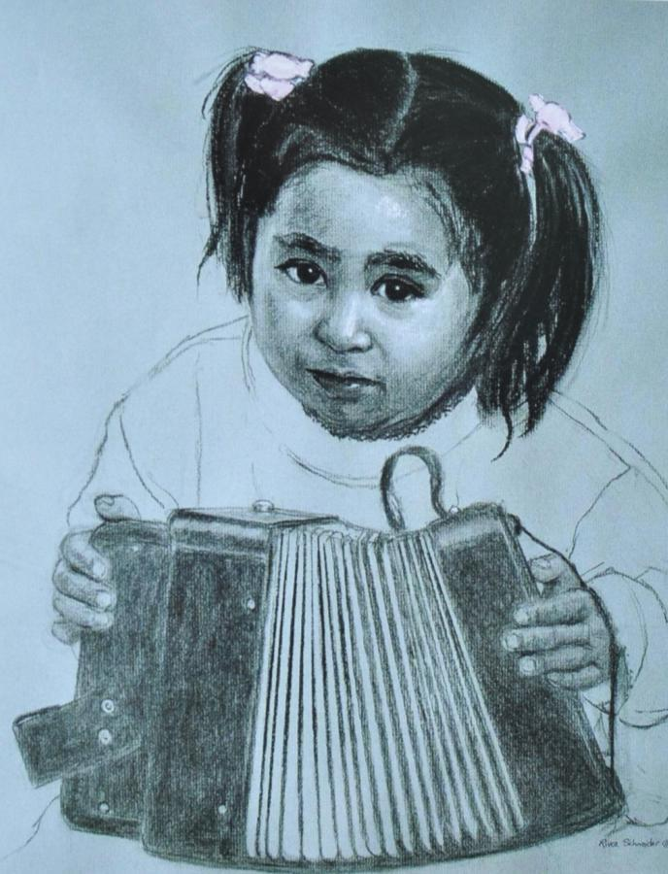
Borderlines: Drawing Border Lives Copyrighted © 2010 by Steven P Schneider and Reetka Schneider

Slide 33
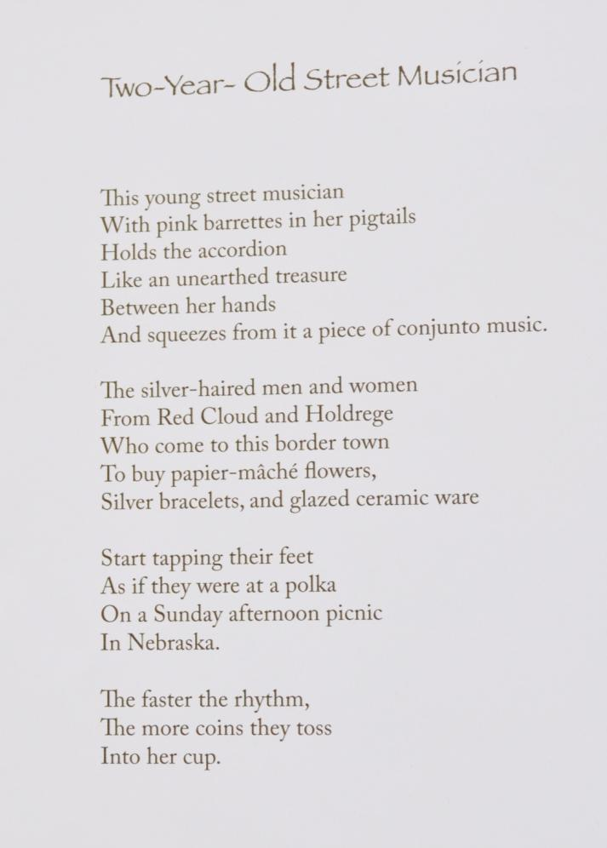

Slide 34
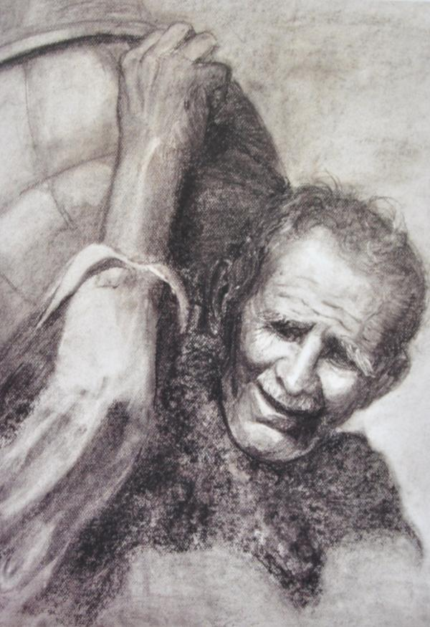
Borderlines: Drawing Border Lives Copyrighted © 2010 by Steven P Schneider and Reetka Schneider

Slide 35
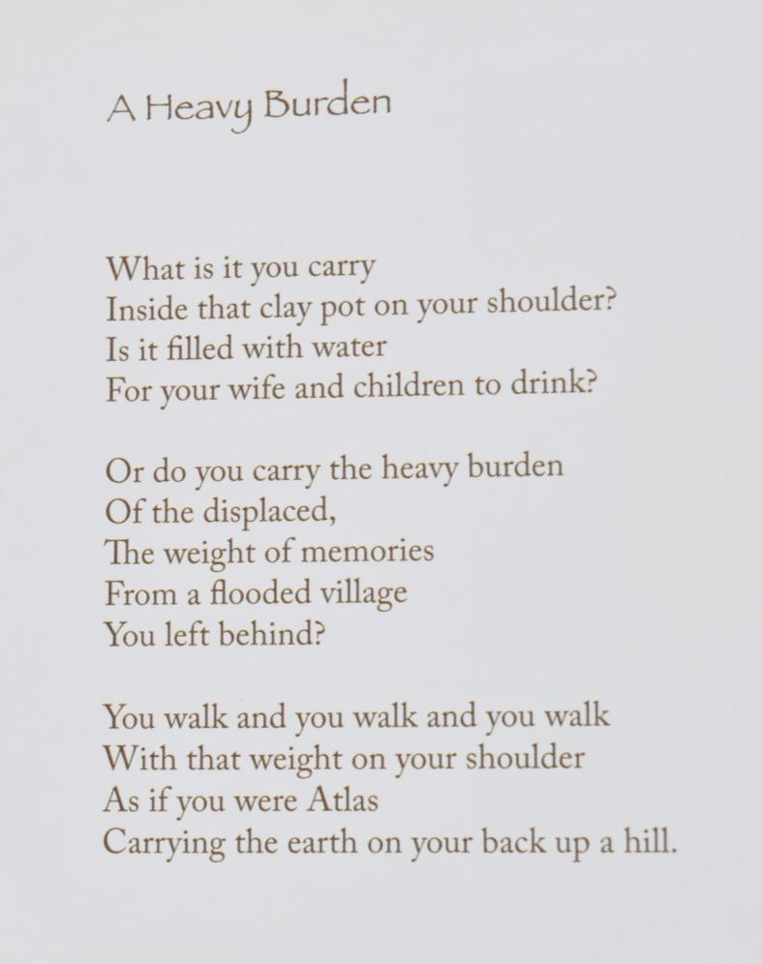

Slide 36
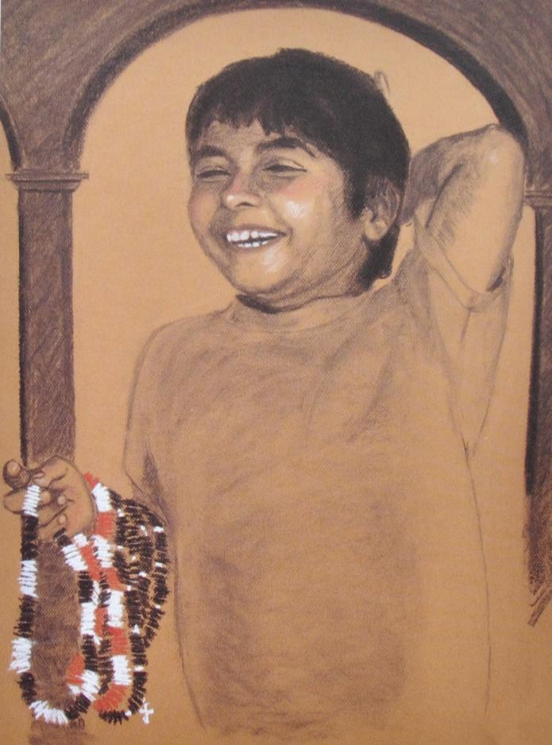
Borderlines: Drawing Border Lives Copyrighted © 2010 by Steven P Schneider and Reetka Schneider

Slide 37
Borderlines: Drawing Border Lives Copyrighted © 2010 by Steven P Schneider and Reetka Schneider

Slide 38
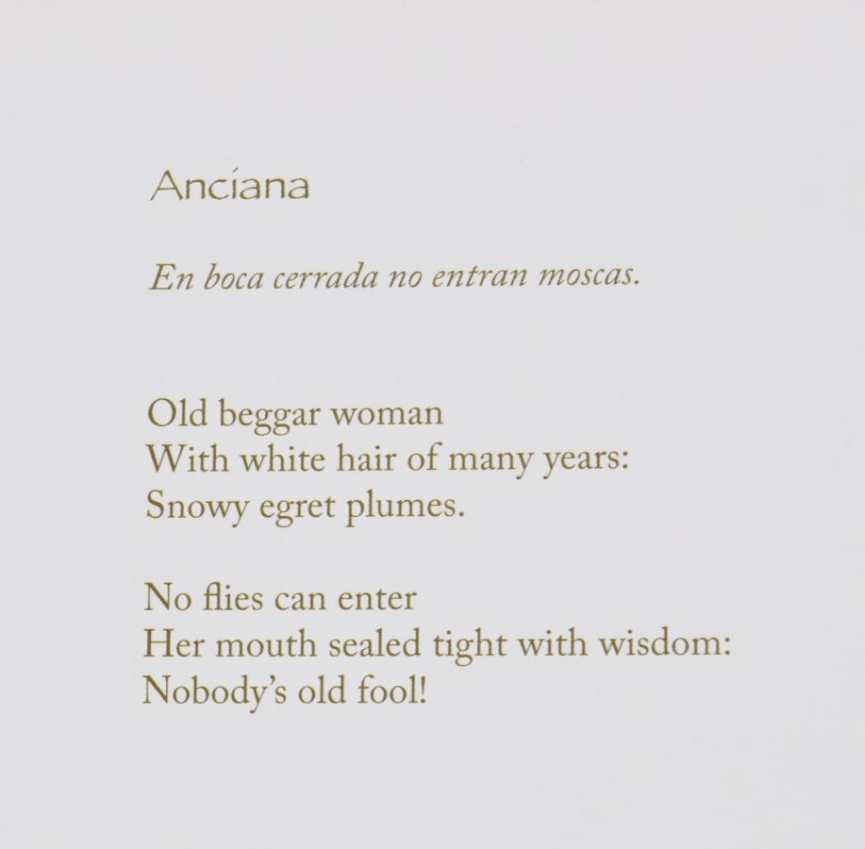

Slide 39
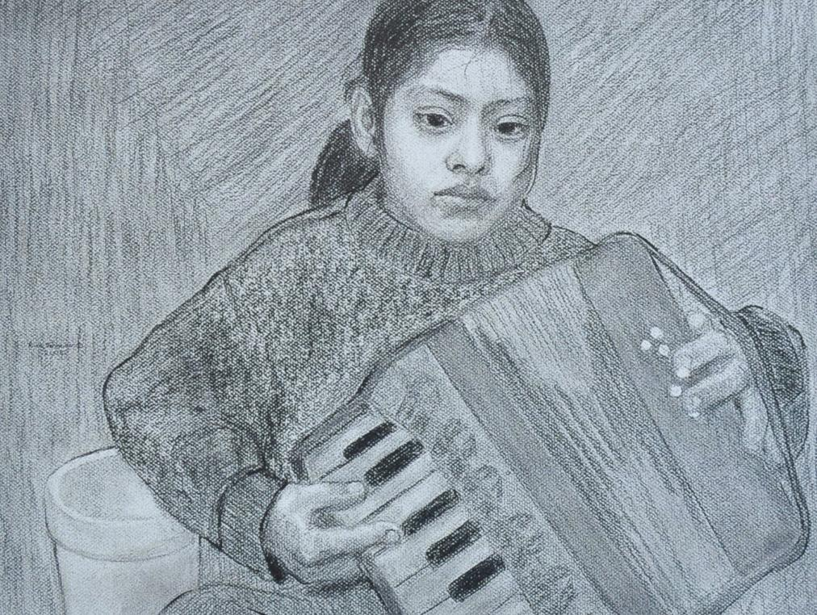
Borderlines: Drawing Border Lives Copyrighted © 2010 by Steven P Schneider and Reetka Schneider

Slide 42
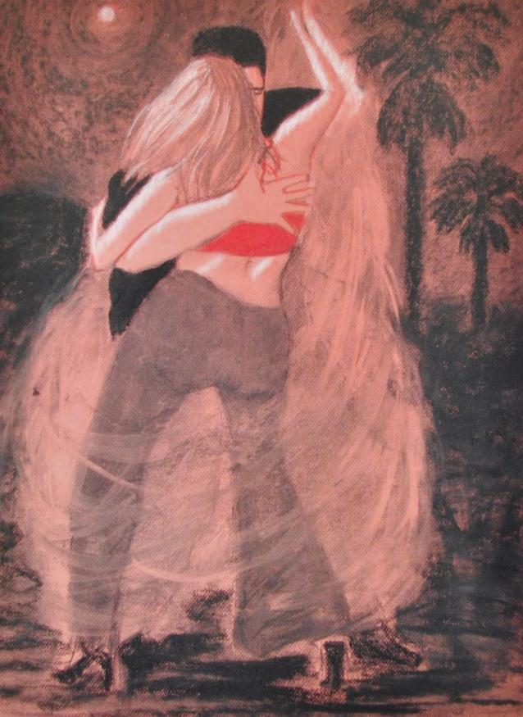
Borderlines: Drawing Border Lives Copyrighted © 2010 by Steven P Schneider and Reetka Schneider

Slide 43
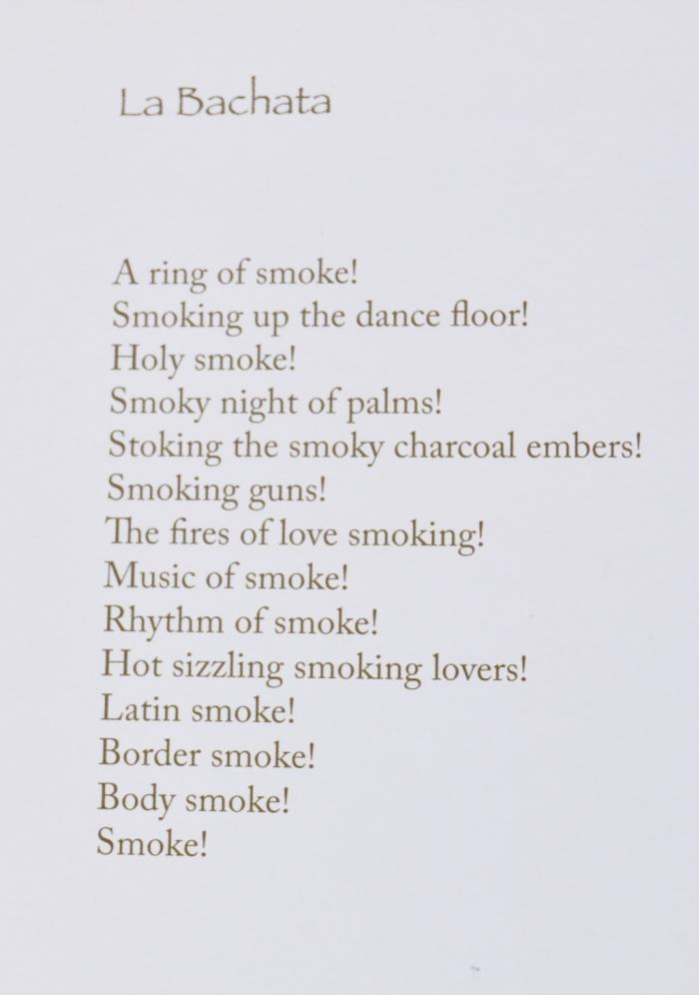

Slide 44
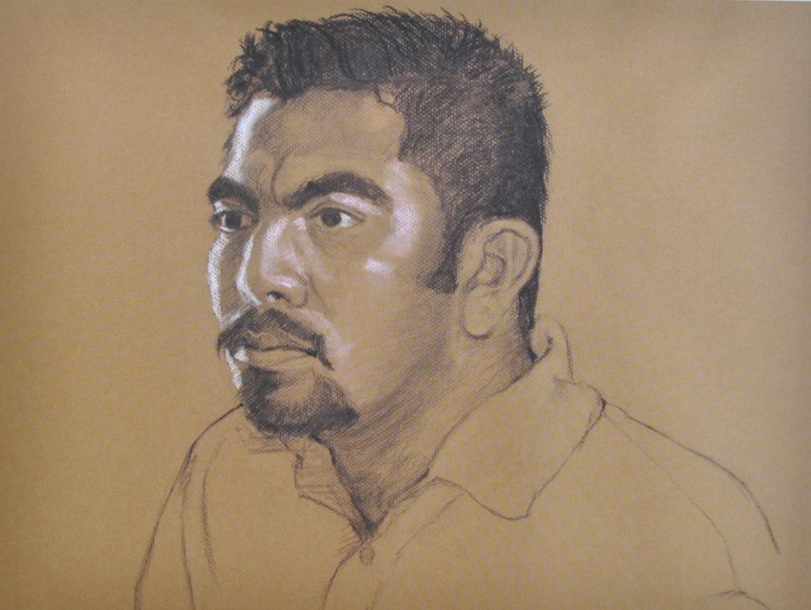
Borderlines: Drawing Border Lives Copyrighted © 2010 by Steven P Schneider and Reetka Schneider

Slide 45
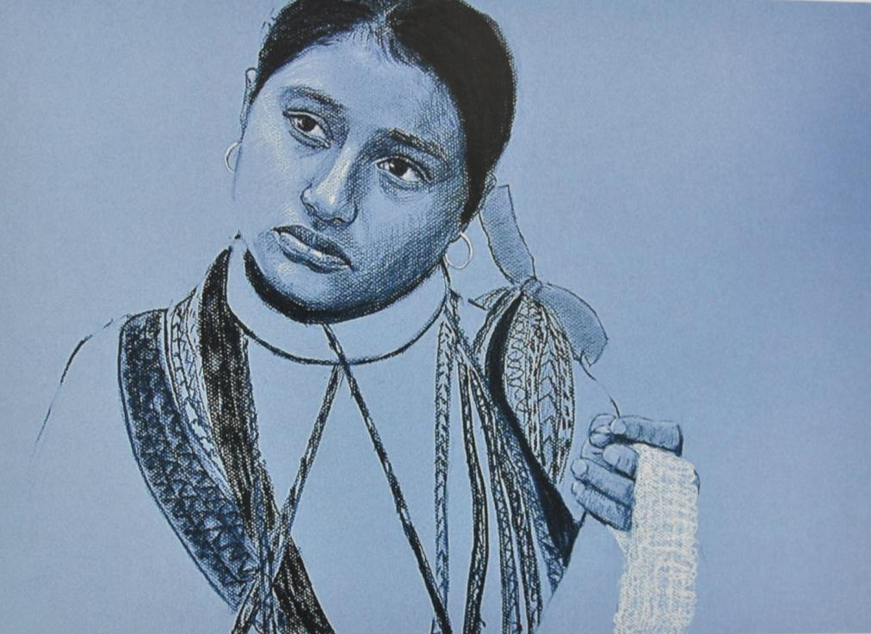
Borderlines: Drawing Border Lives Copyrighted © 2010 by Steven P Schneider and Reetka Schneider

Slide 46
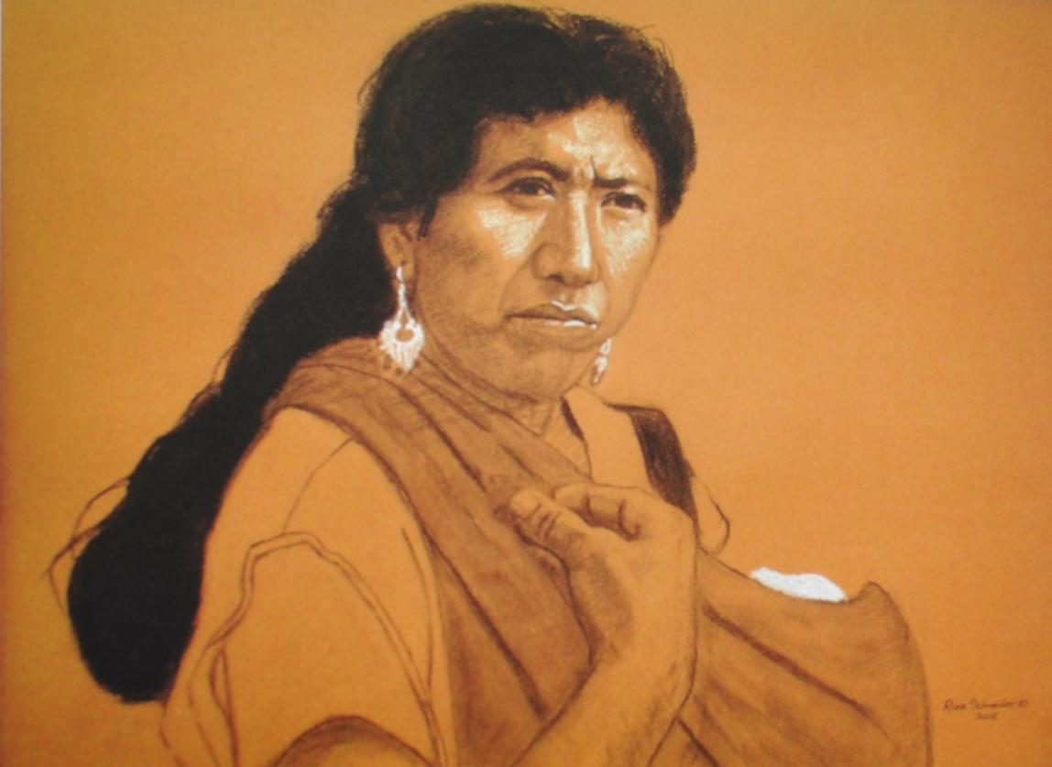
Borderlines: Drawing Border Lives Copyrighted © 2010 by Steven P Schneider and Reetka Schneider

Slide 47
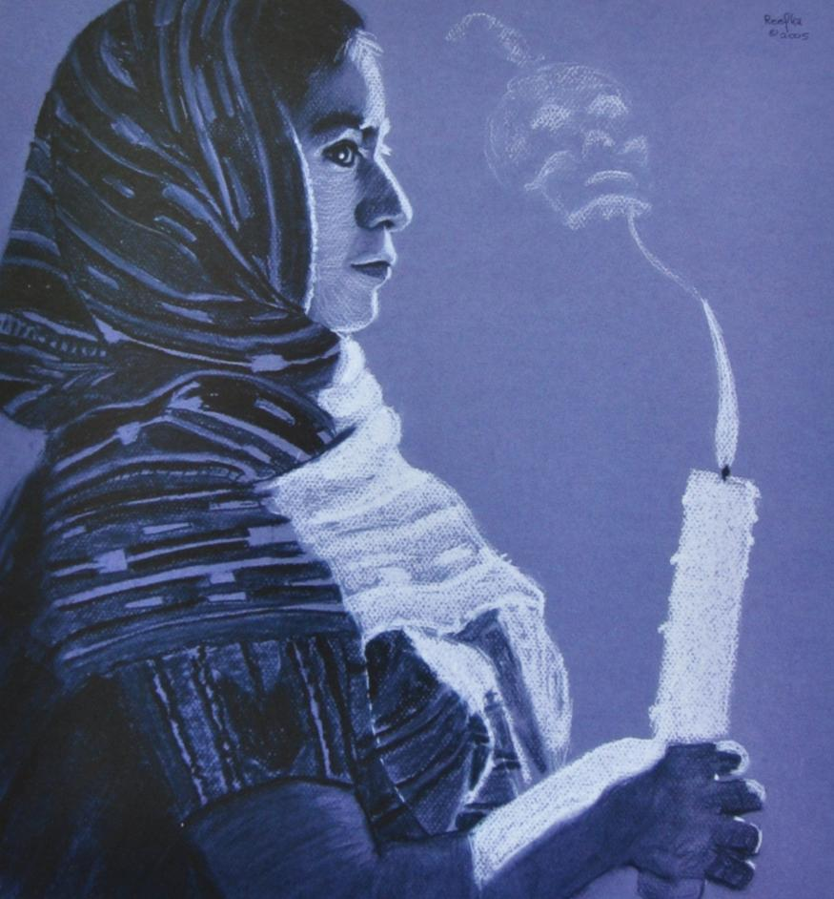
Borderlines: Drawing Border Lives Copyrighted © 2010 by Steven P Schneider and Reetka Schneider

