Slide 1
Immigration and Border Crossings
Why do People Immigrate?

Slide 2
To find a better life – fleeing poverty and starvation (migrants)
To find employment – leaving areas of no opportunities (migrants)
To find relatives that immigrated before them
To get an education and then return
To avoid oppression – fleeing hostile governments (refugees)
To avoid genocide – fleeing warring sanctions or juntas (refugees)
To find religious freedom
You are kidnapped or enslaved and transported to another land (slaves)

Slide 3
Were these immigrants welcomed in the new land?
How Were They Discriminated against? -- NO!
Their economic opportunities were controlled?
Not allowed to become a citizen?
Not allowed to own land?
Prejudicial stereotype degrading statements created to support their oppression
They were not allowed their share of resources:
Poor health care
Not allowed to partake of good educational opportunities
Limited to poor income jobs
Not allowed in the political structure
Not allowed to run for political office
Not allowed to vote
Not allowed in the social structure
Not allowed to join unions
Not allowed to join clubs or social organizations
Not allowed to move into certain neighborhoods
Not allowed to patronize many stores or receive many services
Not allowed to inter-marry

Slide 4
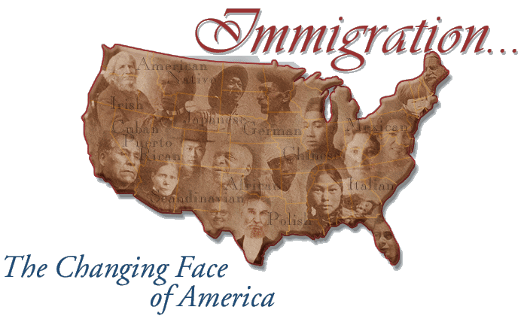
Anglo-Saxons Immigrated to America

Slide 5
When did they migrate?
1600-1650
Why did they migrate?
Seeking wealth from gold, silver, timber, and other resources
Seeking religious freedom (Pilgrims and Puritans)
Seeking relief from political persecution
Those in debtor’s prison were allowed to come to America to work as indentured servants for those who paid their debt.

Slide 6
The Blacks Were Brought to America by Force
1450-1900

Slide 7
When did they migrate?
1450-1900
Why did they migrate?
Captured as slaves and transported against their will

Slide 8
 | Period (450 years) |  | Number of Slaves Accounted For |  |  | %
 | 1450-1600 |  | 409,000 |  |  | 3.6
 | 1601-1700 |  | 1,348,000 |  |  | 11.9
 | 1701-1800 |  | 6,090,000 |  |  | 53.8
 | 1801-1900 |  | 3,466,000 |  |  | 30.6
 | Total Slave Exports |  | 11,313,000 |  |  | 100.0
THE ATLANTIC SLAVE TRADE AND SLAVERY IN AMERICA © 2007, 2008 Neil A. Frankel

Slide 9
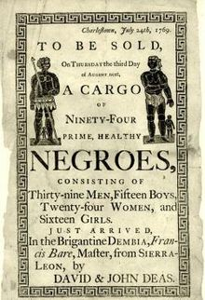
450 Years of Transatlantic Slave Trade (1450-1900)
In 1502, the first slaves arrived in the Americas.
In 1619, twenty Africans arrive at Jamestown, Virginia, aboard a Dutch ship. The transatlantic slave trade joined the colonies.
By the middle of the seventeenth century the transatlantic slave trade was near its peak with Portugal, Brittan, France, Spain, and Americans participating.
In 1807, Brittan stopped trading in slaves.
In 1863, President Abraham Lincoln signed the Emancipation Proclamation.

Slide 10
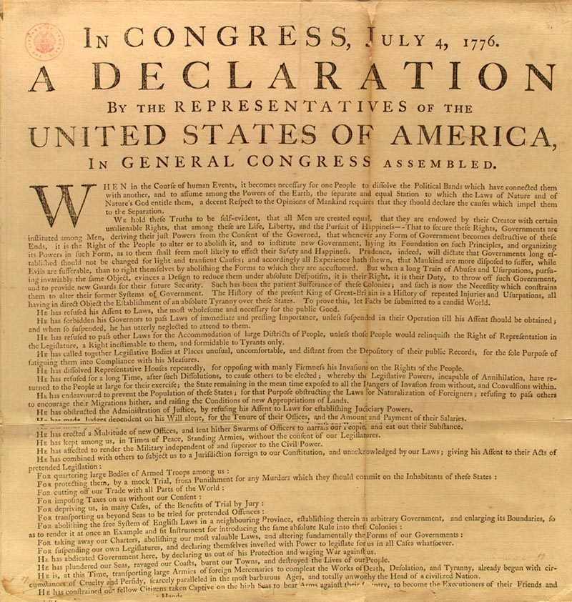
In 1776, the Declaration of Independence stated that “…all men are created equal,” but blacks were then classified as “chattel,” (an idea of Thomas Jefferson) something like cattle, and not considered human.

Slide 11
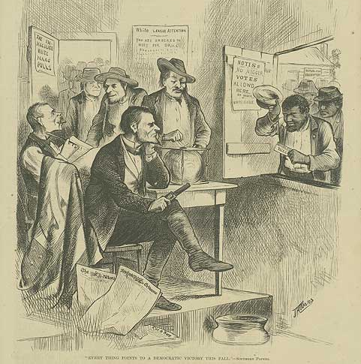
By keeping blacks from owning land, from voting, and from obtaining a good education, and from access to valuable resources, the Anglo-Saxons insured that they would remained in control of the blacks keeping them from well-paying jobs, social privilege and status, and political position.

Slide 12
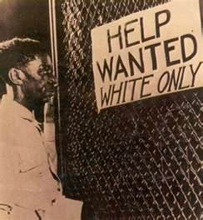
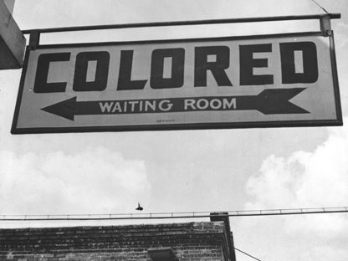
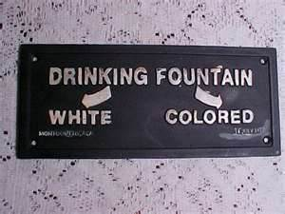
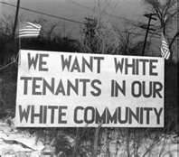

Slide 13
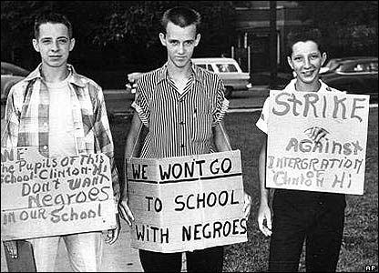
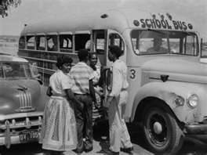
Schools were segregated and underfunded assuring blacks would receive an inadequate education, thus keeping blacks away from high-paying technical and prestigious jobs. 1964 was the first time blacks could vote without paying a poll tax.

Slide 14
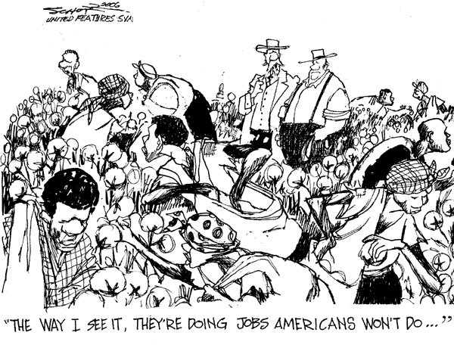

Slide 15
Were these immigrants welcomed in the new land?
How Were They Discriminated against? -- NO!
Their economic opportunities were controlled?
Not allowed to become a citizen?
Not allowed to own land?
Prejudicial stereotype degrading statements created to support their oppression
They were not allowed their share of resources:
Poor health care
Not allowed to partake of good educational opportunities
Limited to poor income jobs
Not allowed in the political structure
Not allowed to run for political office
Not allowed to vote
Not allowed in the social structure
Not allowed to join unions
Not allowed to join clubs or social organizations
Not allowed to move into certain neighborhoods
Not allowed to patronize many stores or receive many services
Not allowed to inter-marry

Slide 16
The Irish Immigrated to America 1830-1860

Slide 17
When did they migrate?
1830 - 1860
Why did they migrate?
To find a better life
To escape poverty
Where did the Irish go?

Slide 18
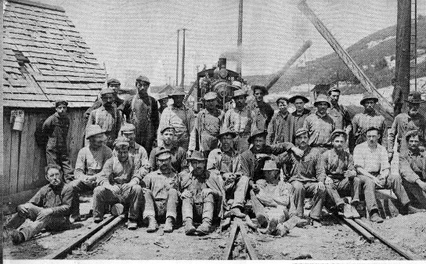
By keeping Irish from owning land, from voting, and from obtaining a good education, and from access to valuable resources, the Anglo-Saxons insured that they would remain in control of the Irish keeping them from well-paying jobs, social privilege and status, and political position.

Slide 19
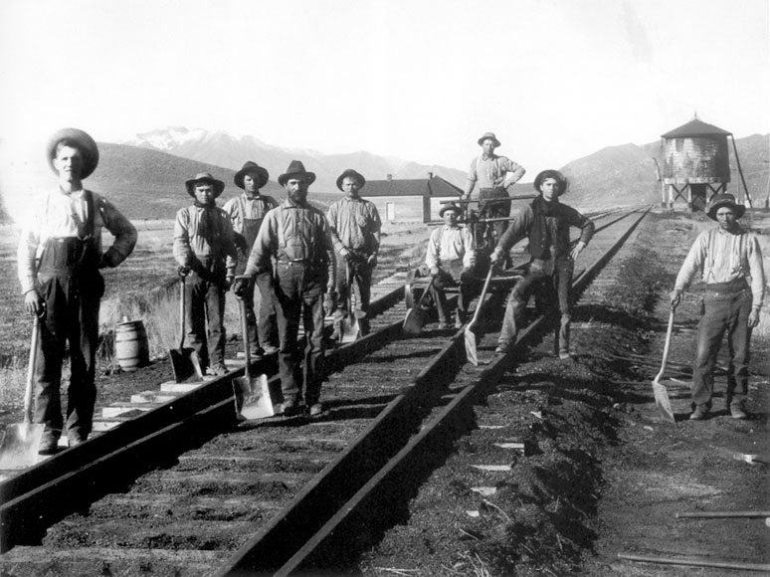
The Irish economic opportunities were restricted in order to insure cheap labor for large profits. Many Irish were employed as indentured servants exchanging their cost of passage for food and lodging under near “slave-like” conditions until their debt was considered paid.

Slide 20
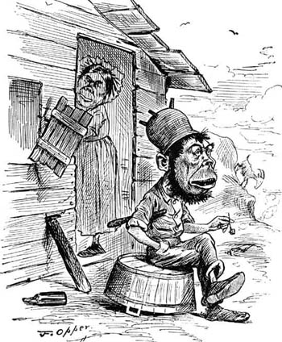
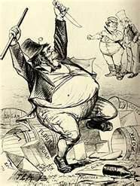
In order to justify the aggressive behavior against the Irish, prejudicial stereotype impressions about the Irish calling them “barbarians” and “no nothings” were promoted. They were depicted as apelike drunks that were hostile and immoral and considered to be the subhuman “missing link” between the apes and Africans. The catch phrase “Americans shall Rule America” continued this prejudicial treatment against the Irish encouraging their continued mistreatment and suppression.

Slide 21
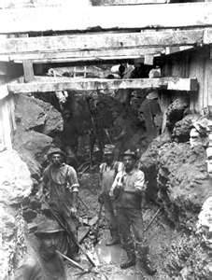
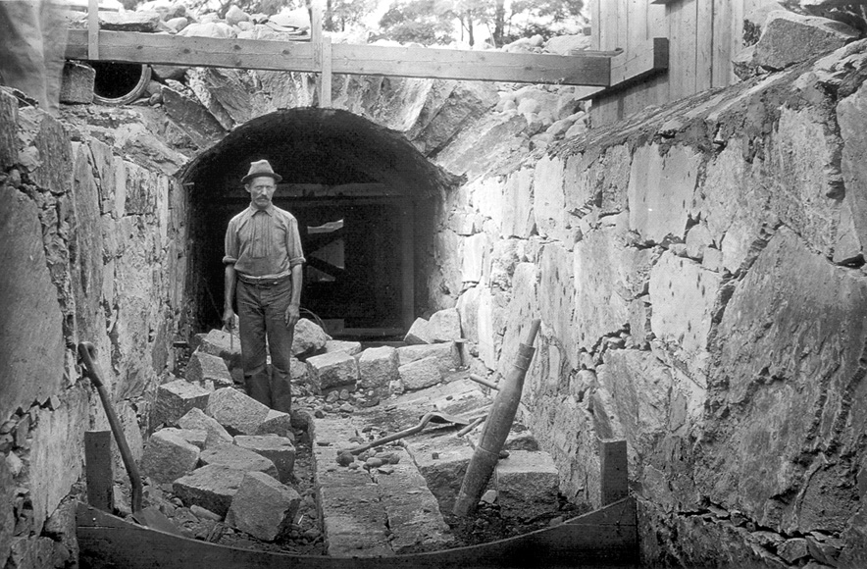
Because the Irish were restricted to low-paying, labor-intensive jobs, they did not support the Underground Railroad movement where black slaves were fleeing the south. The Irish felt the blacks would work for less money and, therefore, threaten their job security.

Slide 22
Because of the poor education offered Irish children, the Catholic Parochial School System gradually emerged as the Irish were forced to educate themselves.

Slide 23
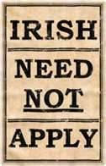
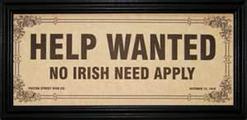
The Irish had a 21-year waiting period for citizenship, and many employment want ads specified, “No Irish Need Apply!”

Slide 24
Were these immigrants welcomed in the new land?
How Were They Discriminated against? -- NO!
Their economic opportunities were controlled?
Not allowed to become a citizen?
Not allowed to own land?
Prejudicial stereotype degrading statements created to support their oppression
They were not allowed their share of resources:
Poor health care
Not allowed to partake of good educational opportunities
Limited to poor income jobs
Not allowed in the political structure
Not allowed to run for political office
Not allowed to vote
Not allowed in the social structure
Not allowed to join unions
Not allowed to join clubs or social organizations
Not allowed to move into certain neighborhoods
Not allowed to patronize many stores or receive many services
Not allowed to inter-marry

Slide 25
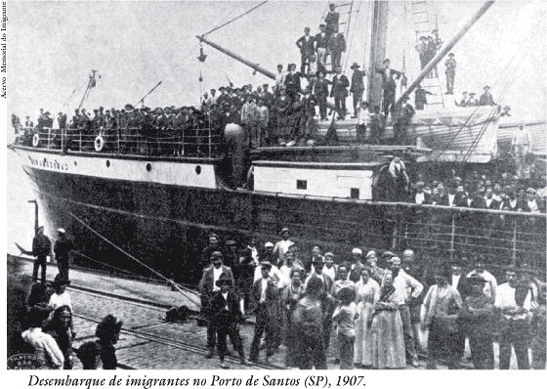
The Italians Immigrated to America 1860-1930

Slide 26
When did they migrate?
1860 - 1930
Why did they migrate?
Where did they go?

Slide 27
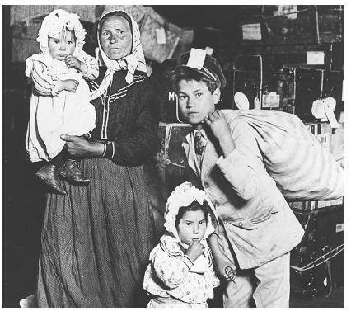
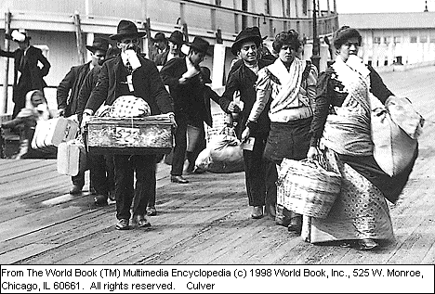
By keeping Italians from owning land, from voting, and from obtaining a good education, and from access to valuable resources, it was insured that they would remain in controlled keeping them from well-paying jobs, social privilege and status, and political position.

Slide 28
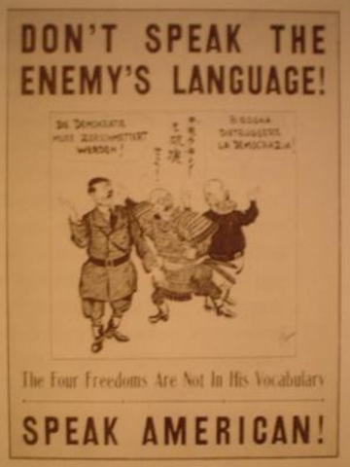
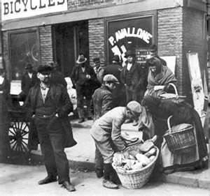
In order to justify the aggressive behavior against the Italians, prejudicial stereotype impressions about the Italians were created calling them “gangsters,” “dagoes,” and “wops.”

Slide 29
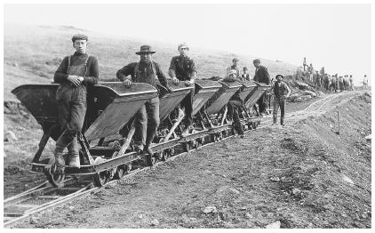
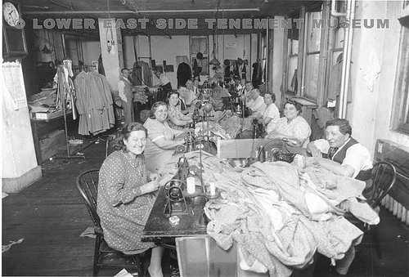
Many Italian men were used in work gangs for the railroads and were shipped to various railroad projects throughout the country while the women worked in garment industry sweatshops. Families were often separated for years.

Slide 30
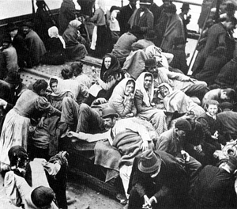
Italians were regarded as low class, stupid, and inferior and were assigned the menial work no one else wanted to do. Italian Americans were classified as non-Anglo and, next to blacks, were the second most likely group to be lynched.

Slide 31
Were these immigrants welcomed in the new land?
How Were They Discriminated against? -- NO!
Their economic opportunities were controlled?
Not allowed to become a citizen?
Not allowed to own land?
Prejudicial stereotype degrading statements created to support their oppression
They were not allowed their share of resources:
Poor health care
Not allowed to partake of good educational opportunities
Limited to poor income jobs
Not allowed in the political structure
Not allowed to run for political office
Not allowed to vote
Not allowed in the social structure
Not allowed to join unions
Not allowed to join clubs or social organizations
Not allowed to move into certain neighborhoods
Not allowed to patronize many stores or receive many services
Not allowed to inter-marry

Slide 32
The Chinese Immigrated to America
1851 to 1900

Slide 33
When did they migrate? 1600-1650
1851 - 1900
Why did they migrate?
To take advantage of the gold rush and
make their fortune
Where did they go?
California, mainly the San Francisco area.

Slide 34
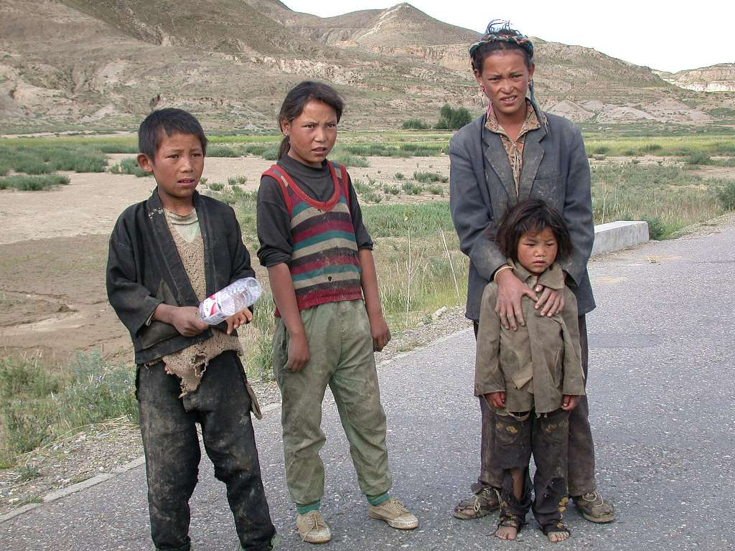
By keeping Chinese from owning land, from voting, from obtaining a good education, and from access to valuable resources, it was insured that the Chinese would be controlled keeping them from well-paying jobs, social privilege and status, and political position.

Slide 35
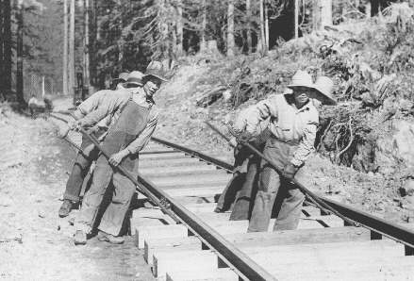
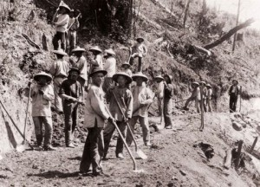
Many Chinese were used to build the railroad out west under horrible “slave-like” conditions.

Slide 36
In order to justify the aggressive behavior against the Chinese, prejudicial stereotype impressions about the Chinese were created calling them “coolies” and “slant-eyes” and “rice eaters.”

Slide 37
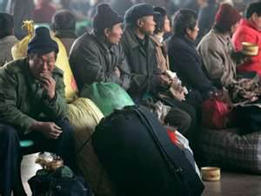
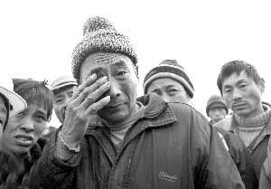
The depression of 1873 was blamed on the Chinese being willing to work for substandard wages, thus taking away the Anglo-Saxon jobs. California citizens complained that Chinese workers sent back to their families in China over $90,000 per day causing an economic catastrophe in California.

Slide 38
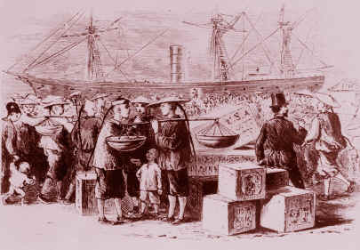
The Chinese did not only mine for gold, but took on jobs such as cooks, peddlers, and storekeepers. In the first decade after the discovery of gold, many had taken jobs nobody else wanted or that were considered too dirty. However, in 1870, hasty exploitation of gold mines and a lack of well-paying jobs for non-Asians spurred sentiment that the "rice-eaters" were to blame. By 1880, a fifth were engaged mining, another fifth in agriculture, a seventh in manufacturing, an added seventh were domestic servants, and a tenth were laundry workers.

Slide 39
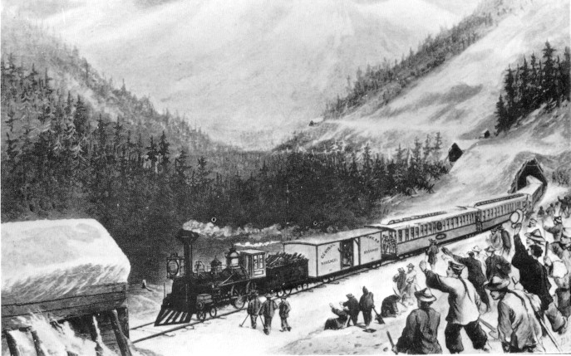
Many Chinese were working on the railroad. The work was backbreaking and highly dangerous. Over a thousand Chinese had their bones shipped back to China to be buried. Nine-tenths of the railroad workers were Chinese.

Slide 40
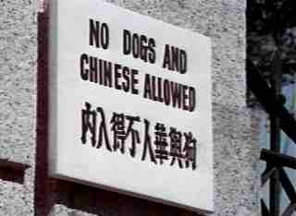
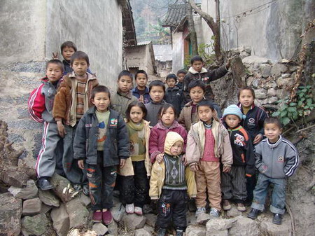

Slide 41
Were these immigrants welcomed in the new land?
How Were They Discriminated against? -- NO!
Their economic opportunities were controlled?
Not allowed to become a citizen?
Not allowed to own land?
Prejudicial stereotype degrading statements created to support their oppression
They were not allowed their share of resources:
Poor health care
Not allowed to partake of good educational opportunities
Limited to poor income jobs
Not allowed in the political structure
Not allowed to run for political office
Not allowed to vote
Not allowed in the social structure
Not allowed to join unions
Not allowed to join clubs or social organizations
Not allowed to move into certain neighborhoods
Not allowed to patronize many stores or receive many services
Not allowed to inter-marry

Slide 42
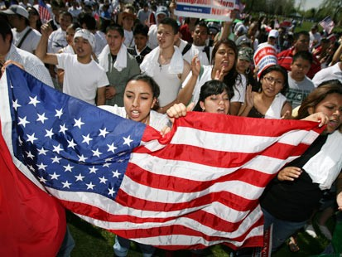
The Puerto Ricans Immigrated to America

Slide 43
When did they migrate?
1900-1945 – pioneers after it became a U.S. Territory
1946-1964 – the Great Migration
1965-present – “Revolving Door Migration”
Why did they migrate?
Overpopulation in Puerto Rico
Better changes for employment in the U.S.
Where did they go?
New York, Texas, Illinois, Ohio, New Jersey, Connecticut and from these states some went to California and Florida.

Slide 44
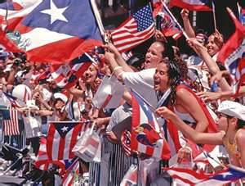

Slide 45
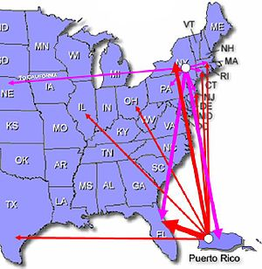

Slide 46
Were these immigrants welcomed in the new land?
How Were They Discriminated against? -- NO!
Their economic opportunities were controlled?
Not allowed to become a citizen?
Not allowed to own land?
Prejudicial stereotype degrading statements created to support their oppression
They were not allowed their share of resources:
Poor health care
Not allowed to partake of good educational opportunities
Limited to poor income jobs
Not allowed in the political structure
Not allowed to run for political office
Not allowed to vote
Not allowed in the social structure
Not allowed to join unions
Not allowed to join clubs or social organizations
Not allowed to move into certain neighborhoods
Not allowed to patronize many stores or receive many services
Not allowed to inter-marry

Slide 47
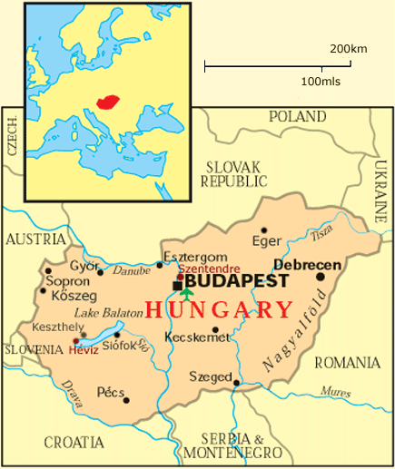
The Hungarians Migrated to America

Slide 48
When did the Hungarians migrate to the U.S.? 1800-1914 – 1.5 million
1945-1956 – 51,000
Why did they migrate?
1800-1914 – overpopulation economic impoverishment
1945 – 1956 – WWII refugees, many under the Displaced Person’s Act of 1948
Where did they go?
Cleveland, Pittsburg, Philadelphia, and New York.

Slide 49
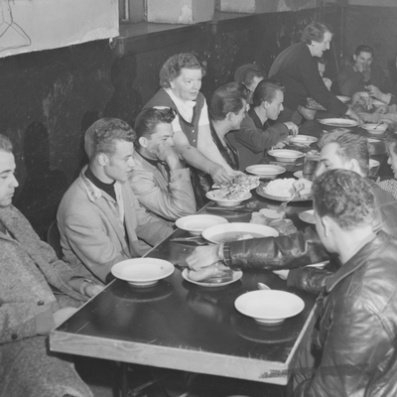

Slide 50
Were these immigrants welcomed in the new land?
How Were They Discriminated against? -- NO!
Their economic opportunities were controlled?
Not allowed to become a citizen?
Not allowed to own land?
Prejudicial stereotype degrading statements created to support their oppression
They were not allowed their share of resources:
Poor health care
Not allowed to partake of good educational opportunities
Limited to poor income jobs
Not allowed in the political structure
Not allowed to run for political office
Not allowed to vote
Not allowed in the social structure
Not allowed to join unions
Not allowed to join clubs or social organizations
Not allowed to move into certain neighborhoods
Not allowed to patronize many stores or receive many services
Not allowed to inter-marry

Slide 51
The Latinos Immigrate to America

Slide 52
When did the latinos migrate?
Present day occurance
Why did they migrate?
Looking for a better life
Fleeing poor economics looking for work
Looking for relatives that migrated before
Fleeing an oppressive government or danger
from other organizations
Where did they go?
Mostly in Texas, California, and Arizona but
they have arrived in all 48 continental states

Slide 53
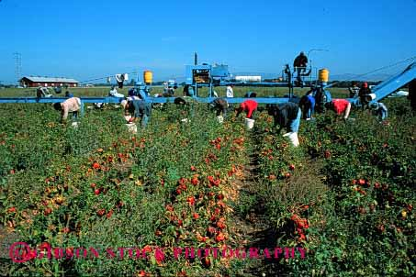
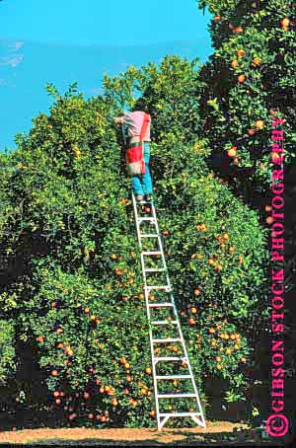
Latinos are often regarded as low class and uneducated and are given the menial work no one else wanted to do. Many Latino immigrants are used to harvest crops and perform unpleasant manufacturing jobs.

Slide 54
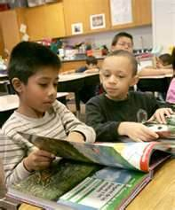
Many Americans believe that English should be the required for everyone living in the United States. They complain that Latinos are not paying taxes yet we are sending their children to school and paying for their medical expenses. Many Anglo-Saxons believe America is for Americans and insist the Latinos learn English and adopt the American culture.

Slide 55
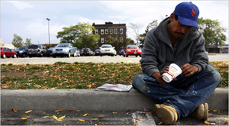
Many poor blacks working menial, labor-intensive jobs are afraid the Latinos will work for even less money and threaten these black’s job security.

Slide 56
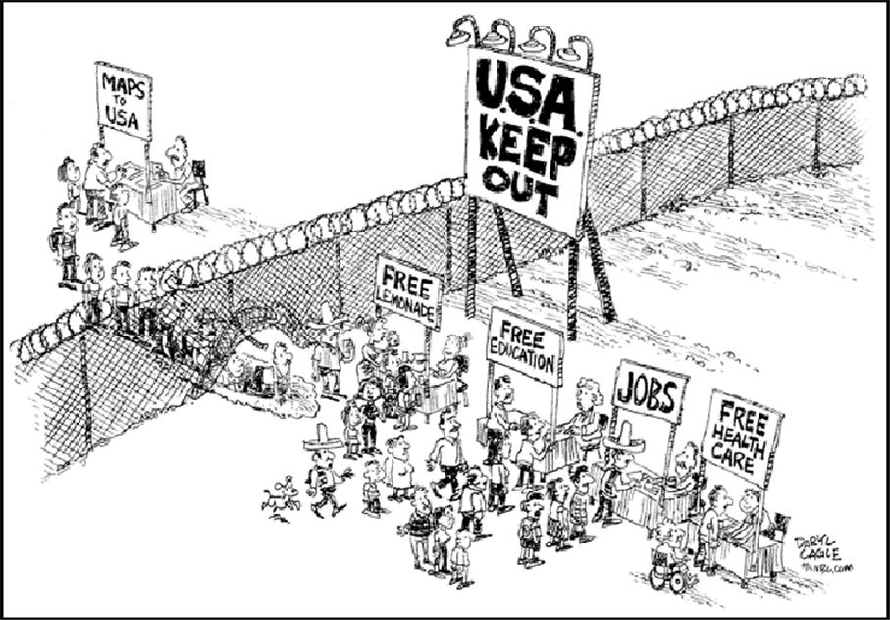

Slide 57
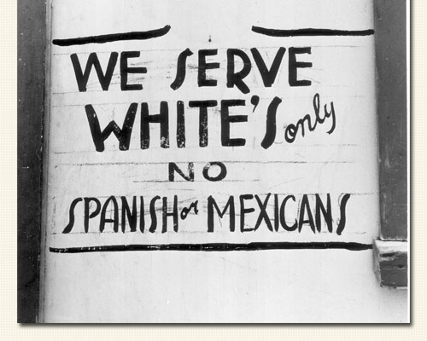

Slide 58
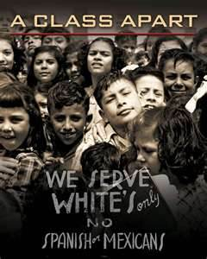

Slide 59
There are now (2009) 42 million Hispanics in the United States representing almost one trillion dollars in economic activity. Texas Tech Today - Written by Leslie Cranford – March 2009

Slide 60
Were these immigrants welcomed in the new land?
How Were They Discriminated against? -- NO!
Their economic opportunities were controlled?
Not allowed to become a citizen?
Not allowed to own land?
Prejudicial stereotype degrading statements created to support their oppression
They were not allowed their share of resources:
Poor health care
Not allowed to partake of good educational opportunities
Limited to poor income jobs
Not allowed in the political structure
Not allowed to run for political office
Not allowed to vote
Not allowed in the social structure
Not allowed to join unions
Not allowed to join clubs or social organizations
Not allowed to move into certain neighborhoods
Not allowed to patronize many stores or receive many services
Not allowed to inter-marry

Slide 61
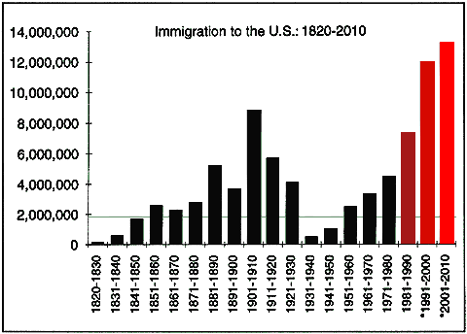
IRISH
CHINESE
ITALIANS
PUERTO RICANS
HUNGARIANS LATINOS JEWS

Slide 63
