Slide 1
The USA/Mexico Border Wall Is it Good, Bad, or Ugly?
Hiram College Carol Donley & Roger Cram

Slide 2
Corridos and Narcocorridos
Corridos are traditional Mexican ballads telling a narrative of historical figures and political heroes. Sometimes they concern a current event or function as news broadcasts for a population that is largely illiterate.
Narcocorridos are ballads about the drug wars, the cartel leaders, and the moving of drugs north to the United States.

Slide 3
Narcocorridos

Slide 4
Mexican Music (500 Bullets)

Slide 5
Most famous traditional corrido: La Cucaracha
Spanish - La cucaracha, la cucaracha, ya no puede caminar porque le falta, porque no tiene marihuana pa' fumar. Ya murió la cucaracha, ya la llevan a enterrar entre cuatro zopilotes y un ratón de sacristán.
English - The cockroach, the cockroach can't walk anymore because it's lacking, because it doesn't have marijuana to smoke. The cockroach just died, now they take her to be buried among four buzzards and a mouse as the sexton.

Slide 6
The corrido form, descended from medieval Spanish ballads, is a storytelling form. Early in the last century, corridos were sung to describe the exploits of the great generals of the Mexican Revolution, and ever since they have served as a popular news service, telling of government corruption, the struggles of immigrants in El Norte or the rise of the Zapatista rebels in Chiapas.

Slide 7
The narcocorrido, however, sings of the drug trafficker, the mariguero, the law and death. And despite the half-hearted protests of some of the genre's stars, many of them glorify the wealth and power of the successful trafficker, the bravery and cunning of the macho, the fatalism of the desperado.

Slide 8
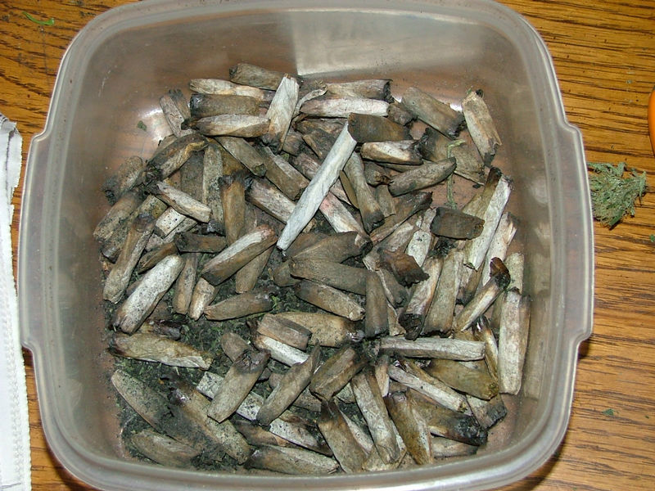
Roach also refers to marijuana

Slide 9
Narcocorrido singers risk getting killed
With his thick mustache and signature cowboy hat and suit, Sergio Vega was known to fans across Mexico and the southern United States as El Shaka – regional slang for “the best.” His death at the age of 40 is the evidence that artists are anything but immune to the violence that has plagued Mexico.

Slide 10
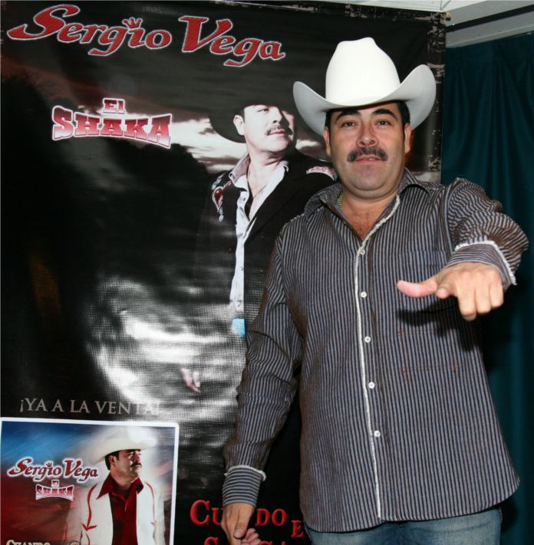
Sergio Vega

Slide 11
El Shaka was the seventh high-profile performer of narcocorridos – ballads dedicated to the drug trade – to be gunned down in Mexico.
But the threat of attack won't stop the performers from doing what they love, counters Mario Quintero Lara, lead singer and songwriter of Los Tucanes de Tijuana, a celebrated six-member norteño band. “Singing or composing corridos today has become a little dangerous,” he says, speaking from San Diego, where Los Tucanes are recording their next album.

Slide 12
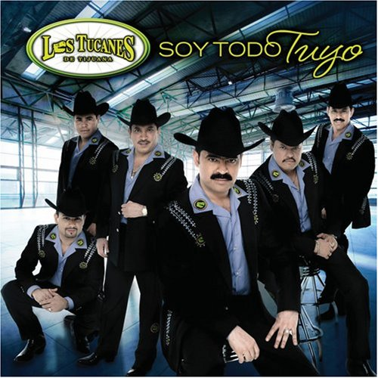

Slide 13
Children in Detention in the United States

Slide 15
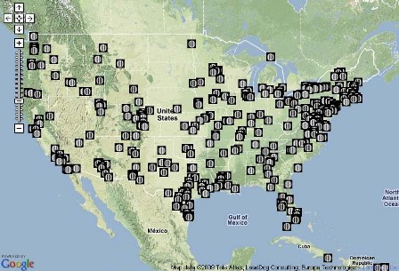
Immigration Detention Centers in the United States

Slide 16
Children immigrants Being Held Illegally by Our Government
http://www.youtube.com/watch?v=I2m92ZjwgS0

Slide 17
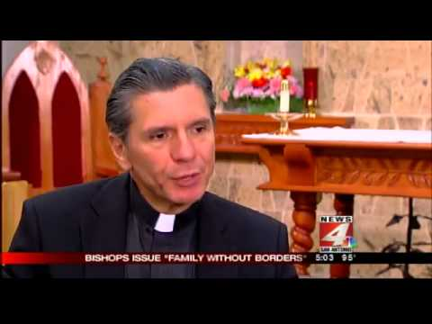
http://www.youtube.com/watch?v=lmIGeAaxfK0

Slide 18
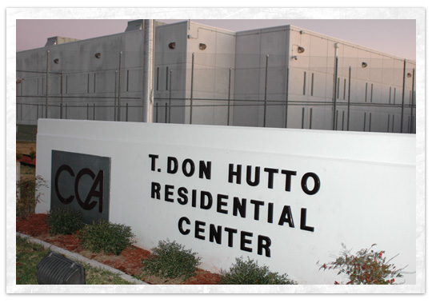
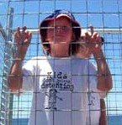
CHILDREN CONFINED- Immigrant Detention at Hutto
http://www.youtube.com/watch?v=HBCAgSCGM04

Slide 19
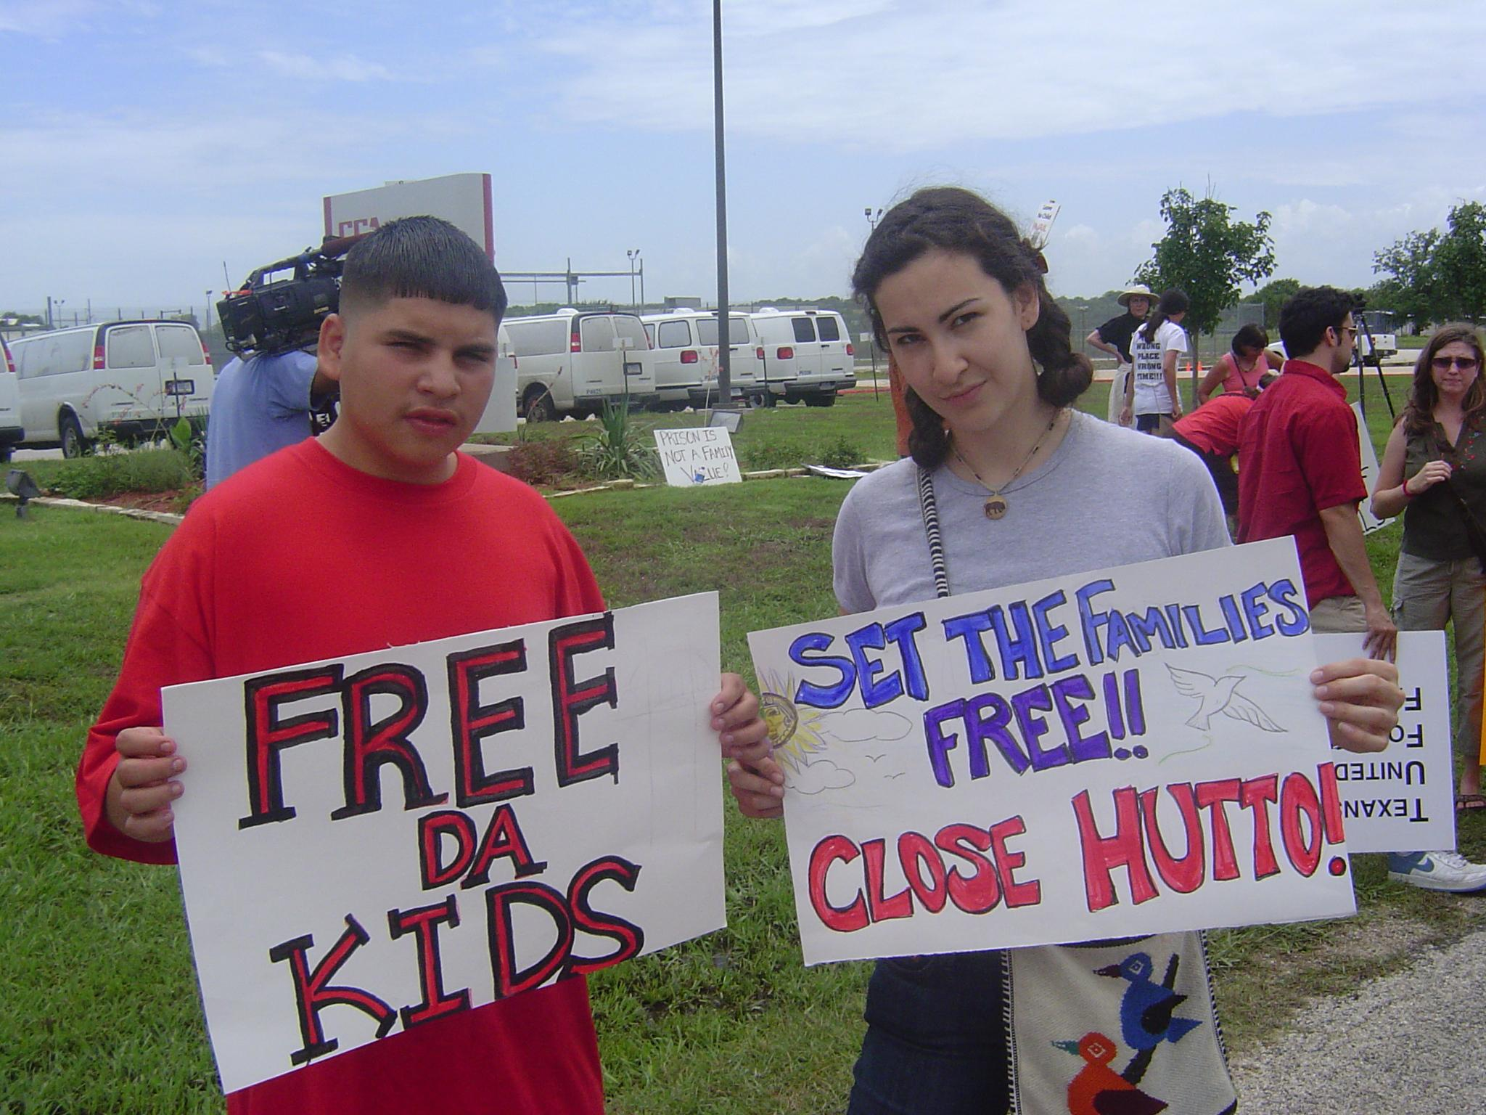

Slide 20
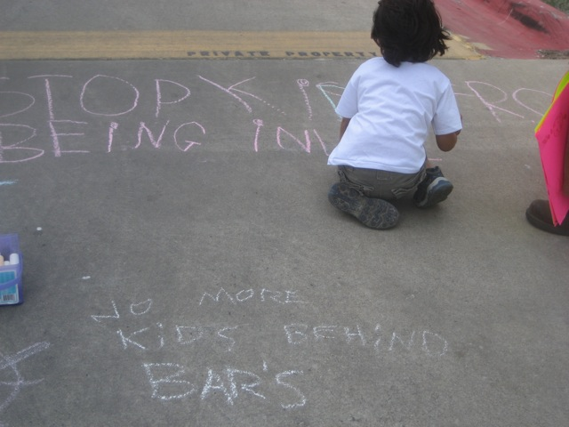

Slide 22
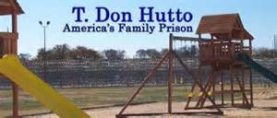

Slide 23
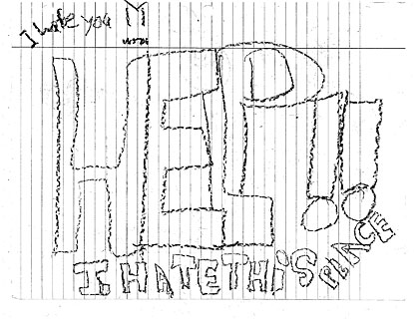

Slide 24
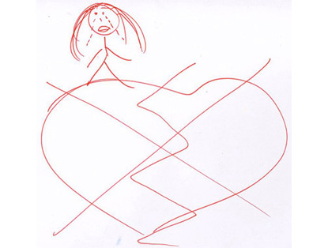
T. Don Hutto Residential Center in Williamson County, Texas

Slide 25
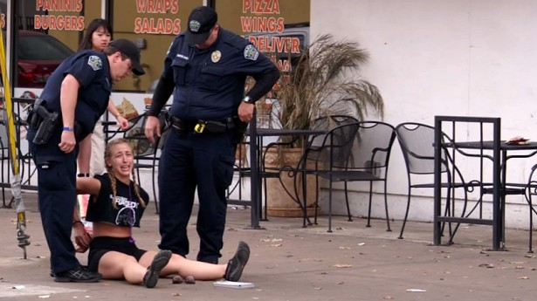
Police Arrest for Speeding 5 MPH over limit
http://www.youtube.com/watch?v=9xwq3oPIG88

Slide 26
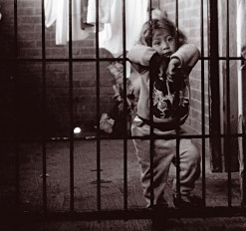
Border detention of children shames America
By Ruben Navarrette, CNN Contributor
updated 2:48 PM EDT, Thu June 12, 2014
http://www.cnn.com/2014/06/12/opinion/navarrette-immigrant-children/index.html

Slide 27
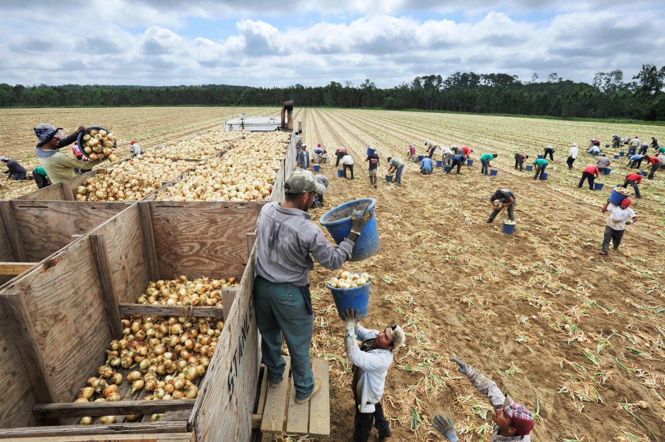
The United States Government is the Largest Employer of Undocumented (and Sometimes Documented) Immigrants in the Country!!!
http://www.youtube.com/watch?v=KWJxUbexVAk

Slide 28
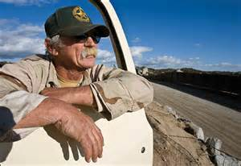
“Little Dog”
The Vigilante at Patriot Point
http://www.youtube.com/watch?v=QSgqmq6fY7o

Slide 29
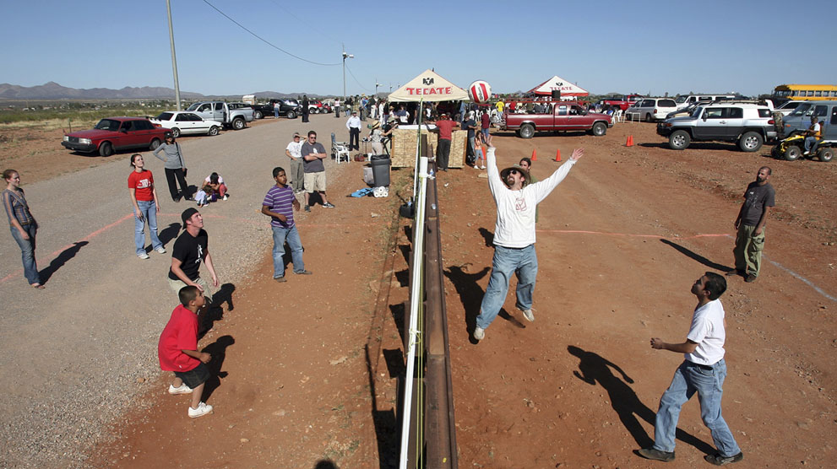

Slide 30
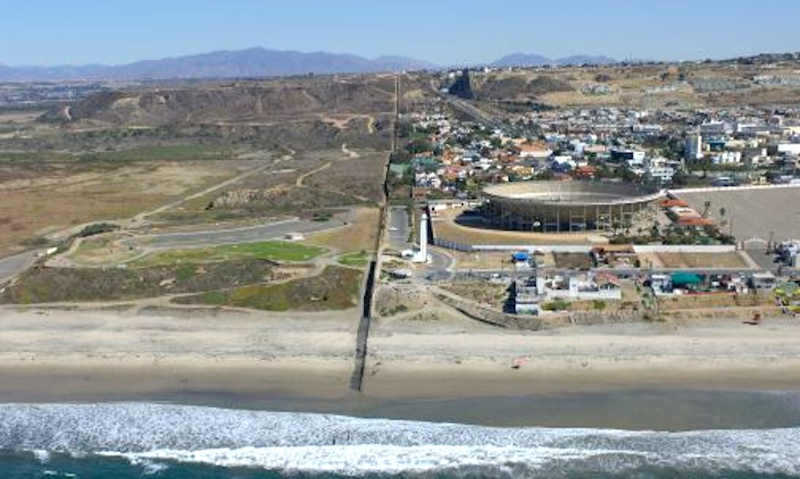

Slide 31
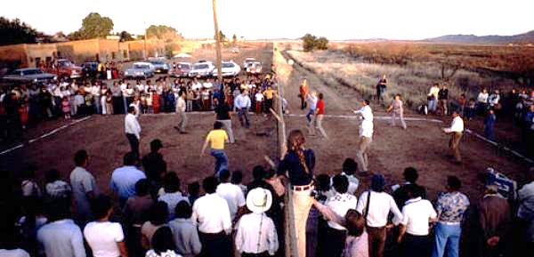

Slide 32
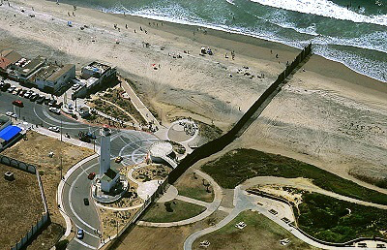

Slide 33
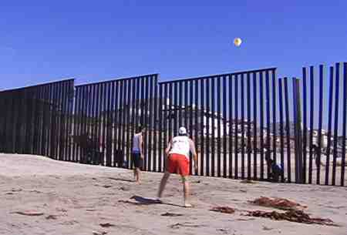

Slide 34
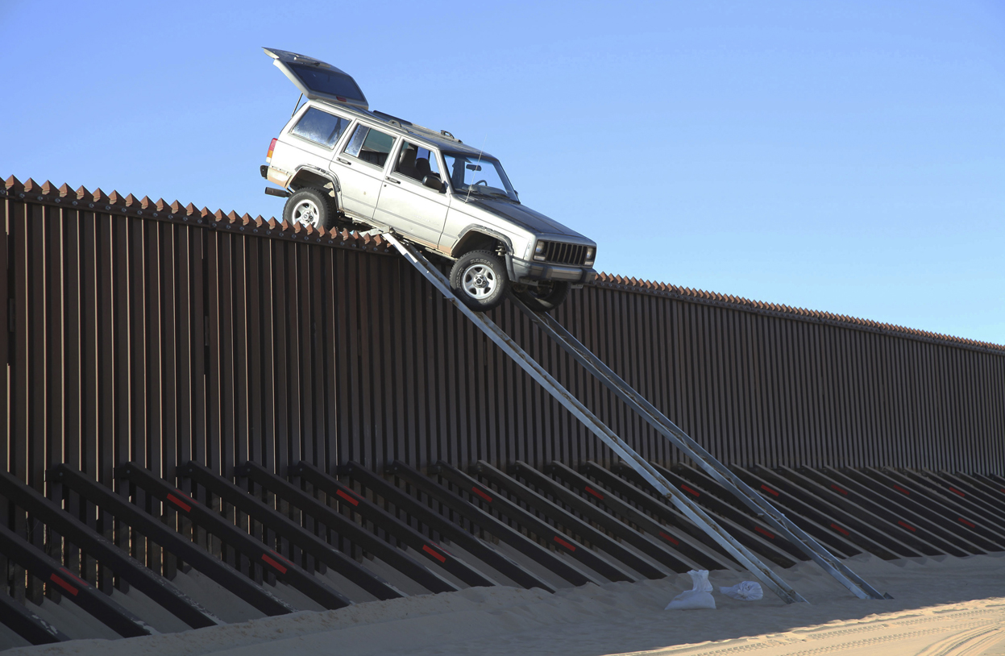

Slide 35
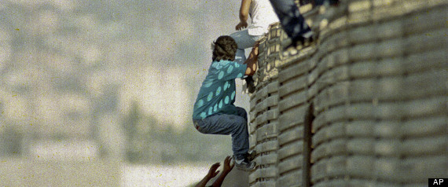

Slide 36
Glenn Weyant plays the wall
SASABE, Ariz. — On a windy day in southern Arizona’s remote borderlands, Glenn Weyant had everything he needed to make music — a cello bow, a mallet and the miles-long fence dividing the United States and Mexico.
His method, like his music, was improvisational and low-tech: He inserted electronic equipment into an Altoids tin, turning it into a microphone. Weyant filled the tin with magnets and pressed it against the fence a few inches off the ground. Wires attached to the tin led to an amp and several effects pedals — the kind electric guitarists use — which allow him to manipulate sounds.
http://www.youtube.com/watch?v=iGfC0eRAFG4

Slide 37
Desert scrub, mesquite and sun-bleached rocks would serve as his audience; sometimes they do double duty as instruments.
“Nobody thought of the border wall as possibly anything other than something to separate people,” he said. “I transform it. I play it.”
For eight years, Weyant has tapped, banged and stroked the fence to produce haunting, sometimes ethereal, sounds in a region he has called the “de facto militarized zone.” Compositions can last a minute — or more than half an hour.
“I’m a border deconstructionist,” said Weyant, a 50-year-old Tucson resident. “I want to deconstruct preconceived notions. What I’m saying is you don’t need to be afraid of the wall. You have nothing to fear.”
http://www.youtube.com/watch?v=xCHs-TLeDN0

Slide 39
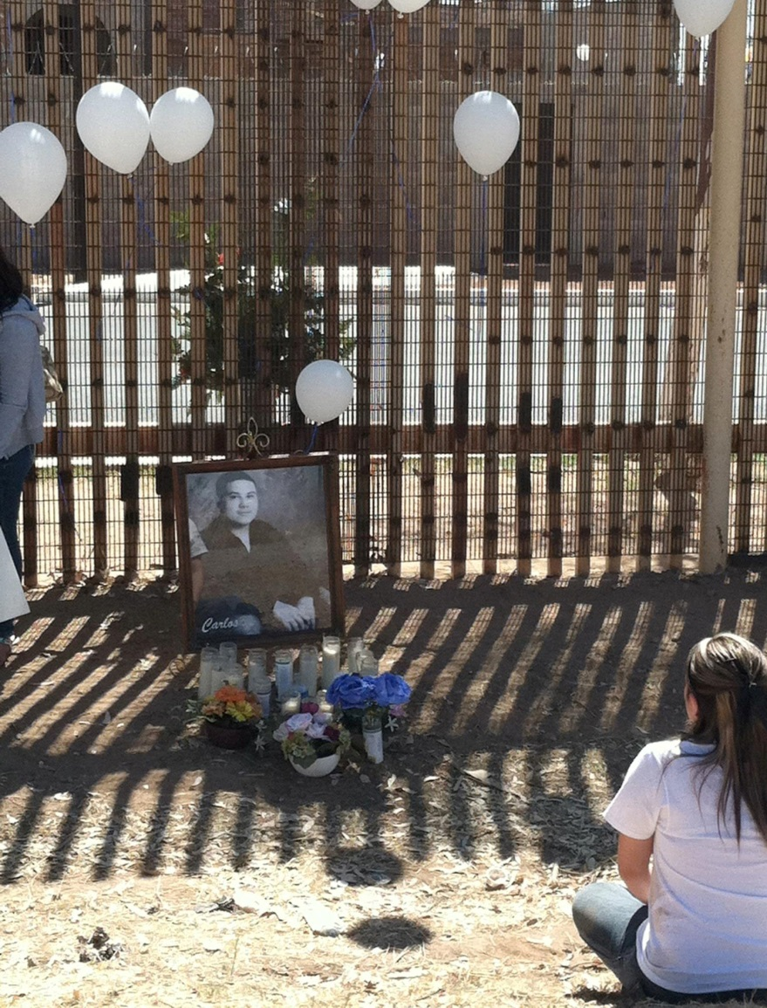
Where do we go from here?

